Slide 1
ADS54J60 LMK Clock
Distribution Mode

Slide 2
ADS54J60
Test conditions:
Fs = 800MHz. External 800MHz @ 12dBm connected to SMA J6 (LMK_CLKIN1)
Fin = 101MHz at CHA SMA J2 (AINP)
LMFS = 8224
K = 16
SYSREF = 50MHz
ADC data rate = 800MHz
FPGA Ref Clock = 250MHz
Lane rate = 4Gbps

Slide 3
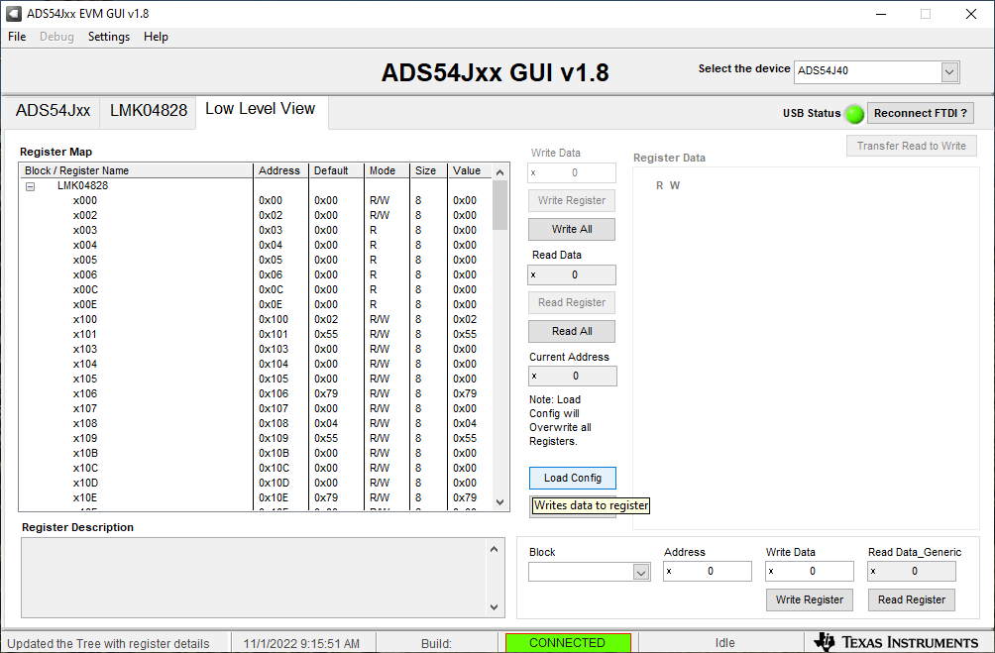
In ADS54Jxx GUI, click on Low Level View tab

Slide 4
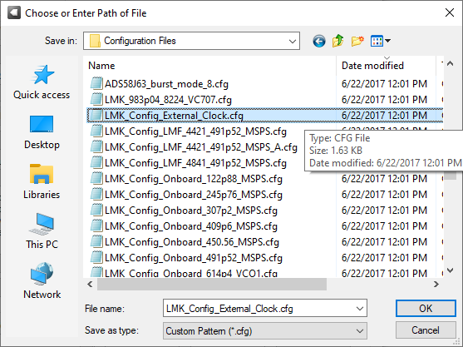
Select file called “LMK_Config_External_Clock.cfg”
After file loads, press board reset switch SW1

Slide 5
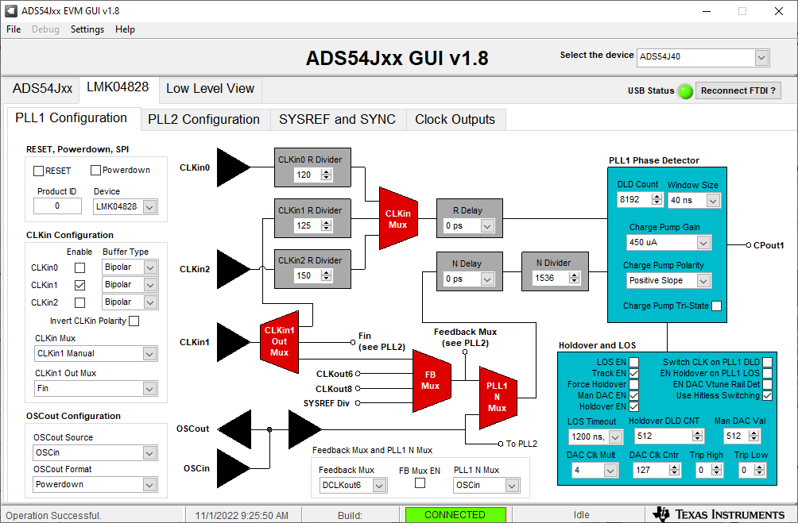
PLL1 configuration LMK clock distribution mode

Slide 6
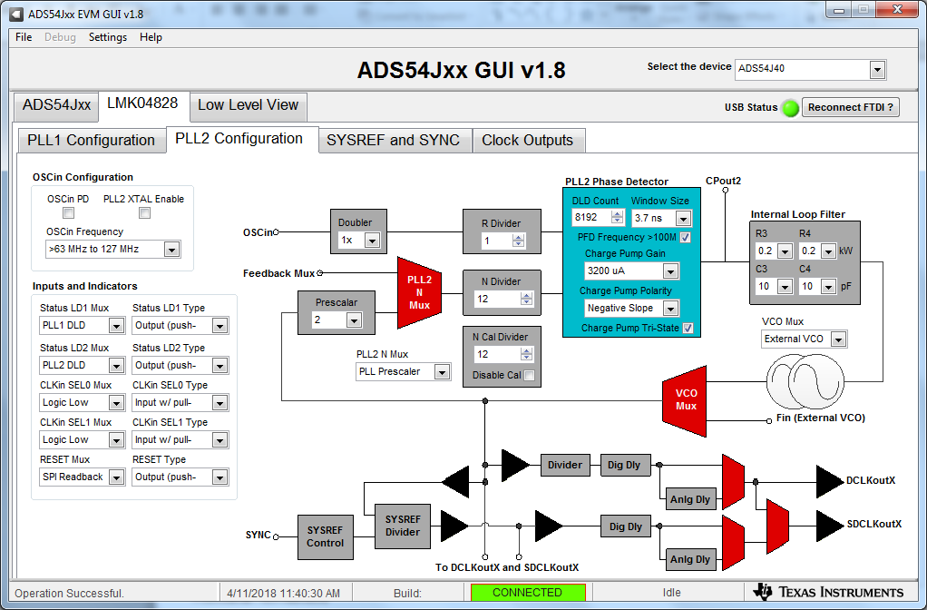
PLL2 configuration LMK clock distribution mode

Slide 7
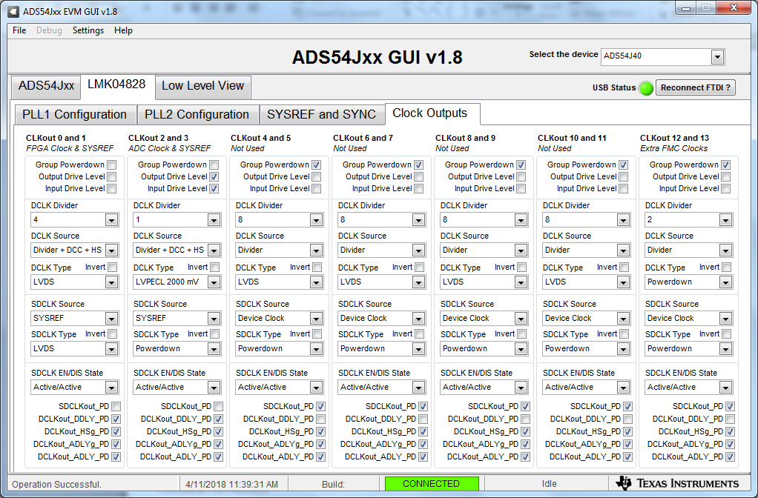
LMK output clock settings
CLKout 0 DCLK Divider = 4, provides 200MHz reference clock to FPGA
CLKout 2 DCLK Divider = 1, provides 800MHz sample clock to ADC

Slide 8
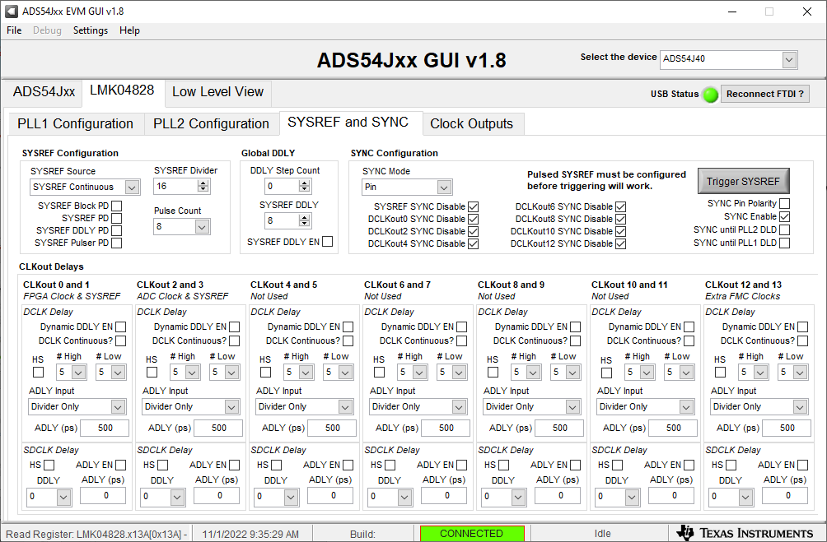
Go to LMK04828 SYSREF and SYNC tab.
Change SYSREF Divider to 16 to provide a 50MHz SYSREF signal.

Slide 9
Go to Low Level View tab

Slide 10
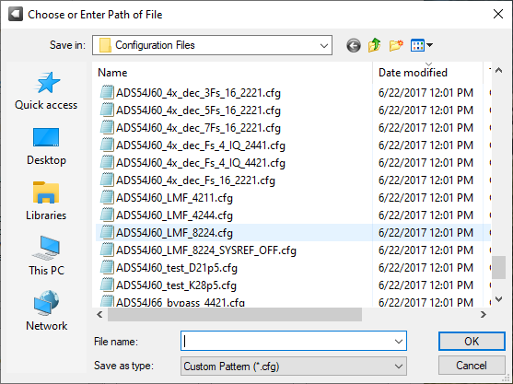
Select “ADS54J60_LMF_8224.cfg” to load ADC configuration.

Slide 11
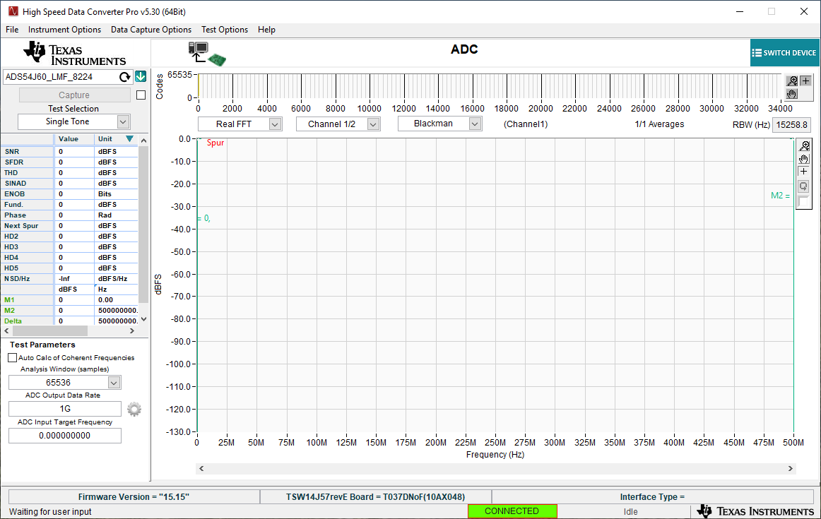
Open HSDC Pro GUI. Select “ADS54J60_LMF_8224”

Slide 12
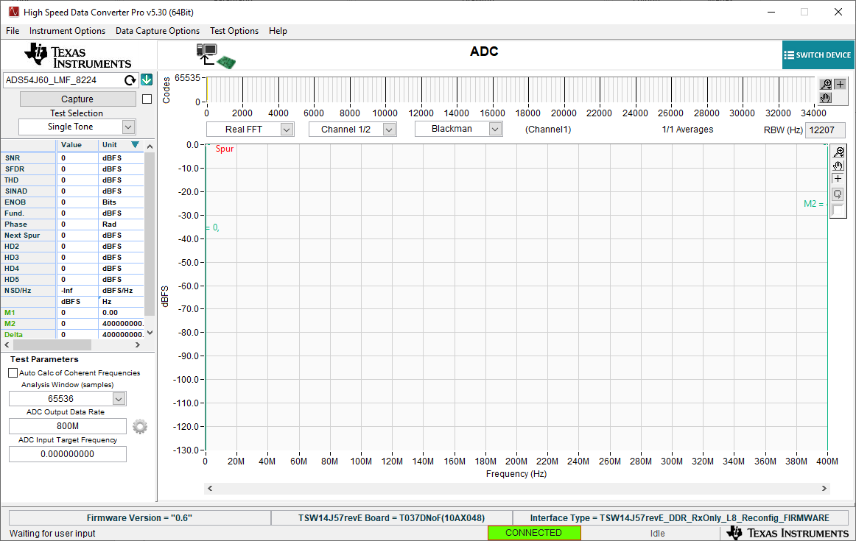
After firmware is loaded, set ADC Output Data Rate to 800M.

Slide 13
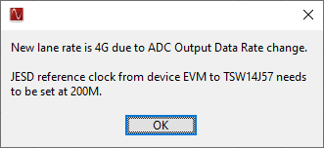
Serdes rate = 4G. FPGA reference clock is 200MHz.

Slide 14
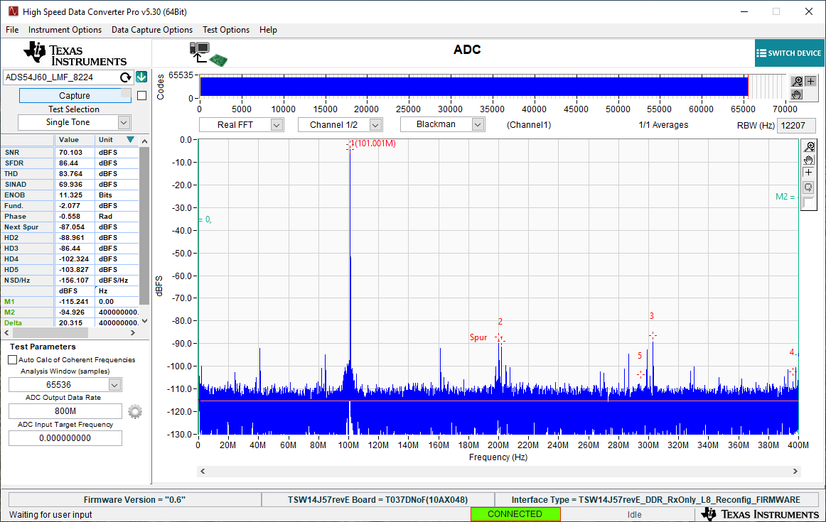
Click “Capture”. 101MHz from CHA

