Slide 1
ADS54J66 Test

Slide 2
ADS54J66
Test Setup:
Single tone is given as input to the device.
Test conditions:
Fs = 300Msps External CLK @ 12dBm
IF = 665/670/675MHz
Bypass mode
LMFS = 4421

Slide 3
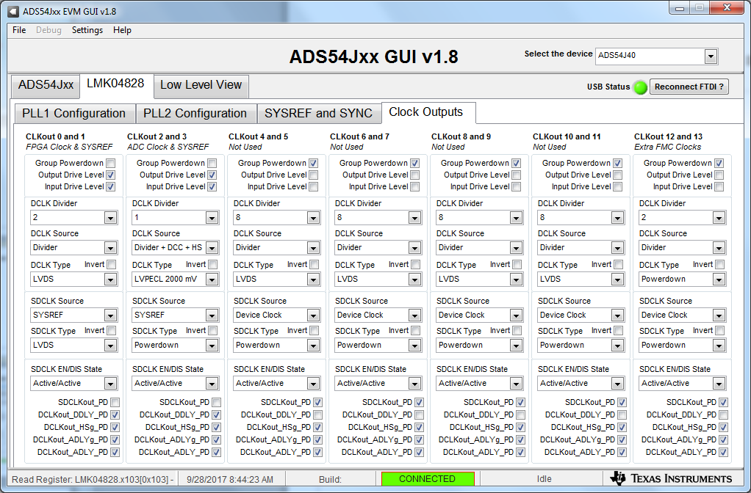
On LMK04828 Clock Outputs tab, set CLK 0 divider to 2 and CLK 2 divider to 1. Make sure CLK 2 DCLK source is as shown below.

Slide 4
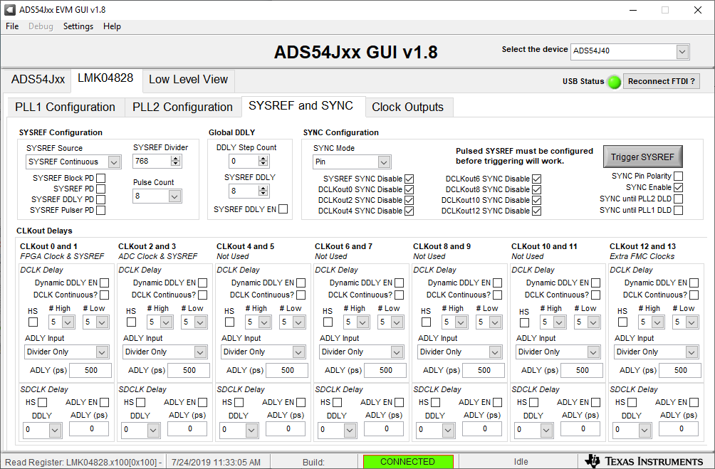
Set SYSREF Divider = 768

Slide 5
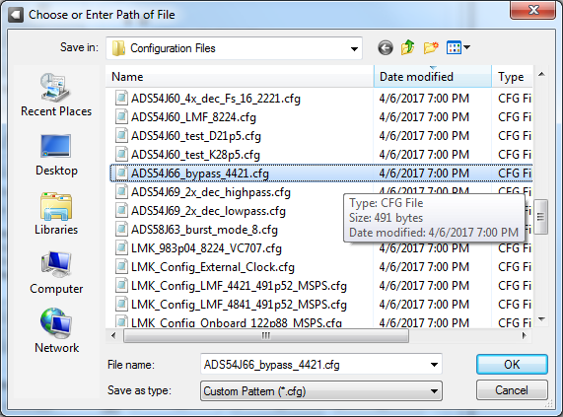
Press the ADS54J66EVM board reset then load the ADC config file shown below.

Slide 6
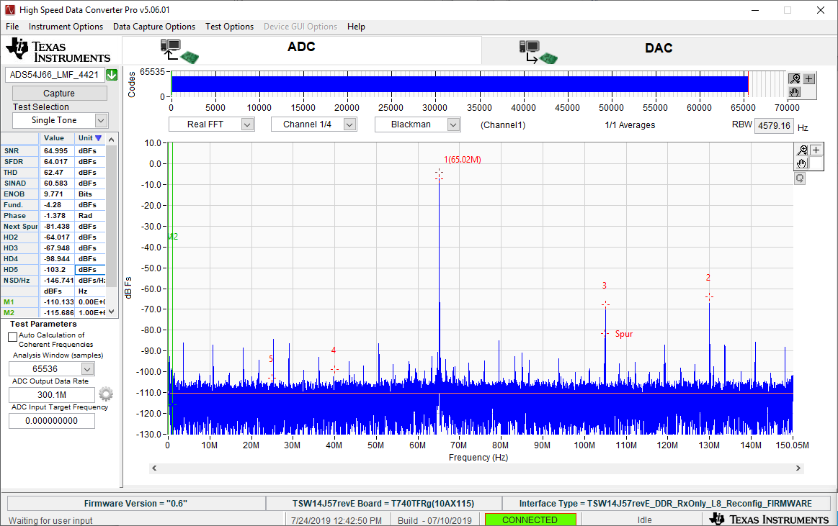
CHA, Fin = 665MHz

Slide 7
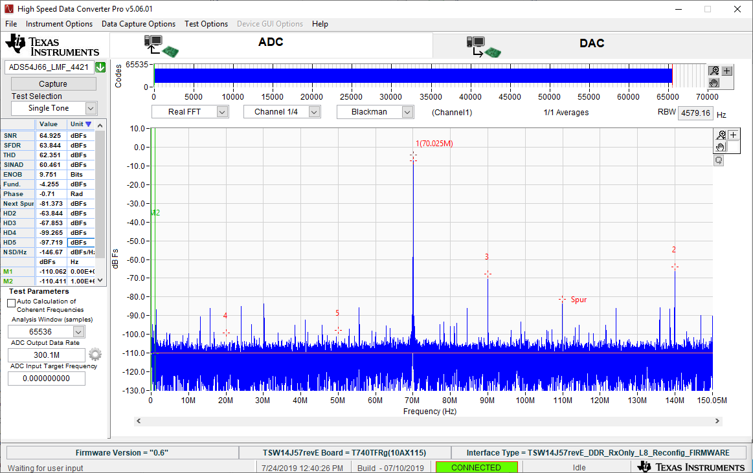
CHA, Fin = 670MHz

Slide 8
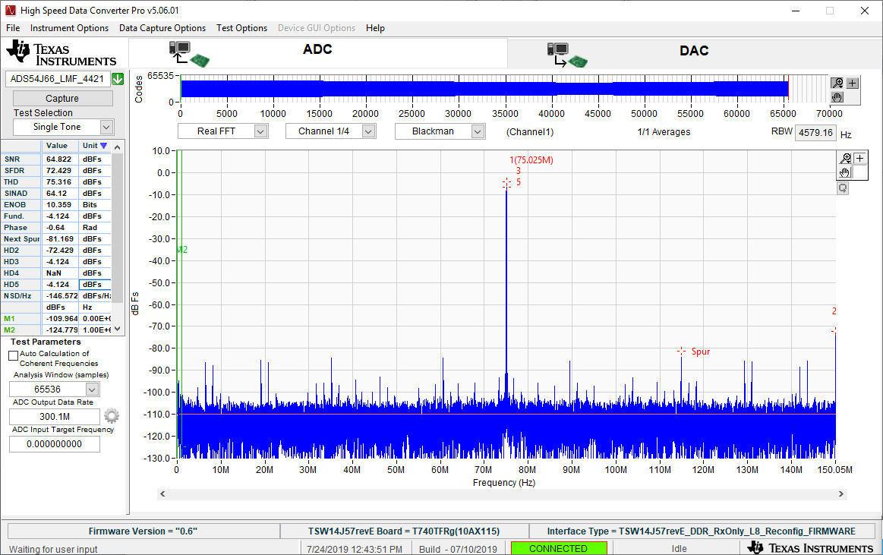
CHA, Fin = 675MHz

