Slide 1
ADS54J66, TSW14J10 & KC705 Testing

Slide 2
Test Setup:
Single tone is given as input to the device.
Test conditions:
Fs = 491.52Msps (internal)
Fin = 70MHz
Mode = 4421
Ref CLK = 245.76Msps
Core CLK = 122.88Msps
Lane rate = 4.9152Gsps

Slide 3
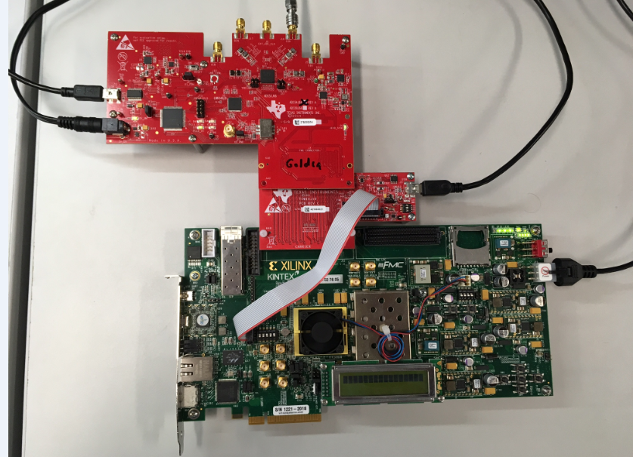
ADS54J66, TSW14J10, KC705 Setup

Slide 4
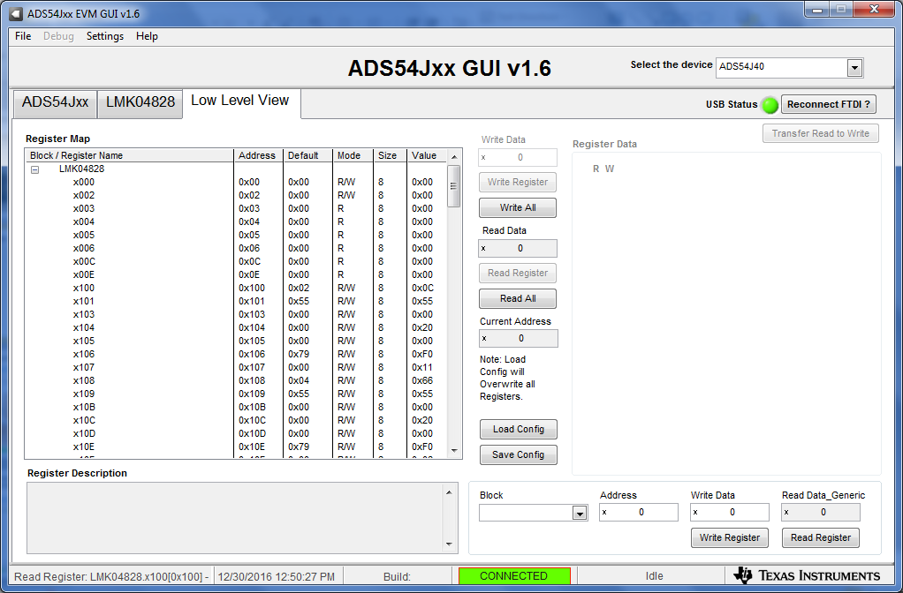
On ADC GUI, go to Low Level View

Slide 5
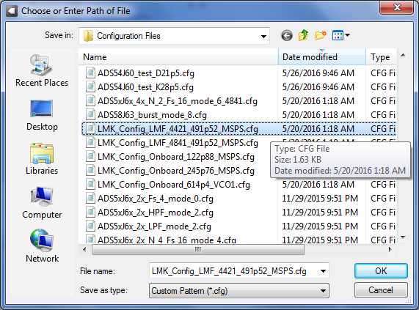
Click on “Load Config” and navigate to “LMK_Config_LMF_4421_491p52_MSPS.cfg”

Slide 6
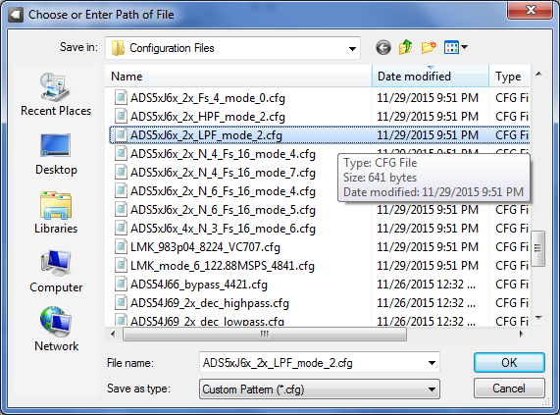
After file has loaded, verify that “PLL2_LK” LED is illuminated on ADS54J66EVM. Click on “Load Config” and load “ADS5xJ6x_2x_LPF_mode_2.cfg”

Slide 7
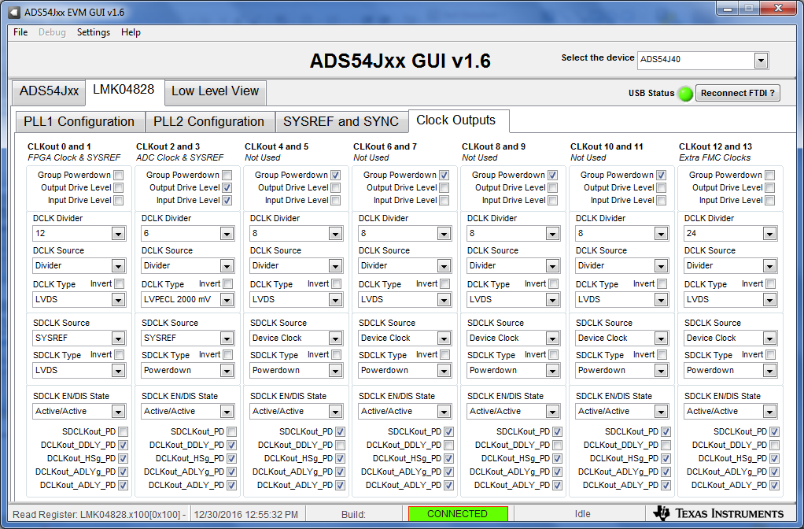
Click on Clock Outputs tab. Set CLKout 0 and 1 DCLK Divider to 12 Unselect Group Powerdown on CLKout 12and 13 and set DCLK Divider to 24, and DCLK type to LVDS, as shown below.

Slide 8
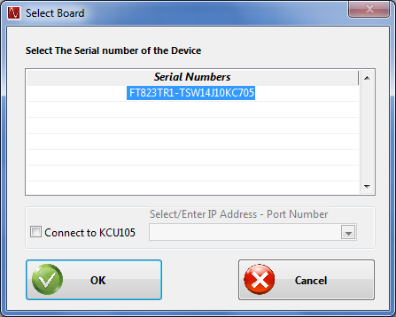
Open HSDCD Pro, and select the serial number that has KC705 at the end, as shown below.

Slide 9
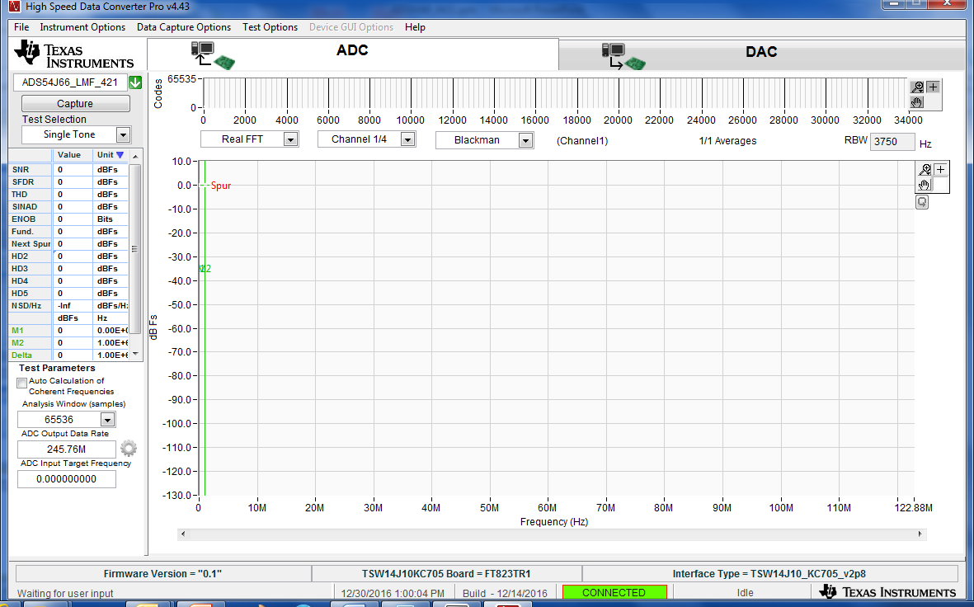
In the device drop down window, select: “ADS54J66_LMF_4421”. After the firmware has loaded, enter “245.76M” for ADC Output Data Rate

Slide 10
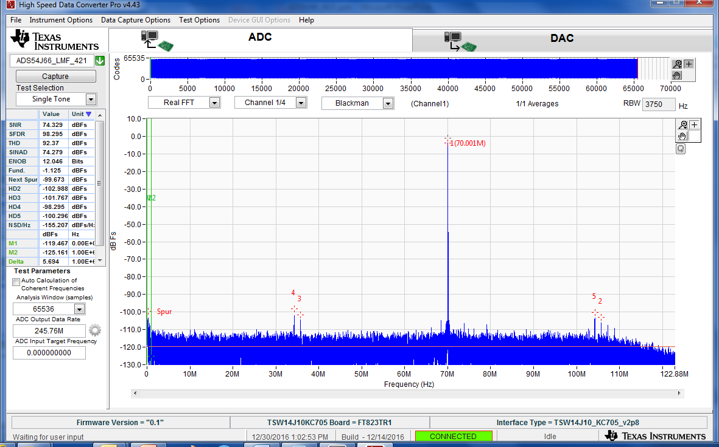
Click on “Capture”. The capture results using a 70MHz input tone is shown below

