Slide 1
ADS54J66 Test

Slide 2
Test Items
DC-Coupling
  Case1: floating amp iuput
  Case2: input 0V
  Case3: input sine
  Case4: input sine with DC offset
AC-Coupling
  Case1: floating amp iuput
  Case2: input sine
  Case3: input sine with DC offset

Slide 3
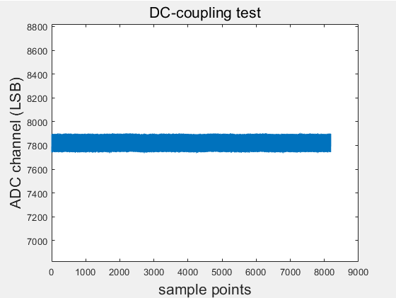
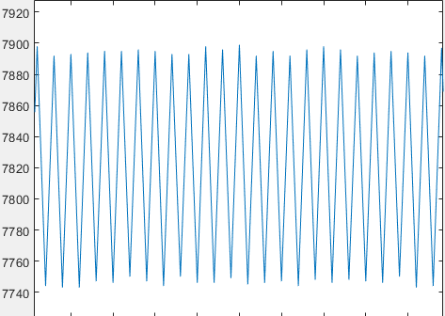
DC-Coupling Case1: Floating amp input
There is a DC-offset about 70mV in ADC differential input
DC offset correction enabled

Slide 4
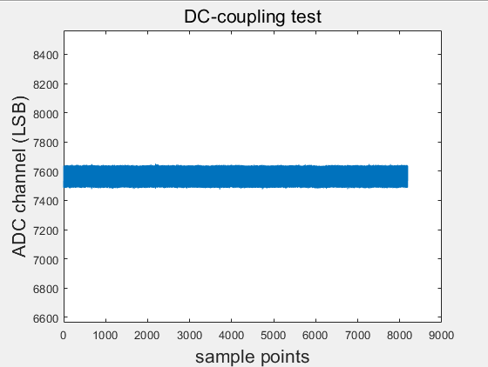
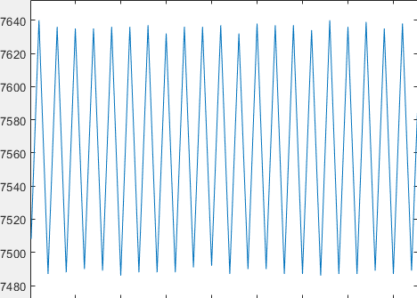
DC-Coupling Case1: Floating amp input
There is a DC-offset about 70mV in ADC differential input
DC offset correction disabled

Slide 5
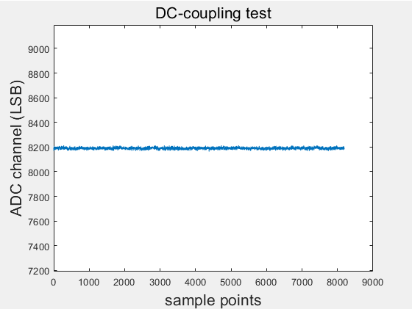
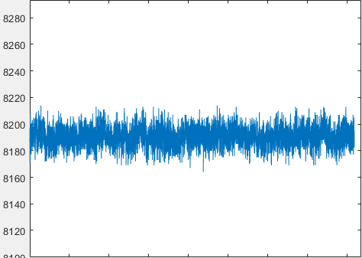
DC-Coupling Case2: input 0V
There is no DC-offset in ADC differential input
DC offset correction enabled

Slide 6
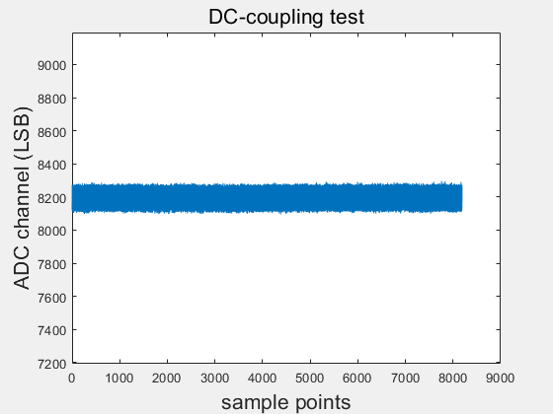
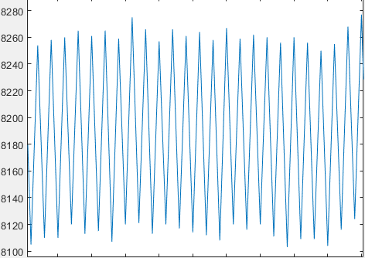
DC-Coupling Case2: input 0V
There is no DC-offset in ADC differential input
DC offset correction disabled

Slide 7
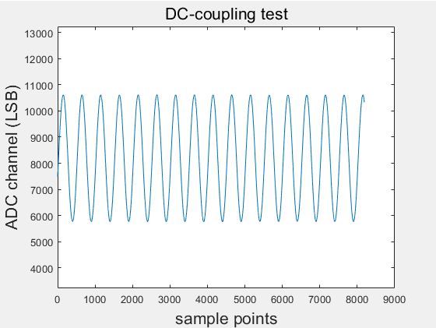
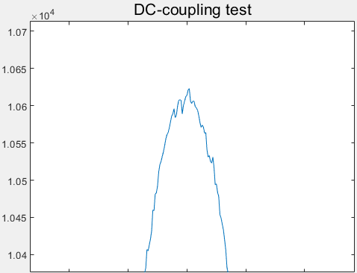
DC-Coupling Case3: input sine
The sine is -300mV~300mV
DC offset correction enabled

Slide 8

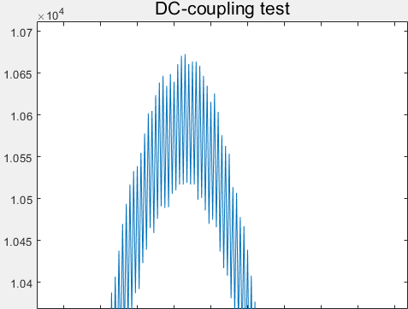
DC-Coupling Case3: input sine
The sine is -300mV~300mV
DC offset correction disabled

Slide 9
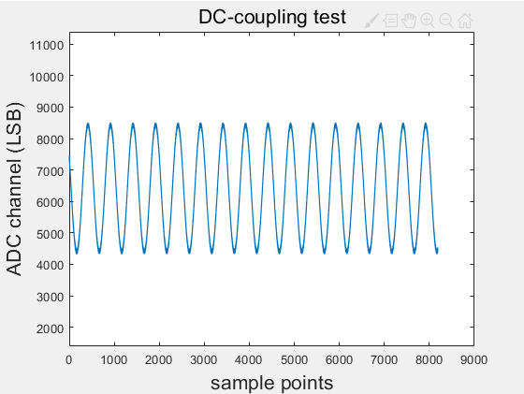
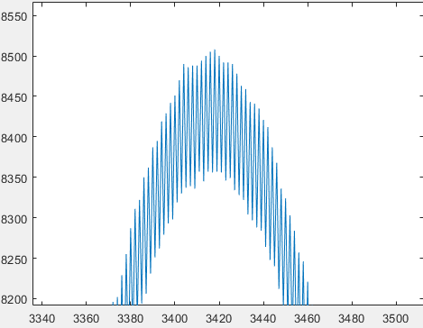
DC-Coupling Case4: input sine with DC offset
The sine is -500mV~0V
DC offset correction enabled

Slide 10
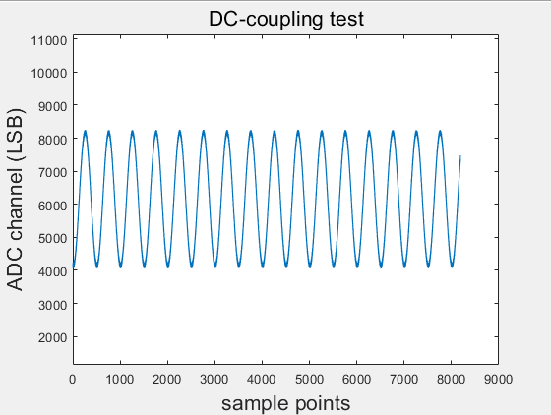
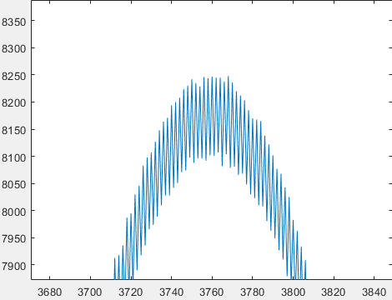
DC-Coupling Case4: input sine with DC offset
The sine is -500mV~0V
DC offset correction disabled

Slide 11
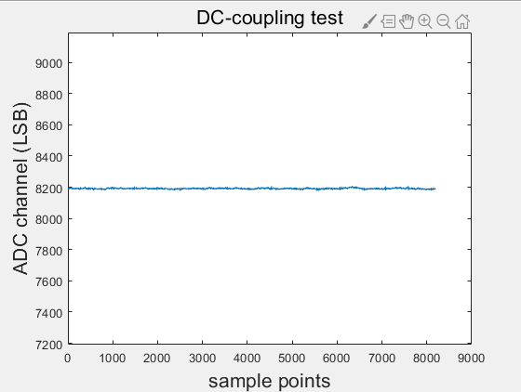
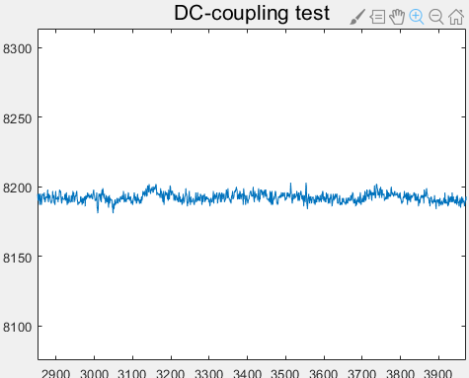
AC-Coupling Case1: Floating amp input
DC offset correction enabled

Slide 12
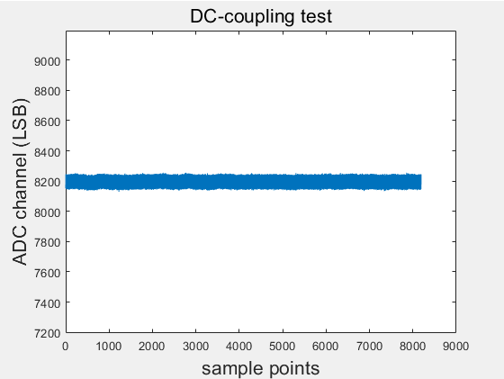
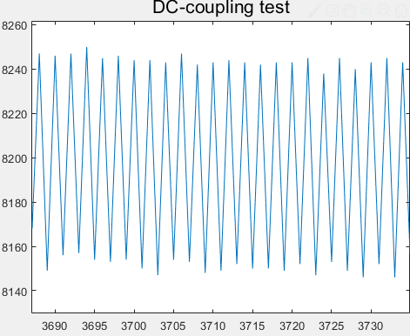
AC-Coupling Case1: Floating amp input
DC offset correction disabled

Slide 13
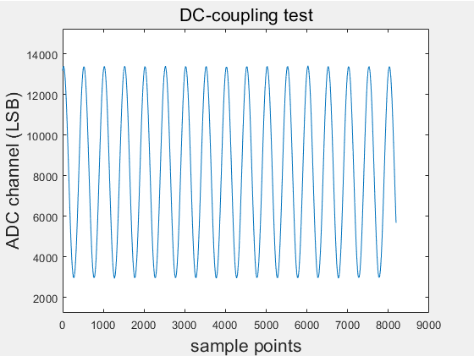
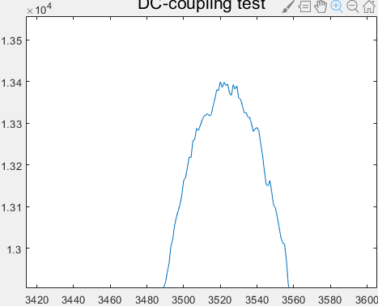
AC-Coupling Case2: input sine
The sine is -300mV~300mV
DC offset correction enabled

Slide 14
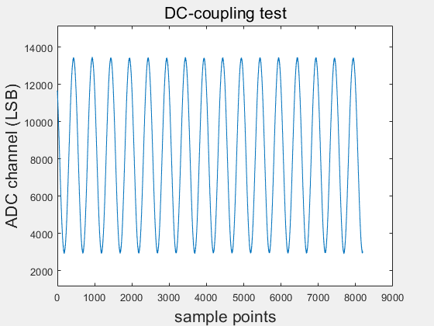
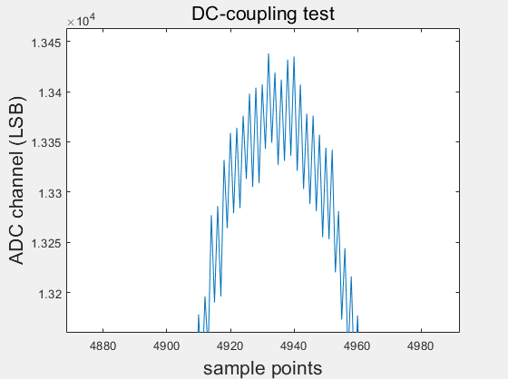
AC-Coupling Case2: input sine
The sine is -300mV~300mV
DC offset correction disabled

Slide 15
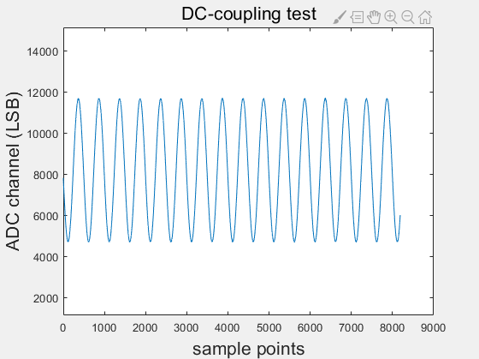
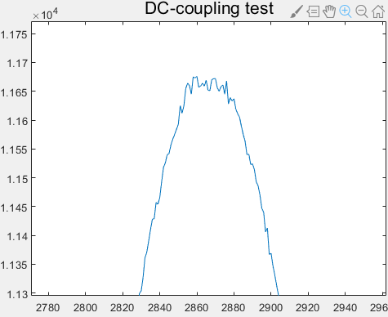
AC-Coupling Case3: input sine
The input sine is -400mV~0mV
DC offset correction enabled

Slide 16
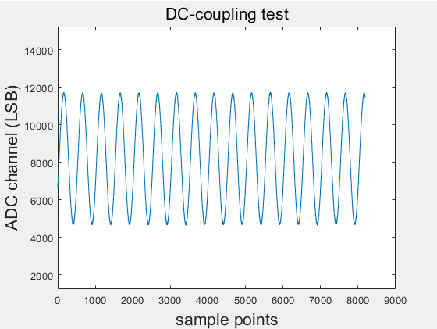
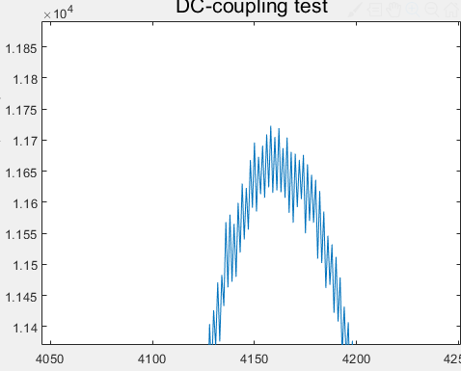
AC-Coupling Case3: input sine
The input sine is -400mV~0mV
DC offset correction disabled

