Slide 1
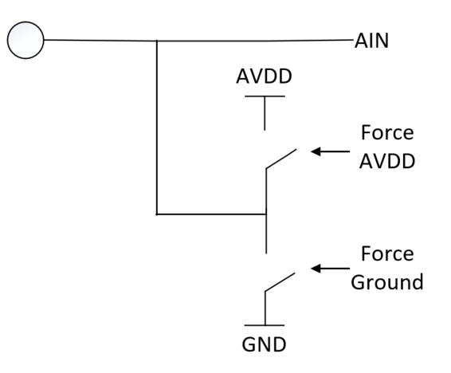
ADS7066 – Designed To Simplify Functional Safety Analysis
Stuck at Fault Detection
Digital Communication Error Detection
How Can one confirm if the Digital Communication ran into an error?
The ADS7066 feature bi-directional cyclic-redundancy-check (CRC) on the digital interface.
ADC transmits data with an 8-bit CRC byte
ADC validates data from host with an 8-bit CRC sent by the host
How can one confirm if the analog input pin has a stuck-at fault?
The analog inputs on ADS7066 can be forced to AVDD or GND internally.
Set the digital output of a channel to logic 1 or 0 and measure back the pin voltage using the ADC.
Reference Voltage Failure Detection
Walking Bit Test
How can one determine if the all ADC bit decisions are working normally?
The ADS7066 has an integrated DAC and a white noise source
Use the internal DAC to generate a test voltage
Adjust DAC output voltage to test ADC
How can one confirm if the reference voltage is OK?
ADS7066 features a 1.8V test-voltage.
The 1.8V is generated independent of the ADC VREF.
Enable diagnostic mode to measure known 1.8V with respect to ADC VREF to determine reference voltage fault.
Notes:
61508

