Slide 1
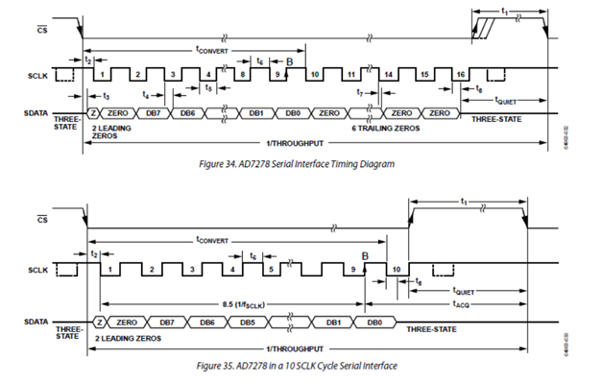
This is an original interface timing diagram of ADS7885.
Serial data consist of 16clks.
The customer wants to read 10clks.
Is it possible?
I think it may be possible because conversion has already finished and all the data has sent.
Is it right?
The customer is considering serial data 10clks. AD7278 consists of 10clks.

