Slide 1
Overview : ADS9224R Data acquisition issue
In the actual evaluation of TI's A / D converter ADS9224R, the conversion values ​​were as follows, so please give us some advice regarding problems in use.
• Supply voltage 5V for both analog and digital
• READY / STROBE signal unused
• Sampling conditions
• Zone 2 Transfer / Protocol ︓ SPI-00-D-SDR / 2MSPS / SCLK ︓ 20M / 40MHz
• Registers were set with a standby time of 150 ms after power was turned on and after power down was restored.
• There is no problem with SPI data transmission / reception between ADS9224R and FPGA (CPU).
• A characteristic tendency can be seen in the acquisition and conversion of analog data of the ADS9224R.
- When a DC difference voltage is applied to the ADS9224R, if the difference voltage is positive, the conversion value will decrease slightly with each sampling, and if the difference voltage is negative, the conversion value will increase slightly with each sampling. However, it does not seem to increase or decrease forever.
- When a sinusoidal differential voltage is applied to the ADS9224R, the amplitude value of the sampling conversion value after power-on and power-down recovery gradually increases.
Note.
The constant of Kickback Filter is set to 1/10 of the value described in the data sheet, and the specification is not satisfied, but we have not confirmed whether this is the cause of this result.

Slide 2
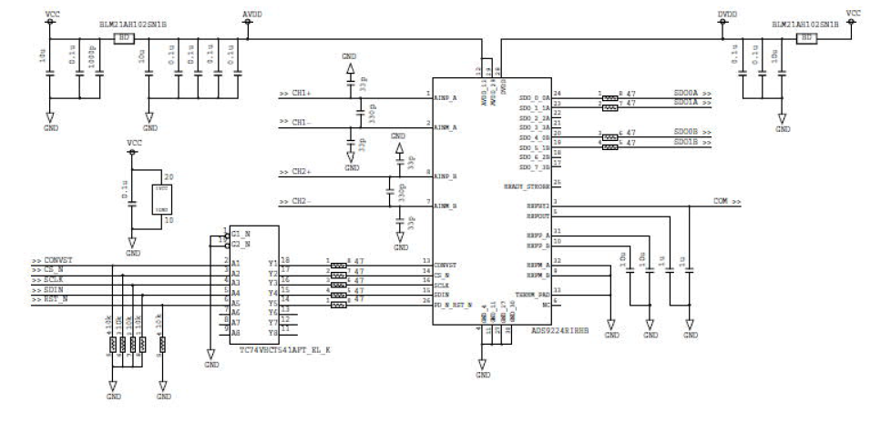
Circuit
• Both analog and digital voltages are supplied from VCC (5V) through a filter.
• Since it is a separate board from the FPGA (CPU) board, a buffer is provided for the control signal.• The CFLT of the Kickback Filter has been set to a small value in relation to the UGB.

Slide 3
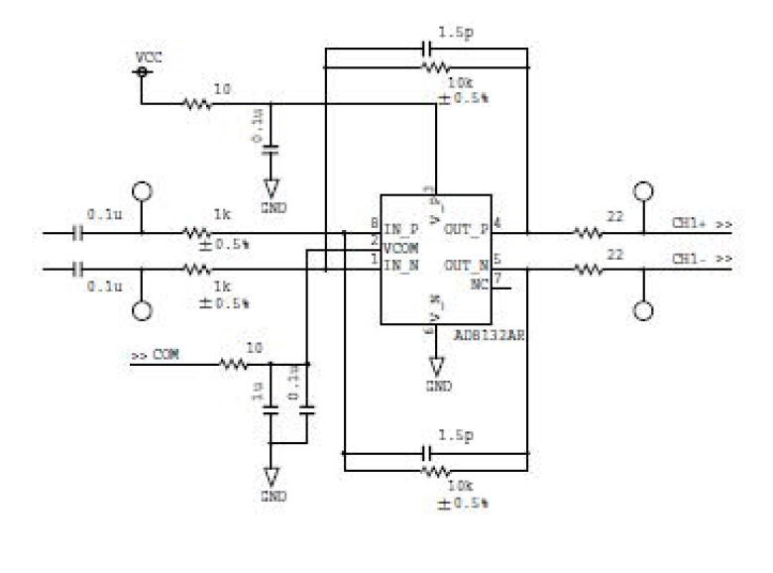
Circuit (differential AMP)
The differential AMP in the previous stage of ADS9224R is the same for both CH-A / B.
• By diverting from the old circuit, the series resistance between the differential AMP and the ADS9224R (corresponding to the RFLT of the Kickback Filter) was designed as 22Ω.

Slide 4
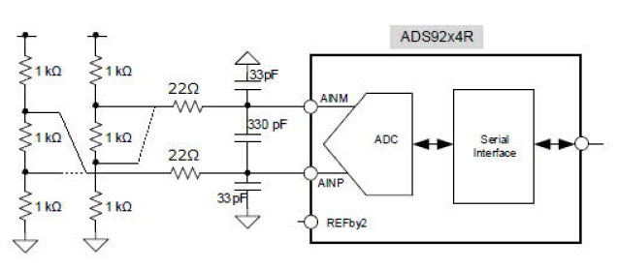
DC input circuit
• In order to confirm the sampling result when a constant voltage is applied, the following circuit was used for evaluation.
• Connect either 1/3 or 2/3 of the 1kΩ resistor to the ADC P/N and apply a constant voltage.
• However, in the case of input with the same potential, the 2/3 partial pressure point on the Japanese side was connected to the P/N.

Slide 5
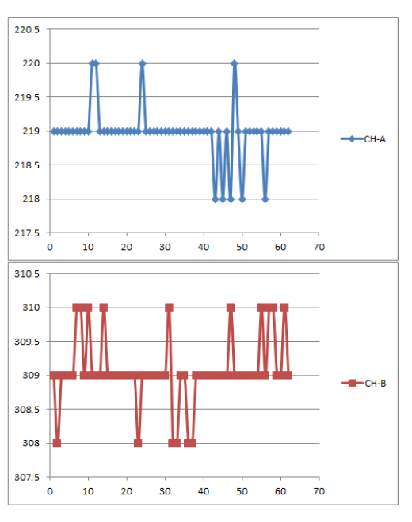
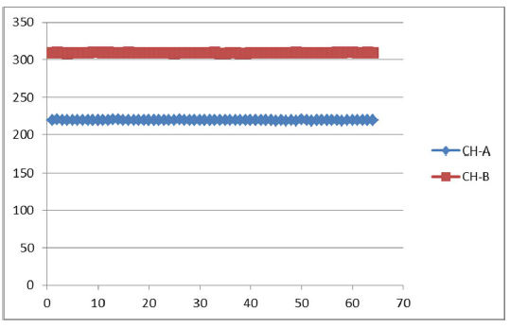
Case1 : DC diffrential Input (same voltage)
Sampling result when the same potential (difference voltage 0V) is applied to the P / N input of both channels of the ADC
The vertical axis is the decimal notation of the reading, and the following values were obtained.
CH-A︓27.375mV ± 1LSB
CH-B︓38.75mV ± 1LSB

Slide 6
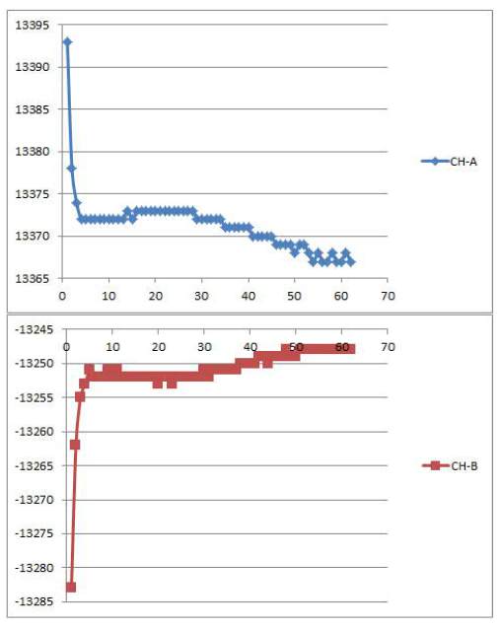
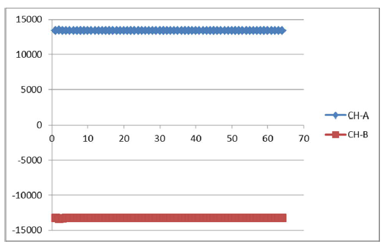
Case2 : differential Input voltage ≠ 0
Sampling result when a difference voltage of 1.684V is applied to CH-A of the ADC and a difference voltage of 1.669V is applied to CH-B.
The vertical axis is the decimal notation of the reading, and the following values were obtained.
CH-A︓ Approximately 1671.25 mV ± 5.5 LSB
CH-B︓ Approximately -166.25 mV ± 7 LSB

Slide 7
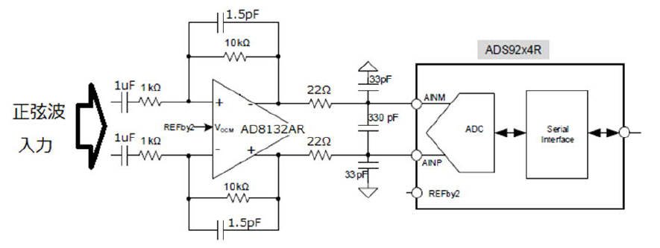
Sine wave input circuit
The sine wave signal was input from the function generator to the designed board, and the sampling result was acquired.
When a certain number of samplings (eg 5000 points) is grouped and the group is executed at a certain interval, the sampling results will be different after the first and second times.
differential
Sin wave
Input

Slide 8
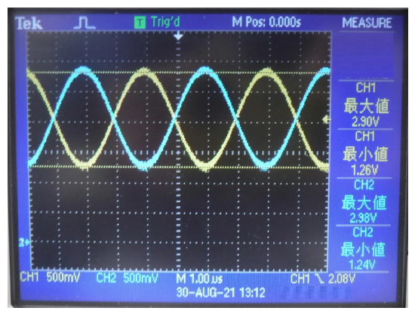
Sine wave input circuit
The sine wave signal was input from the function generator to the designed board, and the sampling result was acquired.
When a certain number of samplings (eg 5000 points) is grouped and the group is executed at a certain interval, the sampling results will be different after the first and second times.
The waveform below is the differential input waveform of the ADS9224R. However, it is not the one when the sampling result is acquired, which will be posted after the next one. The amplitude is small.• This is the waveform acquired when the input status was confirmed prior to the sampling acquired for a series of evaluations.
differential
Sin wave
Input
AINM/P

Slide 9
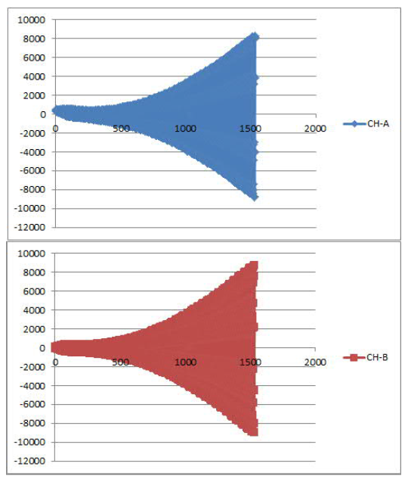
Sine wave input result 1
First sampling result after power-on (1-1499 sampling)
Although there is some fluctuation from FG, sampling is performed with a stable sine wave of a fixed amplitude input, but the conversion result is such that the amplitude gradually increases as shown in the figure on the right.
This is an unintended result.

Slide 10
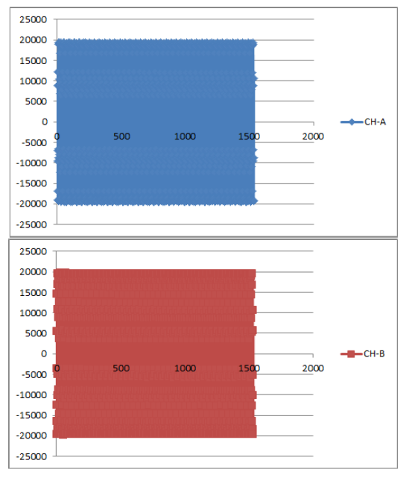
Sine wave input result 2
Second sampling result after power is turned on (1501-3000 sampling)
• The interval between the 1st and 2nd batches is the same regardless of whether it is about 1 second, about 10 seconds, or 30 minutes, and the conversion result corresponds to the amplitude value of the sine wave amplitude supplied from FG. bottom.
• The Excel graph is clogged and cannot be discriminated, but when partially expanded, the values obtained by sampling the sine wave correctly at 2 MSPS are continuous.

Slide 11
Sine wave input result 3
• Power ON-> Sampling several times-> HW reset & register initialization-> Resampling
• Although not as much as immediately after the power is turned on, the conversion result immediately after the start of sampling is converted as a small amplitude value, and the amplitude increases sharply.

Slide 12
Sine wave input result
This is an image of evaluation that samples a sine wave signal and acquires data.
The data on the left is the first time immediately after the power is turned on, and the data on the right side is the second and third times.
It is not clear how many times a single batch of samples should be sampled to reach the steady state (the expected conversion value) because the number of data that can be acquired is limited.
Conversion
Result
Power on

