Slide 1
AFE7422EVM & TSW14J57
10/13/2021

Slide 2
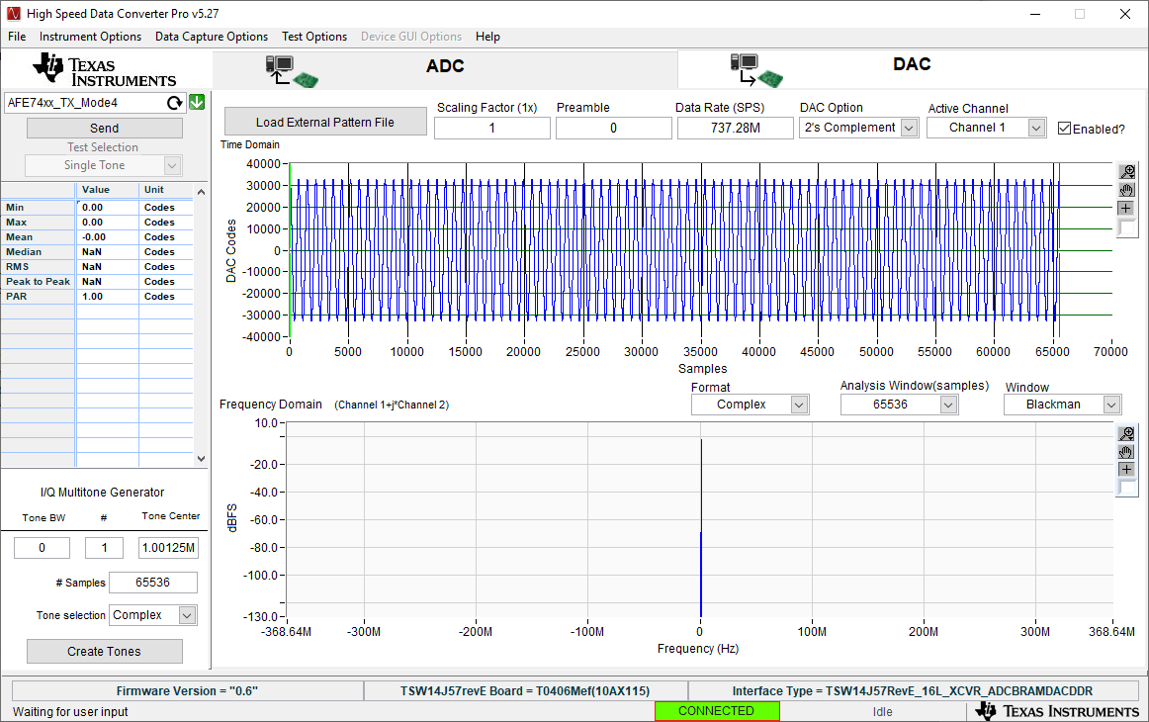
Step 1: Send a tone from HSDC Pro
Open HSDC Pro and select the DAC tab.
Select AFE74xx_TX_Mode4
Set the data rate to 737.28M
Create the tone
Press Send

Slide 3
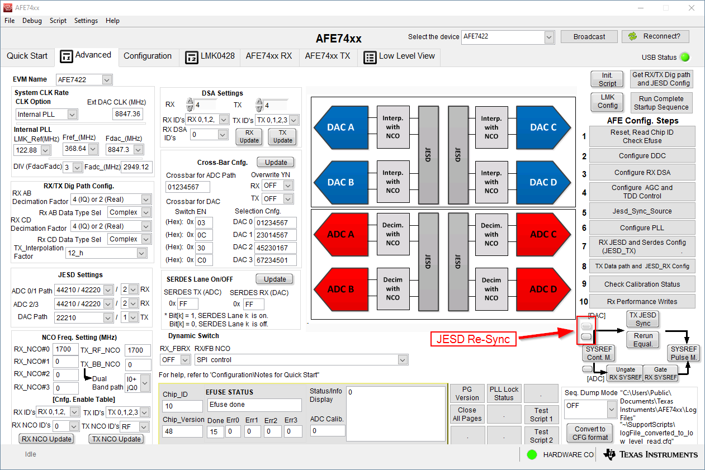
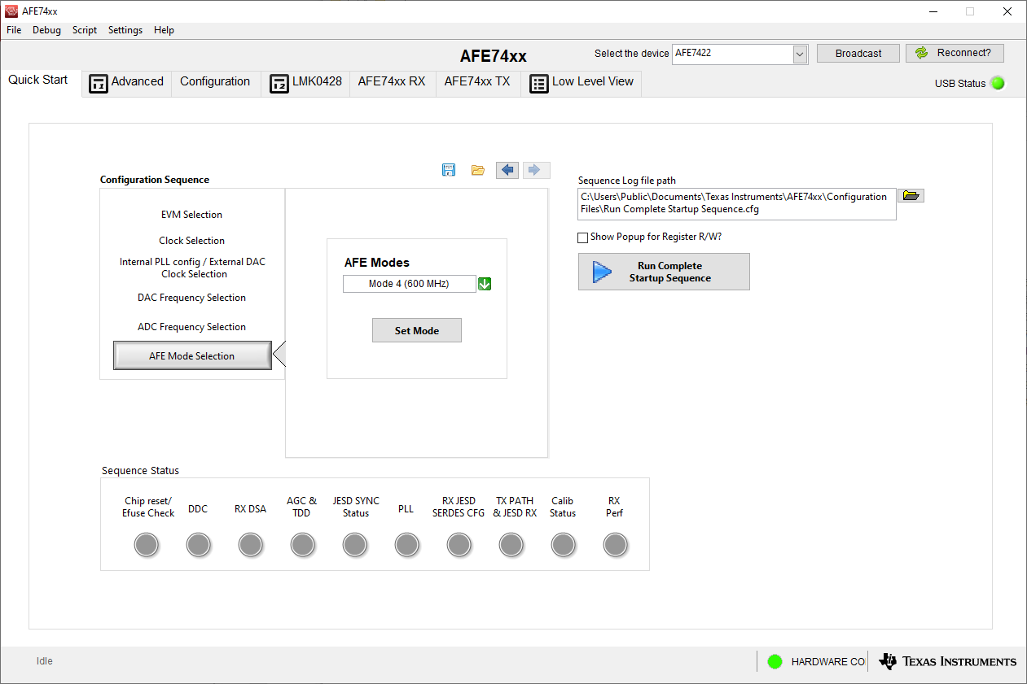
Step 2: Configure AFE from AFE74xx GUI
Select Mode 4 (600 MHz) and press “Set Mode”
Then Press the “Run Complete Startup Sequence” button
Confirm the presence of Tx output
If the Tx output is not present go back to HSDC Pro and press Send again
Then press the JESD Re-Sync buttons
Notes:
If you receive more errors and the JESD Links are not established press send in HSDC Pro again and type in the command AFE.adcDacSync()
After

Slide 4
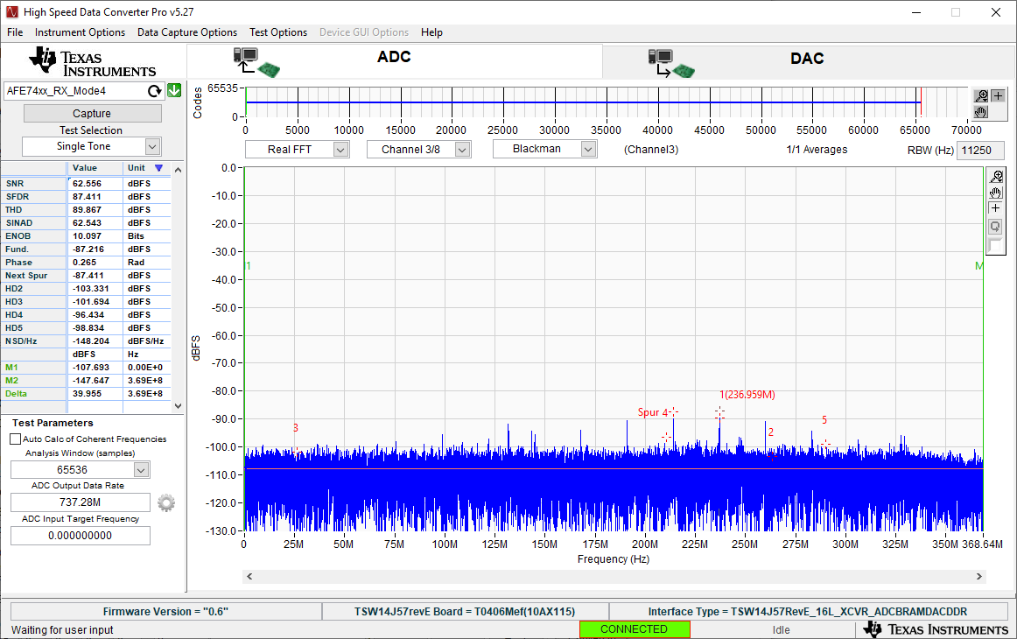
Step 3: Establish ADC link
In HSDC Pro open the ADC tab and select the ‘AFE74xx_RX_Mode4’ ini file
Change the ADC output data rate to 737.28MHz
You can now establish the ADC link by clicking capture
A successful ADC link up should usually disrupt the DAC output. This is expected.

Slide 5
Step 4: Reestablish DAC link
To reestablish the DAC link press Send in the DAC tab of HSDC Pro
Then press the JESD Re-Sync buttons in the AFE74xx GUI

Slide 6
Step 5: Change ini files
Once you have both ADC and DAC link function you now need to change the ini files for both the ADC and DAC tabs
For the DAC tab we need to change the selected ini file to ‘AFE74xx_RX_Mode4_XCVR’
Press send and you should continue to see the Tx output
For the ADC tab we need to change the selected ini file to ‘AFE74xx_TX_Mode4_XCVR’
Press capture and the ADC link should stay established without affecting the DAC link
If you do not have this file please follow the steps in the next slide to create it

Slide 7
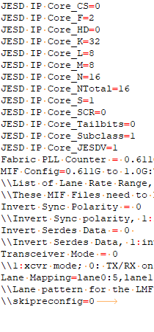
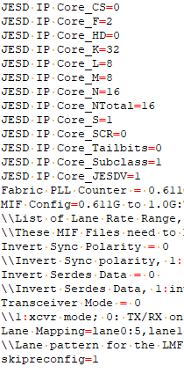
Step 6: Creating AFE74xx_TX_Mode4_XCVR
To create this file you will need to create a copy of the AFE74xx_TX_Mode4 ini file. Save this modified ini file as AFE74xx_TX_Mode4_ XCVR.
The change you will need to make is to uncomment the last line and make it equal to 1. (skipreconfig=1)
Before:
After:

Slide 8
Step 7: Capture and send Data
From this point additional capture on the ADC and sending tones from the DAC should no longer affect the DAC link.
It’ll continue to be the case until you re-initialize the JESD link from the AFE side

