Slide 1
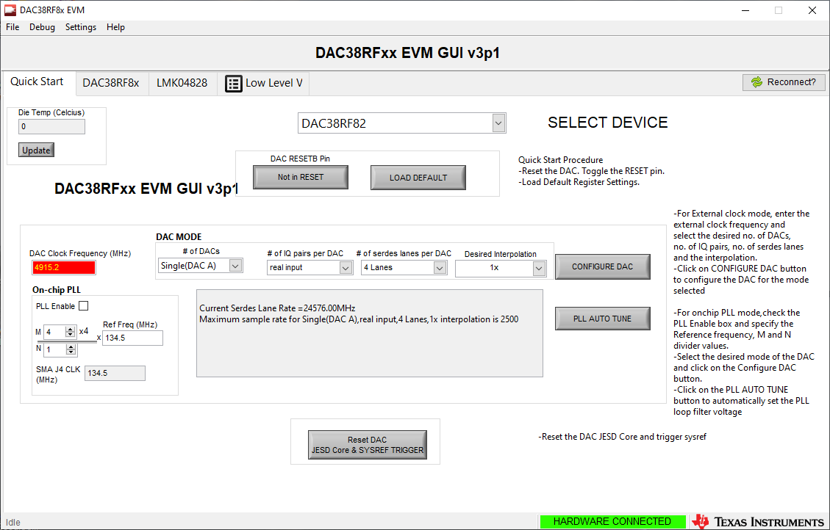
Hardware Connected should be Green

Slide 2
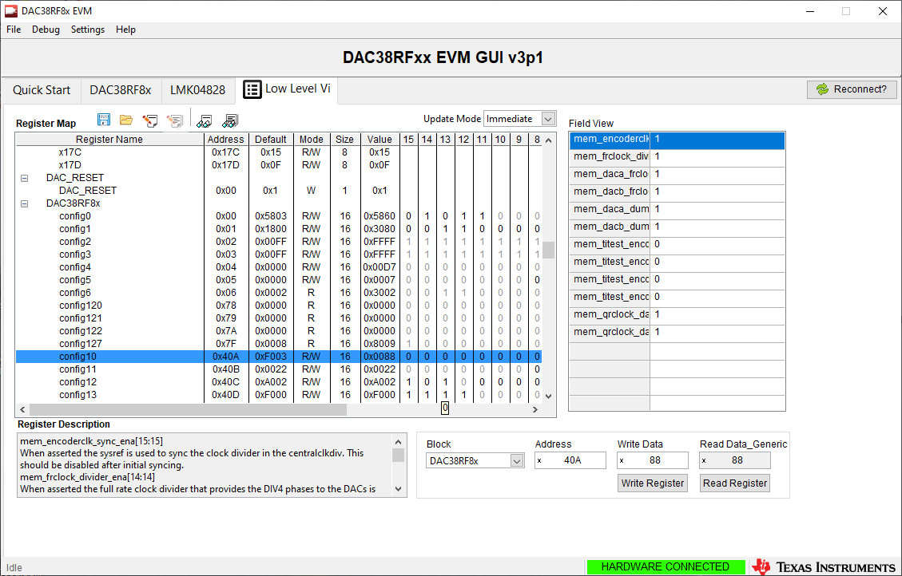
Low Level view tab. Verify you can write and read address config10

Slide 3
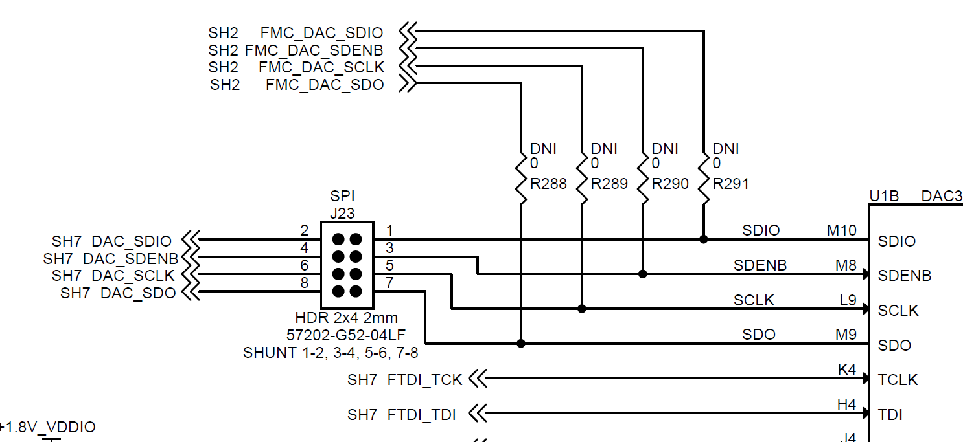
J23 should have all shunts installed

