Slide 1
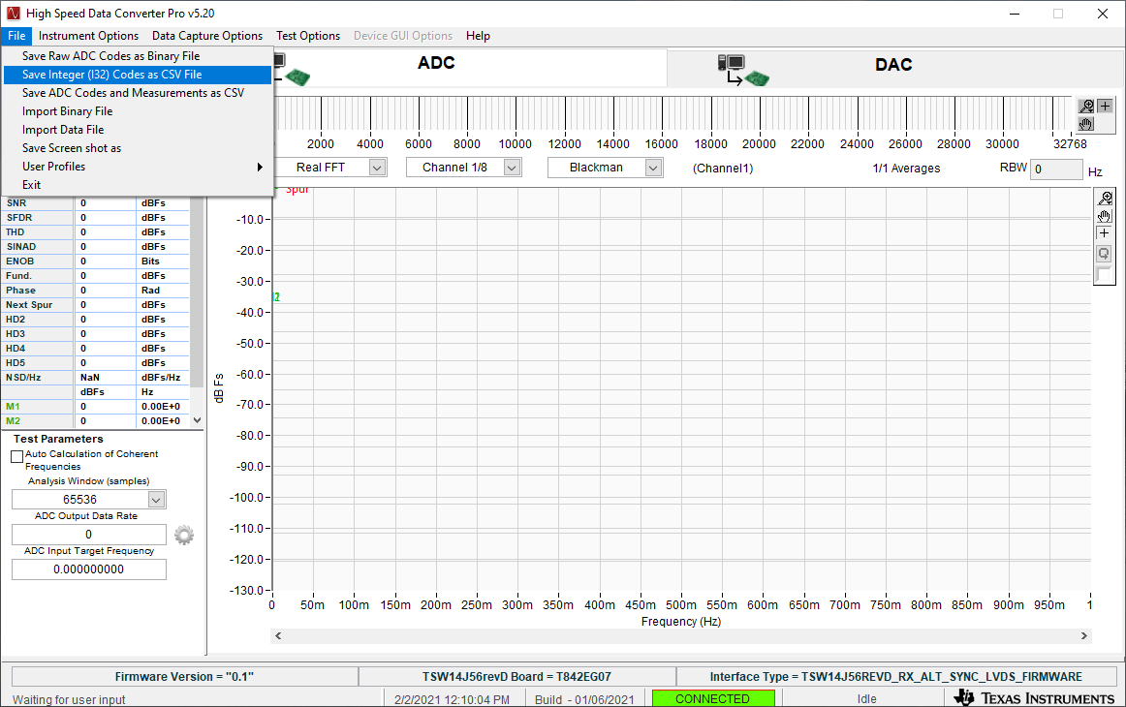
Click on “File” then select the CSV format shown below.

