Slide 1
AFE5832LP
THS4552
ADS9217
FPGA
I want to implement the CW circuit.
I use AFE5832LP → THS4552 → ADS9217 → FPGA.
The approximate input/output is shown in the figure above.
I would like to know the reference of R and C values of THS4552 and ADS9217 input output terminals. There is confusion because the EVM and reference circuit diagram R and C values received from TI are different. Please review it.
Attach a circuit Schematic. Thank you.

Slide 2
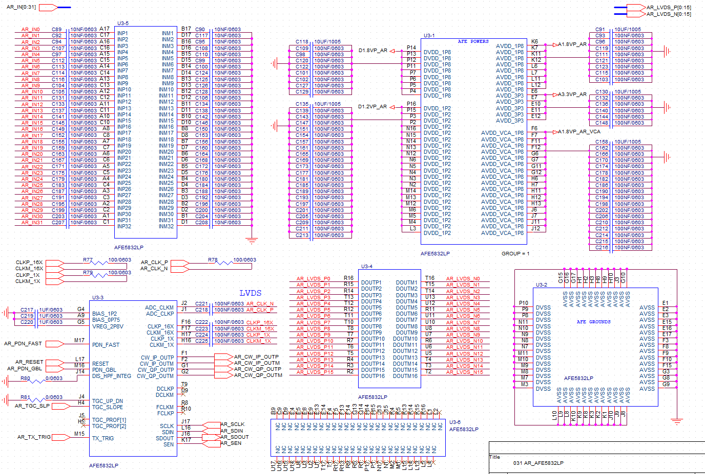
AFE5832LP

Slide 3
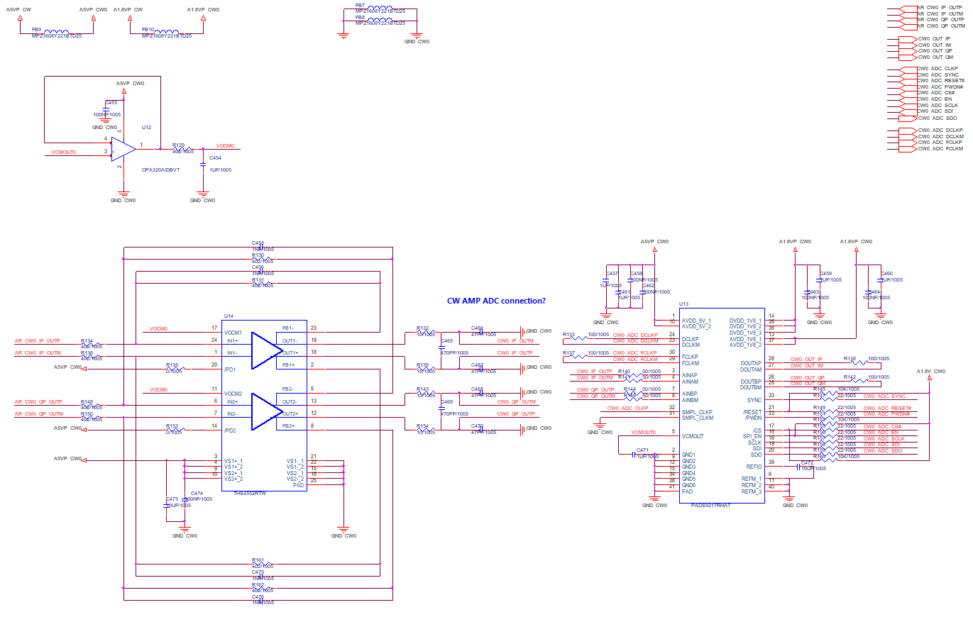
CW(THS4552+ADS9217)

Slide 4
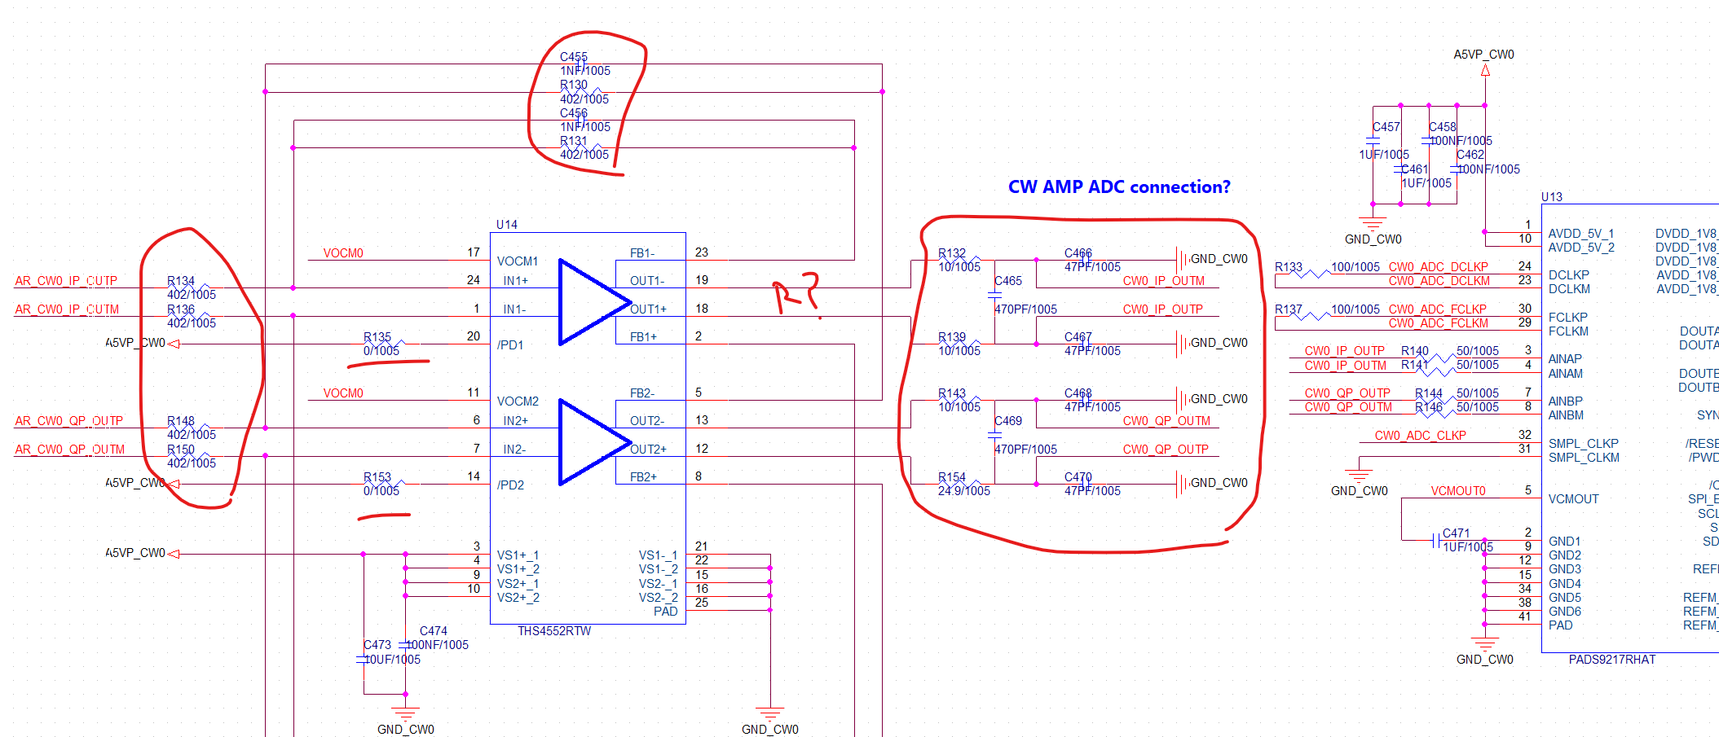
Question

Slide 5
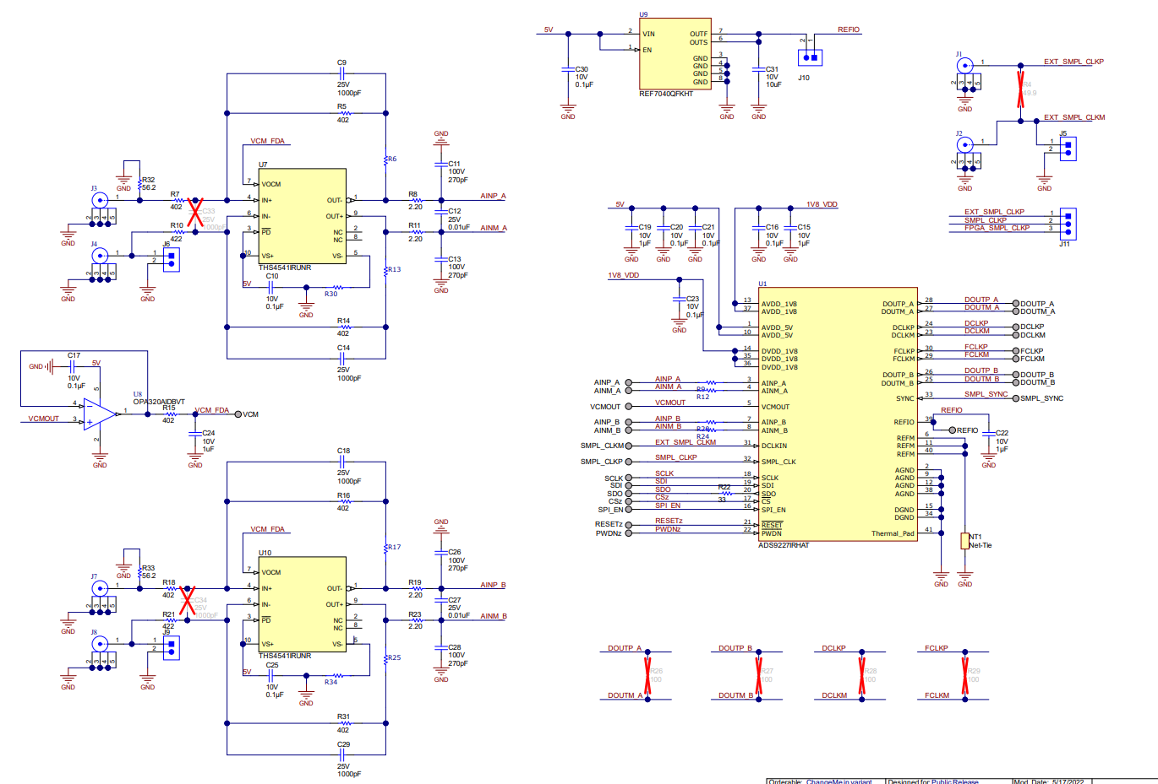
Refference TI

Slide 6
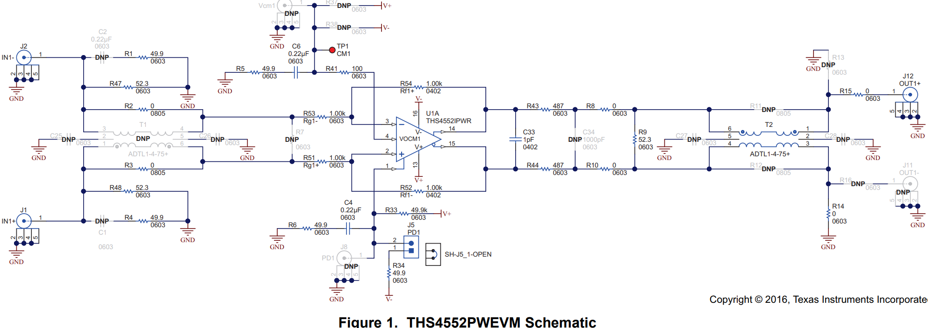
Refference TI EVM

