Slide 1
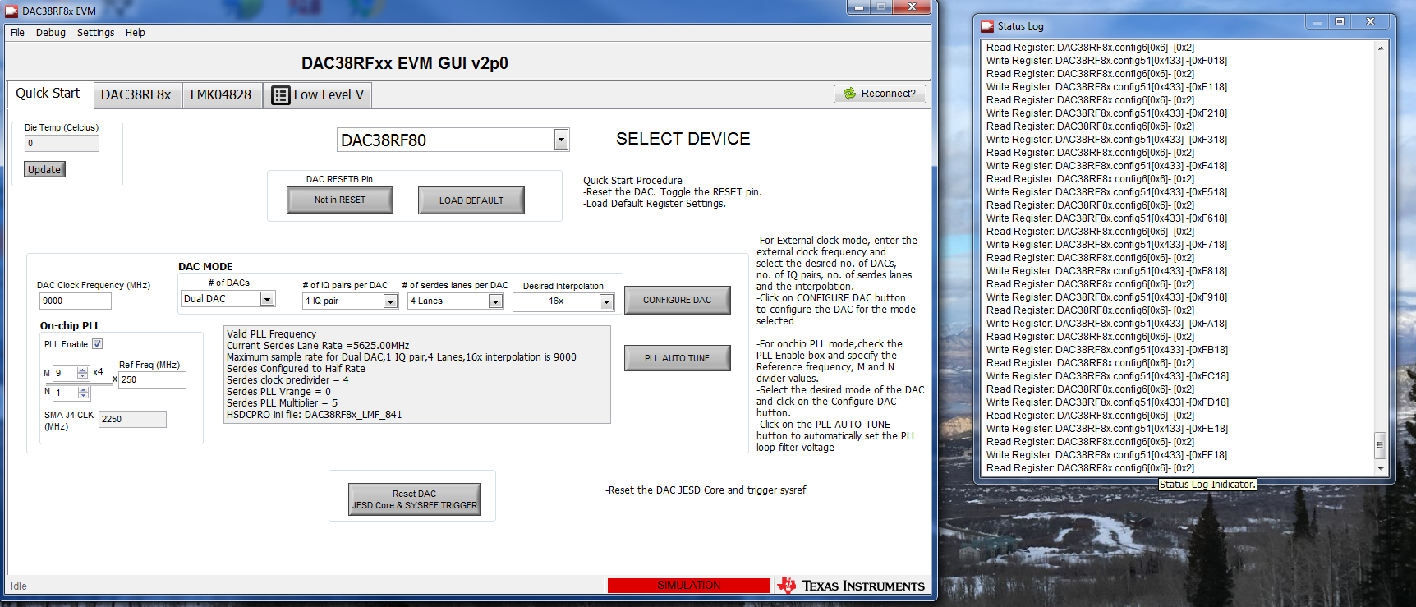
Double click next to “Idle” in the lower left of GUI opens a register log.

Slide 2
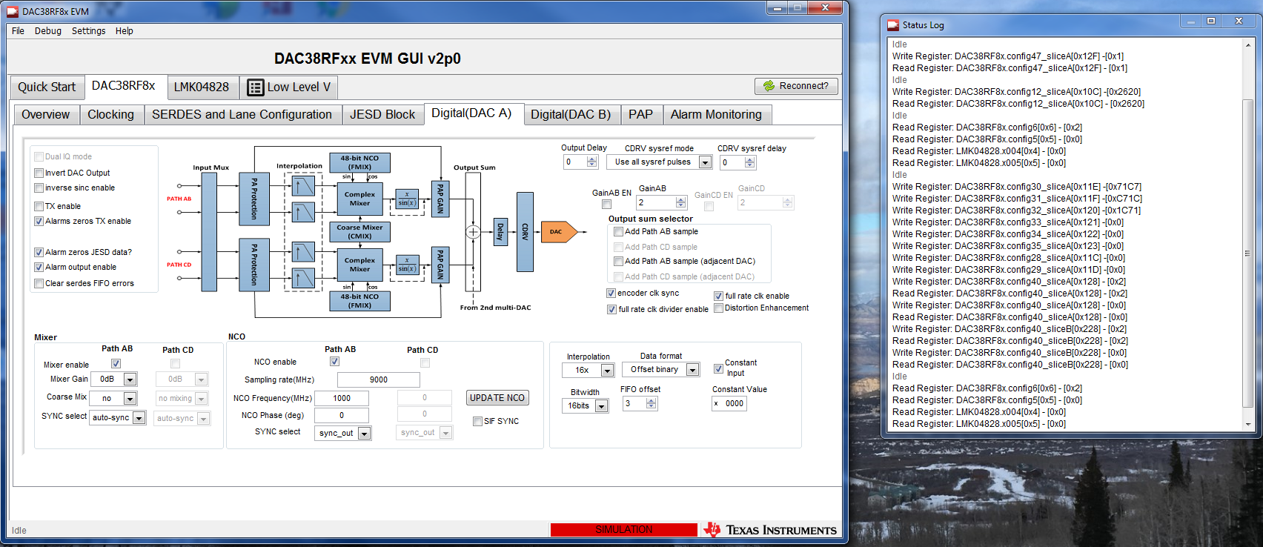
CW settings required and the register writes associated with this

Slide 3
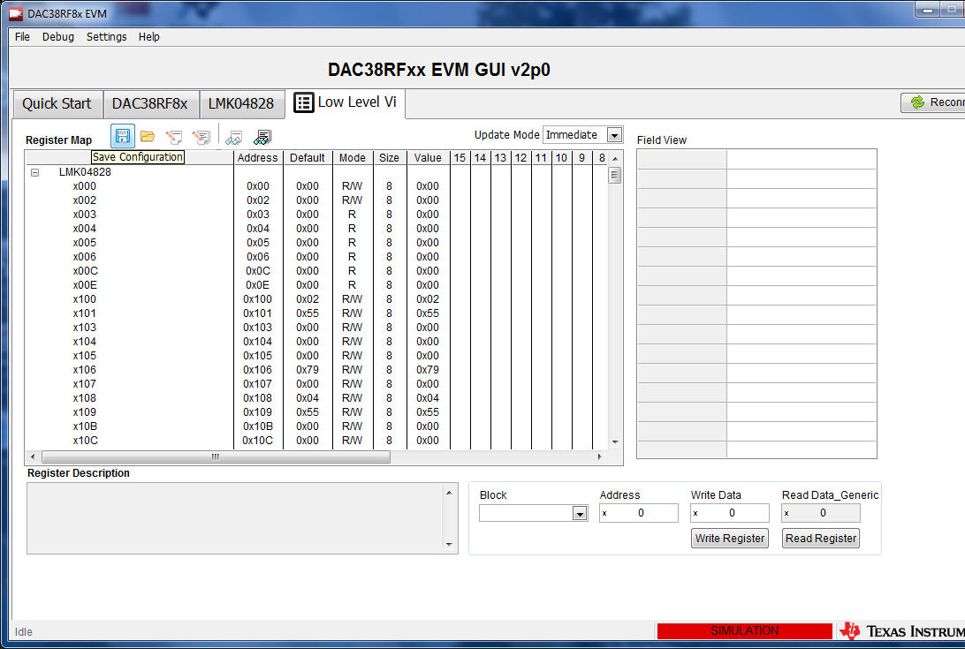
Click on floppy icon to save a configuration

Slide 4
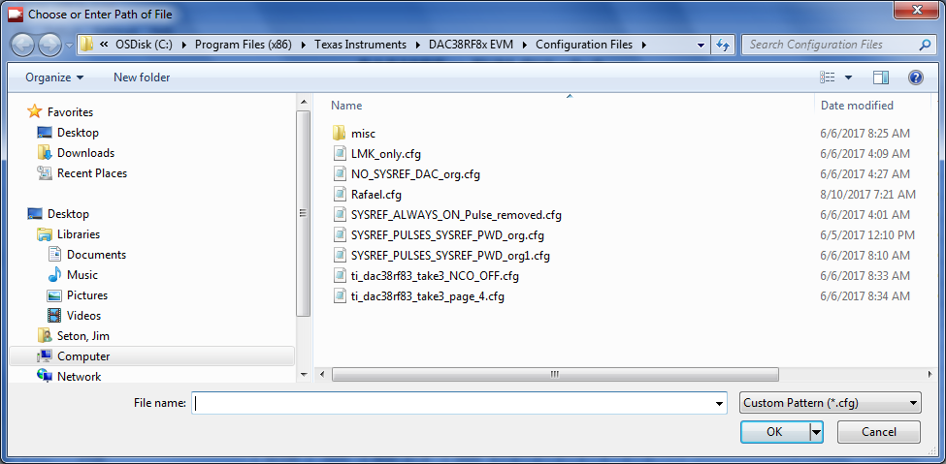
.cfg file will contain all LMK and DAC register settings

