Slide 1
DAC Concepts
Texas Instruments
High Speed Data Converters
June 2014

Slide 2
Outline
Current steering architecture used in high speed DACs – what is inside
DAC full-scale calculation
DAC specifications
  SNR, SFDR, IMD
  Harmonics in sampled systems
Noise and distortion in high speed DACs
Clocking high speed DACs
  phase noise, jitter, slew rate
Improving DAC SFDR with dithering

Slide 3
High Speed Current Steering DACs
- what is inside

Slide 4
Current Steering DAC “under the hood”
IOUT1
IOUT2
Analog Output
=
DAC
Digital Input Data
Switch Drivers
Decoder
Logic
Full Scale = 30mA
Switch Array
IOUT1
IOUT2
30mA
0mA
Bias
Circuit
15mA
15mA
Current
Source Array
0mA
30mA

Slide 5
DACs can be source or sink types
NMOS
(sink)
PMOS (source)
VCC
VCC+ 0.5 Volts
Ioutb
Iout
VCC - 0.5 Volts
Current Source Cascodes
Switches
Switches
Current Sink Cascodes
+1/0.5 Volts
- 1/0.5 Volts
Ioutb
Iout
DAC(2)90x, DAC2932, DAC56x2, DAC38J84
DAC34xx, DAC3174
DAC5686/87/88/89, DAC5681/82Z,
DAC3282/83
DAC3152/62
Notes:
PMOS is Source
NMOS sink
Swing will be above and below VCC at node, which is 3.0V with VCC = 3.3V using 25 Ohms

Slide 6
Simple 3-bit Binary DAC
AVDD
AVDD
Pro: Least number of current sources and switches.
Con: Higher distortion.
1000
1000
Vout
1
0
1
0
1
0
bit 3
bit 2
bit 1
500uA
250uA
125uA
(875u*1K)
(625u*1K)
(375u*1K)
(125u*1K)
Vout
– (125u*1K)
– (375u*1K)
– (625u*1K)
– (875u*1K)
bit1 and bit2 turn off, bit3 turns on
000
001
010
011
100
101
110
111
bit 3
bit 2
bit 1

Slide 7
Equivalent 3-bit Thermometer Coded DAC
AVDD
AVDD
Pro: Reduced distortion (easier to match equal current sources.)
Con: More current sources and switches required.
1000
1000
Vout
1
0
1
0
1
0
therm 7
therm 2
therm 1
125uA
125uA
125uA
(875u*1K)
(625u*1K)
(375u*1K)
(125u*1K)
Vout
– (125u*1K)
– (375u*1K)
– (625u*1K)
– (875u*1K)
one more equal valued current source turns on
0000000
0000001
0000011
0000111
0001111
0011111
0111111
1111111
bit 3
bit 2
bit 1

Slide 8
DACs can be segmented and mixed coded
therm(7:1) to MSB segment
AVDD
AVDD
input 6b word
decoder logic
bit(3:1) to LSB segment
1000
1000
Vout
1
0
1
0
1
0
therm 7
therm 2
therm 1
Thermometer 3b MSB DAC
125uA
125uA
125uA
1
0
1
0
1
0
bit 3
bit 2
bit 1
Binary 3b LSB DAC
62.5uA
31.25uA
15.625uA

Slide 9
Simplified TI 16b DAC topology
Ex: DAC34xx
IOUT1
MSB Thermo(63:0)
IOUT2
MSB segment decoding
D(15:10)
(6 MSB Bits)
73 switch drivers
73 switches
LSB binary(9:0)
LSB segment decoding
D(9:0)
(10 LSB Bits)
63
10
MSB cascodes
LSB cascodes
EXTIO
bias circuits
RBIAS
MSB current sources
LSB current sources

Slide 10
DAC Full-scale Calculation

Slide 11
Offset Binary vs. 2’s Complement
Most of our DACs have ability to accept either offset binary or twos complement mode.
The data format depends on user preference.
To convert offset binary to twos complement code, simply invert the MSB.

Slide 12
Current Sink DAC
NMOS (C05 – 180nm)
NPN (Bipolar)
AVDD + 0.5 Volts
Ioutp
Ioutn
AVDD + 0.3 Volts
Ioutp
Ioutn
AVDD - 0.5 Volts
AVDD – 1.0 Volts
Switches
Switches
Current Sink Cascodes
Current Sink Cascodes
DAC5686/87/88,
DAC5681/82Z
DAC5675, DAC5675A,
The bipolar DAC5675/A uses an NPN sink-type architecture since most bipolar technologies do not include a high-speed PNP.

Slide 13
Current Sink DAC Operation
(example shown with 25Ω load to AVDD)
Sinking current:
Minimum voltage
No current:
Maximum voltage

Slide 14
Current Source DAC
PMOS (C05 – 180nm)
PMOS (C027-90nm)
AVDD
AVDD
Current Source Cascodes
Current Source Cascodes
Switches
Switches
+1.25 Volts
+0.6 Volts
-1.0 Volts
Ioutp
Ioutn
-0.5 Volts
Ioutp
Ioutn
DAC90x, DAC290x, DAC2932, DAC56x2, DAC5674
DAC348x Family

Slide 15
Current Source DAC Operation
(example shown with 25Ω load to GND)
Sourcing current:
Maximum voltage
No current:
Minimum voltage

Slide 16
Three Ways to Program Full-Scale Current:
DAC_Gain, VEXTIO, and R_{BIAS}
The full-scale current can be adjusted by three different factors:
  DAC_gain: this is the 4-bit programmable register in the DACs. This scales the output current in 16 steps.
  VEXTIO: the internally generated or externally provided reference voltage. The internally generated voltage is typically 1.2V.
  R_{BIAS}: externally connected bias resistor.

Slide 17
DAC Specifications

Slide 18
Time & Frequency Domain Comparison

Slide 19
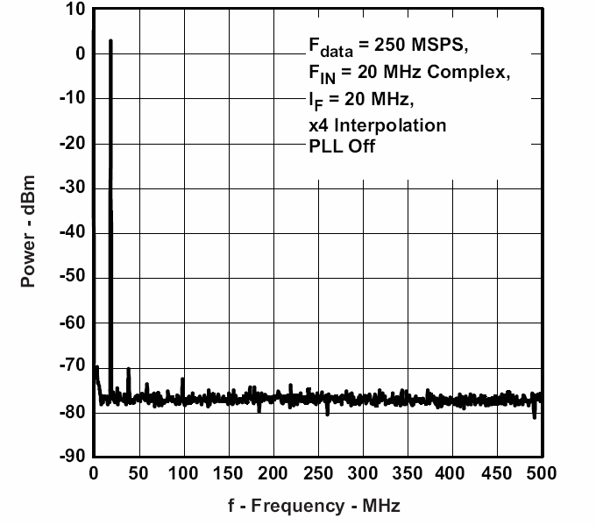
DAC SNR
SNR is measured with an output signal
Noise = the sum of the output over the 1st Nyquist zone (fs/2) excluding spurs and the signal
SNR = Signal/Noise
fs = 1GSPS
f out = 20MHz
DAC output noise is comprised of
  Quantization noise
  Thermal noise
  Jitter noise
  Data dependent noise
Signal
Noise

Slide 20
DAC SFDR
SFDR is measured with a single-tone signal
SFDR = Signal / highest spur
Spurs are a mixture of harmonics, sampling products
fs = 1GSPS
f out = 20MHz
SFDR
Other spurs

Slide 21
DAC IMDx
IMDx is the xth-order inter-modulation distortion, which is measured with a two-tone signal.
IMD3, the 3rd IMD, is usually the hardest IMD to remove by filtering.
fs = 1GSPS
f1 = 39.5MHz
f2 = 40.5MHz
3rd IMD spurs

Slide 22
Harmonics in Sampled Systems
Analog Harmonics
Signal
HD2
HD3
HD4
HD5
…
fo
2*fo
3*fo
4*fo
5*fo
Sampled System
Signal
2nd Nyquist
HD5
HD4
HD3
HD2
HD2
HD3
HD4
HD5
…
fo
2*fo
3*fo
4*fo
5*fo
Fs - fo
Fs/2
Fs
Fs - 5*fo
Fs - 4*fo
Fs - 3*fo
Fs - 2*fo
Sample Systems have additional harmonics at Fs – N*fo

Slide 23
Noise and Distortion in High Speed DACs

Slide 24
Noise and Distortion in High Speed DACs
amplitude error
jitter
bandwidth
limitation
Amplitude
1
2
3
4
5
6
7
8
Time (T_{sample})
A DAC output has a wanted amplitude (voltage or current) vs. time
For zero order hold (ZOH) output, the new amplitude is set at the beginning
of the sample period and held to the end of the sample period
Noise and distortion is due to either amplitude or switch time (jitter) error
Bandwidth limitations do not generate noise or distortion, just smooth out
the transitions

Slide 25
AC Noise and Distortion Sources:
Amplitude Errors
IOUT
Amplitude errors
  DC linearity (current source matching)
    INL, DNL
    Adjusted in production test
    Limitation at low output frequency
    High order harmonics
  Current source noise (1/f)
    Produces low frequency noise (< 1 MHz)
IOUTB
73 switch drivers
73 switches
Time
63
10
MSB cascodes
LSB cascodes
MSB current sources
LSB current sources
Amplitude
25
Notes:
25

Slide 26
AC Noise and Distortion Sources:
Timing Errors (Jitter)
Random clock jitter
  PLL/VCO
  Clock buffers
Deterministic jitter
  Random switch time matching
  Code dependent switch time
  Output voltage dependent switch time
  Dominated high IF/RF distortion
Clock spurs
  External spur sources – other clocks, LOs, switching regulators
  Internal sources – digital circuit clocks
IOUT1
IOUT2
73 switch drivers
73 switches
Time
63
10
MSB cascodes
LSB cascodes
MSB current sources
LSB current sources
Amplitude
26
Notes:
26

Slide 27
AC Noise and Distortion Sources:
Deterministic Jitter
Random switch time matching
  Switch driver transistors
  Matching improves with larger transistor area
  Dependent on rise/fall times – faster transistors are better
  Generates low – medium order harmonics (e.g. HD2 - HD7) dominant and vary from device to device
Code dependent switch time
  Increases with driver load capacitance, eg. Cload = Switch
  Improves with aggressive technology in switch driver
  Degrades with increased transistor area
  Results in low order harmonics
Output voltage dependent switch time
  Switch time depends on the output voltage seen by the switch
  Results in low order harmonics
27
Notes:
27

Slide 28
Cancellation of Even order Harmonics
Iout and IoutB are mirror images of each other:
IoutB = FS - Iout
Even order harmonics cancel each other, odd order do not
In practice outputs are not exactly matched, and often HD2 limits distortion performance
Iout
HD2
IoutB
Iout
HD3
IoutB
+
= 0
+
≠ 0

Slide 29
Clocking High Speed DACs

Slide 30
SNR & Jitter Estimate for DACs
The total SNR is the vector sum of all individual SNR contributions
Similar treatment of clock jitter (integrated phase noise) for SNR limit of DAC sampled system
SNR_{QUANT} = SNR due to quantization
SNR_{CLK} = SNR due to clock and aperture jitter
SNR_{THERM} = SNR due to thermal and transistor noise
30

Slide 31
DAC NSD or SNR Specification
Newer datasheet specifies NSD (dBc/Hz). It is the difference of power between the output fundamental tone power and the noise floor of 1Hz bandwidth.
fs = 1GSPS
f out = 20MHz
Signal
Noise

Slide 32
Why NSD over SNR?
In real systems, there is often tight filtering around the band of interest, where all the noise outside of that band is filtered out.
Rather than showing the SNR of the signal in the first Nyquist zone, it is more convenient to show the noise power so that the total noise power in the unfiltered band can be readily calculated
For example, consider a DAC3484 running at 1228.8 MSPS with a band of interest of 100 MHz and the following filters:
  A 614.4-MHz low-pass filter (passing full first Nyquist zone):
  A 100-MHz low-pass filter:
32

Slide 33
Converting NSD to SNR
The SNR of the DAC can be calculated from the NSD spec
The SNR was traditionally defined as the ratio of the power of the fundamental to the power of the noise integrated over the first Nyquist zone.
It can also be calculated directly in dBFS from the NSD in dBc/Hz
Example: DAC3484 running at 1.25 GSPS with 10 MHz output
33

Slide 34
NSD to SNR tradeoffs – Jitter/Phase noise
SNR estimates based on Jitter are good estimates for SNR for the entire Nyquist band – may be too pessimistic for BW limited applications.
SNR estimates based on NSD (typically measured at some MHz offset) do not account for close-in phase noise which could affect inband EVM - would be good for out of band estimates like ACPR
Using the clock NSD and BW limited noise calculations would be the ideal solution for in-band and out-of-band measurements.

Slide 35
CLK Phase Noise Effects on Sampled Systems
For both sampled systems of the ADC and DAC the CLK phase noise will be translated from the clock to the sampled outputs with the following relationship
All in-band (%EVM, RX sensitivity) and out-of-band (ACPR, TX Mask) measurements can be based on the measured phase noise plot of the ADC and DAC clock source

Slide 36
Intrinsic DAC Noise Effects
At higher frequency offsets where the phase noise of the clock drops off, the intrinsic noise of the DAC will play a role in the overall noise floor of the output spectrum
Measurements of the CLK NSD and the DAC output NSD show that there is some discrepancy between the estimates – this is accounted for by the DAC intrinsic noise due to the Thermal/Device effects

Slide 37
Intrinsic DAC Noise Effects
The Intrinsic DAC noise is frequency dependent and measured at a particular offset frequency will only be approximately accurate for other offset frequencies.
Intrinsic Noise estimates made at 40MHz offset are somewhat accurate for NSD estimates at the same frequency offset using different clock sources.
DAC intrinsic noise @40MHz
Error in all cases
-146
0
50
100
150
200
250
300
350
400
450
500
2
-148
1.5
1ps_peaking
500fs_peaking
200fs_peaking
1ps_1MHz
-150
1
500fs_1MHz
200fs_1MHz
DAC noise
Error (dB)
-152
0.5
-154
0
0
50
100
150
200
250
300
350
400
450
500
-156
-0.5
-158
-1
-160
-1.5
-162
-2
DAC output frequency
DAC output frequency (MHz)

Slide 38
DAC NSD Application measurement - EVM
WCDMA signal 3.84MHz BW, IF=122.88M, Sample rate 983.04Msps, 1% EVM (40dBc SNR equivalently)
Assuming that %EVM is a measure of the SNR of the average inband signal power to the average inband NSD we can estimate the required average NSD of the clock (-105.84dBc/Hz avg at DAC output)
Scale by IF and Sample rate (-87.78dBc/Hz avg at Clock source)

Slide 39
DAC NSD Application Measurement - EVM
Average Clock NSD within 3.84MHz around the fundamental clock frequency needs to be less than -87.78dBc/Hz
The average clock NSD must be less than the predicted clock NSD to meet system requirements for EVM
Phase noise
Peaking NSD – cause EVM fluctuation
Predicted clock NSD
Average in-band NSD @ clock – determine EVM
1.92MHz
Frequency shift

Slide 40
DAC NSD Application Measurement - ACPR
WCDMA signal 3.84MHz BW, IF=122.88M, Sample rate 983.04Msps, ACPR=70dB, Alt ACPR=75dBc
The Clock NSD for both the ACPR and Alt ACPR is given by:
Clock NSD ACPR = -118dBc/Hz, Clock NSD Alt ACPR = -123dBc/Hz

Slide 41
DAC NSD Application Measurement - ACPR
Using some common clock sources we can see that the Clock NSD at ACPR and Alt ACPR frequency offsets is well below these NSD numbers.

Slide 42
DAC NSD Application Measurement - ACPR
Clock NSD at the ACPR and Alt ACPR offsets that there is negligible difference between using different clocks at different IF frequencies. Follows the shape of Intrinsic DAC noise.

Slide 43
DAC NSD Application Measurement – ACPR
Same results with Alt ACPR.

Slide 44
Slew Rate and Jitter Performance
As shown in the example before, adding a filter can reduce the slew rate of the clocking signal by filtering out harmonics
The slower slew rate is more susceptible to variations in the zero crossing point due to noise

Slide 45
Sine Wave Amplitude vs Slew Rate
Using a larger sine wave can overcome the reduced slew rate since a larger amplitude will result in a quicker transition through the zero crossing point. This will reduce the impact of noise on the zero crossing point.

Slide 46
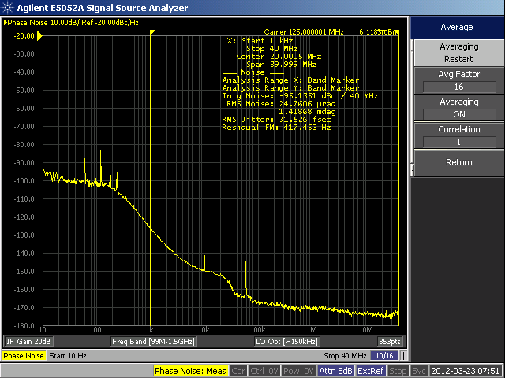
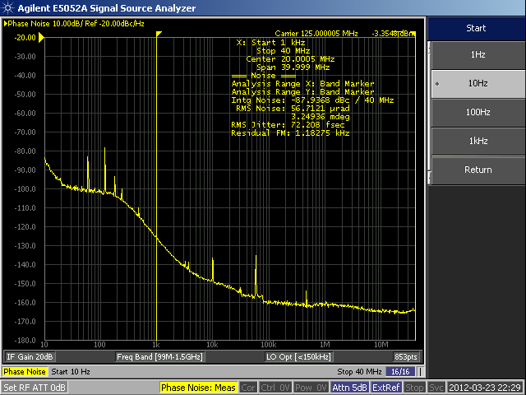
Phase Noise for Slower Slew Rate
For a clock that has ~9 dBm less power, the amount of jitter has been increased from 31.52 fs to 72.208 fs
6.11 dBm Clock:
-3.35 dBm Clock:

Slide 47
Improving DAC SFDR with Dithering

Slide 48
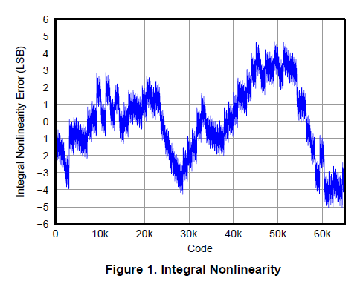
DAC Integral Nonlinearity
Integral Nonlinearity is the
error from an ideal linear DAC
IOUTS
MSB Thermo(30:0)
MSB segment decoding
D(15:11)
(5 MSB Bits)
MID Thermo(14:0)
53 switches
MID segment decoding
53 switch drivers
D(10:7)
(4 MID Bits)
LSB binary(6:0)
D(6:0)
LSB segment decoding
(7 LSB Bits)
31
15
7
Transition from 1 current
segment to the next
MSB cascodes
MID cascodes
LSB cascodes
EXTIO
bias circuits
MSB current sources
MID current sources
LSB current sources
RBIAS
Mismatch in the current sources
give errors in the DAC INL

Slide 49
DAC INL Error Produces Harmonics
Sinewave Signal
Sinewave with
HUGE INL Error
Output Spectrum
*
=
INL breaks generate harmonics,
especially high order harmonics

Slide 50
Dither
Dither is a random signal that can be added to DAC output
Adding dither randomized the INL breaks
Dither is effective in improving high order harmonics from INL breaks, does not improve low order harmonics from other distortion sources
Dither randomly moves when
the INL breaks occur

Slide 51
Adding Dither to Improve High Order Harmonics
Dither can be band limited and then filtered at the DAC output
  0IF system – dither placed near Fs/2
  Complex IF system – dither placed near 0 Hz
The exact dither spectrum does not matter
The amplitude needs to be on the order of the DAC MSB current source segments
Future DACs will include built in dither generating circuits

Slide 52
Demonstration of Dither: Setup
TSW3100+DAC34H84
Fs=1228.8MHz
NCO: disabled
Output signal power: -1.95dBm
Output signal frequency: 210MHz
Generation of dithering noise
  200-tone signal
  WCDMA carrier

Slide 53
Example of Improvement of High Order Harmonics with Dithering
HD5
HD17
HD13
HD11
Dither Signal
Significant improvement to HD11, HD13, HD17. Not much improvement to HD5.
TI Information – NDA Required

Slide 54
Summary on the Effect of Dithering Noise Amplitude
Amplitude of dithering noise (dBc) | HD5 (dBc) | HD11 (dBc) | HD13 (dBc) | HD17 (dBc)
- Inf (w/o dithering) | -69.89 | -77.05 | -81 | -75.09
-35.75 | -70.23 | < -84 | < -84 | -80.13
-41.77 | -69.86 | < -84 | < -84 | -78.2
-45.28 | -69.22 | < -84 | < -84 | -76.6
Note: the dithering noise BW=20MHz
Conclusion: larger amplitude can bring better performance, however, it may cause overloading.
TI Information – NDA Required

Slide 55
Summary on the Effect of Dithering Noise Bandwidth
10 MHz
30 MHz
Bandwidth of dithering noise (MHz) | HD5 (dBc) | HD11 (dBc) | HD13 (dBc) | HD17 (dBc)
0 (w/o dithering) | -69.89 | -77.05 | -81 | -75.09
10 | -70.02 | < -84 | < -84 | -79.58
20 | -70.23 | < -84 | < -84 | -80.13
30 | -70.00 | < -84 | < -84 | -81.31
TI Information – NDA Required

Slide 56
Summary on the Effect of Dithering Noise Pattern
Dithering noise pattern | HD5 (dBc) | HD11 (dBc) | HD13 (dBc) | HD17 (dBc)
w/o dithering | -69.89 | -77.05 | -81 | -75.09
200-tone signal | -70.23 | < -84 | < -84 | -80.13
WCDMA 1-carrier signal | -70.17 | < -84 | < -84 | -80.21
Note: the dithering noise amplitude ≈ -35.5dBc
the dithering noise BW ≈ 20MHz
Conclusion: similar performance.
TI Information – NDA Required

Slide 57
Thank you!

