Slide 1
DAC3152EVM Quick Start Up
11/7/2018

Slide 2
Required Hardware
The following equipment is required for evaluation of the DAC3152 EVM
DAC3152 Evaluation Board (EVM)
TSW1400EVM Capture card
HP 8643A Signal Generator or equivalent
Tektronix 500MHz Oscilloscope or equivalent
2 SMA cables
• Two +5V, 3A output, 100-240VAC, 50-60Hz, 0.6A input or equivalent
2 Banana Cables
Standard USB Cable

Slide 3
Required Software
The following software is required to operate the DAC3152 EVM and is available through TI
High Speed Data Converter Pro software (latest version)
www.ti.com/tool/dataconverterpro-sw

Slide 4
Installations and Setup
High Speed Data Converter Pro GUI Installation
High Speed Data Converter Pro (HSDC Pro) is used to control the TSW1400EVM and generate waveforms for the DAC. Please see the HSDC Pro user’s guide for more information.
Download HSDC Pro from the TI website. The References section of this document contains the link to find the software on the TI website.
System Administrator privileges are required for installation and use
Extract the files from the zip file.
Run setup.exe and follow the installation prompts. Installation to the default directory location is recommended.
After installation has completed, power the TSW board and connect its USB cable to the PC. This will finalize the driver installation on the PC.
Copy configuration files into HSDC Pro
INI files provided by TI must be copied to proper locations in the HSDC Pro installation directory as they are not yet part of the released package. The path below assumes HSDC Pro was installed to the default installation directory [recommended]
DAC3152.ini
Copy to C:\Program Files (x86)\Texas Instruments\High Speed Data Converter Pro\1400 Details\DAC files

Slide 5
Installations and Setup

Slide 6
Driver Initialization on Windows PC
The first time the EVM and TSW board are connected to the PC a driver initialization sequence will initiate from Windows. Allow the driver installation to complete before moving on to the next step in the setup.

Slide 7
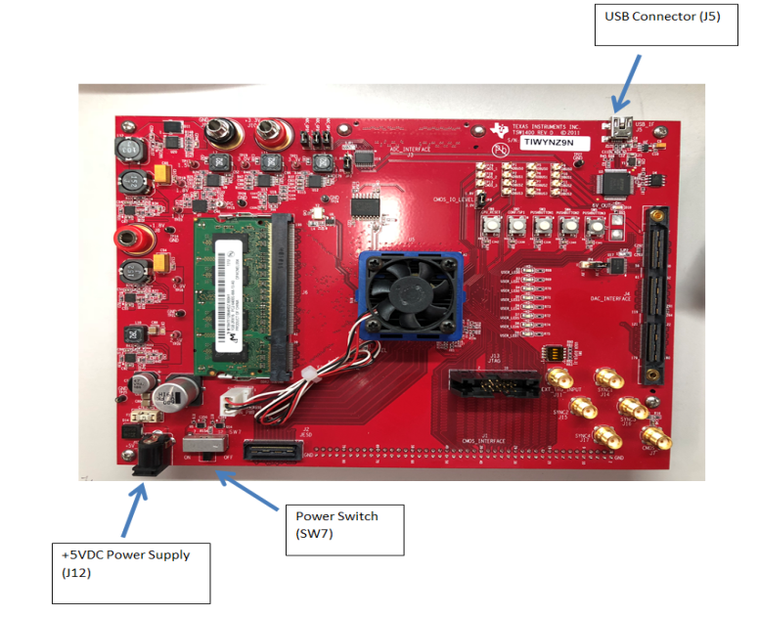
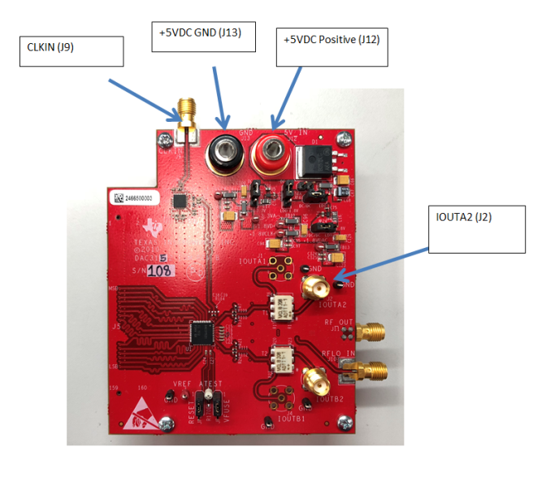
Steps
1) Connect the DAC3152EVM to the TSW1400EVM.
2) Connect the positive output of one of the +5VDC power supplies to J12 of the DAC3152EVM. Connect the return to J13.
3) Connect the USB cable between the TSW1400EVM and the host PC through J5.
4) Connect the output of one of the +5VDC power supplies to J12 of the TSW1400EVM and the input to a 110-240 AC source. Turn on both power supplies. Turn on the TSW1400 using SW7.
5) Connect a SMA cable between the output SMA J2 (IOUTA2) of the DAC3152EVM and an oscilloscope.
6) Connect a SMA cable between the signal generator output and J9 (CLKIN) of the DAC3152EVM.
7) Set the signal generator to output a 500MHz sine wave with an amplitude of 15 dBm.
3
6
2
5
4

Slide 8
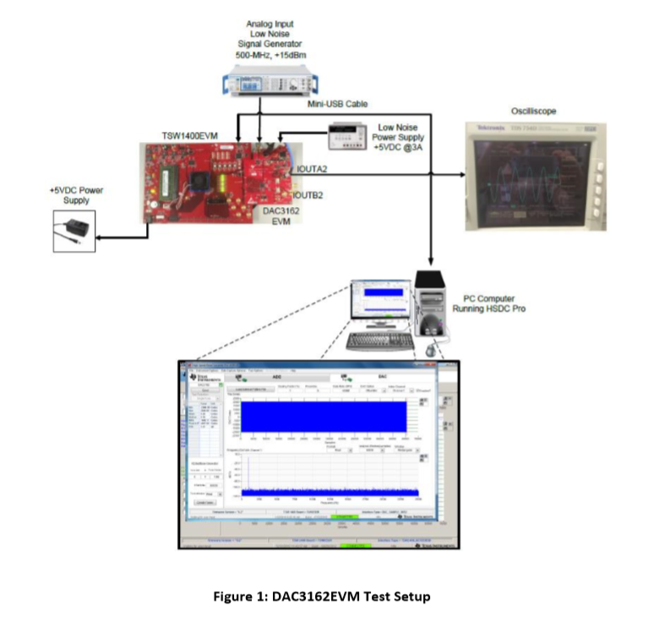
DAC3152EVM Test Setup
12

Slide 9
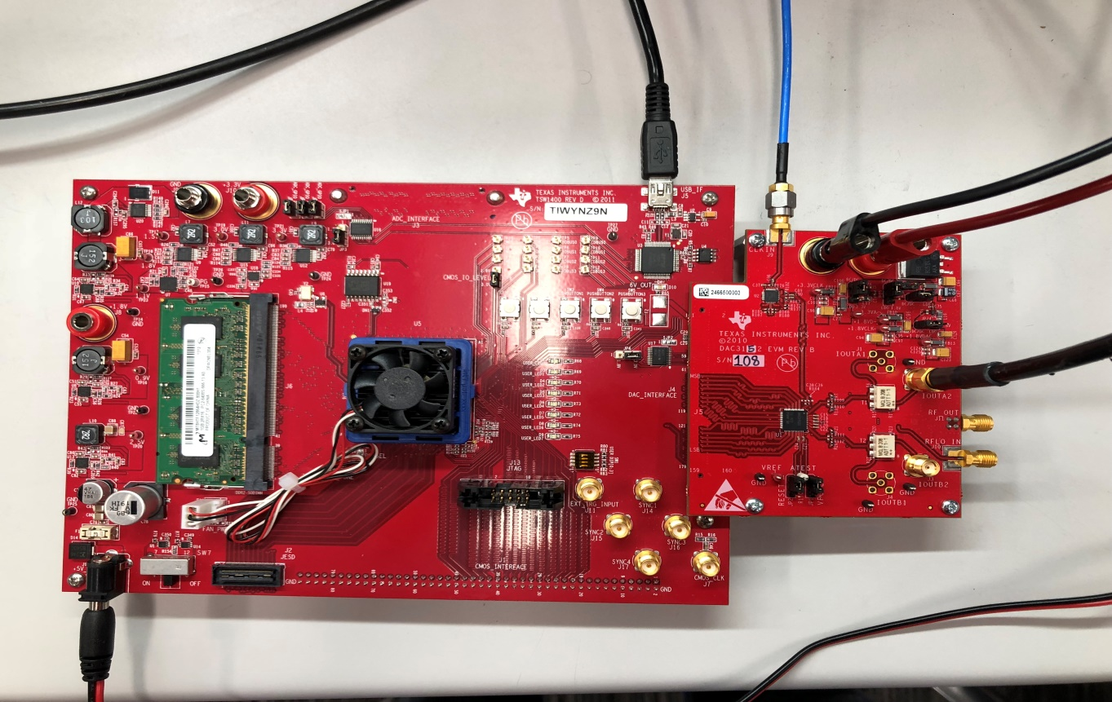
Setup

Slide 10
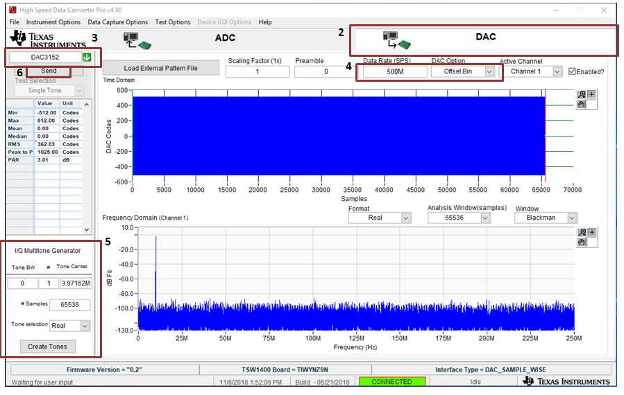
Go to HSDCpro software
Launch HSDC Pro (as ADMINISTRATOR), connect to J57 board as prompted.
Click OK if message appears ‘no firmware’
On HSDC Pro click DAC TAB ( set the DAC tab as shown in the picture below)
On the DAC tab select DAC3152 ini file( say yes to down the firmware popup)
Set Data Rate (SPS) to 500M and DAC Option to Offset Bin
Go to to I/Q Multitone Generator # 1, Tone Center 10M, Real, # Samples 65536 and click Create Tones
Click Send

Slide 11
DAC Output
The signal shall now appear on the oscilloscope as a 1V +/-0.1V p-p 10MHz sine wave.

