Slide 1
DAC3482 Internal Clock Operation

Slide 2
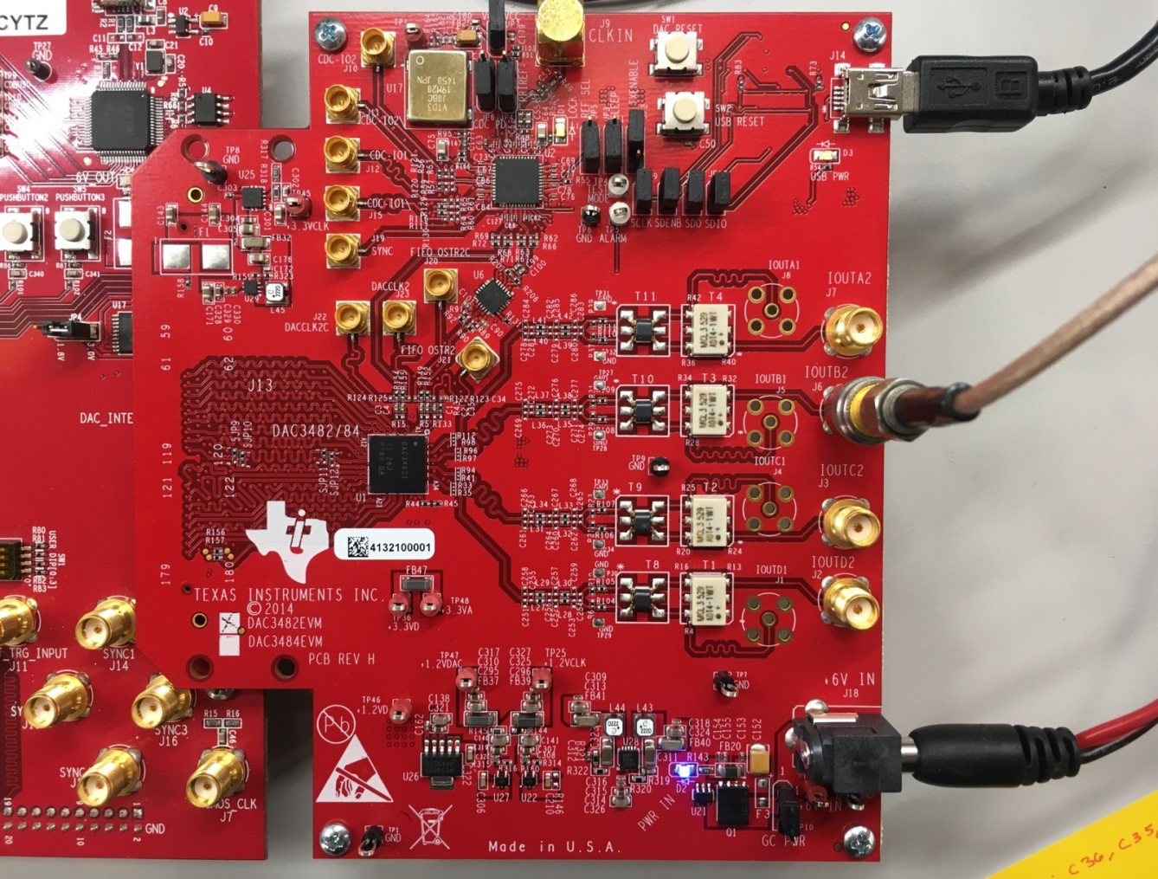
Setup
Verify Jumper Settings
J97 ATTACHED
JP6 1-2
JP4 1-2
JP5 2-3
JP3 2-3
USB
6V IN

Slide 3
Generating 100MHz Fout. Fin = 50MHz, NCO = 50Mhz Steps (Pictures for verification reference on next slide)
Power up TSW & DAC
Click Reset Dac button on DAC EVM
Run HSDC Pro
Select DAC3482
Enter data rate
Create desired tone
Run DAC348x GUI (as administrator)
Click Reset USB
Load Config File
Verify that Y3: FPGA clock divider in CDC tab to 16
Verify NCO settings are set
Click update NCO freq
Toggle Sif Sync button
Click Send all
Navigate to HSDC PRO click Send
If no tone, press “dac reset on board”, “send all” in GUI , then “send” in HSDC pro

Slide 4
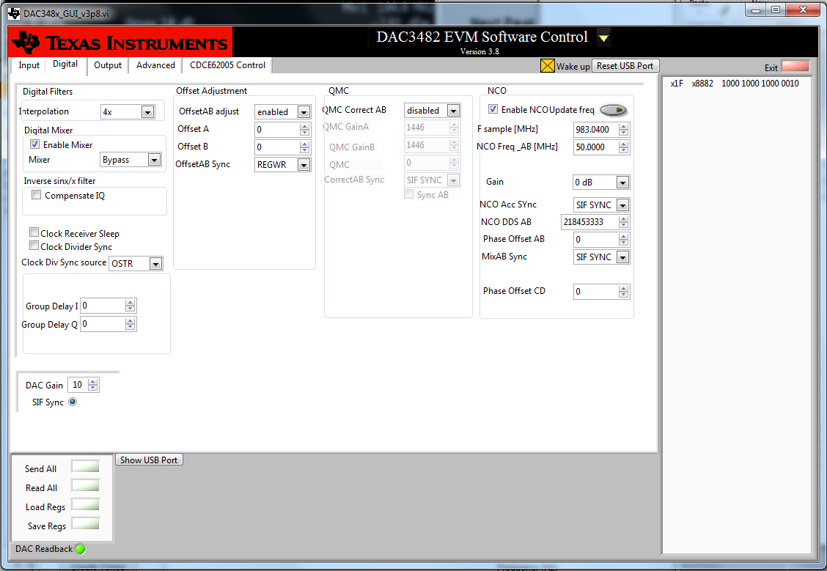
DAC Gui Tab

Slide 5
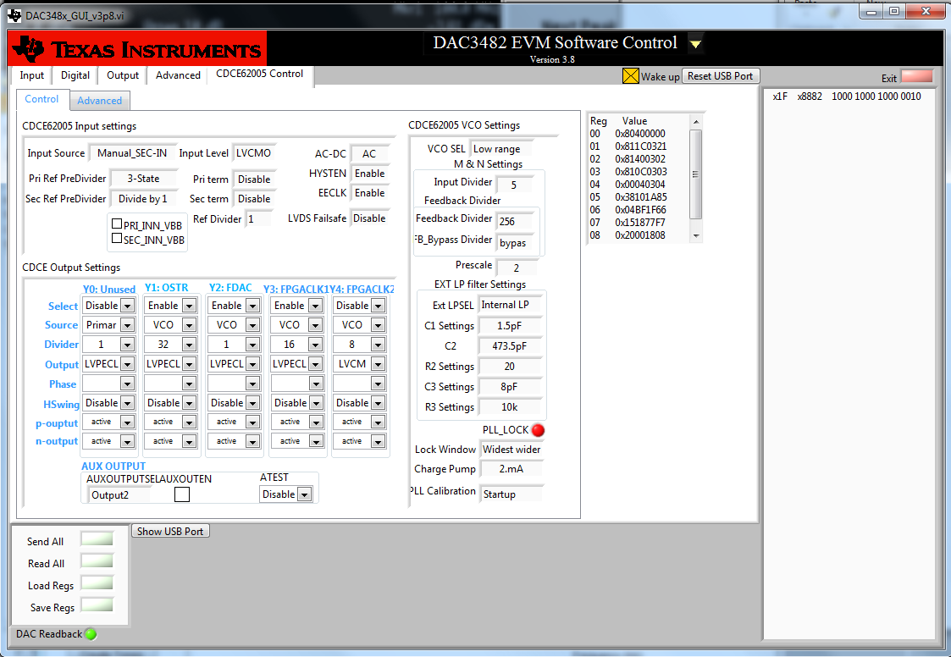
CDC Control Tab

Slide 6
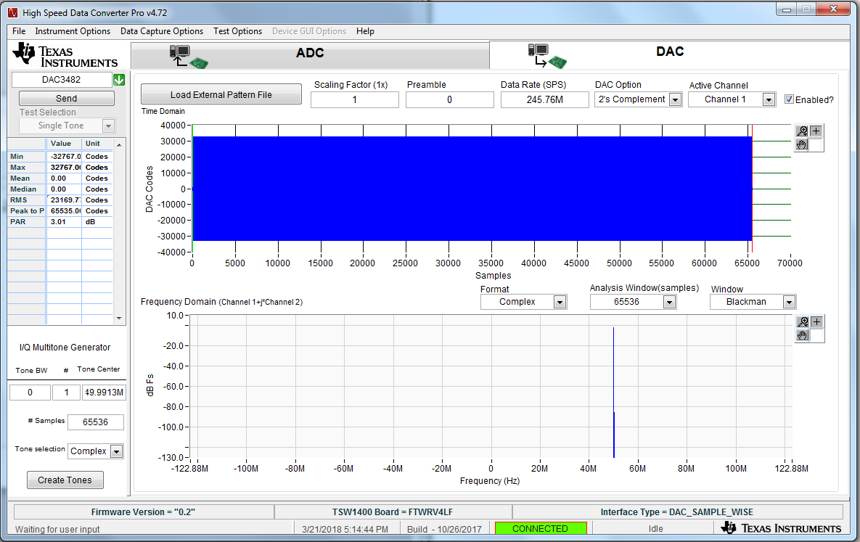
HSDC PRO

Slide 7
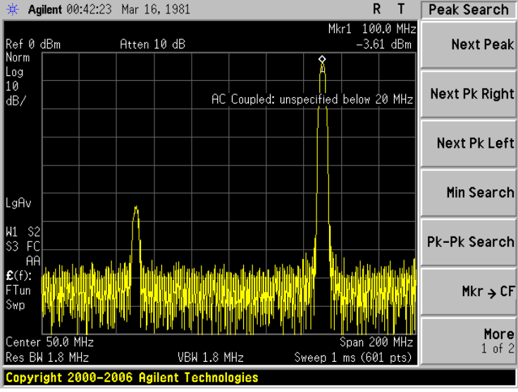
Verified Tone at RF output = 100MHz

Slide 8
Troubleshoot
If signal is distorted at Dac output, press reset dac button and “send all” again in Gui. Then press send again in HSDC.
If pll is not locked, try resetting the CDC by toggling the CDC PD pin (JP6). Then press send again in HSDC pro.
If tone is at undesired location. Make sure to NCO is updated by pressing “nco update” and then toggling sif sync

