Slide 1
DAC3482 Test

Slide 2
DAC3482 Test
Test Setup:
10MHz complex tone sent from TSW1406EVM
Test conditions:
Fdac = 1228.8Msps Ext Clk connected to J9
4x Interpolation
Set jumper shunts as follows: JP2 1-2, JP3 2-3, JP4 2-3, JP5 1-2, JP6 1-2, JP10 1-2 and JP7, JP8,
JP9, JP12, and JP13 installed
After power is applied, press DAC_RESET button on DAC EVM
Note: Must run DAC GUI as administrator

Slide 3
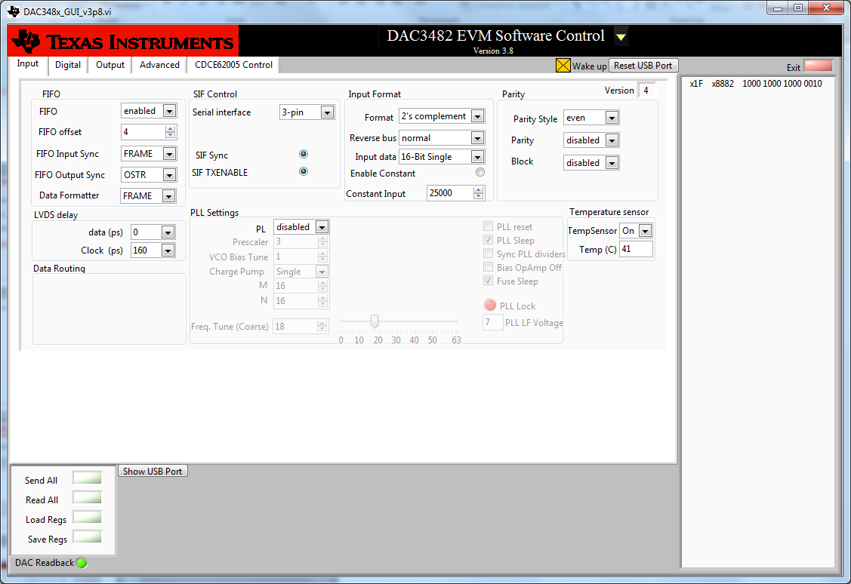
DAC3482 GUI Select “DAC3482” in the top middle of the GUI

Slide 4
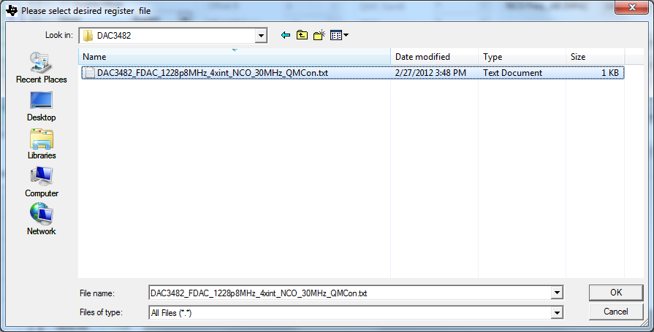
Click on “Load Regs” and load the file shown.

Slide 5
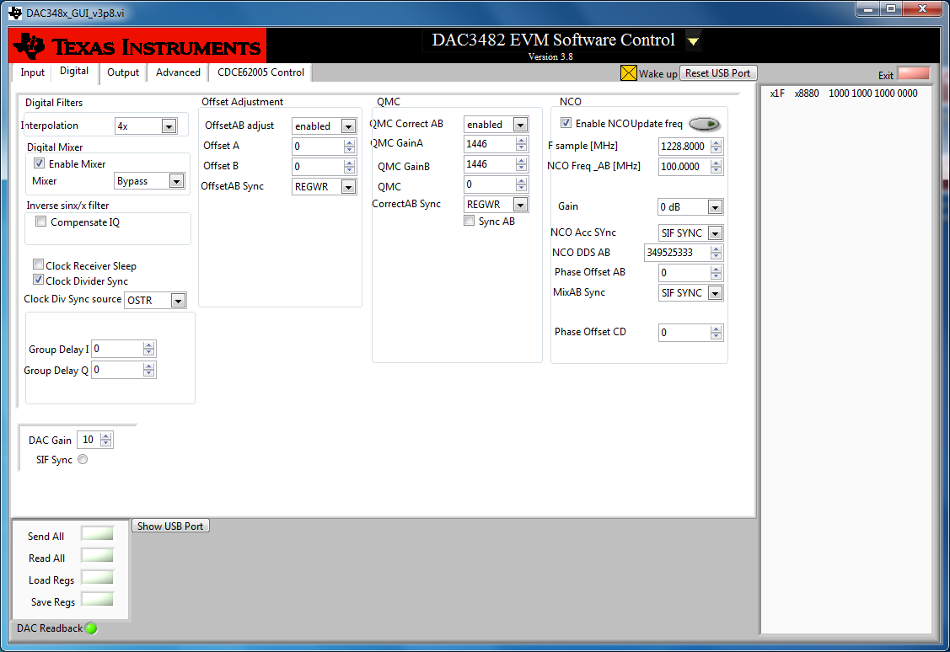
Digital Tab Set the F sample to 1228.8MHz Set NCO 100MHz. Click on button to the right of “Enable NCO Update freq”. Toggle SIF Sync button.

Slide 6
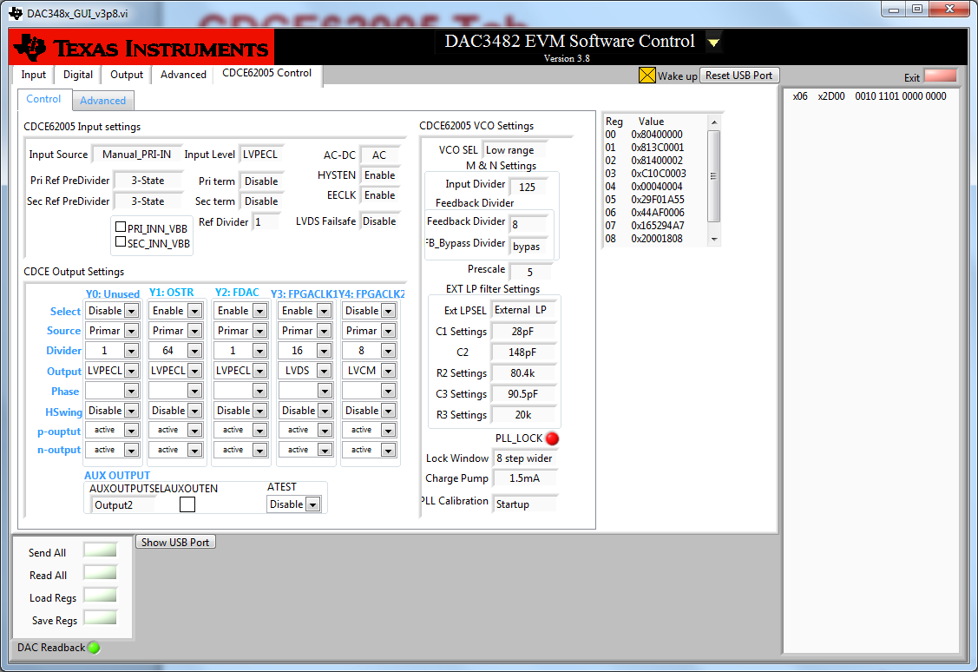
CDCE62005 Tab

Slide 7
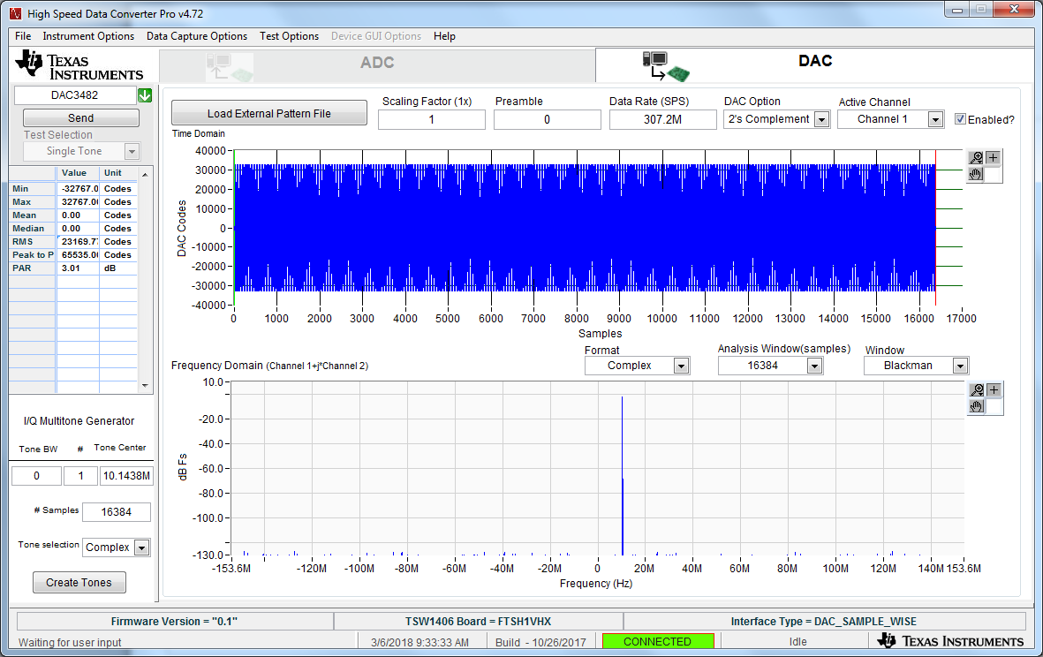
HSDC Pro Setup

Slide 8
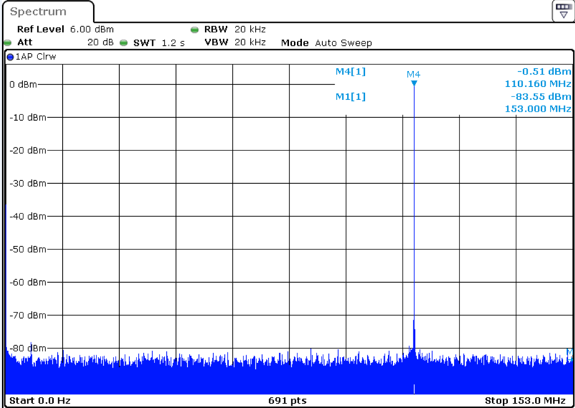
CHB tone at 110MHz (Input = 10MHz, NCO = 100MHz)

