Slide 1
DAC37J82EVM, TSW14J10EVM, KC705

Slide 2
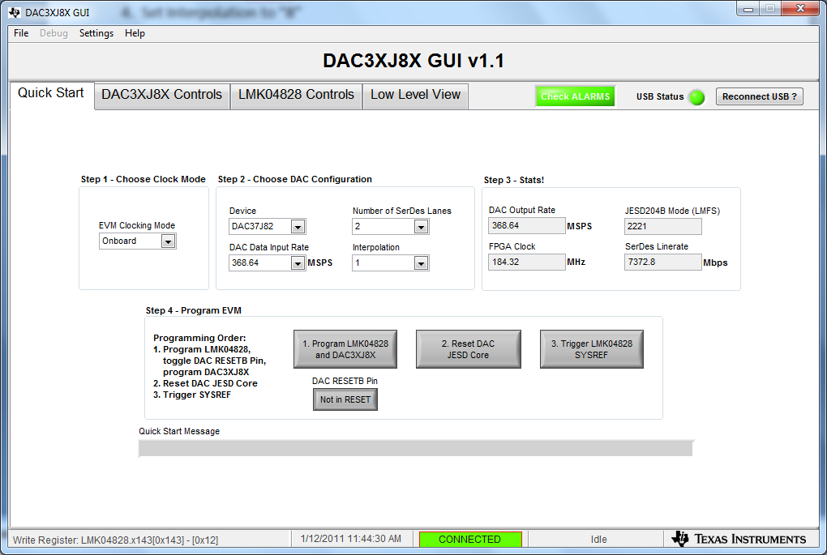
1. Set EVM Clocking Mode to “Internal Clock” 2. Set DAC Data Input Rate to “368.64” 3. Set Number of SerDes Lanes to “2” 4. Set Interpolation to “1” GUI shall look as shown below

Slide 3
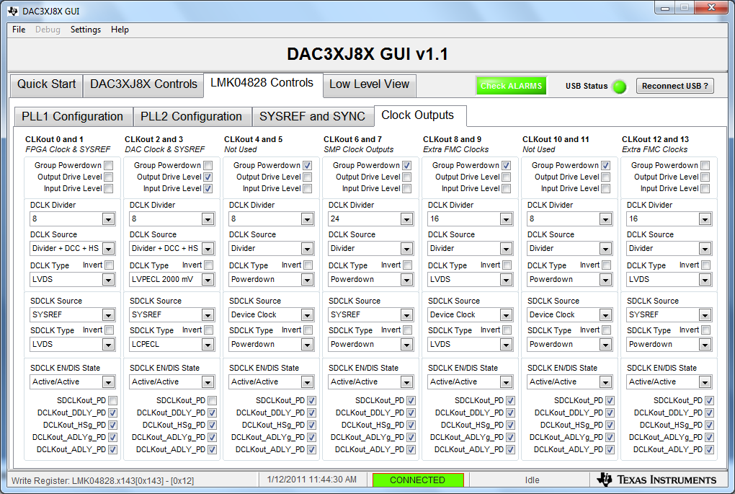
1. Set clk0 to div by 8 (for FPGA reference clock = 368.64MHz) 2. Deselect Group powerdown and set CLKout 12 and 13 to div 16 (for FPGA core clock = 184.32MHz)

Slide 4
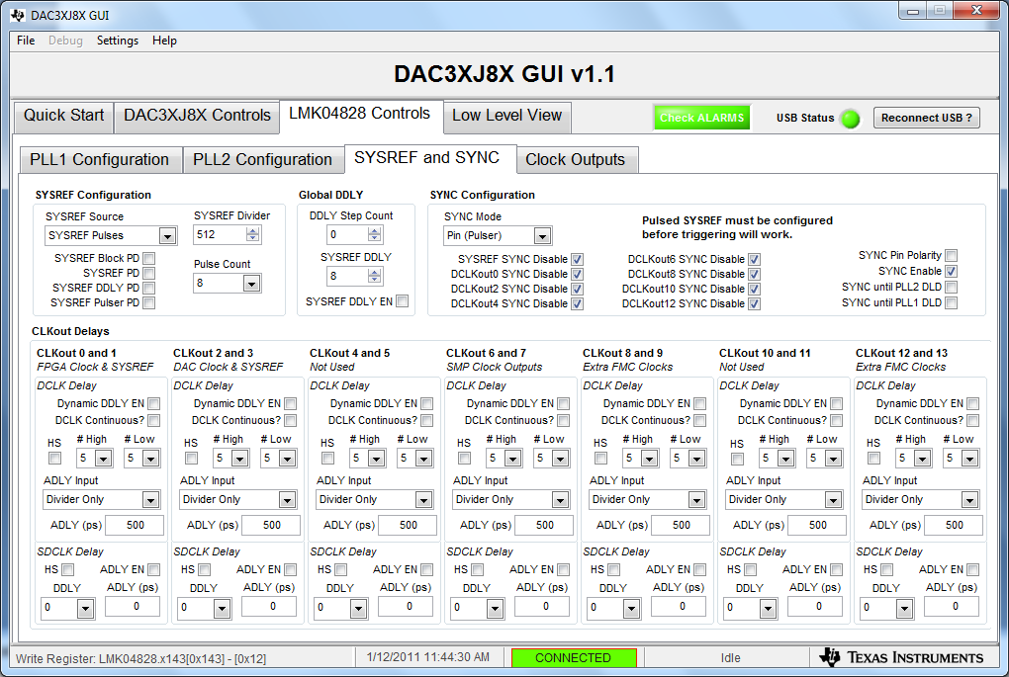
1. Set SYSREF divider to 512 to generate a 5.76MHz SYSREF clock

Slide 5
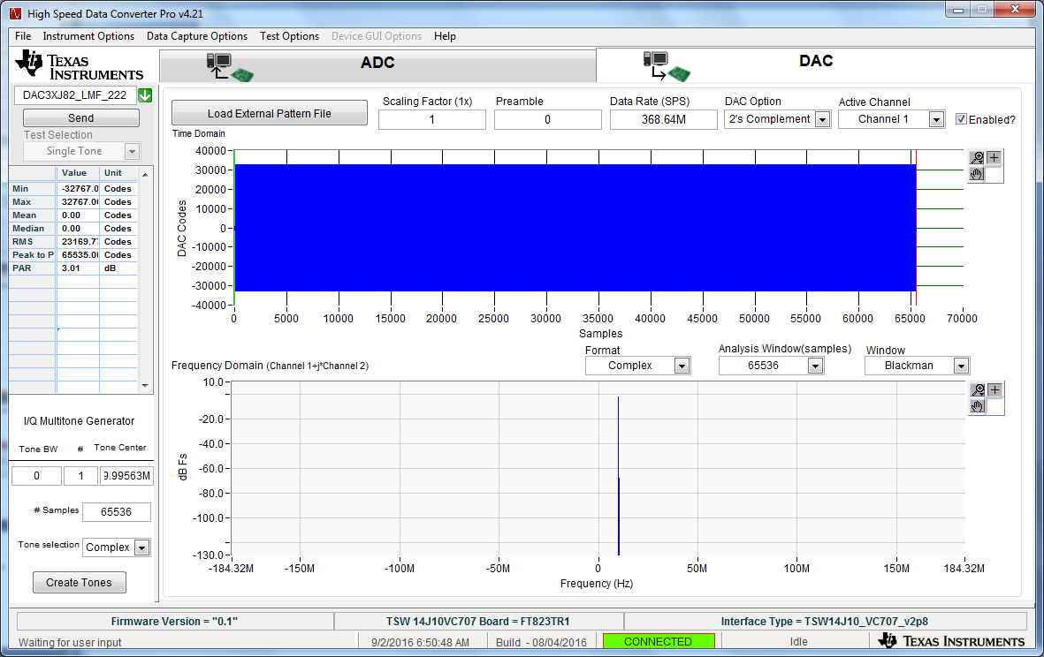
Loaded 10MHz tone DAC Test Pattern
5

Slide 6
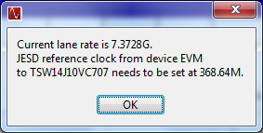
Click on “Send”. Lane rate is 7.3728G. FPGA REF CLK is 368.64M. FPGA Core CLK is set to 184.32M.
6

Slide 7
The KC705 status LED’s shall look as follows: D1 – Blinking D2 – Blinking D3 – Blinking D4 – on D5 – off D6 – off D7 – off D8 – on

Slide 8
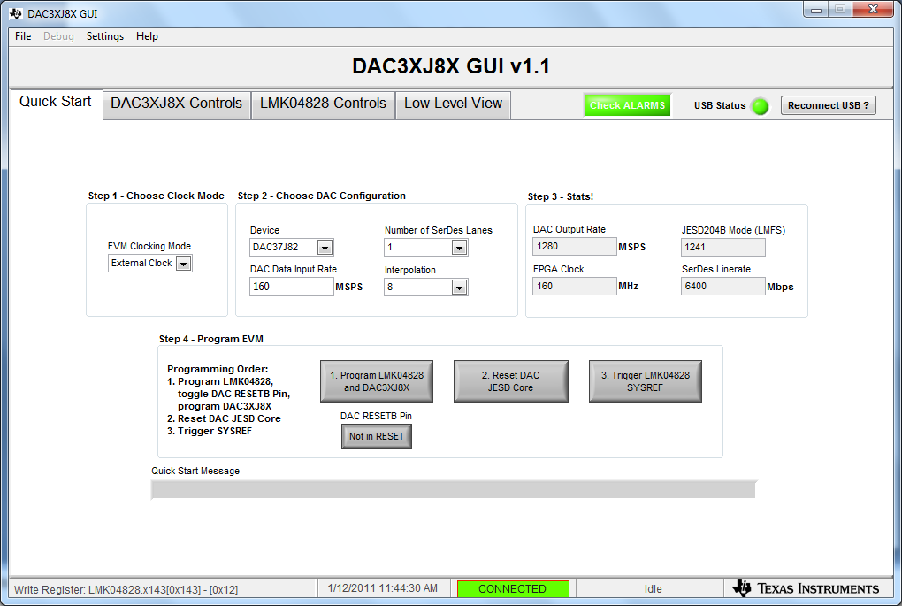
Go back to the DAC38J8x GUI 1. Click on button 2 called “Reset DAC JESD Core” 2. Click on button 3 called “Trigger LMK04828 SYSREF”

Slide 9
Alarm status

