Slide 1
DAC38J82 EVM Quick Start Guide
Jim Seton
May, 2016

Slide 2
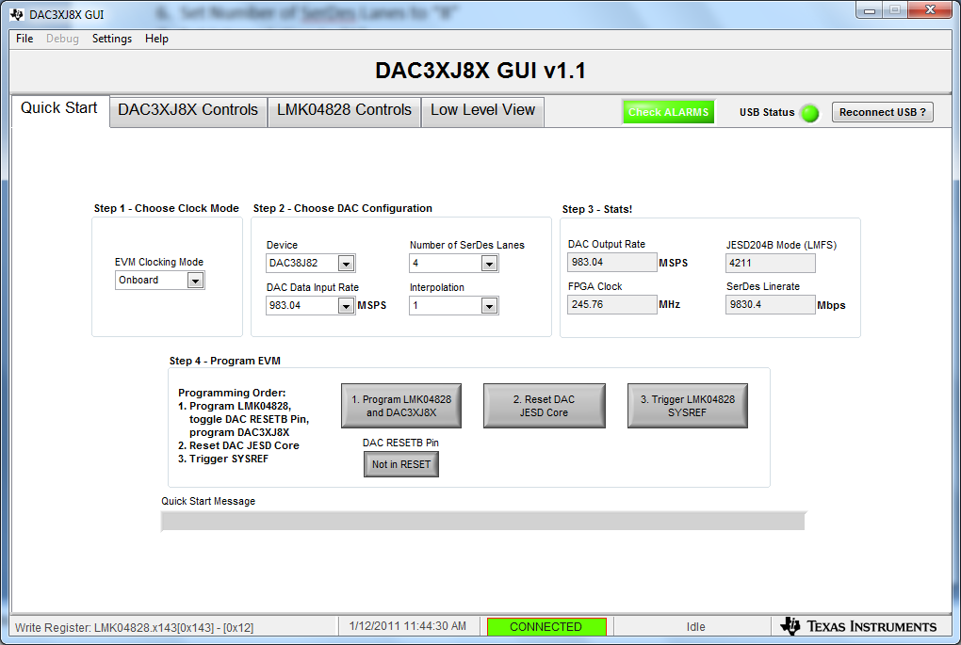
3. Must cycle FPGA power before starting
4. Set EVM Clocking Mode to “Onboard”
5. Set DAC Data Input Rate to “737.28”
6. Set Number of SerDes Lanes to “8”
7. Set Interpolation to “1”
GUI shall look as shown below

Slide 3
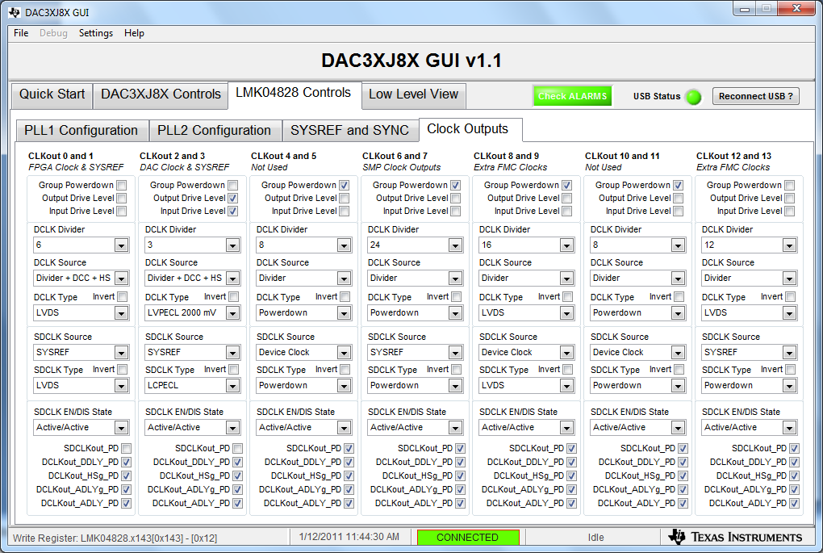
3. Set clk0 to div by 6
4. Set clk12 to div 12

Slide 4
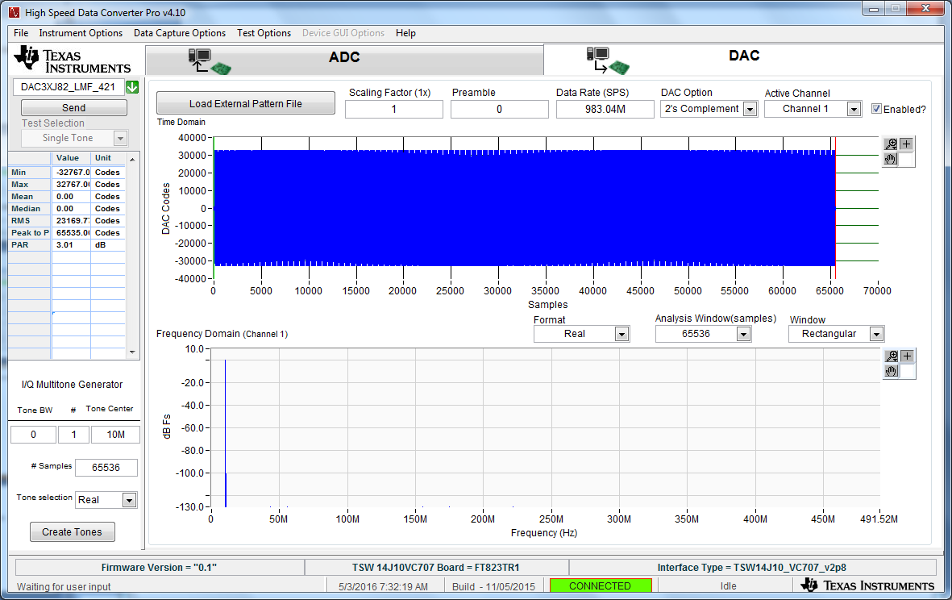
Loaded 10MHz tone DAC Test Pattern
4

Slide 5
The VC707 status LED’s shall look as follows:
D1 – Blinking
D2 – Blinking
D3 – Blinking
D4 – on
D5 – off
D6 – off
D7 – off
D8 – on

Slide 6
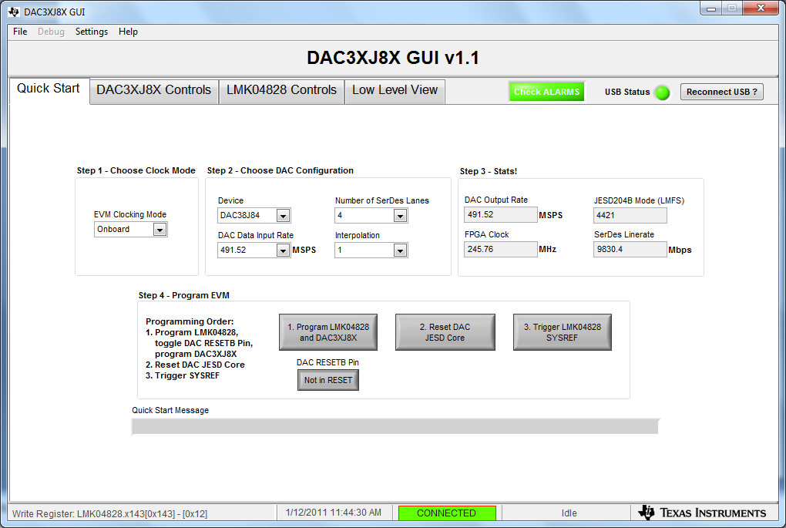
Go back to the DAC38J8x GUI
1. Click on button 2 called “Reset DAC JESD Core”
2. Click on button 3 called “Trigger LMK04828 SYSREF”

Slide 7
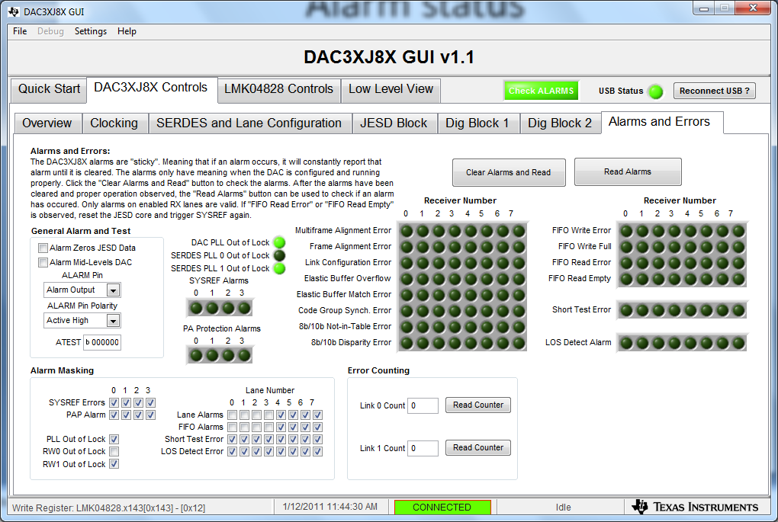
Alarm status

Slide 8
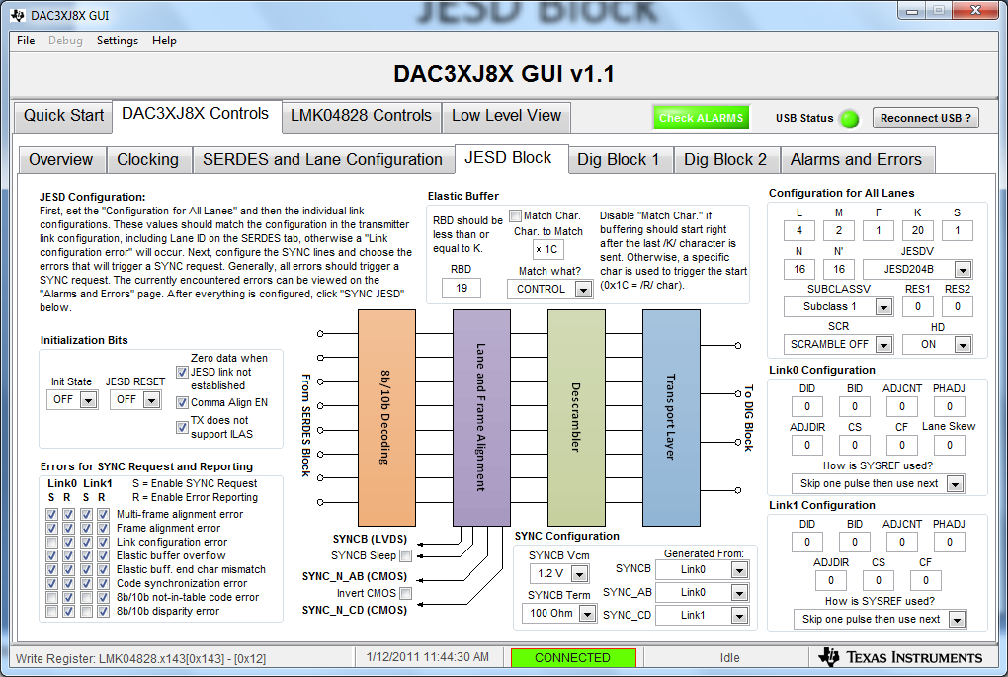
JESD Block

