Slide 1
DAC38J82 Test

Slide 2
DAC38J82 LMF 124 16x int
Test Setup:
Ext 2400MHz clock
Int 16x
LMF = 124
TSW14J56EVM reference clock = 150MHz
IF = 50MHz
Lane rate = 6Gbps
This will use RX0 for input data.

Slide 3
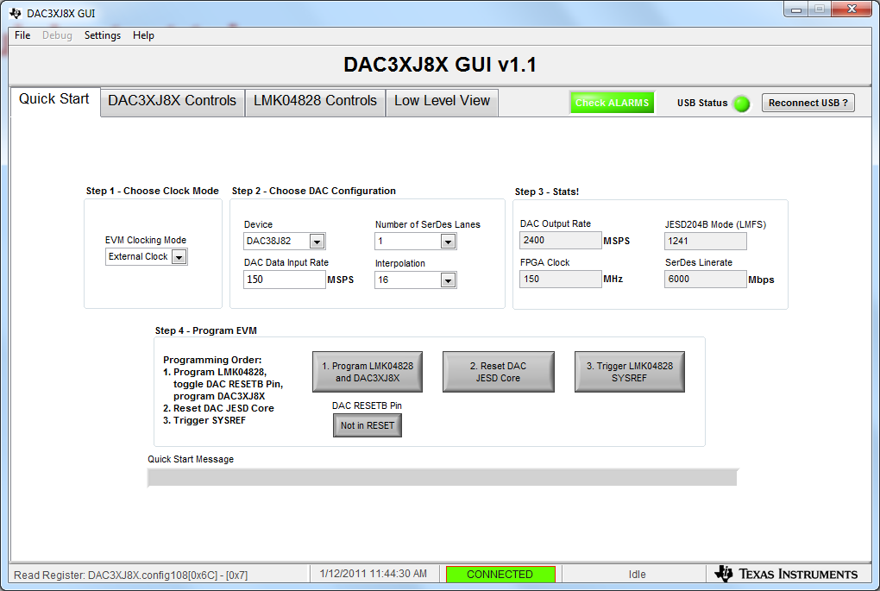
Quick start tab

Slide 4
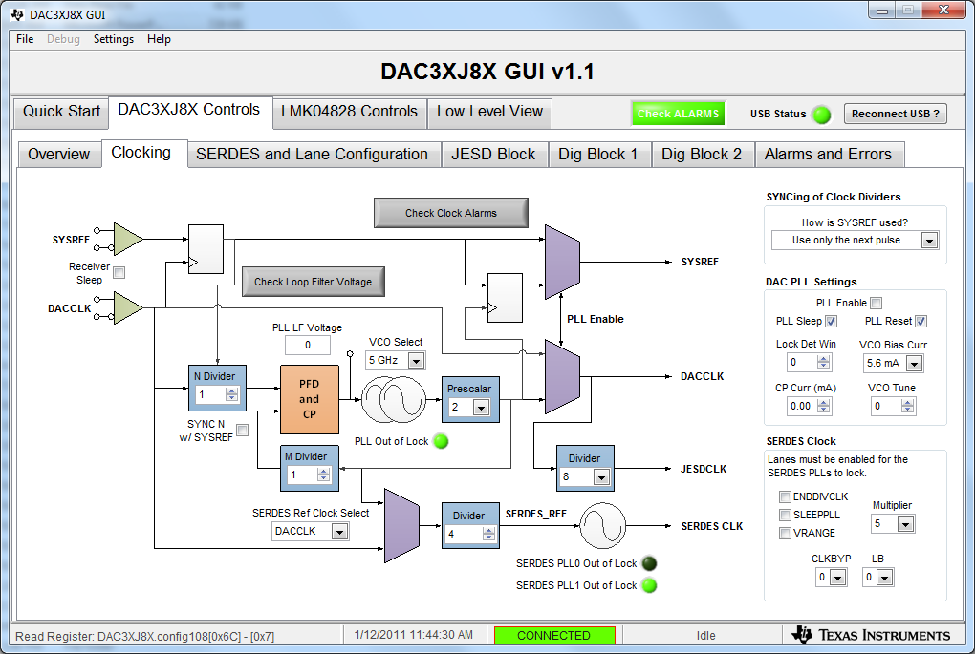
Clocking tab.

Slide 5
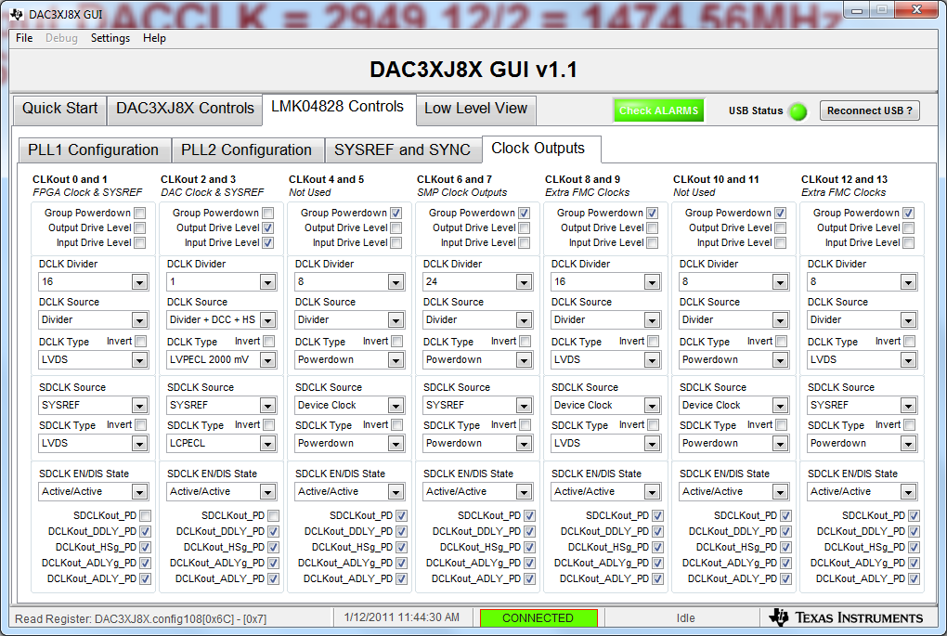
Input DACCLK

Slide 6
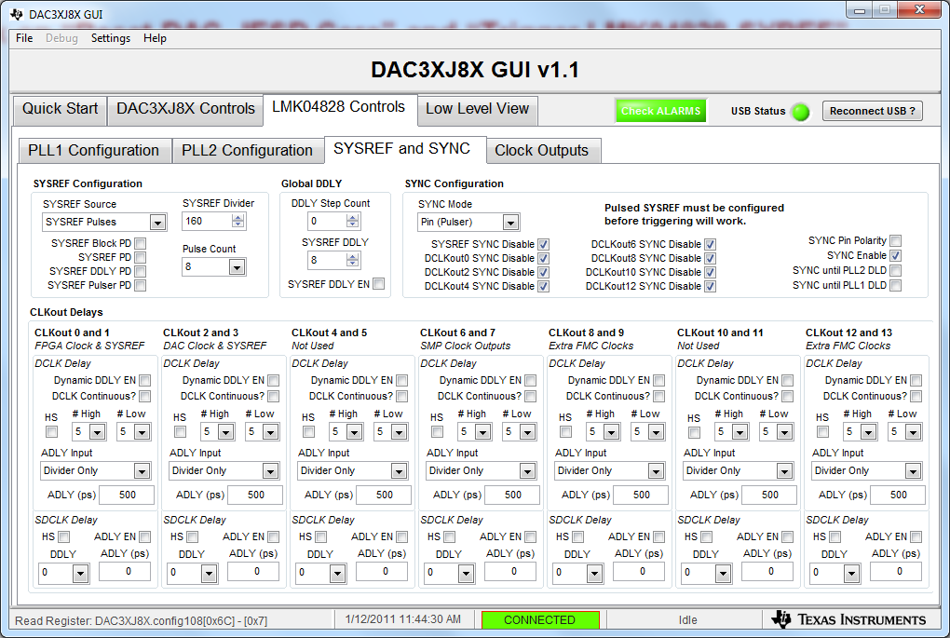
SYSREF = 2400MHz/160 = 15MHz

Slide 7
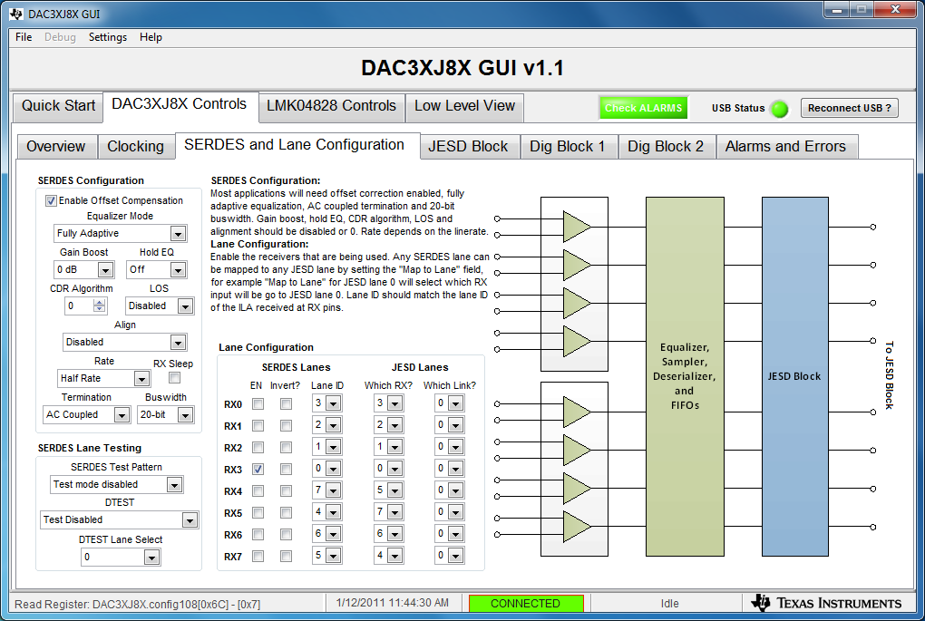
Default DAC38J82EVM Serdes configuration

Slide 8
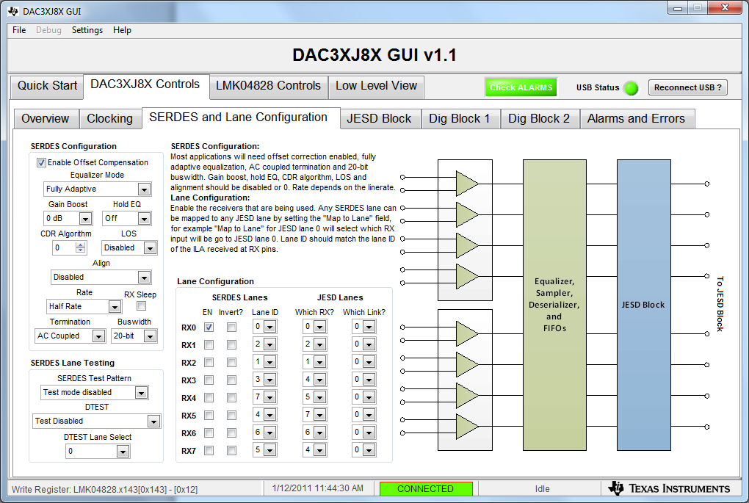
Serdes configuration with RX0 as input.

Slide 9
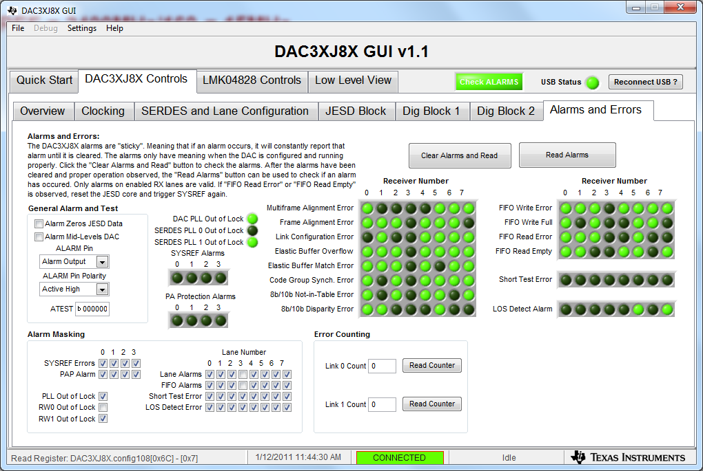
DAC Alarms

Slide 10
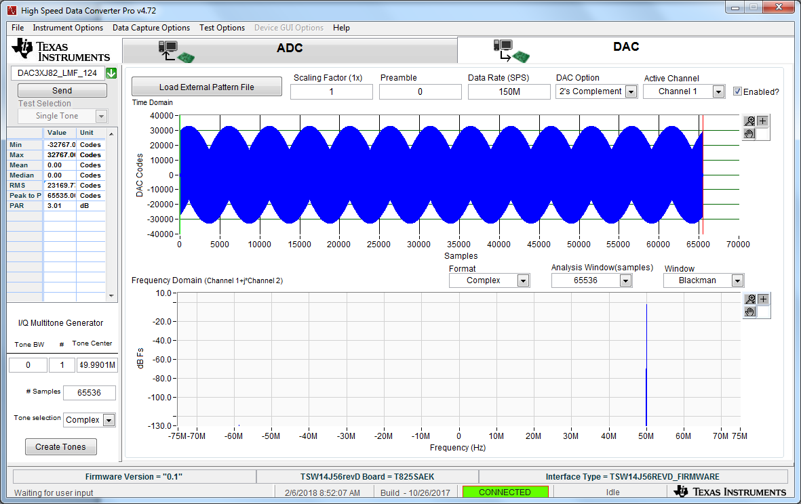
DAC input data rate = 150MHz

Slide 11
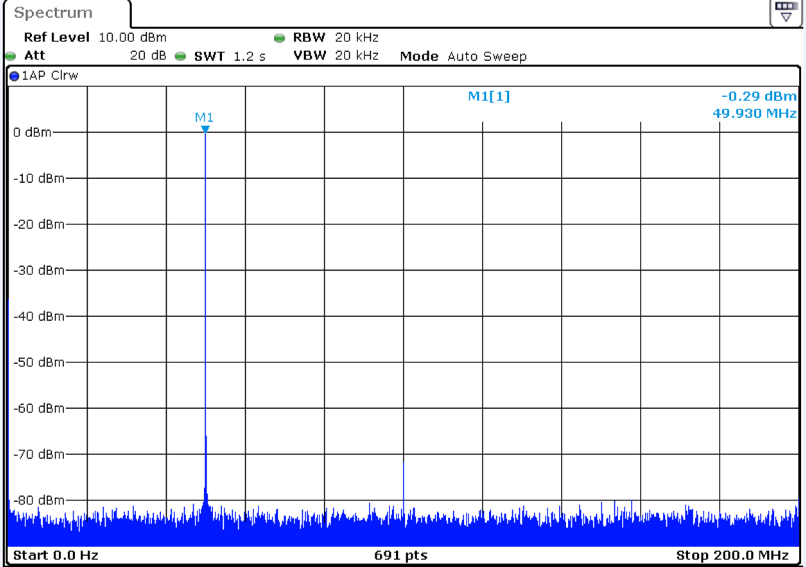
DAC output = 50MHz

