Slide 1
DAC38J84 NCO SYSREF test

Slide 2
Hardware Setup
DAC38J84
Connect output SMA J2 (channel A) to Spectrum Analyzer
Connect USB cable to J14 and host PC
Connect the provided +5VDC power supply to J6 (located on bottom)

Slide 3
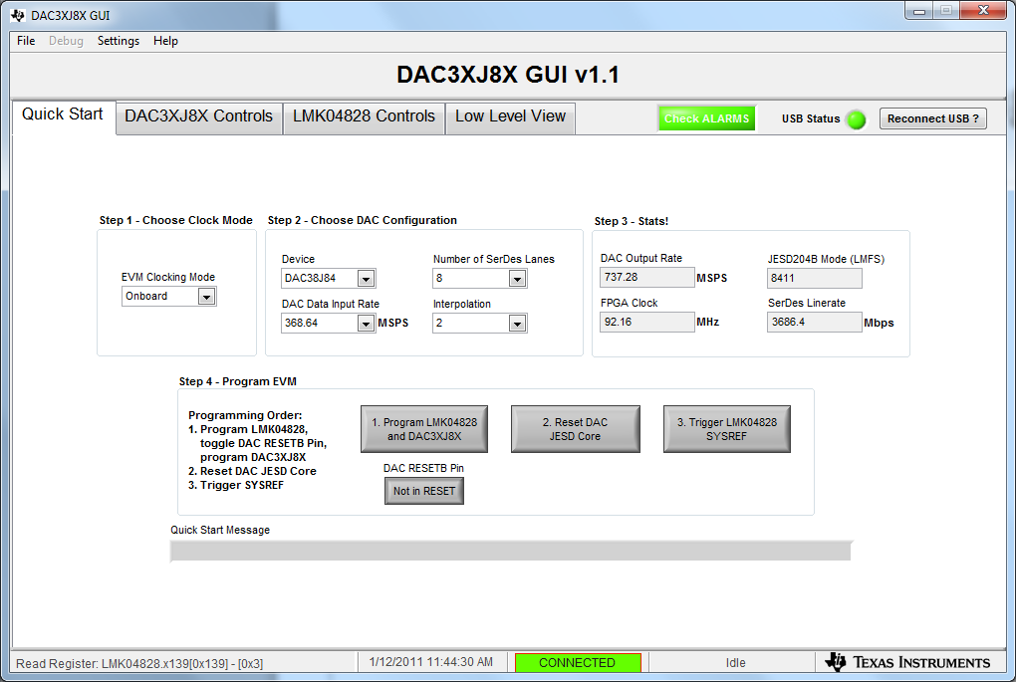
Quick Start settings

Slide 4
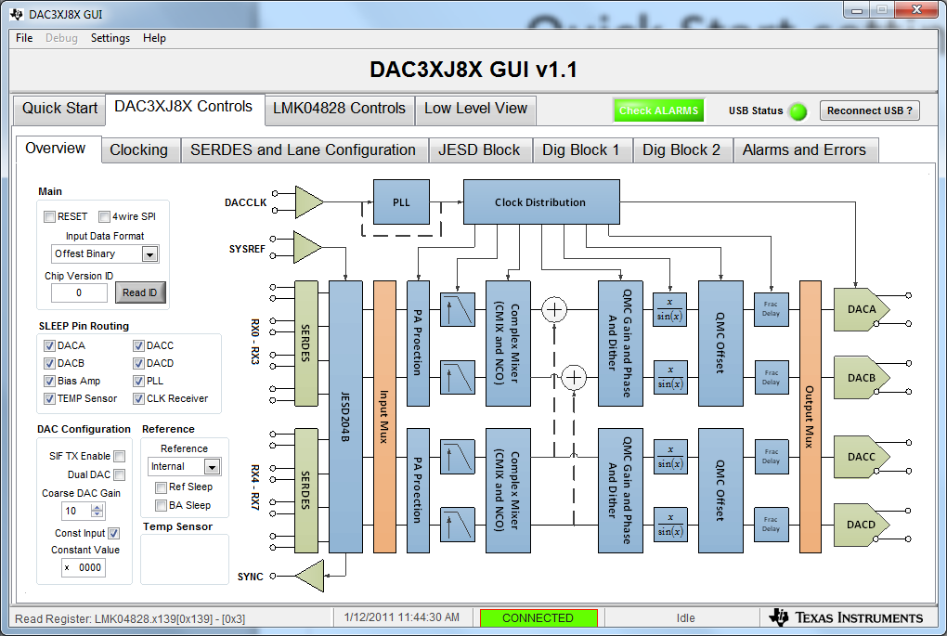
Overview settings

Slide 5
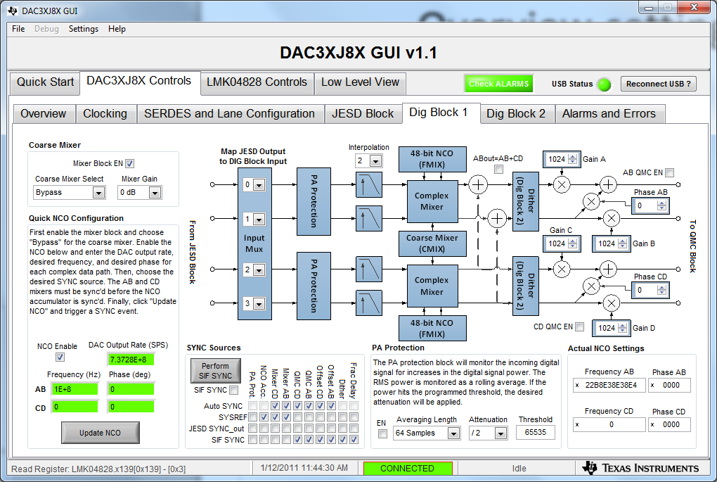
Dig Block1 settings

Slide 6
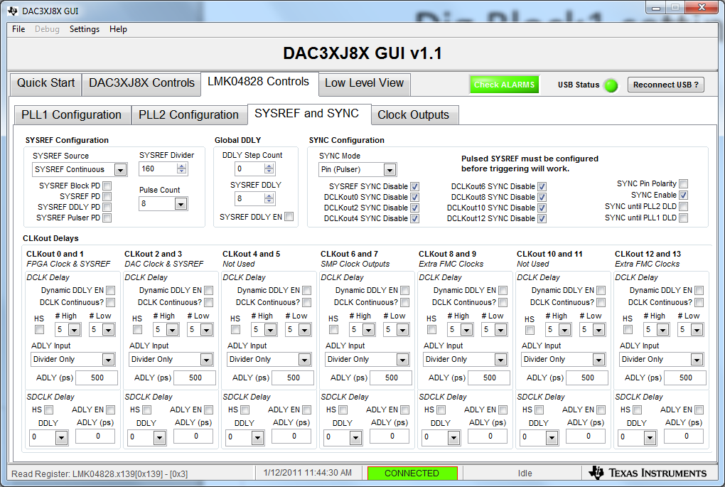
LMK settings

Slide 7
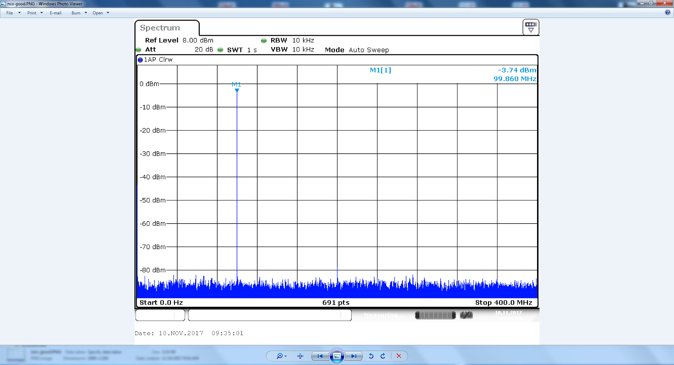
NCO output synchronized to SIF SYNC

Slide 8
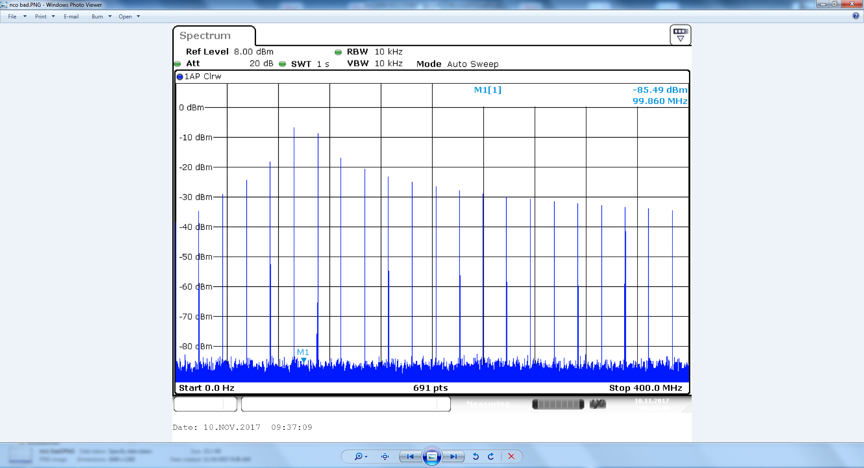
NCO output synchronized to SYSREF

