Slide 1
DAC38J84 EVM Quick Start Guide
Jim Seton
Feb, 2014

Slide 2
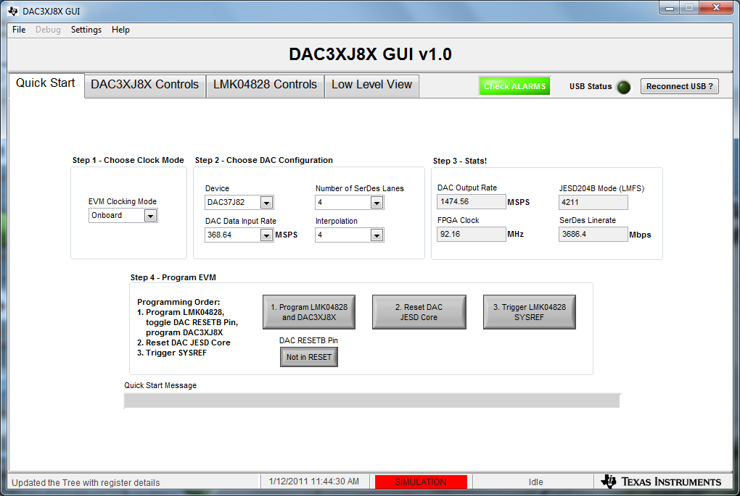
3. Set EVM Clocking Mode to “Onboard”
4. Set DAC Data Input Rate to “368.64”
5. Set Number of SerDes Lanes to “4”
6. Set Interpolation to “4”

Slide 3
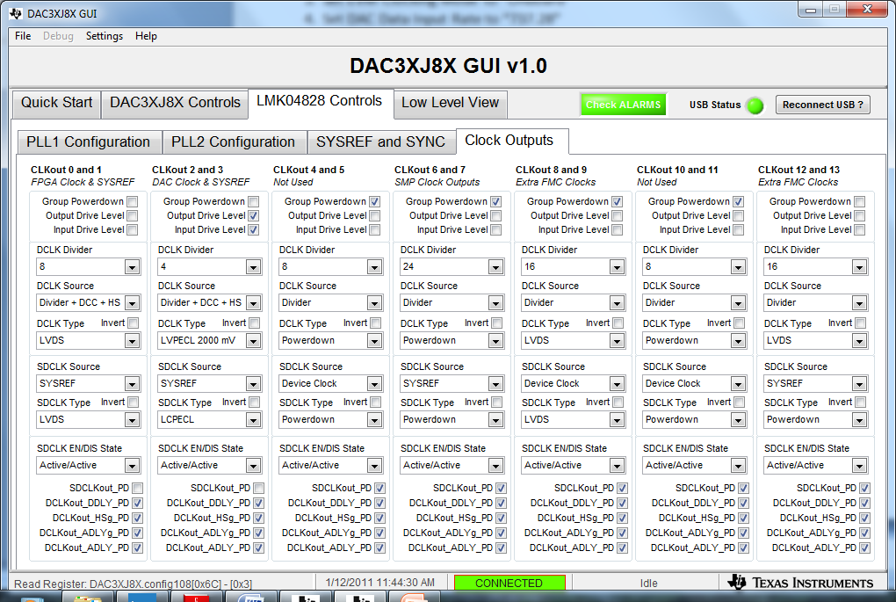
3. Set clk0 to div by 8
4. Set clk12 to div 16

Slide 4
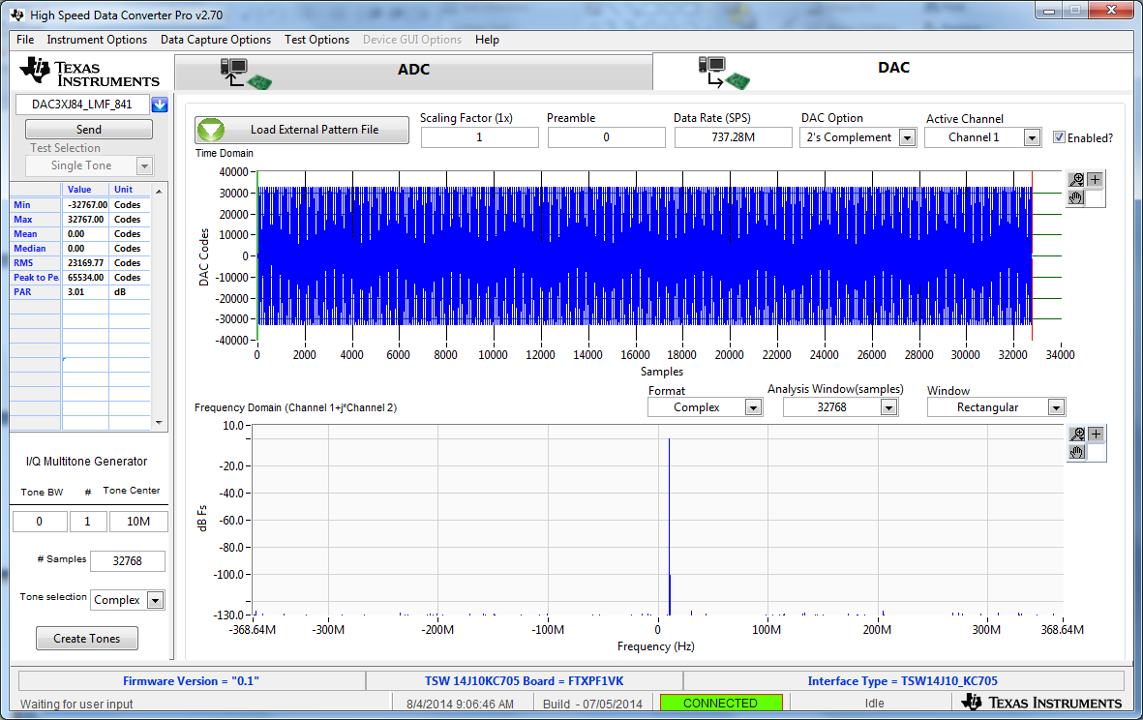
Loaded 10MHz tone DAC Test Pattern
4

Slide 5
The KC705 status LED’s shall look as follows:
D7 – Blinking
D6 – Blinking
D5 – Blinking
D4 – on
D3 – off
D2 – off
D1 – off
D0 – on

Slide 6
Go back to the DAC38J8x GUI
1. Click on button 2 called “Reset DAC JESD Core”
2. Click on button 3 called “Trigger LMK04828 SYSREF”

Slide 7
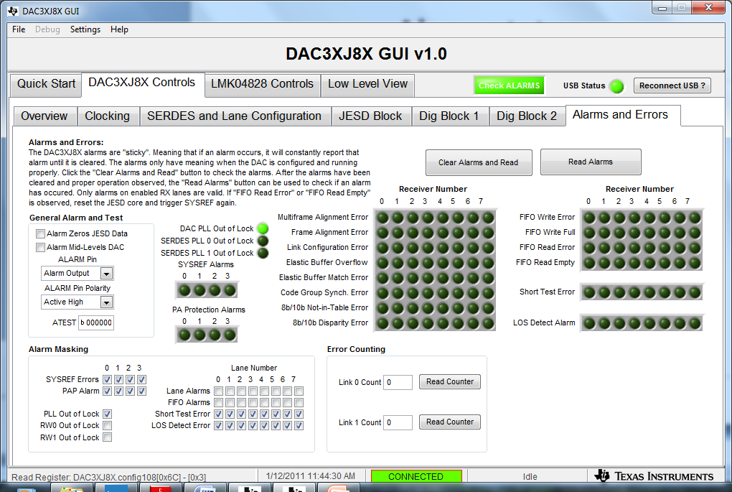
Alarm status

Slide 8
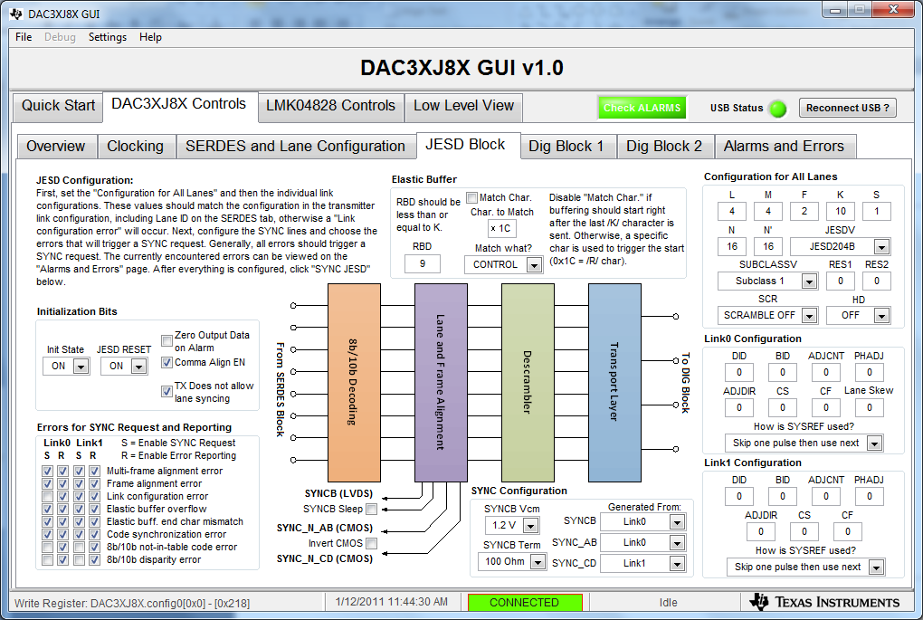
JESD Block

Slide 9
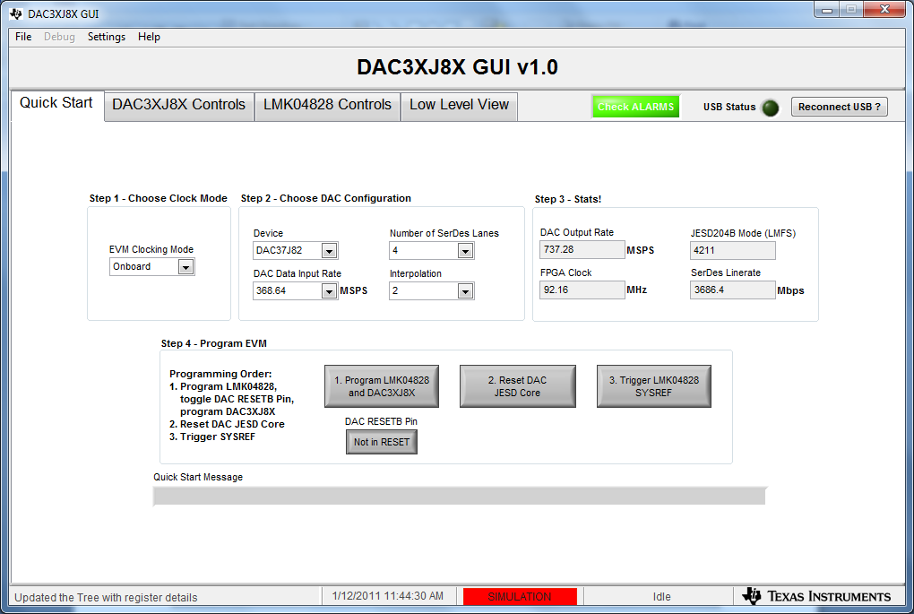
Int x2

Slide 10
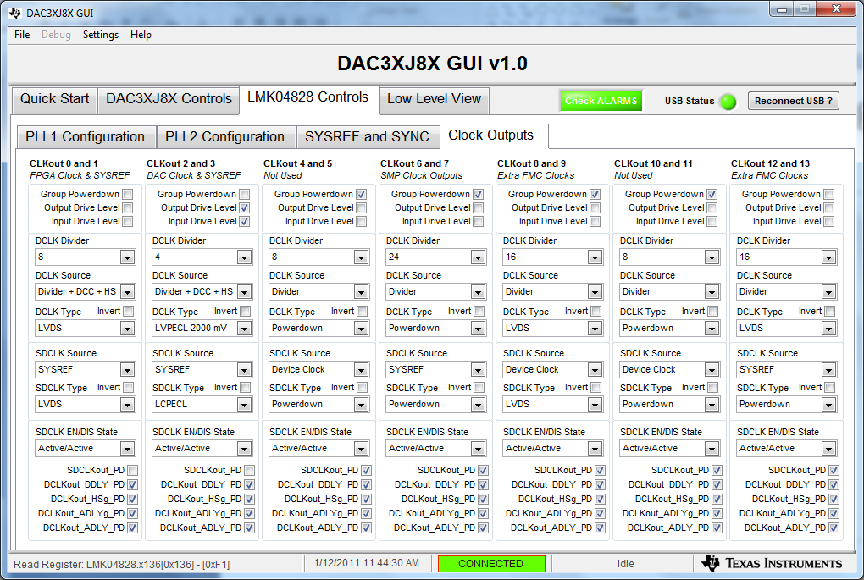
Must reload firmware after making any clk changes.

