Slide 1
DAC38J84 Test

Slide 2
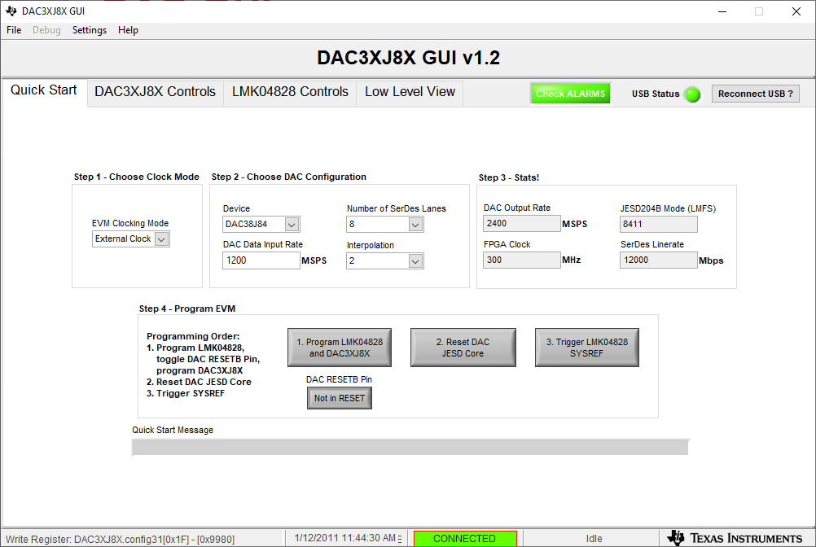
DAC GUI

Slide 3
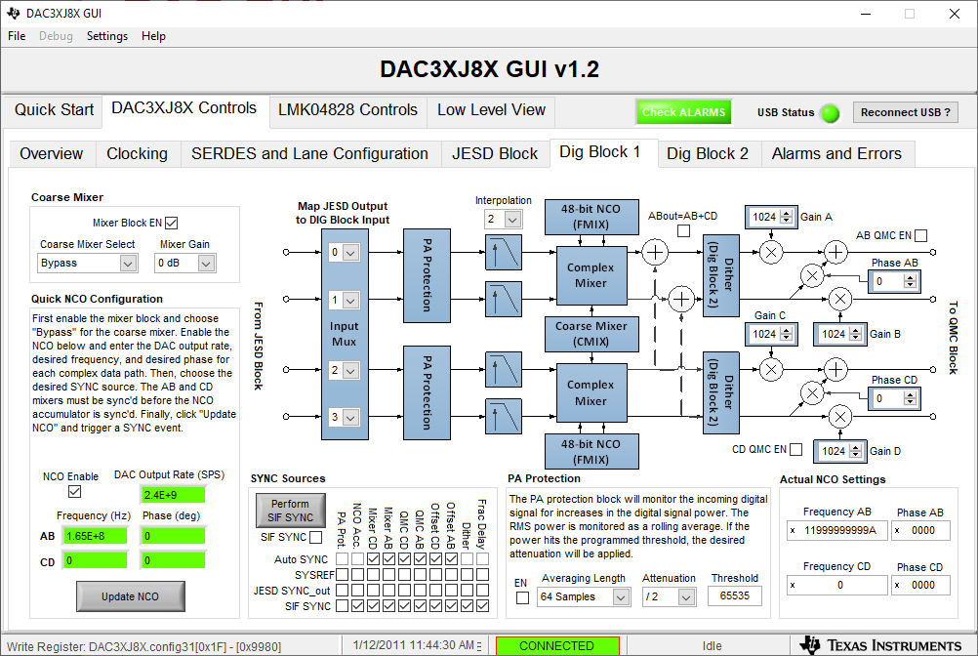
DAC GUI

Slide 4
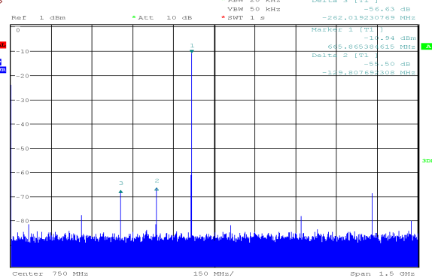
DAC output at 665MHz

Slide 5
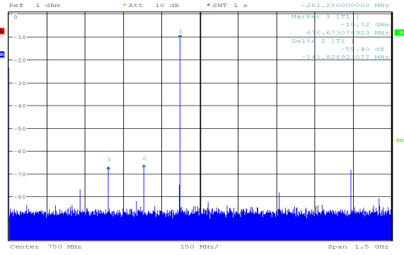
DAC output at 670MHz

Slide 6
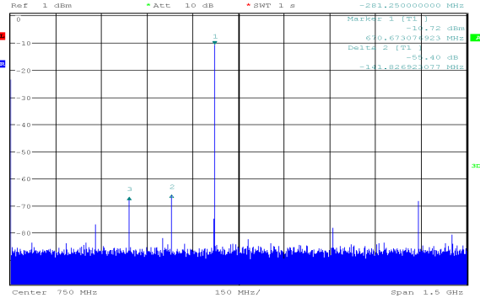
DAC output at 675MHz

