Slide 1
DAC38J84, TSW14J10, ZC706 Quick Start Guide

Slide 2
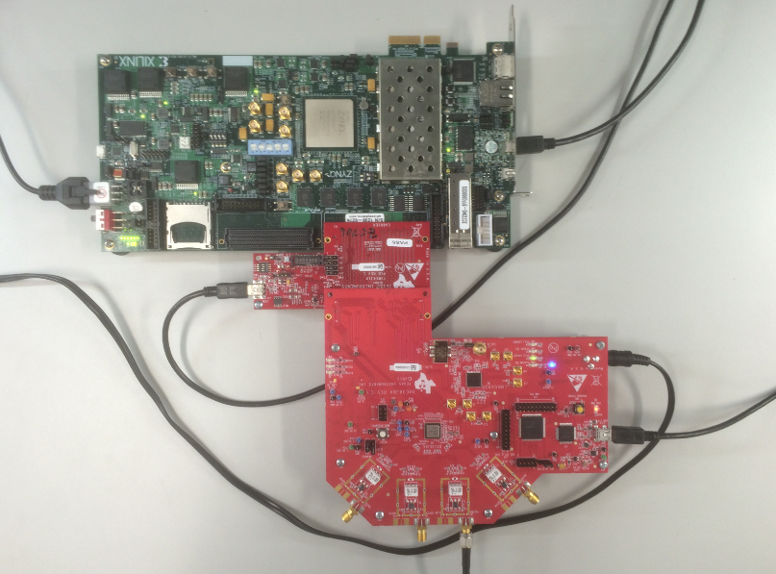
DAC38J84EVM, TSW14J10EVM & ZC706

Slide 3
1. After connecting boards, power up the DAC38J84 and ZC706 boards.
2. Open the DAC3XJ8X GUI.
3. Set EVM Clocking Mode to “Onboard”
4. Set DAC Data Input Rate to “1228.8”
5. Set Number of SerDes Lanes to “8”
6. Set Interpolation to “1”
7. Click on “Program LMK04828 and DAC3XJ8X” button
8. The GUI shall look as shown below
Note: The GTEX2 transceivers with speed grade -2 devices have a max serdes rate of 10.3125Gbps. This test may not always work.

Slide 4
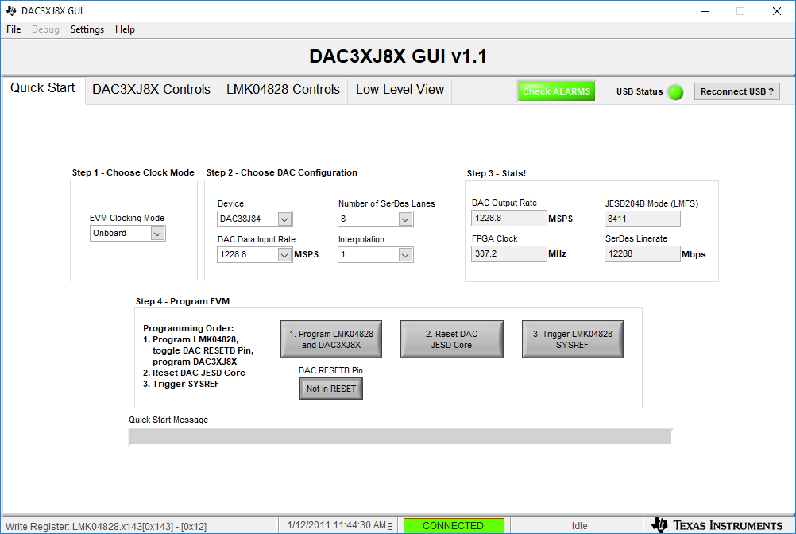
DAC3XJ8X GUI

Slide 5
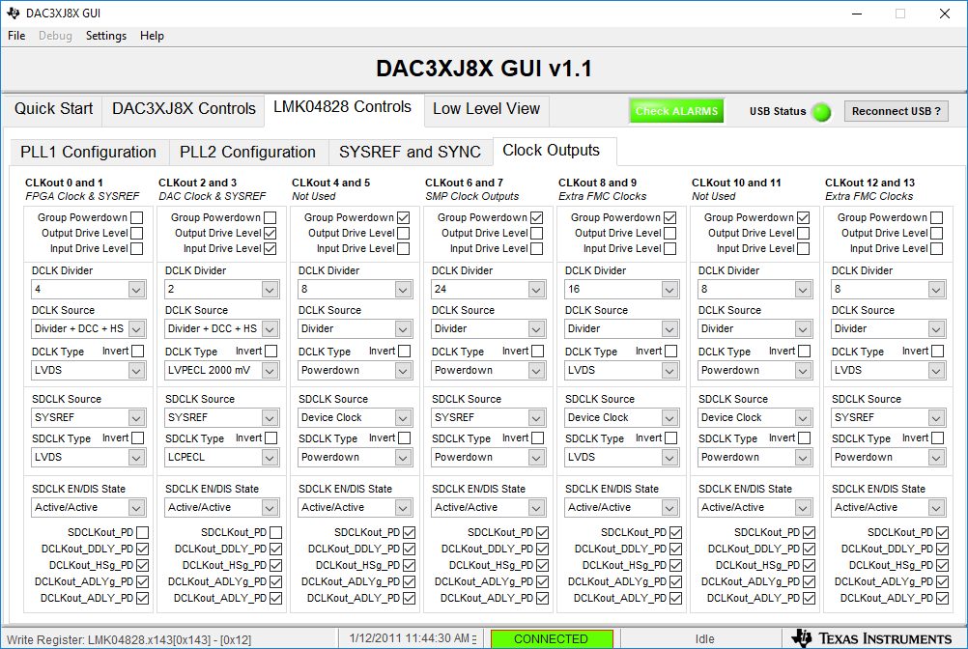
9. Set clk0 to div by 4
10. For clk12, unselect “Group Powerdown “ and set to div 8

Slide 6
1. Load the ZC706 firmware.
2. Open HSDC Pro GUI.
2. Select “DAC” mode of operation.
3. Set Data Rate to “1228.8M”.
4. Set DAC Option to “2’s Complement”.
5. In I/Q Multitone Generator, set # to “1”
6. Set Tone Center to “80M”.
7. Set Tone selection to “complex”.
8. Set # Samples to 65536
9. Click on “Create Tones”
10. Click on “Send”. The GUI shall look as shown in next slide.

Slide 7
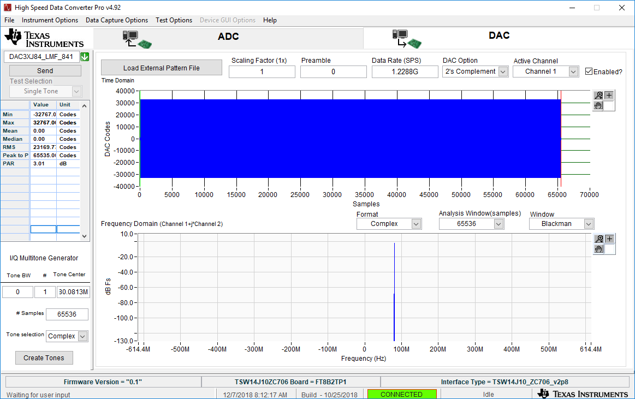
Loaded 80MHz tone DAC Test Pattern
7

Slide 8
Go back to the DAC38J8x GUI
1. Click on button 2 called “Reset DAC JESD Core”
2. Click on button 3 called “Trigger LMK04828 SYSREF”

