Slide 1
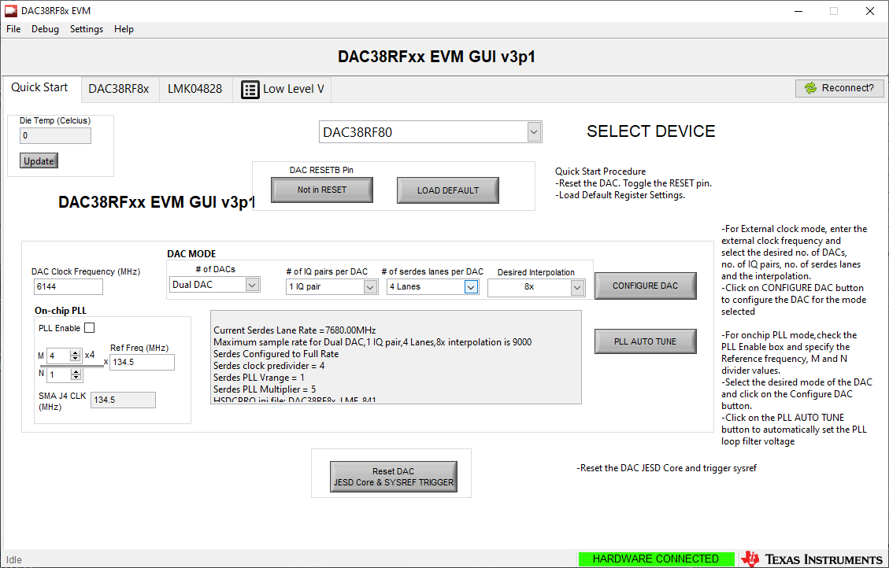
Quick start tab Make sure JP10 shunt is installed

Slide 2
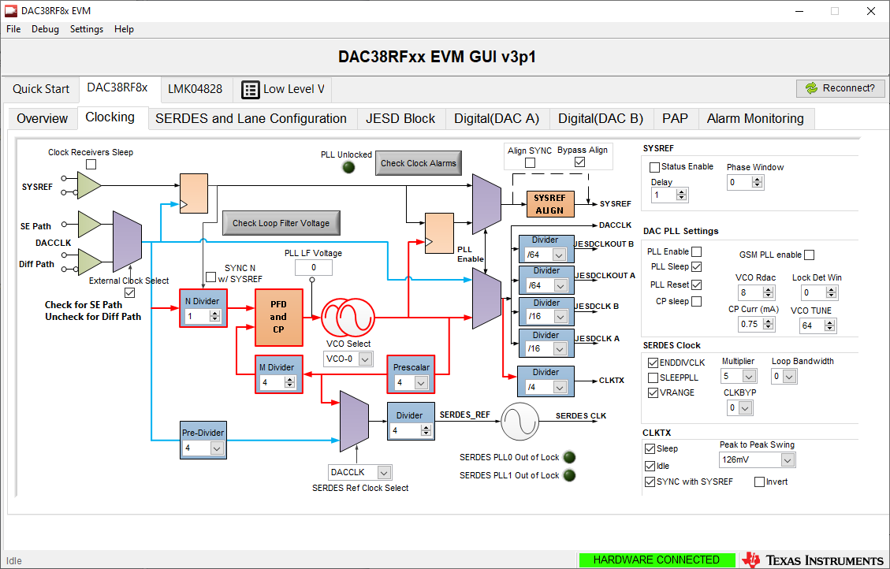
Both Serdes PLL’s locked

Slide 3
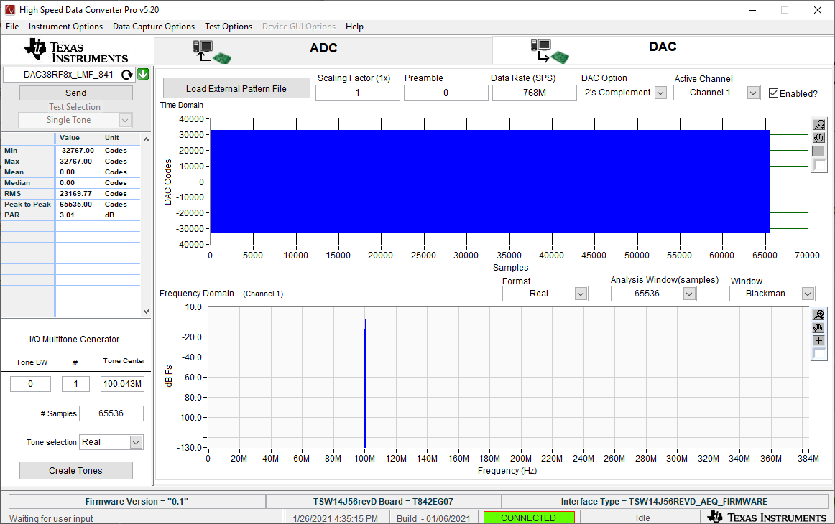
HSDC Pro setting

