Slide 1
DAC38RF82EVM bring up guide
6144 MSPS, Fully onboard clocking, with TSW14J56/57EVM

Slide 2
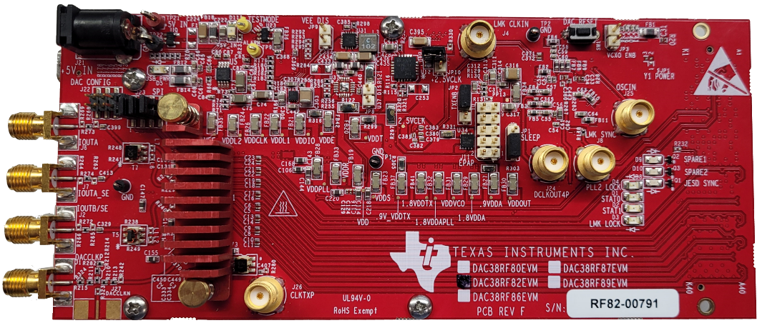
DAC38RF82 EVM Overview
JP10 shorted means LMK_CLKin1 is sourced from the External CLK input divided-by-4 (through an onboard RF divider)
5V input
JP10
LMK_CLKin1
USB input
JP3
DAC38RFxx
(under heatsink)
Channel A
Channel B
External CLK

Slide 3
DAC38RF82EVM setup details
Shunt JP3 shorted
Shunt JP10 removed
DAC Sample rate: 6144 MSPS
6x Interpolation -> DAC Input data rate = 1024 MSPS
LMK PLL2 set to VCO1 at 3072 MHz. DAC CLK divider set as 12 to provide 3072 MHz / 12 = 256 MHz tone for the DAC PLL reference.
DAC PLL, M=6, N=1 -> DAC CLK = 256MHz * 4 * (6/1) = 6144 MHz

Slide 4
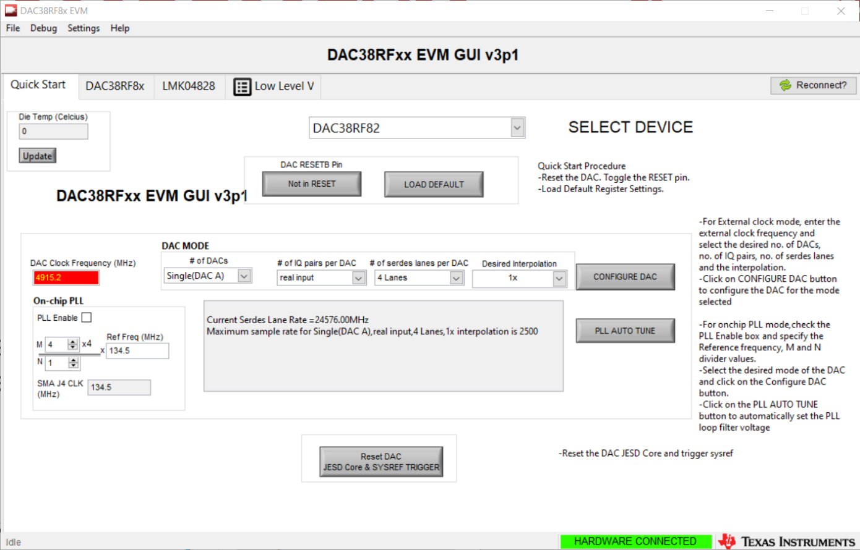
DAC38RF82EVM configuration
1.
Toggle reset
Wait until red
Toggle again
2. Press Load Default

Slide 5
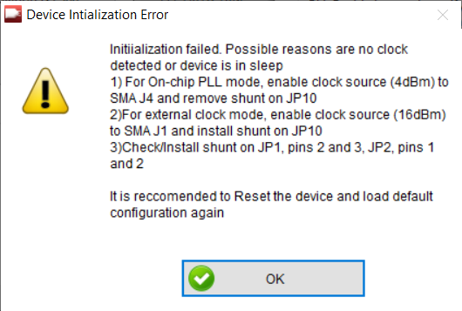
DAC38RF82EVM configuration
If you see this message, ignore it and press OK.
This is because in this default mode, the DAC is expecting a PLL reference input through SMA connector J4.

Slide 6
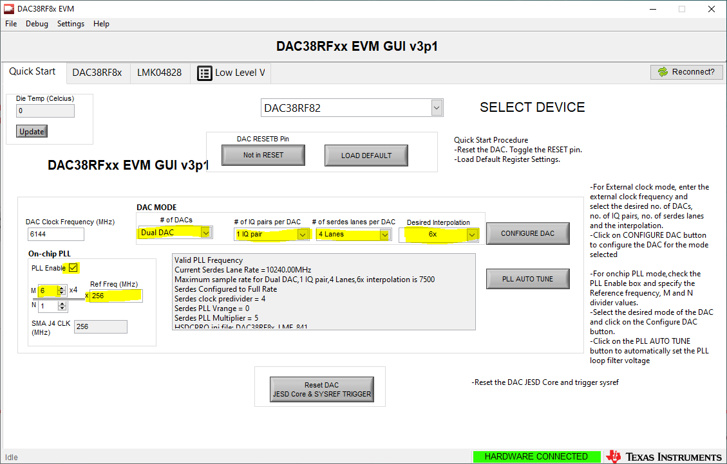
DAC38RF82EVM configuration
Change these parameters for desired DAC configuration
Then press Configure DAC

Slide 7
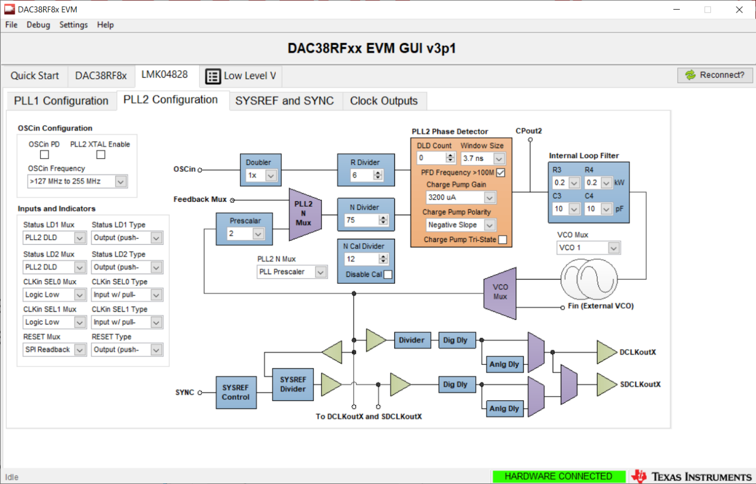
DAC38RF82EVM configuration
Uncheck CP Tri-state
Choose VCO1
Change R Divider to 6
Change N Divider to 74
Change Pre-scalar to 2
Press up arrow to change N Divider to 75
(software bug)
Verify that LMK LOCK and PLL2 LOCK Green LEDs are lit up on DAC EVM

Slide 8
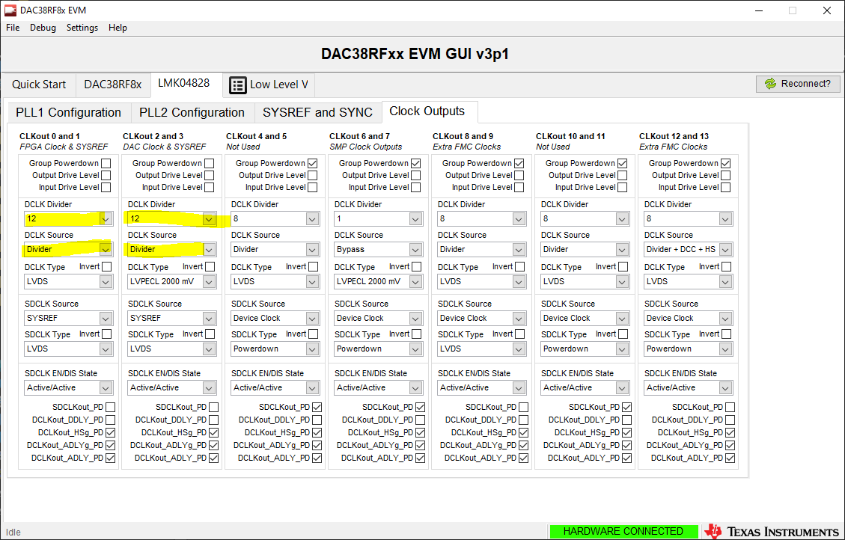
DAC38RF82EVM configuration
Change these parameters to 12 and set DCLK source to Divider

Slide 9
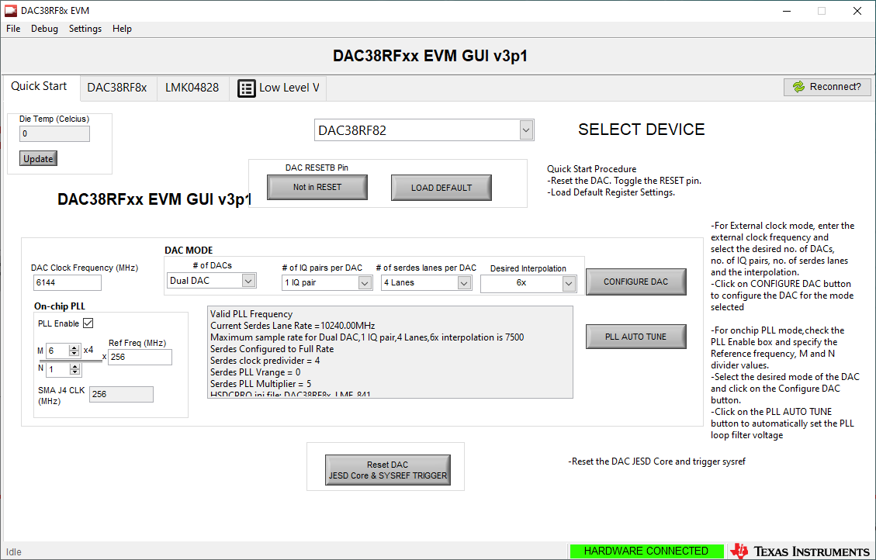
DAC38RF82EVM configuration
1. PLL AUTO TUNE

Slide 10
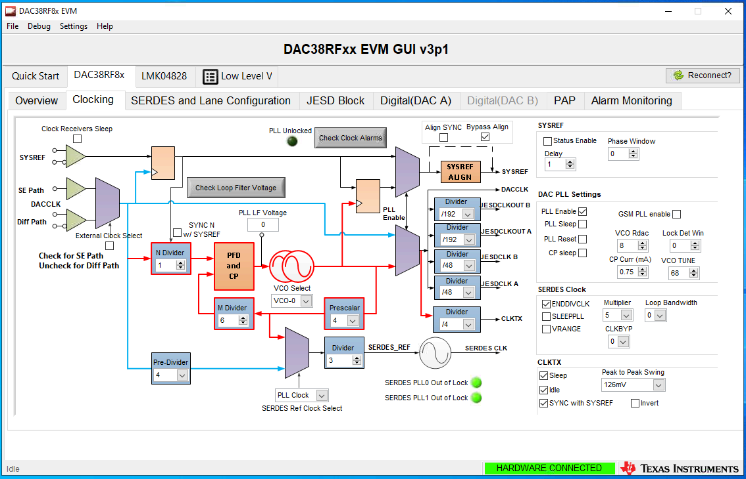
DAC38RF82EVM configuration
Press check LF Voltage
PLL LF Voltage should read as 4
** If PLL LF Voltage is not 4:
Toggle to DACCLK, then immediately toggle back to PLL Clock
PLL AUTO TUNE

Slide 11
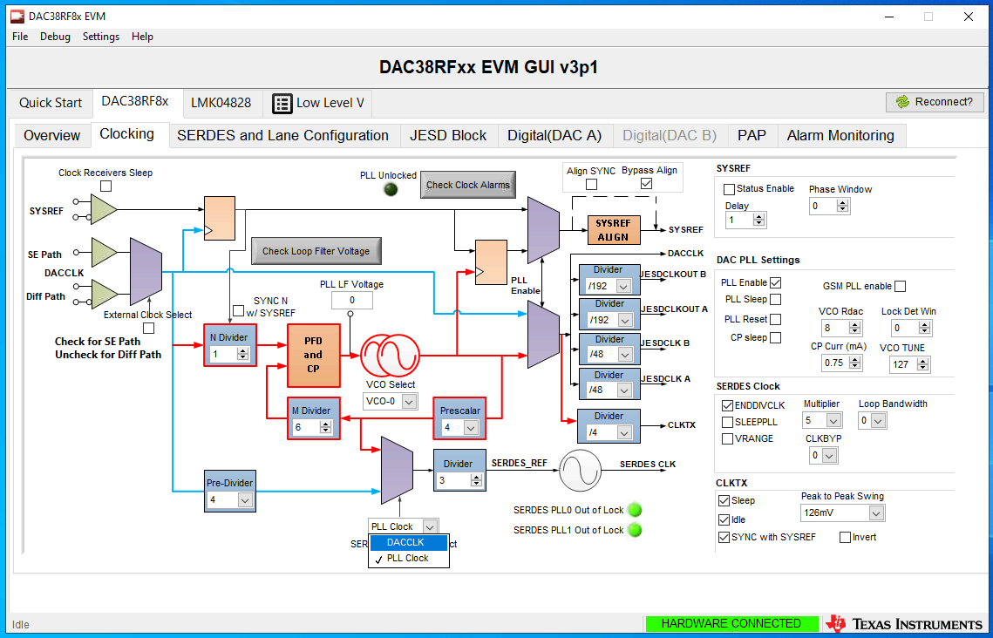
DAC38RF82EVM configuration
** If PLL LF Voltage is not 4:
Toggle to DACCLK, then immediately toggle back to PLL Clock
PLL AUTO TUNE

Slide 12
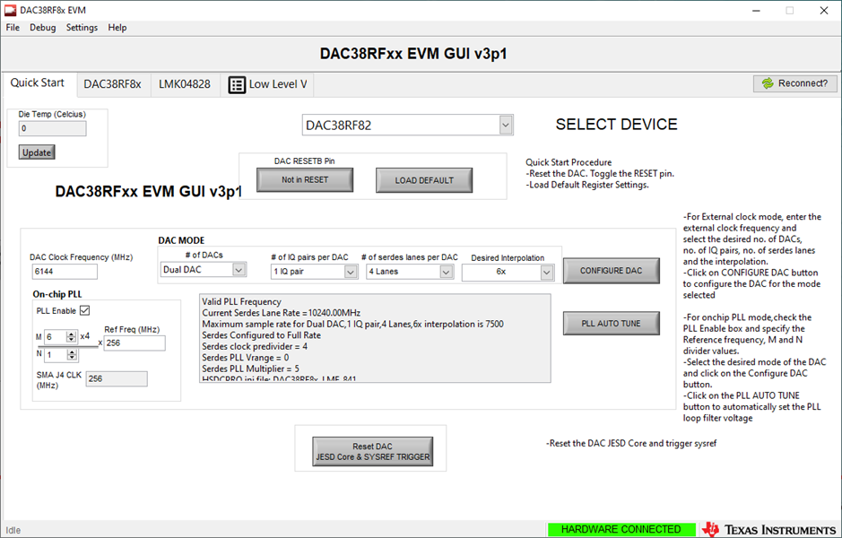
DAC38RF82EVM configuration
** If PLL LF Voltage is not 4:
Toggle to DACCLK, then immediately toggle back to PLL Clock
PLL AUTO TUNE

Slide 13
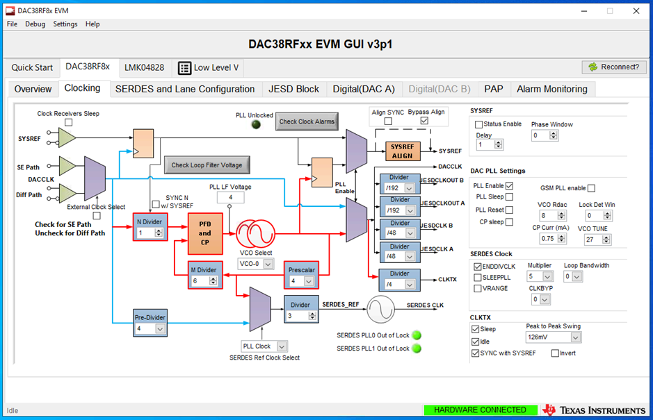
DAC38RF82EVM configuration
Press check LF Voltage
PLL LF Voltage should now read as 4

Slide 14
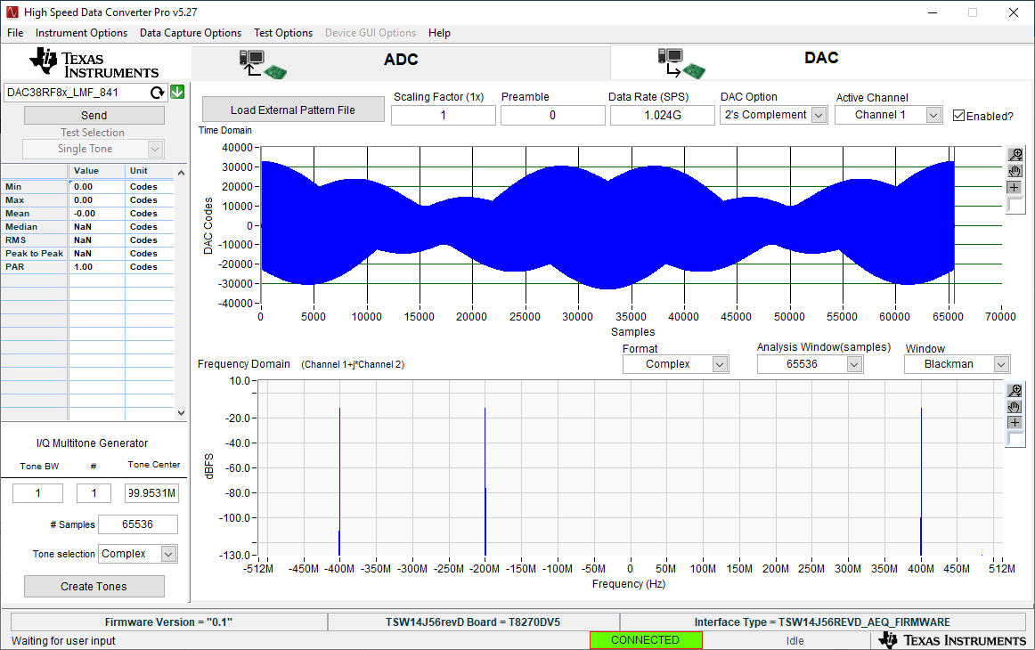
DAC38RF82EVM configuration
Press send in HSDC Pro

Slide 15

DAC38RF82EVM configuration
Press Reset DAC JESD Core & SYSREF TRIGGER

Slide 16
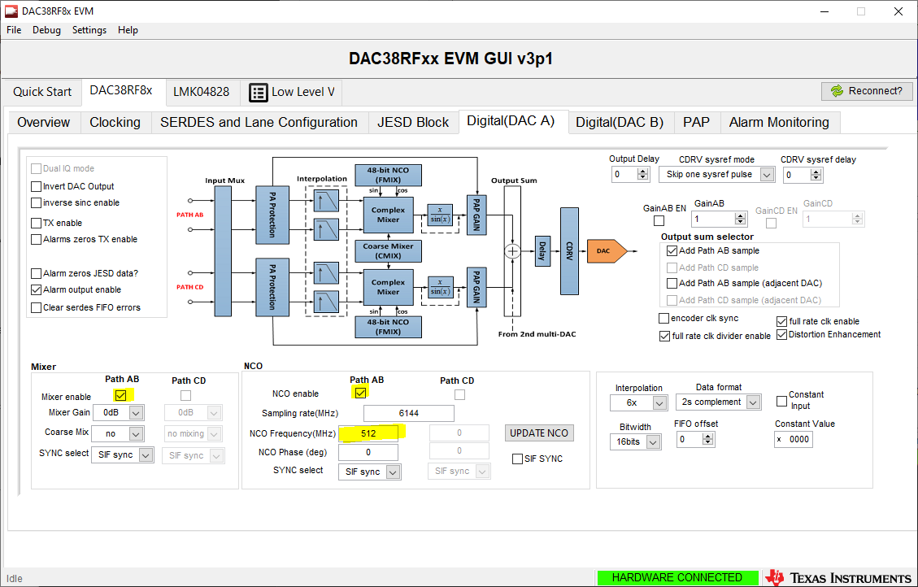
DAC38RF82EVM configuration
Enable the NCO and set to 512 MHz (1.024G / 2)
Press Update NCO
Tones should appear on output at 112M, 312M, 912M

Slide 17
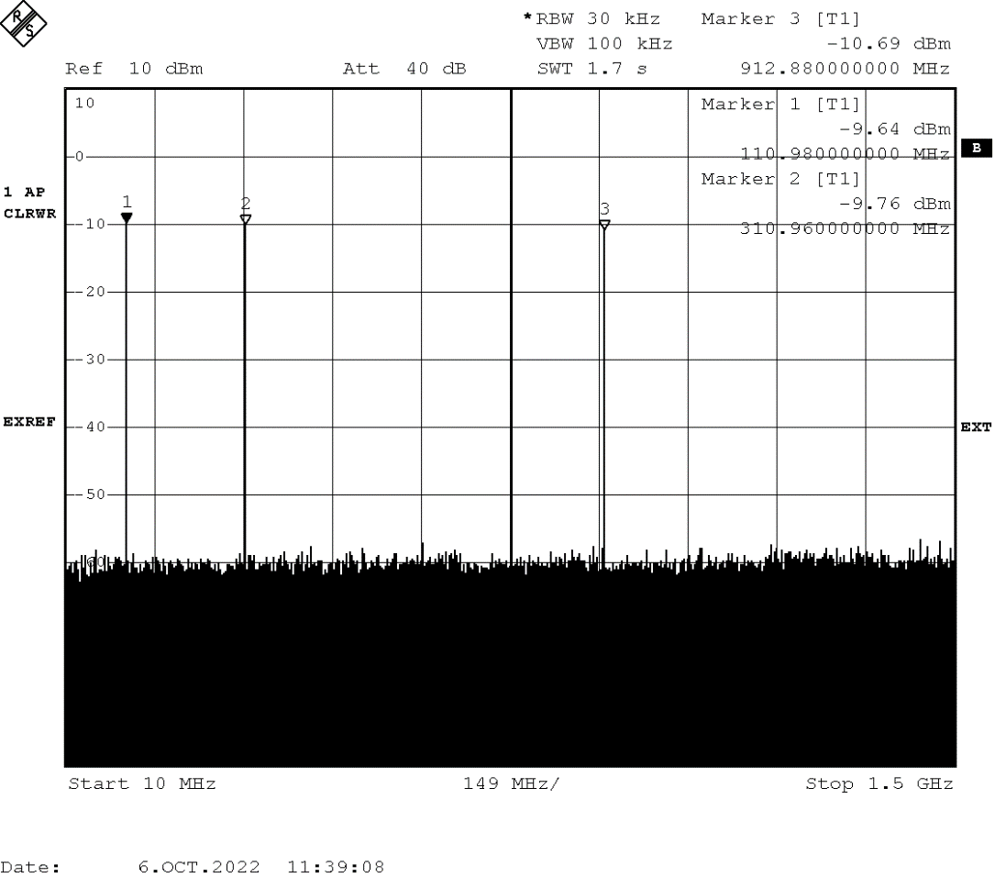
DAC38RF82EVM configuration
Frequencies are not exact because spectrum analyzer is not reference locked to the DAC.
To fix this, reference lock signal generator to spectrum analyzer using 10MHz reference, apply a 122.88MHz input into J4, uncheck PLL1 tri-state, change N divider in PLL1 to match Clkin1 R divider value.

