Slide 1
DAC38RF82EVM bring up guide
8847.36 MSPS, Fully onboard clocking, DDS mode

Slide 2
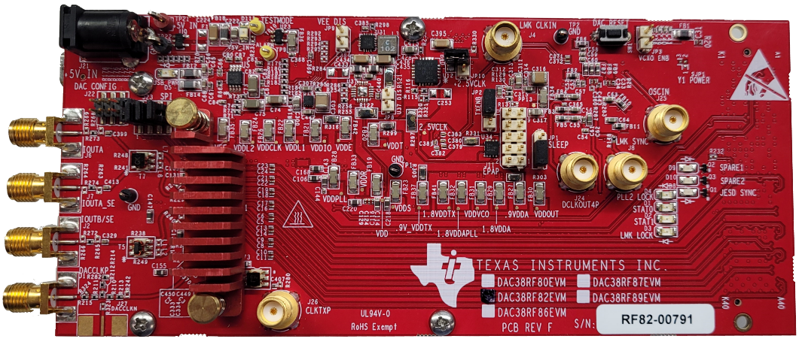
DAC38RF82 EVM Overview
JP10 shorted means LMK_CLKin1 is sourced from the External CLK input divided-by-4 (through an onboard RF divider)
5V input
JP10
LMK_CLKin1
USB input
JP3
DAC38RFxx
(under heatsink)
Channel A
Channel B
External CLK

Slide 3
DAC38RF82EVM setup details
Shunt JP3 shorted
Shunt JP10 removed
DAC Sample rate: 8847.36 MSPS
This tutorial uses a constant input mode (DDS mode) and the output is simply just the NCO frequency. For single narrowband output, DDS mode is the best option!
6x Interpolation -> DAC Input data rate = 1474.56 MSPS (Only relevant if using FPGA to send data to DAC.)
LMK PLL2 set to VCO1 at 2949.12 MHz. DAC CLK divider set as 12 to provide 2949.12 MHz / 12 = 245.76 MHz tone for the DAC PLL reference.
DAC PLL, M=9, N=1 -> DAC CLK = 245.76MHz * 4 * (9/1) = 8847.36 MHz

Slide 4
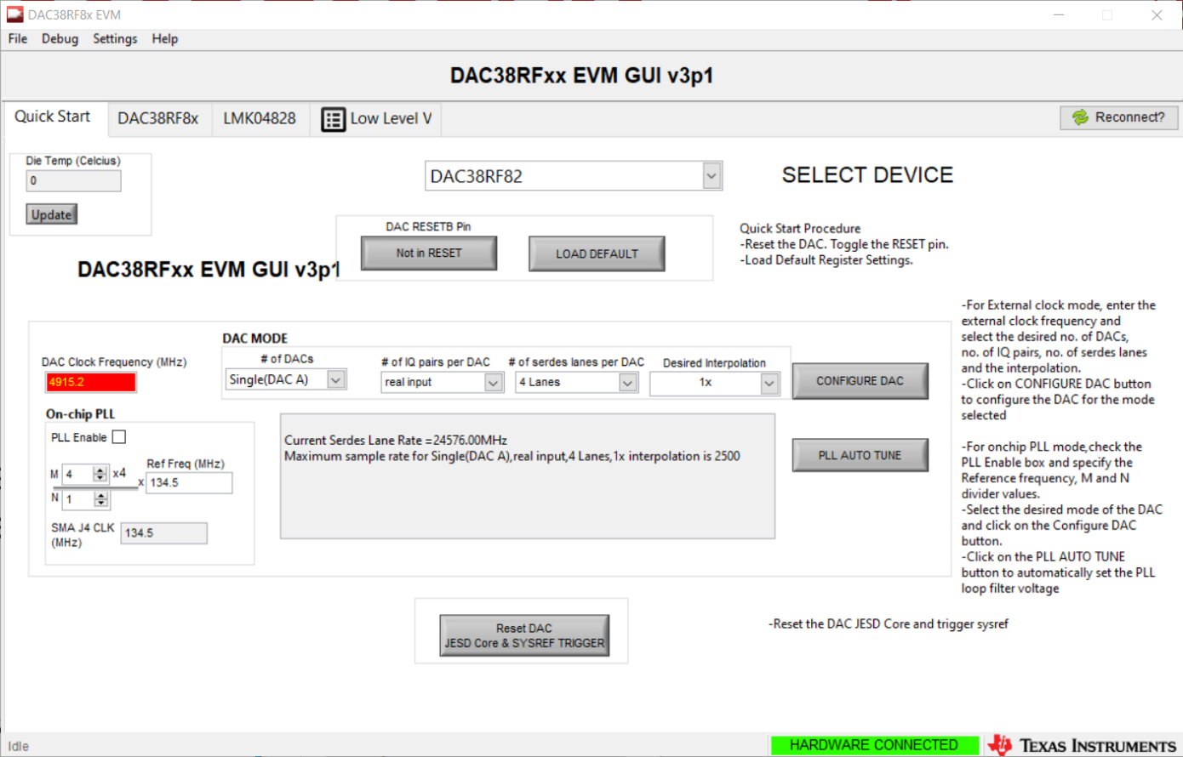
DAC38RF82EVM configuration
1.
Toggle reset
Wait until red
Toggle again
2. Press Load Default

Slide 5
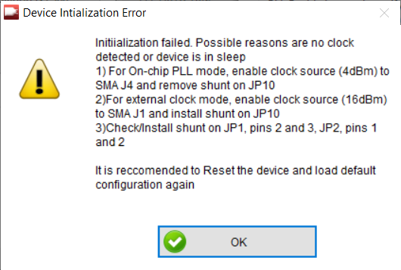
DAC38RF82EVM configuration
If you see this message, ignore it and press OK.
This is because in this default mode, the DAC is expecting a PLL reference input through SMA connector J4.

Slide 6
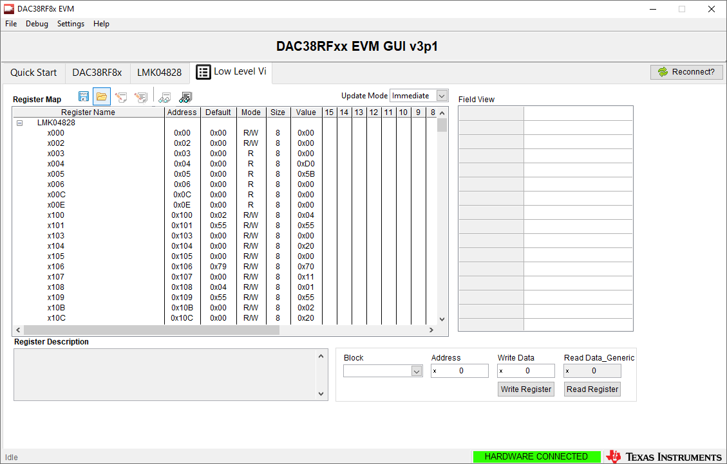
DAC38RF82EVM configuration
Save the configuration file at the top right of this slide
Load configuration
Verify output using spectrum analyzer

Slide 7
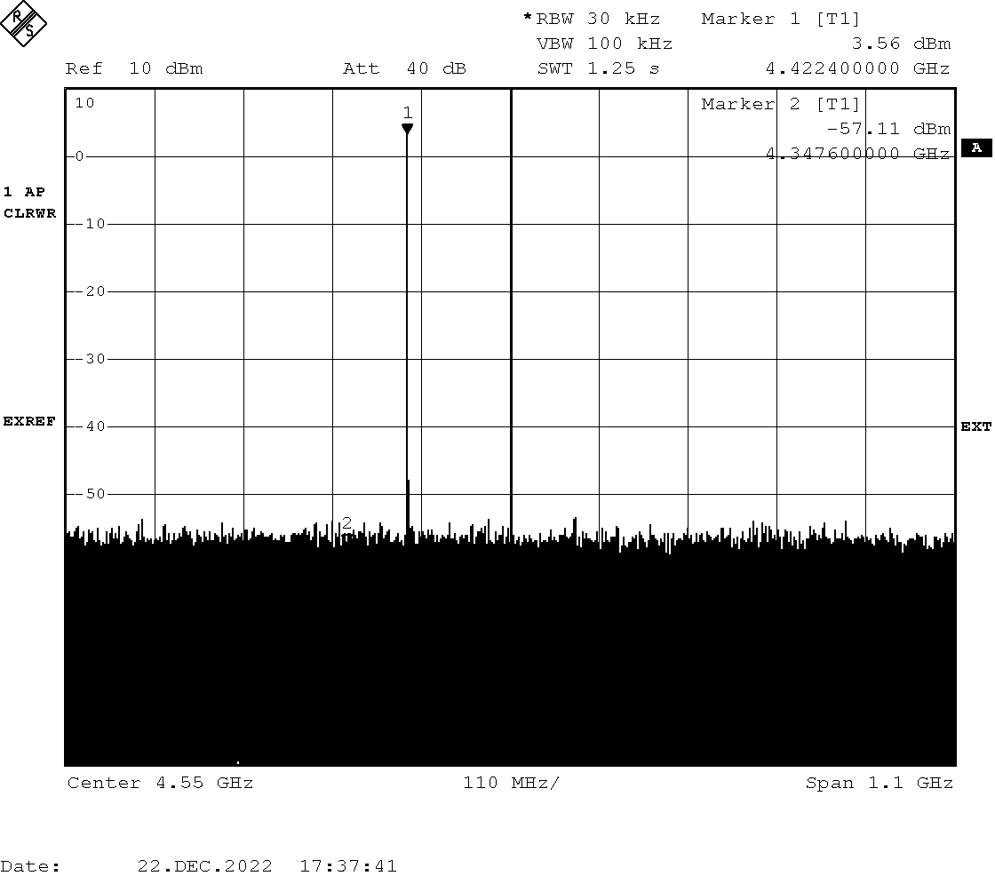
DAC38RF82EVM output
Single tone present at the NCO frequency (4423.68 MHz)

