Slide 1
DAC38RF82 Test

Slide 2
DAC38RF82 Test
Test Setup:
300MHz complex tone sent from TSW14J56EVM
Ext 10MHz reference clock to J4.
Shunt on JP10, JP8 and JP9 removed. Shunt on JP3 installed
Test conditions:
Fdac = 6144Msps PLL mode
LMK PLL VCO1 set to 3072MHz
8x Interpolation
LMFS = 841
DAC PLL settings M = 25, N = 2
Dual DAC, 1 IQ

Slide 3
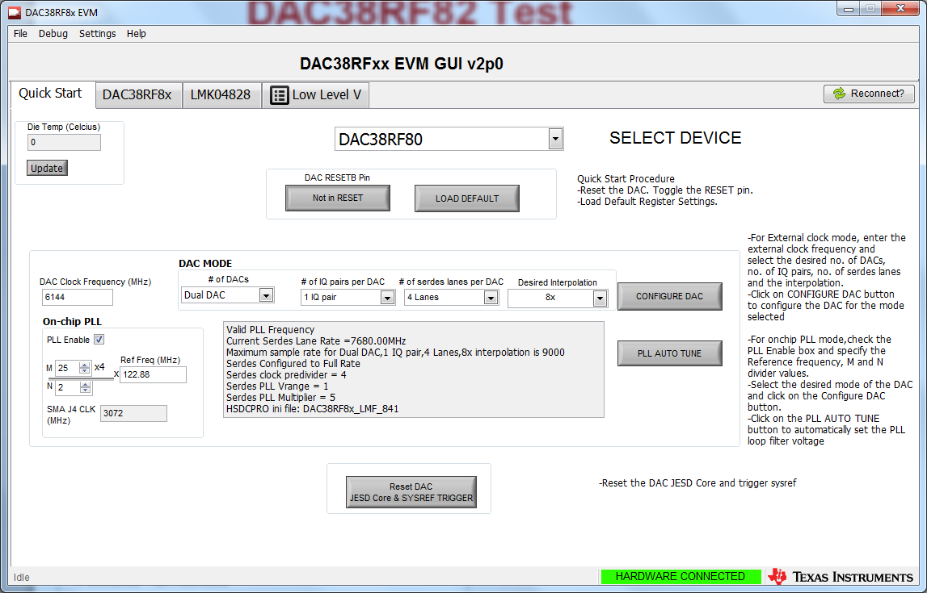
Power up both boards then open the DAC GUI

Slide 4
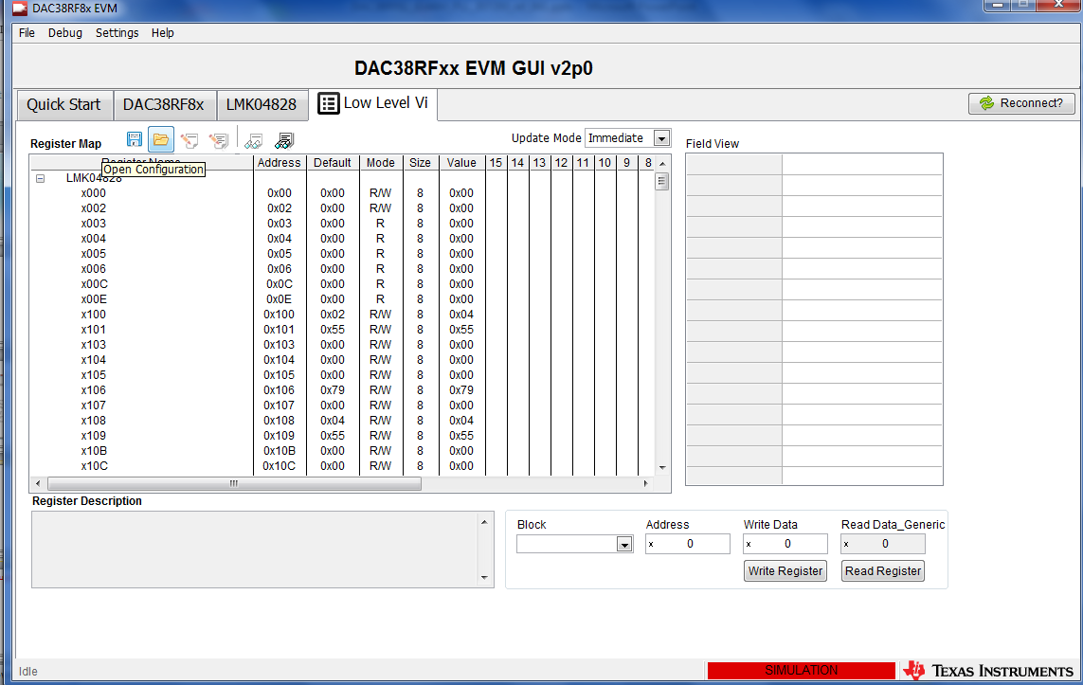
Click on Low Level V tab then click on the folder Icon and load the config file called “6144MSPS_8X_10M_ref_LMF_841.cfg”

Slide 5
LED D4 should now be on indicating LMK VCO1 is locked to the 122.88MHz VCXO and set to 3072MHz.
If there is no 10MHz provided to J4, LED D3 will be off. This is only required if the 122.88MHz VCXO needs to be synchronized to an external 10MHz source.

Slide 6
Go to the Quick Start tab and click on “PLL AUTO TUNE” to lock the DAC PLL

Slide 7
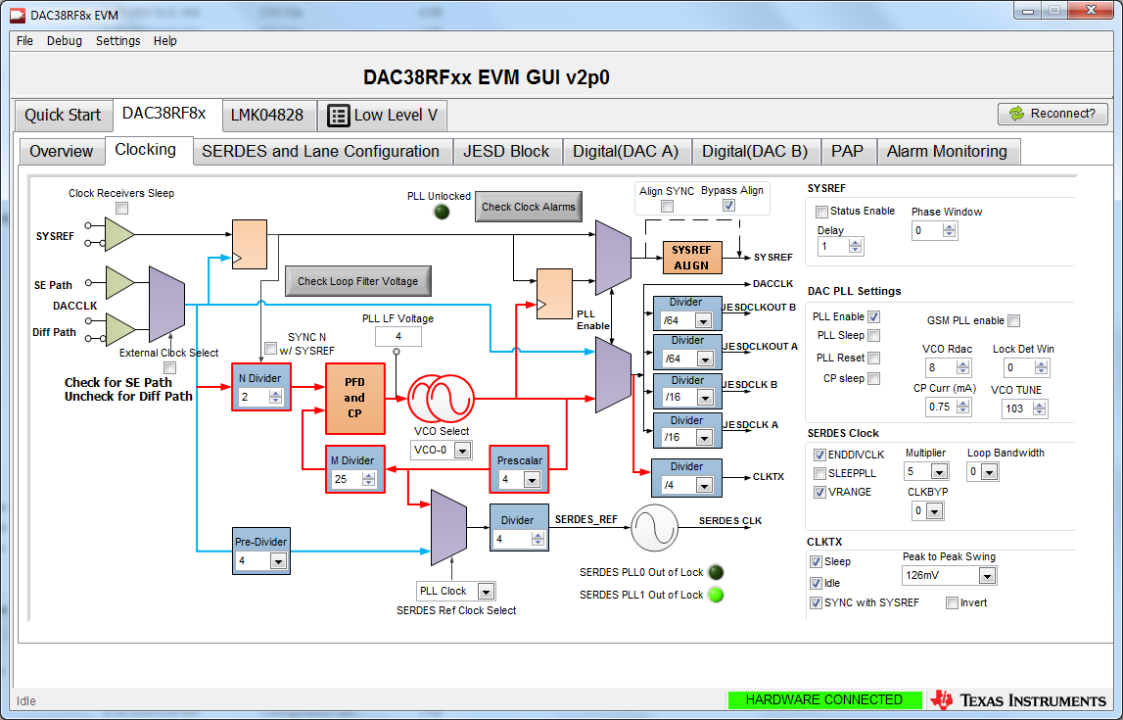
Go to the Clocking tab as shown below. Click on “Check Loop Filter Voltage”. The PLL LF Voltage should read between 3-5. This indicates the DAC PLL is locked.

Slide 8
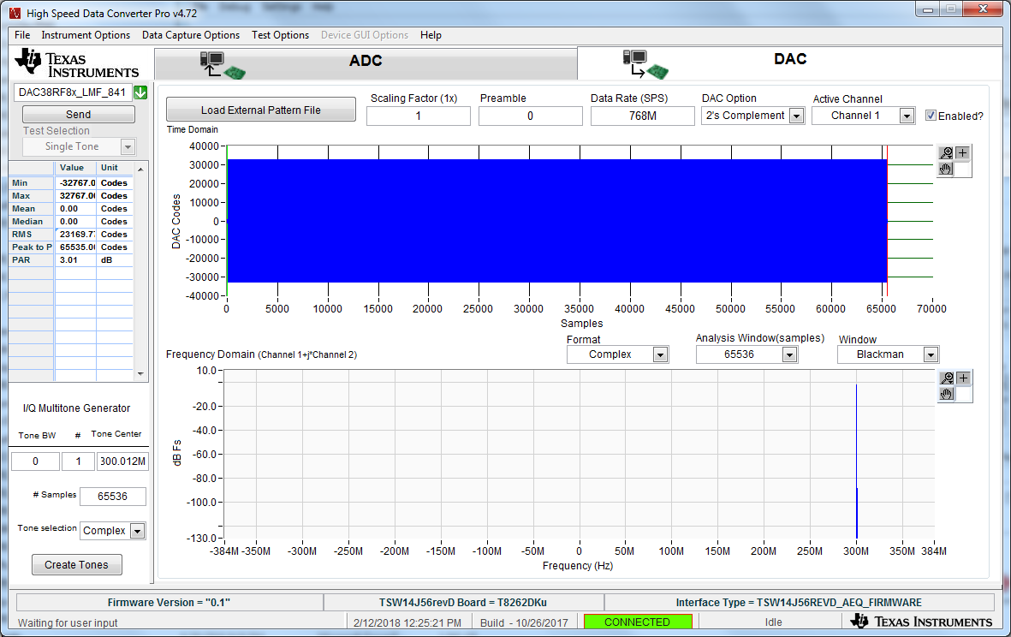
Open HSDC Pro and setup as shown below. After you create the tone, click on “Send”.

Slide 9
Go back to the DAC GUI Quick Start tab and click on “Reset JESD Core & SYSREF TRIGGER. There should now be a 200MHz output tone from the DAC.

Slide 10
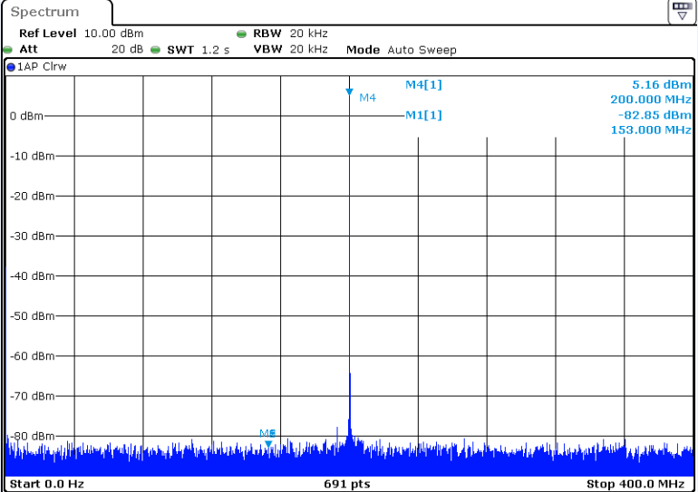
DAC output tone

