Slide 1
DAC38RF82 Test

Slide 2
DAC38RF82 Test
Test conditions:
Fdac = 625Msps ext clock
K = 20
SYSREF = 15.625MHz
8x Interpolation
Single DAC
LMF = 421
1 I/Q channel
Serdes rate = 781.25Mbps
FPGA reference clock 156.25MHz
FPGA data rate = 78.125Msps, Input test tone = 30MHz

Slide 3
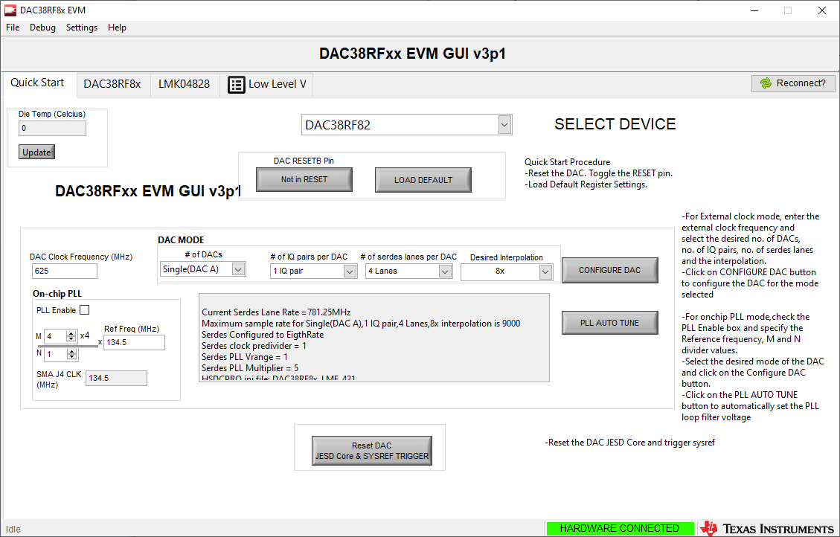

Slide 4
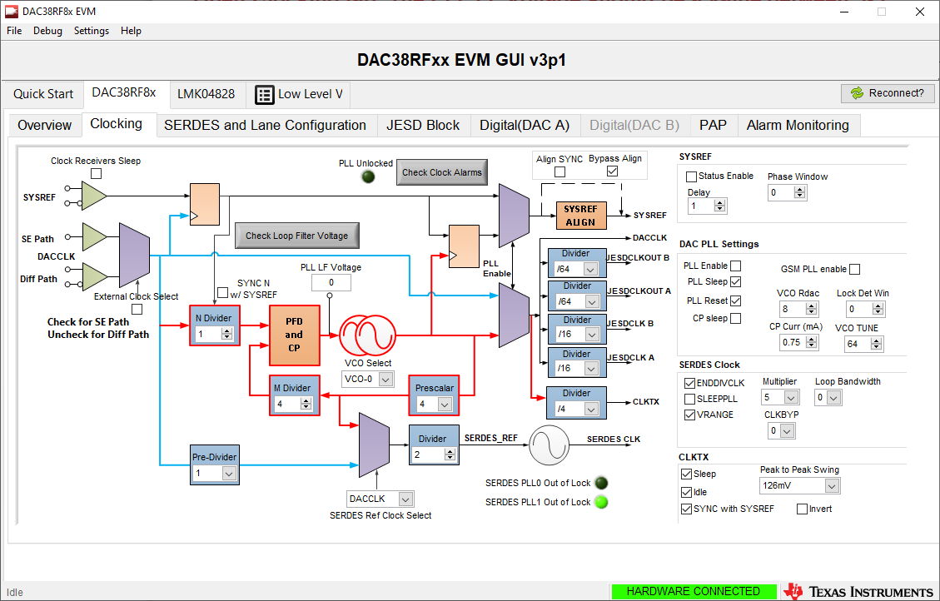

Slide 5
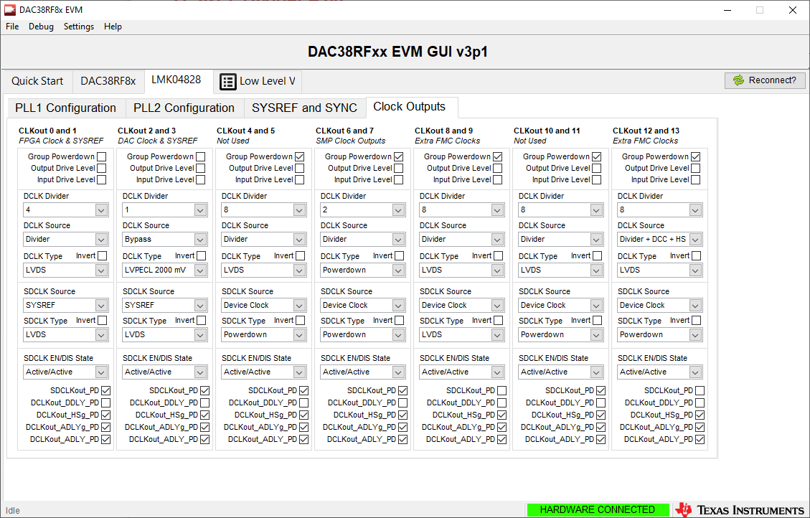

Slide 6
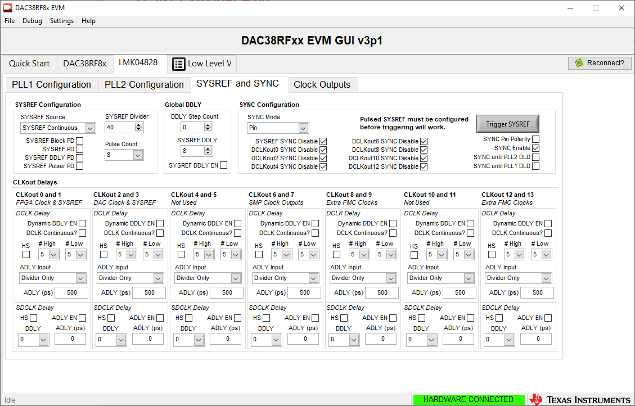

Slide 7
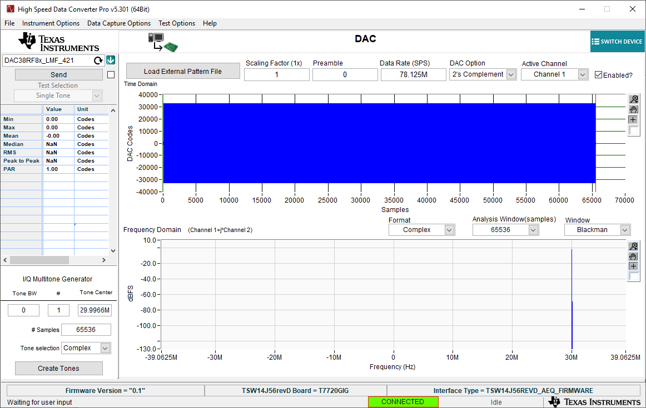
LMK04828 in clock distribution mode

Slide 8
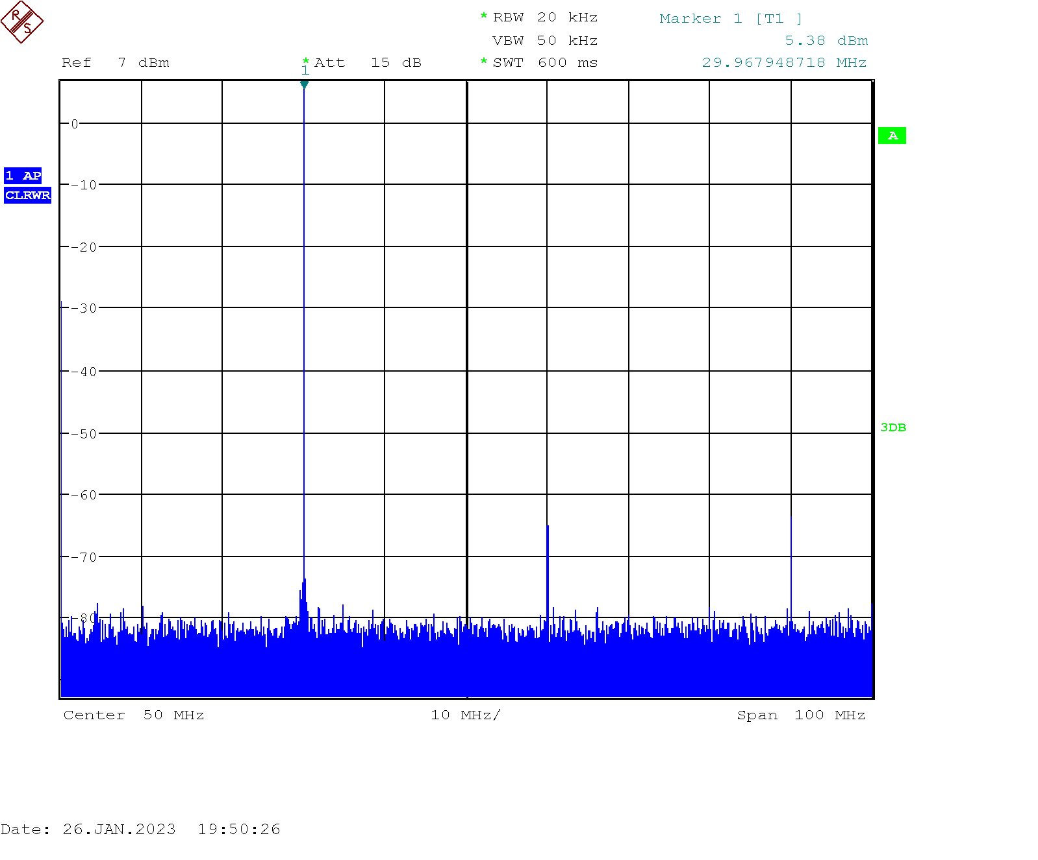
DAC CHA Output

