Slide 1
DAC38RF82 EVM NCO Output Only

Slide 2
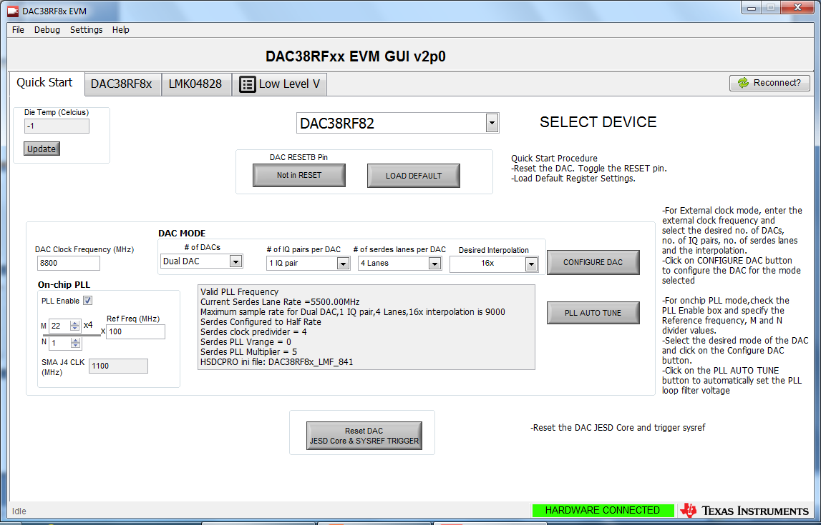
Open latest version of DAC38RFxx GUI (v2p0) found on the TI website.
Select device.
Click on “Not in RESET”. This will change to “DAC in RESET”. Click on it one more time.
Click on “Load DEFAULT”. This will load all of the registers with the default values.
Click on “DAC38RF8x” tab

Slide 3
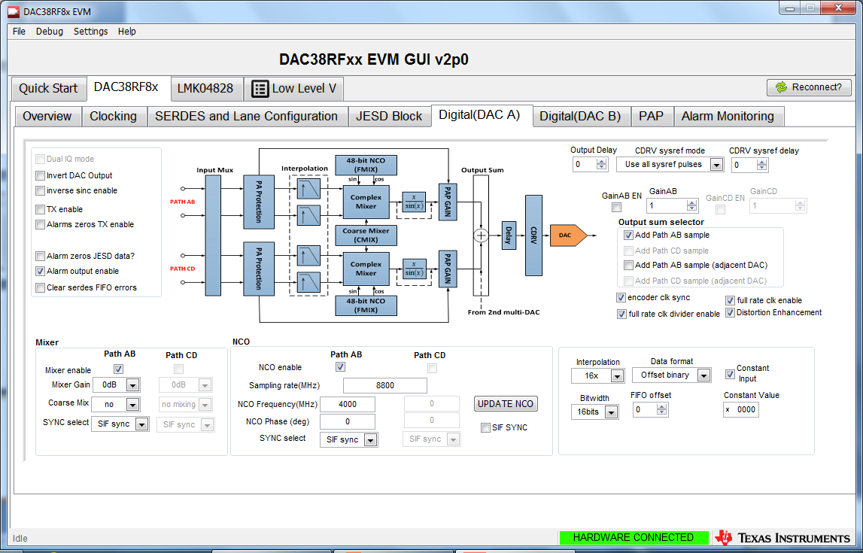
Click on “Digital(DAC A)” tab
Click on Mixer enable, Path AB, and Constant Input as shown below.
Set the Data format to “Offset binary”.
Enter the Sampling rate in MHz. Below example is using 8800MHz.
Enter desired NCO frequency in the NCO frequency box. Example below is set to 4000MHz.
Click on “UPDATE NCO”. There should now be a 4000MHz tone at SMA J7.
3

