Slide 1
DAC38RF82 Test

Slide 2
DAC38RF82 Test
Test Setup:
100MHz complex tone sent from TSW14J56EVM
Test conditions:
Fdac = 5898.24Msps PLL mode
Ext Ref CLK = 245.76MHz
PLL ref = 122.88MHz

Slide 3
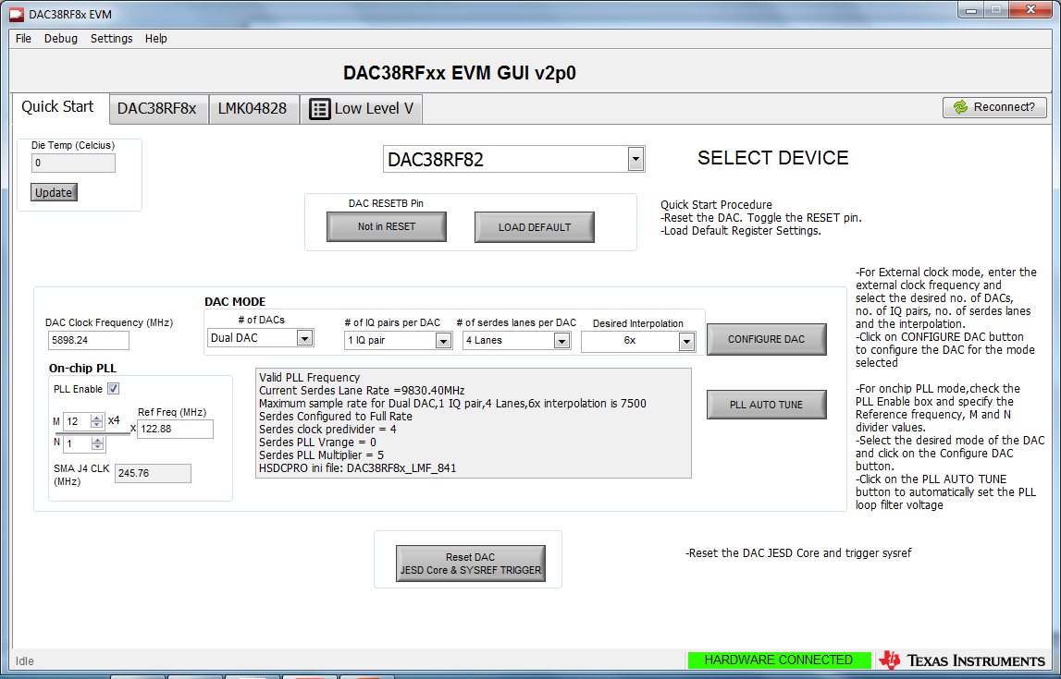
DAC GUI

Slide 4
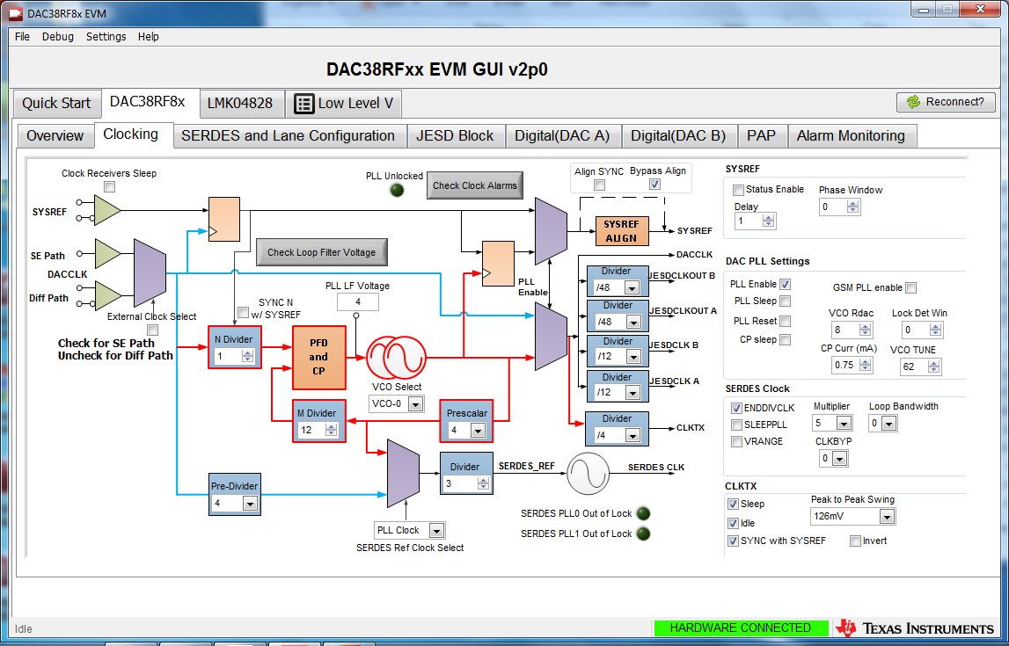
DAC GUI

Slide 5
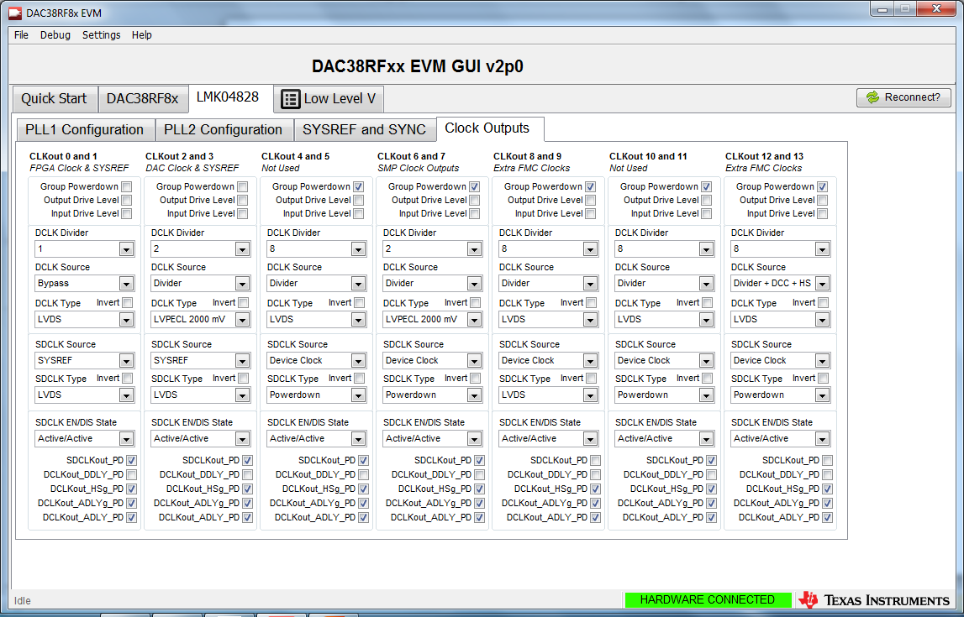

Slide 6
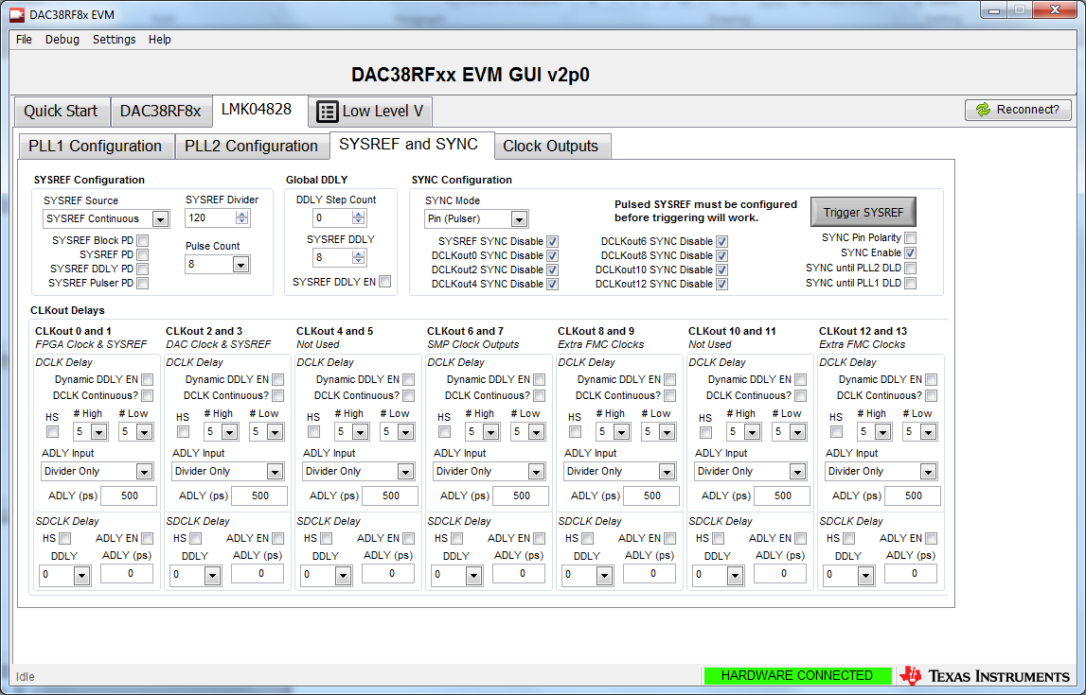

Slide 7
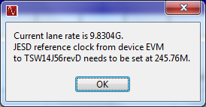

Slide 8
