Slide 1
DAC38RFxx Fundamentals
Chase Wood
Applications Engineer, High Speed Data Converters
October 31, 2022

Slide 2
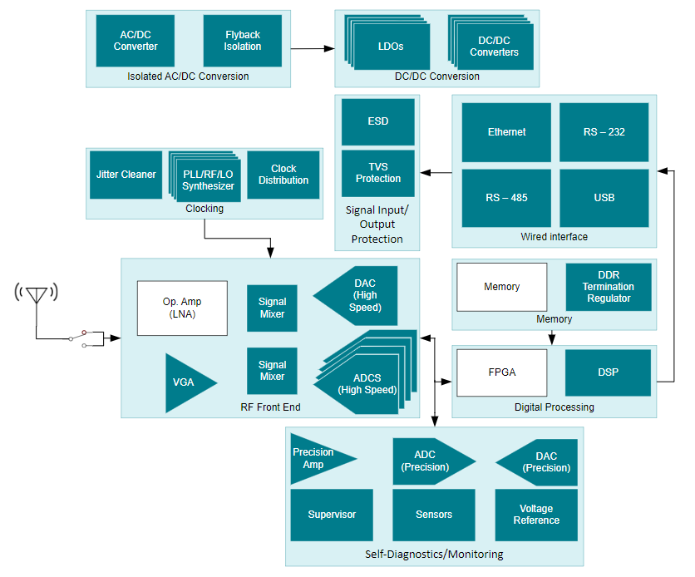
Agenda
Review DAC fundamentals
"IF" vs "RF" Devices
Typical "RF" DAC applications
DAC38RF8x device family/history
Main device features
EVM Overview
SPI-DAC mode
Typical TX/RX signal chain

Slide 3
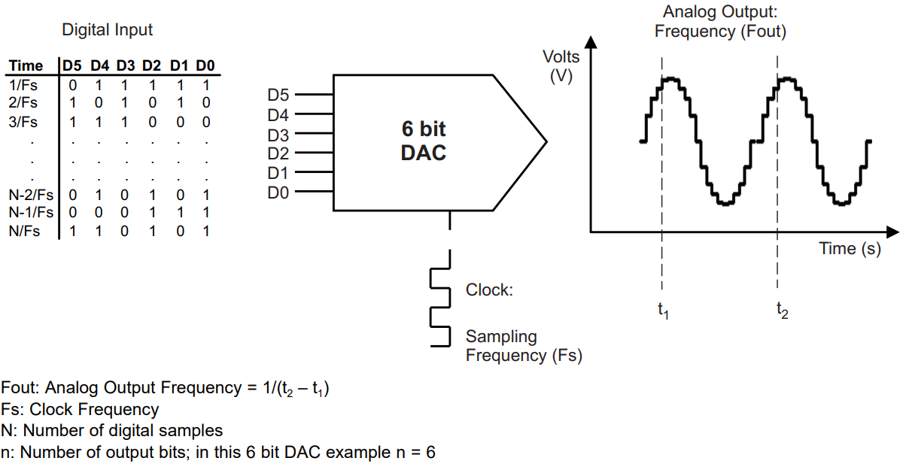
DAC fundamentals

Slide 4
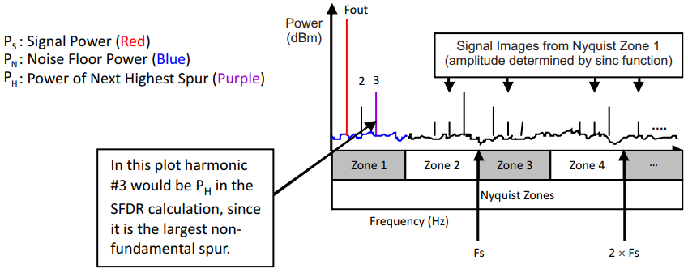
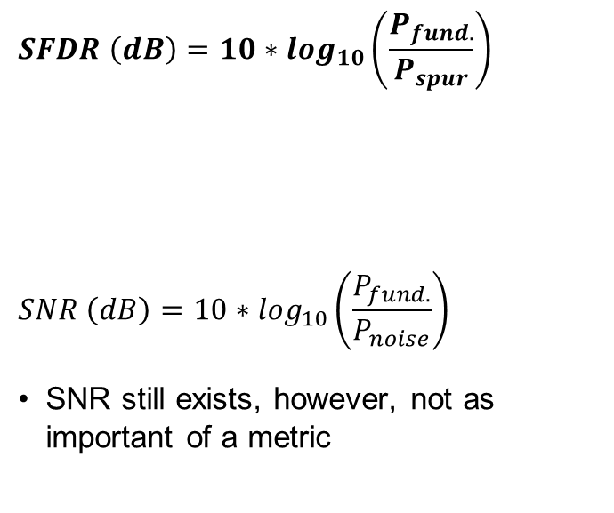
DAC fundamentals
$$SFDR \left(dB\right)=10∗\log_{10}\left(\frac{P_{fund.}}{P_{spur}}\right)$$
$$SNR \left(dB\right)=10∗\log_{10}\left(\frac{P_{fund.}}{P_{noise}}\right)$$
SNR still exists, however, not as important of a metric
* SFDR is typically measured while including DC, HD2, HD3, HD4, HD5
Notes:
SNR is less important because it can never be achieved. It will only tell you the residual wideband noise, which is the contributing factors towards an elevated noise floor. Spurs will always be present and a harmonic-less and spur-less output is not achievable, therefore SNR is irrelevant.

Slide 5
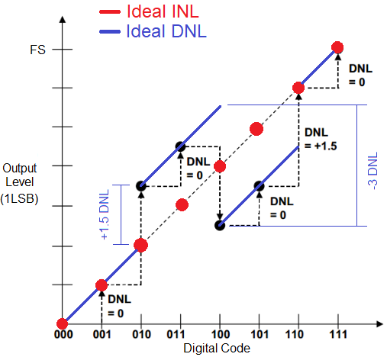
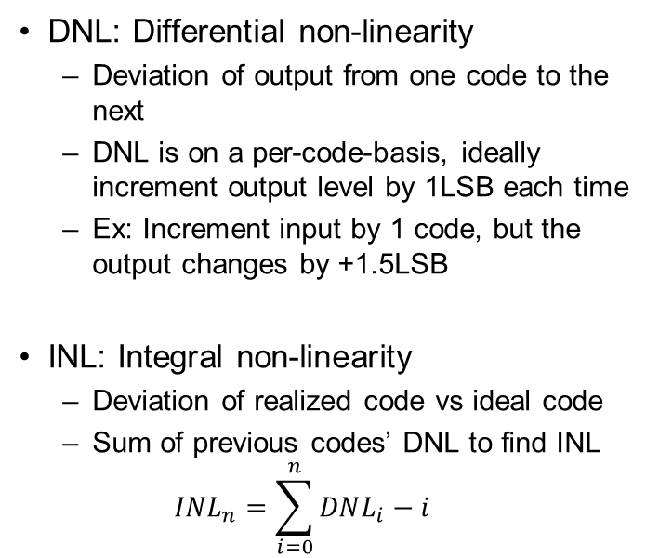
DAC fundamentals
DNL: Differential non-linearity
Deviation of output from one code to the next
DNL is on a per-code-basis, ideally increment output level by 1LSB each time
Ex: Increment input by 1 code, but the output changes by +1.5LSB
INL: Integral non-linearity
Deviation of realized code vs ideal code
Sum of previous codes’ DNL to find INL
$$INL_{n}=\sum_{i=0}^{n}{DNL_{i}−i}$$
Notes:
Ideally, DNL is zero for each code transition. This means that when incrementing from code ‘N’ to code ‘N+1’, the output level changes by 1LSB.

Slide 6
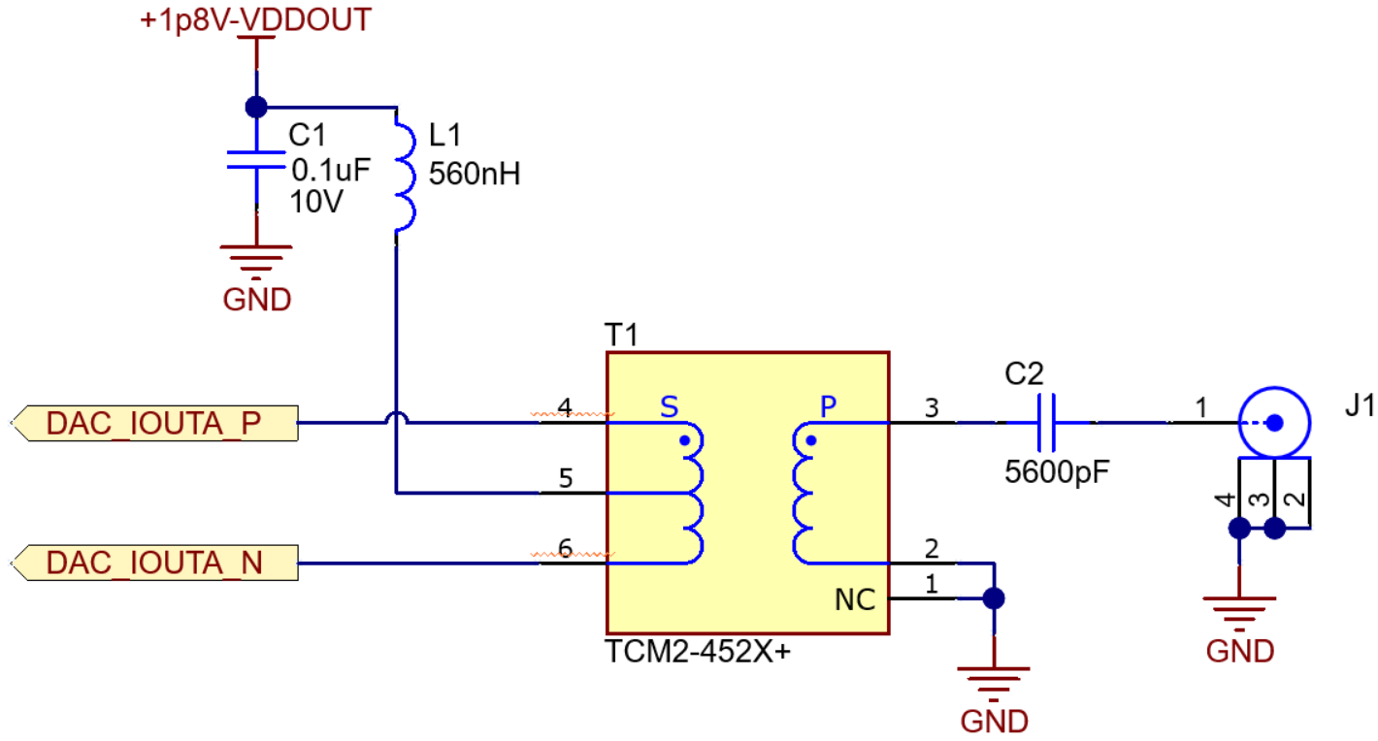
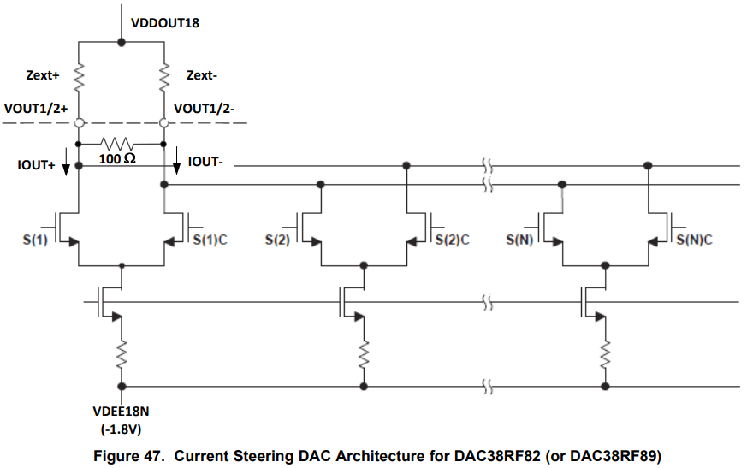
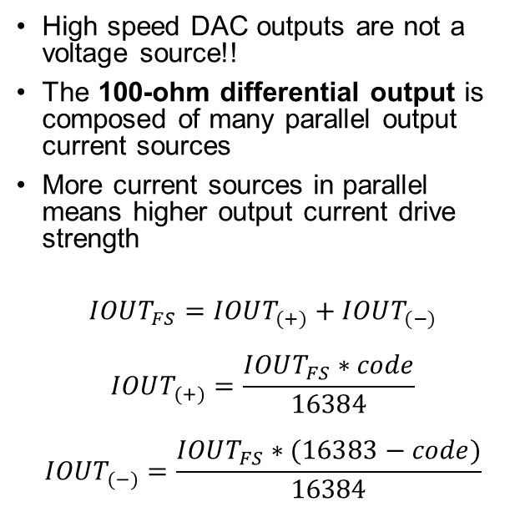
DAC fundamentals
TCM2-452X:
1:2 impedance ratio (P:S)
High speed DAC outputs are not a voltage source!!
The 100-ohm differential output is composed of many parallel output current sources
More current sources in parallel means higher output current drive strength
$$IOUT_{FS}=IOUT_{(+)}+IOUT_{(−)}$$
$$IOUT_{(+)}=\frac{IOUT_{FS}∗code}{16384}$$
$$IOUT_{(−)}=\frac{IOUT_{FS}∗(16383−code)}{16384}$$
100Ω
50Ω
Notes:
Ideally, DNL is zero for each code transition. This means that when incrementing from code ‘N’ to code ‘N+1’, the output level changes by 1LSB.

Slide 7
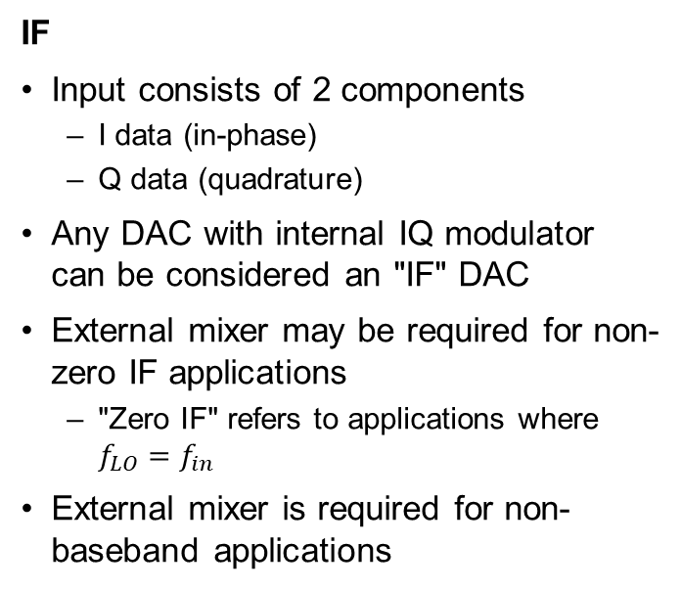
IF vs RF converters
IF
Input consists of 2 components
I data (in-phase)
Q data (quadrature)
Any DAC with internal IQ modulator can be considered an "IF" DAC
External mixer may be required for non-zero IF applications
"Zero IF" refers to applications where $f_{LO}=f_{in}$
External mixer is required for non-baseband applications
RF
Improvement to "IF" devices
Higher sampling rate
Enabling larger instantaneous bandwidth (IBW)
More interpolation options
Higher interpolation factors
Enables a similar output while inputting much less data
Wide range NCO
Internal to device
Enables up-mixing without additional HW
Eliminates LO feed-through and analog mixer sideband images

Slide 8
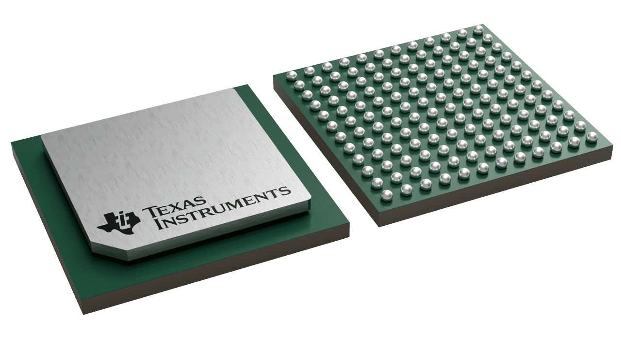
DAC38RFxx Typical Applications
Arbitrary waveform generators
Radar and electronic warfare
Communications test equipment
Direct RF synthesis for DOCSIS 3.0/3.1 (home internet)
Microwave backhaul (Communication systems)
144-pin BGA (AAV)
100mm² (10mm x 10mm)

Slide 9
DAC38RFxx Device Family
12 pin compatible devices
Main devices:
DAC38RF82:
6 GHz internal VCO
9 GHz internal VCO
DAC38RF89:
5 GHz internal VCO
7.5 GHz internal VCO
Main device family parts
Often referred within TI as “fully unlocked” devices
Only difference between these devices is the VCO range supported
Remaining devices in family:
DAC38RF80
DAC38RF83
DAC38RF84
DAC38RF85
DAC38RF86
DAC38RF87
DAC38RF90
DAC38RF93
DAC38RF96
DAC38RF97
Common differences:
Integrated balun vs differential output
VCO range options
Interpolation options
Single vs dual channel

Slide 10
DAC38RFxx Device Family
 | Ch’s | Bandwidth | Max Input Rate (Complex) | RF Output | Max Output Rate | DUCs/Ch. | Bypass-able internal VCO/PLL | Interpolation
DAC38RF82 | 2 | Wide-band | 2.5 GSPS 16-bit 3.3 GSPS 12-bit 9 GSPS 8-bit real | Differential | 9.0 GSPS | 1 | 6, 9 GHz | 1x-24x
DAC38RF89 |  |  | 2.5 GSPS 16-bit 3.3 GSPS 12-bit 9 GSPS 8-bit real | Differential | 9.0 GSPS | 1 | 5, 7.5 GHz | 1x-24x
DAC38RF83 |  | Standard (no export license) | 1.25 GSPS | Differential | 9.0 GSPS | 2 | 6, 9 GHz | 6x-24x
DAC38RF80 |  |  | 1.25 GSPS | SE balun | 9.0 GSPS | 2 | 6, 9 GHz | 6x-24x
DAC38RF86 |  |  | 1.25 GSPS | SE balun | 9.0 GSPS | 2 | 9 GHz low noise | 6x-24x
DAC38RF87 |  |  | 1.25 GSPS | SE balun | 9.0 GSPS | 2 | 6 GHz low noise | 6x-24x
DAC38RF93 |  | Narrow (no export license) | 750 MSPS | Differential | 9.0 GSPS | 1 | 6, 9 GHz | 12x-24x
DAC38RF90 |  |  | 750 MSPS | SE balun | 9.0 GSPS | 1 | 6, 9 GHz | 12x-24x
DAC38RF96 |  |  | 750 MSPS | SE balun | 9.0 GSPS | 1 | 9 GHz low noise | 12x-24x
DAC38RF97 |  |  | 750 MSPS | SE balun | 9.0 GSPS | 1 | 6 GHz low noise | 12x-24x
DAC38RF85 | 1 | Standard (no export license) | 1.2 GSPS | Differential | 9.0 GSPS | 2 | 6, 9 GHz | 6x-24x
DAC38RF84 |  |  | 1.25 GSPS | SE balun | 9.0 GSPS | 2 | 6, 9 GHz | 6x-24x

Slide 11
DAC38RFxx Device Features
DAC38RF82
Multi-DUC B
Multi-DUC A
DUC1 (Path AB)
DUC2 (Path CD)
DUC2 (Path CD)
DUC1 (Path AB)
Each of the 4 DUCs contain:
Individually controllable NCO
PA Protection block
IQ modulator
Summation block
Inverse Sinc(x) filter
Delay

Slide 12
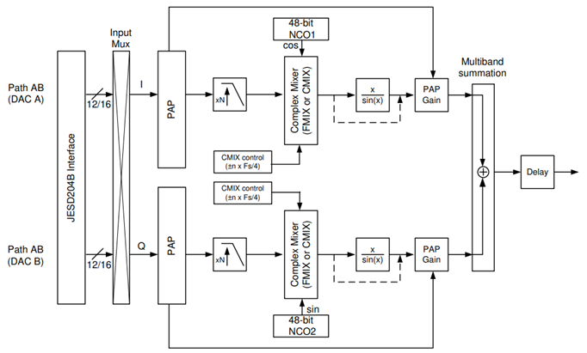
DAC38RFxx Device Features
Individually controllable NCO
PA Protection block
IQ modulator
Summation block
Inverse Sinc(x) filter
Delay

Slide 13
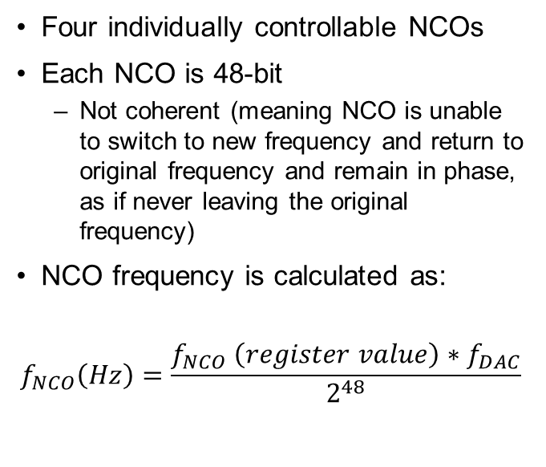
DAC38RFxx NCO
Four individually controllable NCOs
Each NCO is 48-bit
Not coherent (meaning NCO is unable to switch to new frequency and return to original frequency and remain in phase, as if never leaving the original frequency)
NCO frequency is calculated as:
$$f_{NCO}\left(Hz\right)=\frac{f_{NCO} \left(register value\right)∗f_{DAC}}{2^{48}}$$

Slide 14
DAC38RFxx Device Features
Individually controllable NCO
PA Protection block
IQ modulator
Summation block
Inverse Sinc(x) filter
Delay

Slide 15
DAC38RFxx Power Amplifier (PA) Protection
Important to avoid overdriving output
When input data will over-range DAC, PA kicks in to reduce amplitude to avoid saturating on DAC output

Slide 16
DAC38RFxx Device Features
Individually controllable NCO
PA Protection block
IQ modulator
Summation block
Inverse Sinc(x) filter
Delay

Slide 17
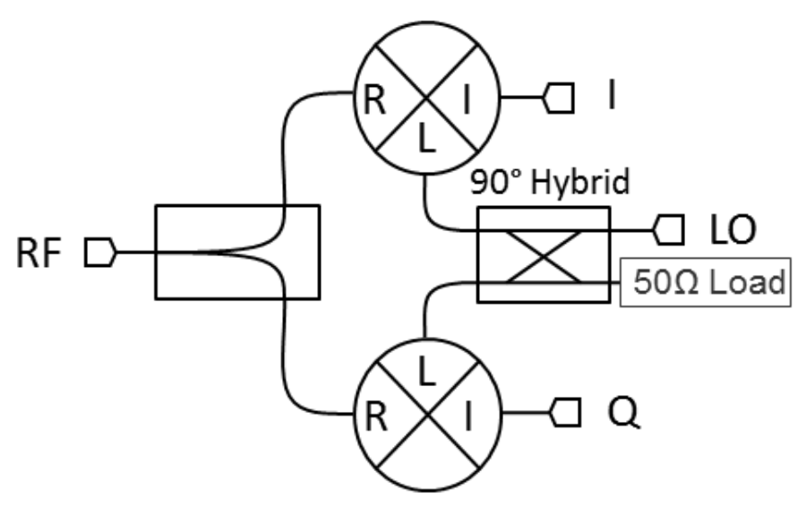
DAC38RFxx IQ Modulator
IQ Mixer:
2 real data input signals (either analog or digital)
Mix one with cosine wave
Mix other with sine wave
Outputs are now both imaginary (containing magnitude and phase components) and level is cut in half after mixing process
DAC38RFxx supports adding 6dB gain after mixing to account for the mixing loss
Credit: Marki Microwave

Slide 18
DAC38RFxx Device Features
Individually controllable NCO
PA Protection block
IQ modulator
Summation block
Inverse Sinc(x) filter
Delay

Slide 19
DAC38RFxx Summation Block
Used for adding output of DUCs (or Multi-DUC) together
Useful for 2-IQ Mode (enabling Path AB and Path CD) on each multi-DUC
Allows for combining 2 IQ signals into a single output waveform
Dual band operation at lower output power level (to avoid OVR)
Useful in wideband DUC mode
(8-bit only) to transmit I-data through DAC A and Q-data through DAC B
Allows for IQ signals at high data rates which corresponds to high instantaneous bandwidths

Slide 20
DAC38RFxx Device Features
Individually controllable NCO
PA Protection block
IQ modulator
Summation block
Inverse Sinc(x) filter
Delay

Slide 21
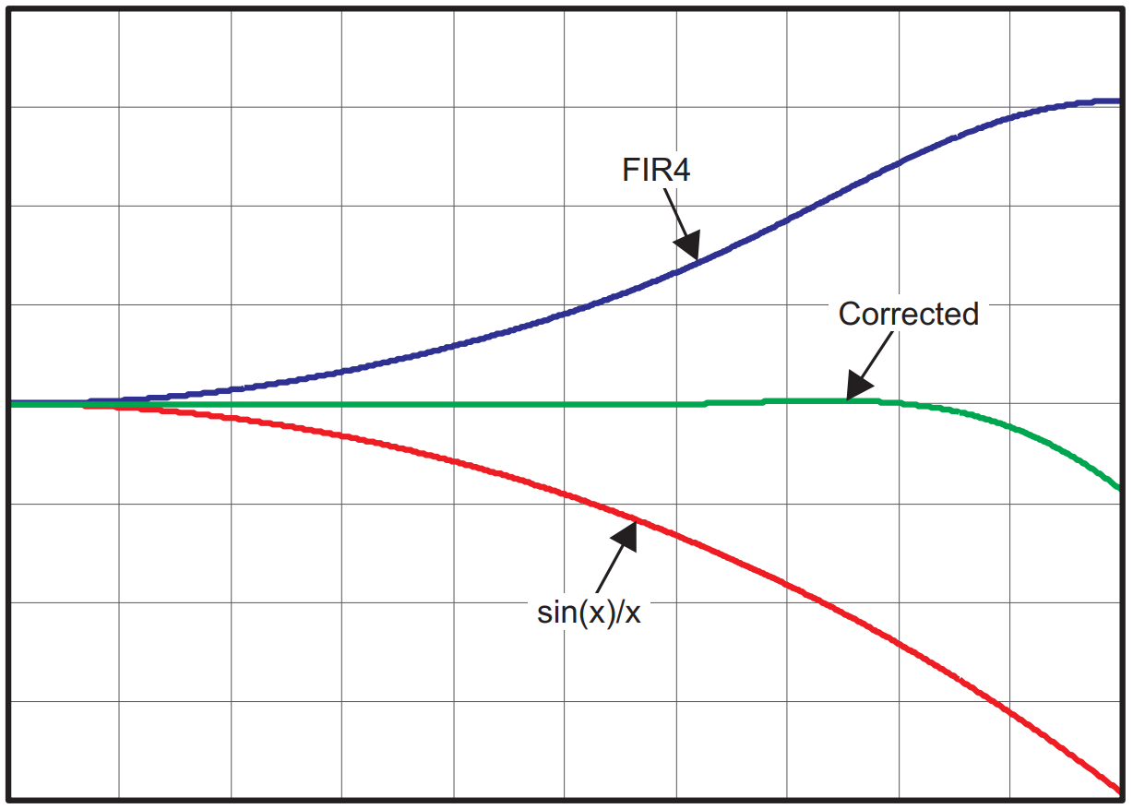
DAC38RFxx Inverse Sinc Filter
Due to sample-hold architecture of DAC, output BW looks as Sinc(x) function (red)
Optional Sinc(x) filter will digitally correct the signal prior to DAC output
Uses 9-tap digital FIR filter
Frequency response of:
Sinc(x) filter (red)
Inverse Sinc(x) filter (blue)
Summation (green)

Slide 22
DAC38RFxx Device Features
Individually controllable NCO
PA Protection block
IQ modulator
Summation block
Inverse Sinc(x) filter
Delay

Slide 23
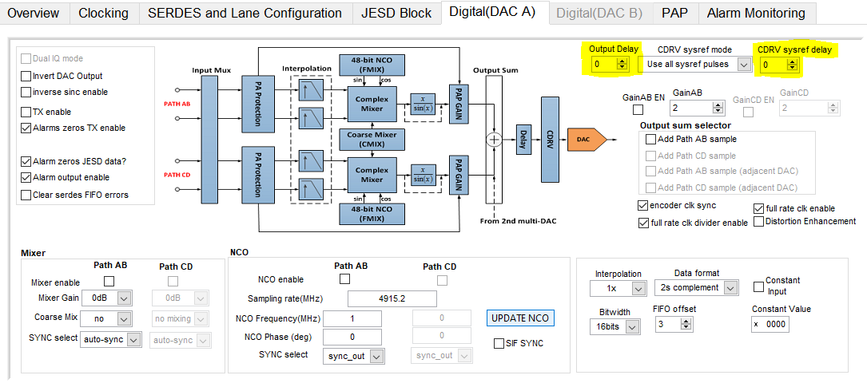
DAC38RFxx Delay Options
Optional output delay by up to 15 clock cycles
Delay sysref into the CDRV block (clock dividers) – Not relevant in most applications, mainly used to accommodate poor SYSREF length matching to multiple devices

Slide 24
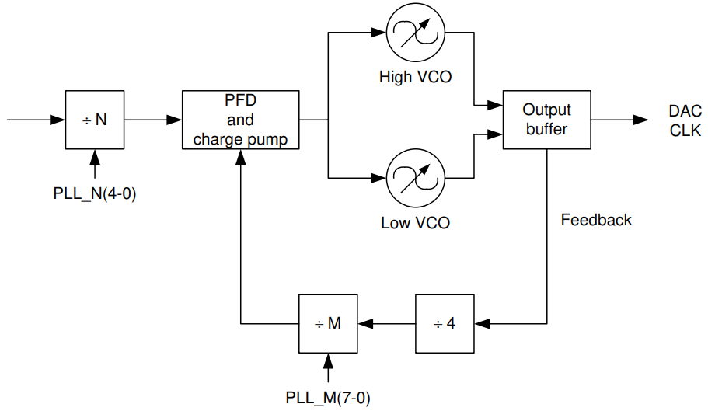
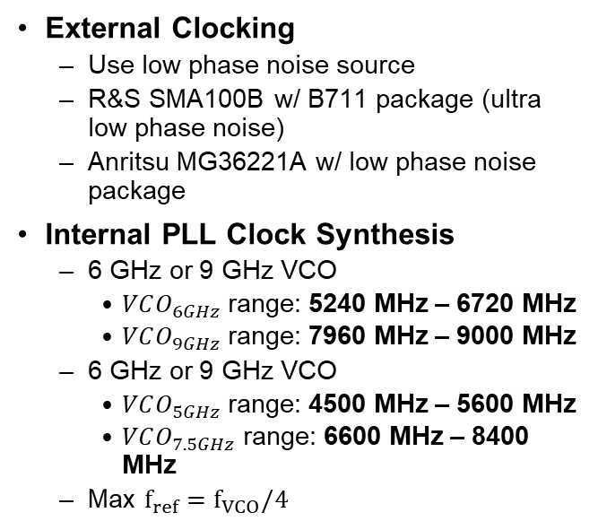
DAC38RFxx Clocking
External Clocking
Use low phase noise source
R&S SMA100B w/ B711 package (ultra low phase noise)
Anritsu MG36221A w/ low phase noise package
Internal PLL Clock Synthesis
6 GHz or 9 GHz VCO
$VCO_{6GHz}$ range: 5240 MHz – 6720 MHz
$VCO_{9GHz}$ range: 7960 MHz – 9000 MHz
6 GHz or 9 GHz VCO
$VCO_{5GHz}$ range: 4500 MHz – 5600 MHz
$VCO_{7.5GHz}$ range: 6600 MHz – 8400 MHz
Max $f_{ref}=f_{VCO}/4$
DACCLK

Slide 25
DAC38RFxx Clocking
Typically, PLL is good trade-off for MOST customers
Saves customer grief by not requiring a 6 GHz or 9 GHz clock input
PLL has two M dividers:
First is fixed at div-by-4
Second is user-defined
DACCLK

Slide 26
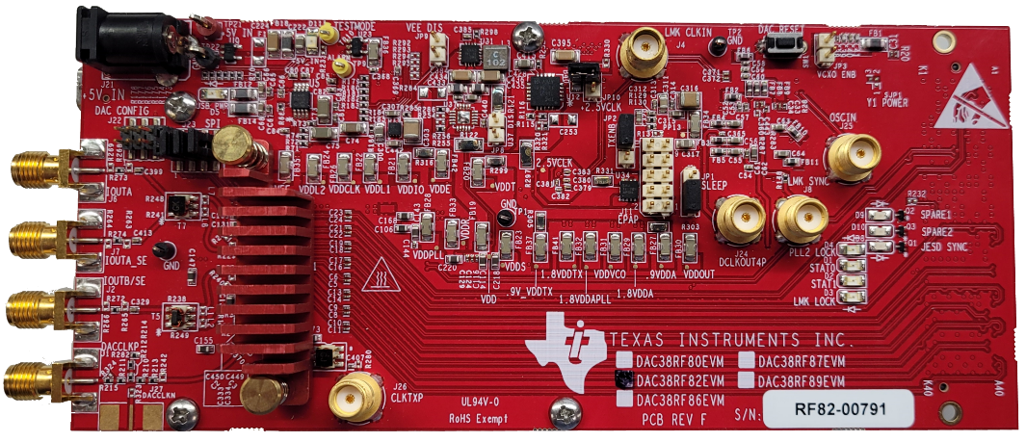
DAC38RFxx EVM Overview
JP10 shorted means LMK_CLKin1 is sourced from the External CLK input divided-by-4 (through an onboard RF divider)
5V input
JP10
LMK_CLKin1
USB input
JP3
DAC38RFxx
(under heatsink)
Channel A
Channel B
External CLK

Slide 27
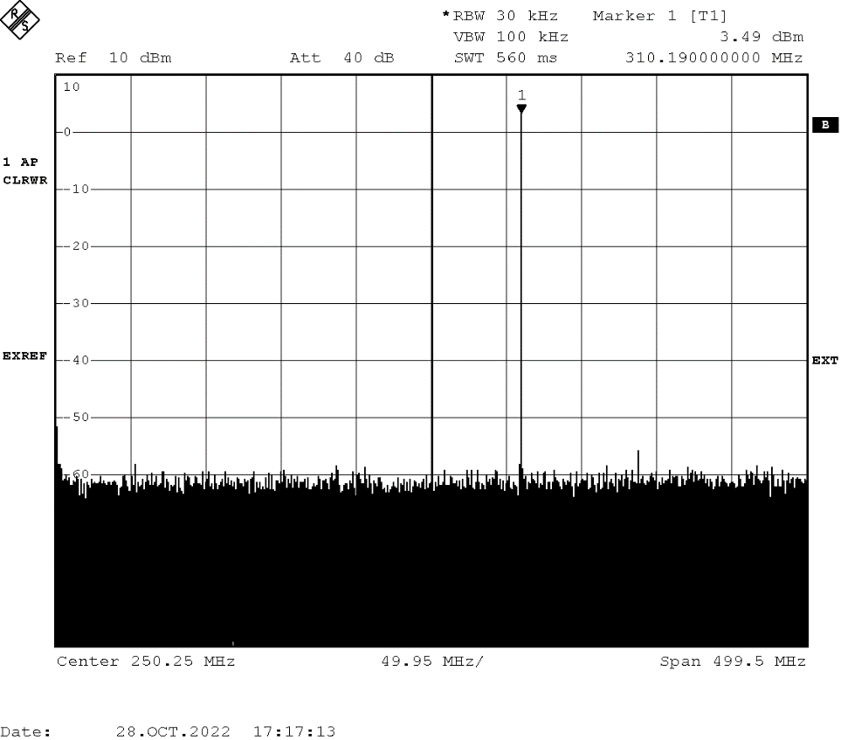

DAC38RFxx SPI DAC Mode
SPI DAC Mode
Set the DAC into Constant Input mode
Eliminates the need for an FPGA
Input data is set to a fixed register value and repeated
Mix the fixed input data pattern with an NCO frequency (set via SPI)
The result is a single tone output at the NCO frequency (310MHz shown to right)

Slide 28
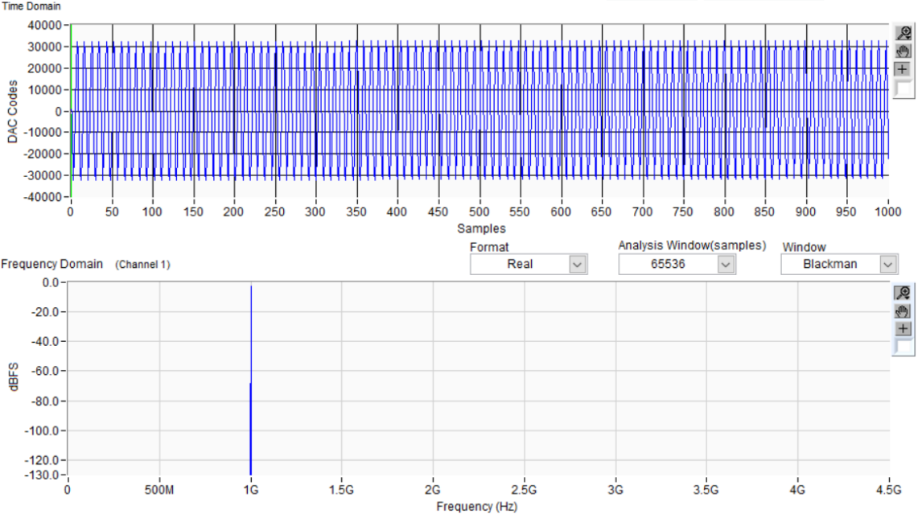
Tips about RF DAC Testing
Characterize DAC performance using a full scale single tone sinusoid
Harmonics (HD2-HD5) are worst with narrowband, large input level tones
Most customer applications:
Wideband input tones ☺
Single tone CW ☹
(the most narrowband input tone you can give!)

Slide 29
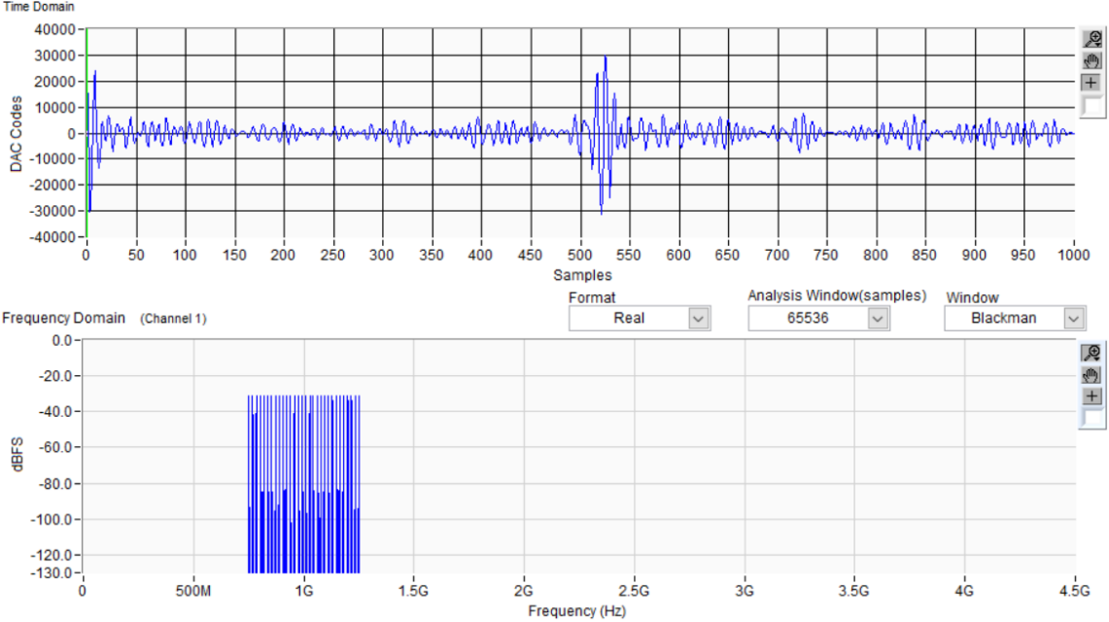
Tips about RF DAC Testing
Characterize DAC performance using a full scale single tone sinusoid
Harmonics (HD2-HD5) are worst with narrowband, large input level tones
Most customer applications:
Wideband input tones ☺
Single tone CW ☹
(the most narrowband input tone you can give!)

Slide 30
Quiz
True or False:
The maximum sampling rate for the DAC38RF82 is 9.5 GSPS?

Slide 31
Quiz
True or False:
The maximum sampling rate for the DAC38RF82 is 9.5 9.0 GSPS.

Slide 32
Quiz
True or False:
The output of the DAC38RFxx is a voltage source?

Slide 33
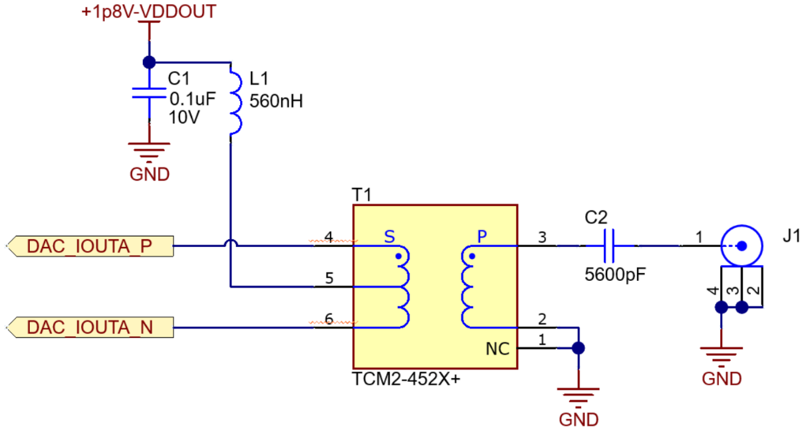
Quiz
True or False:
The output of the DAC38RFxx is a current source! A balun is required to convert to voltage.

Slide 34
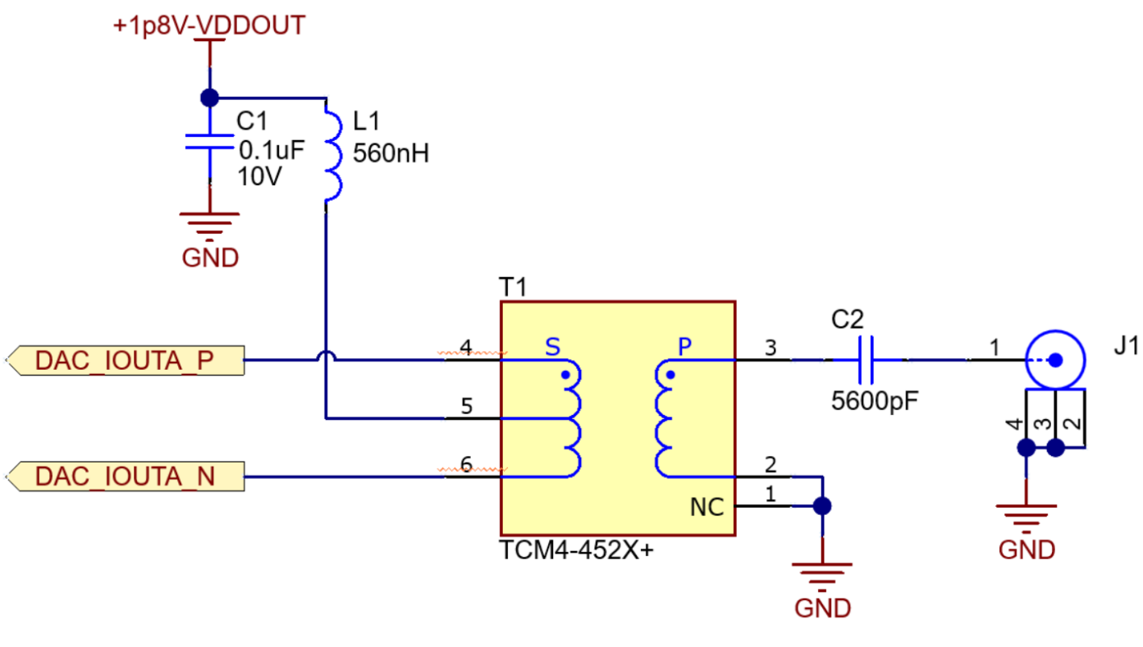
Quiz
What is the impedance at the output J1? Is it okay to connect to 50Ω test equipment?
100Ω
???

Slide 35

Quiz
What is the impedance at the output J1?
TCM4-452X
1:4 impedance ratio (P:S) $$Z_{secondary}=100Ω$$
$$Z_{primary}=Z_{secondary}∗P:S Ratio$$
$$Z_{primary}=100Ω∗\frac{1}{4}→Z_{primary}=25Ω$$
100Ω
25Ω

Slide 36
Quiz
Is it okay to connect to 50Ω test equipment?
You should not connect to 50Ω test equipment. This has the potential to damage equipment meant to be driven ONLY by 50Ω source.
*Always treat impedance recommendations as requirements to avoid damaging equipment.
100Ω
25Ω

Slide 37
Resources
https://www.ti.com/lit/an/slaa523a/slaa523a.pdf

