Slide 1
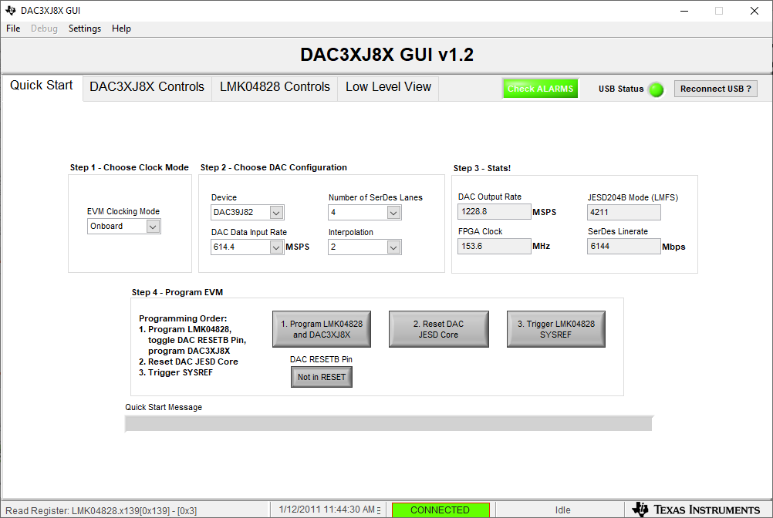
After power up and before setting up FPGA, only click on #1 below.

Slide 2
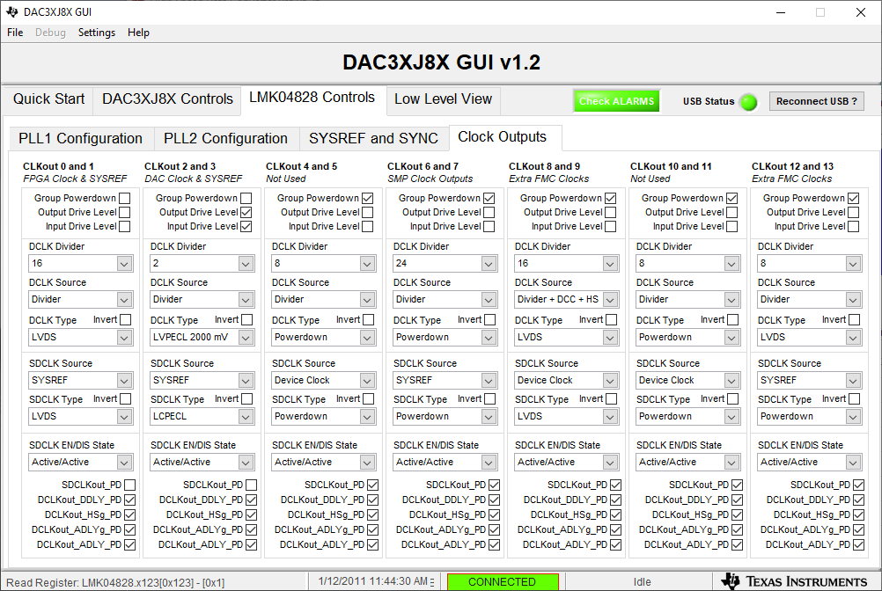
Make sure DCLK Source is set to “Divider” and not Divider+DCC+HS” for both of these.

Slide 3
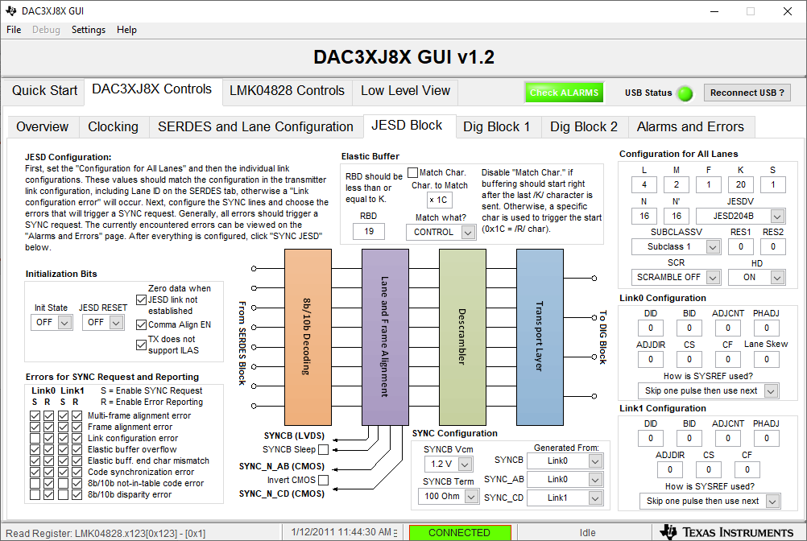
Make sure FPGA has K = 20

Slide 4
After FPGA is setup, click on #2 and #3 below.

Slide 5
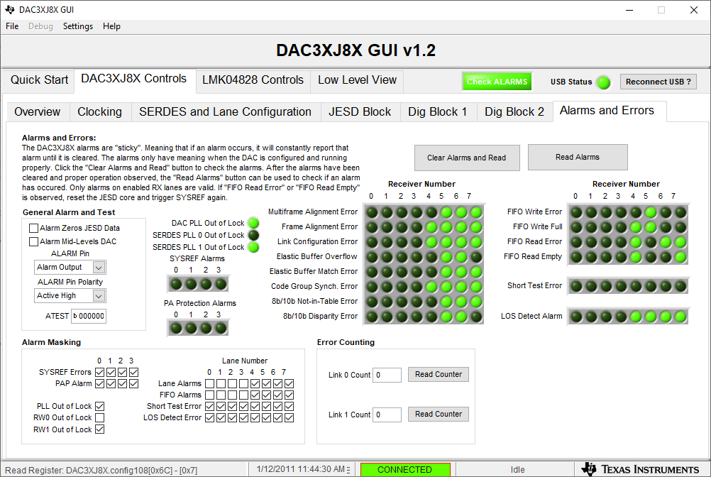
Alarm status

