Slide 1
DAC39J84 EVM Quick Start Guide

Slide 2
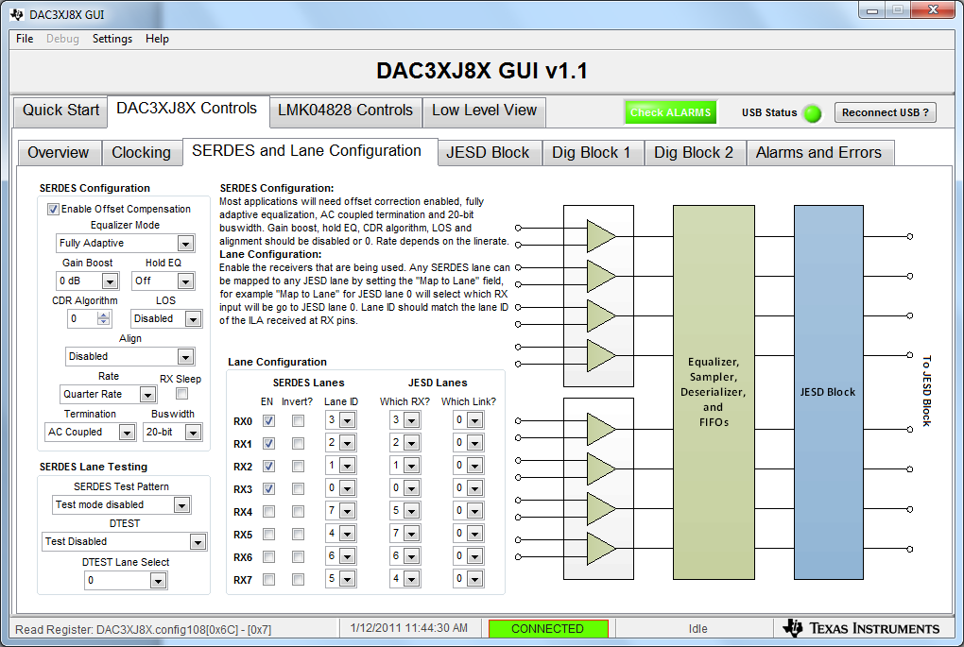
3. Set serdes lane configuration as shown below

Slide 3
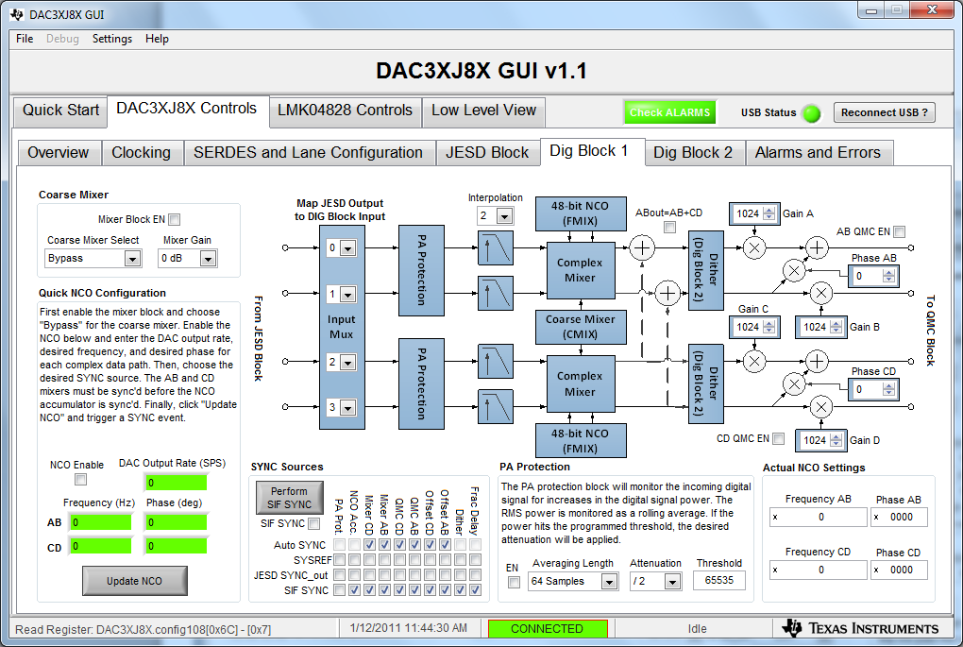
3. Set DIG Block 1 as shown below.

Slide 4
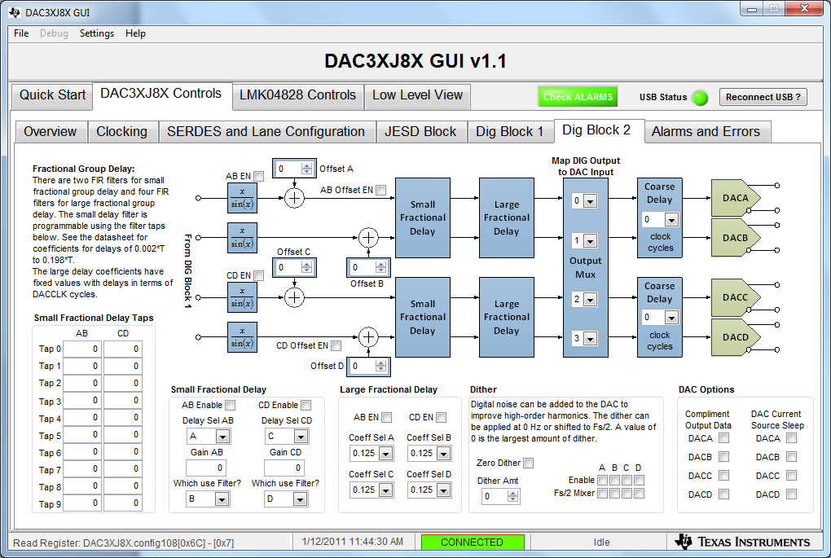
3. Set DIG Block 2 as shown below.

Slide 5
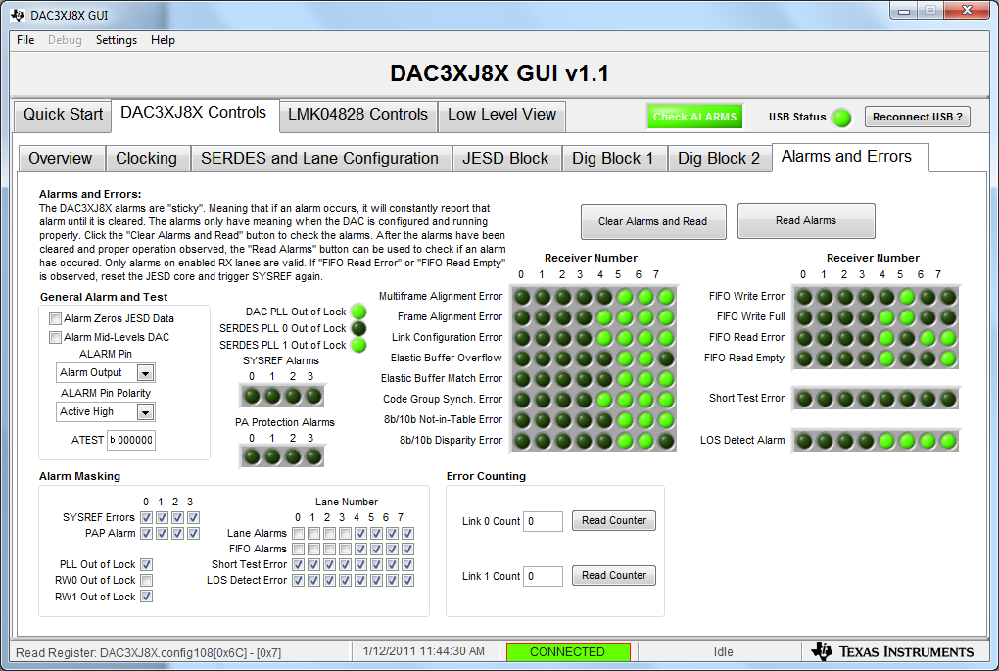
Alarm status

