Slide 1
DAC5682z EVM Labview SPI Utilities
07/15/2015
Kang Hsia

Slide 2
Required Software
Computer with pre-installed DAC5682z EVM GUI. The computer must have the EVM device driver installed
Labview 2014 or above to run the Labview utilities.

Slide 3
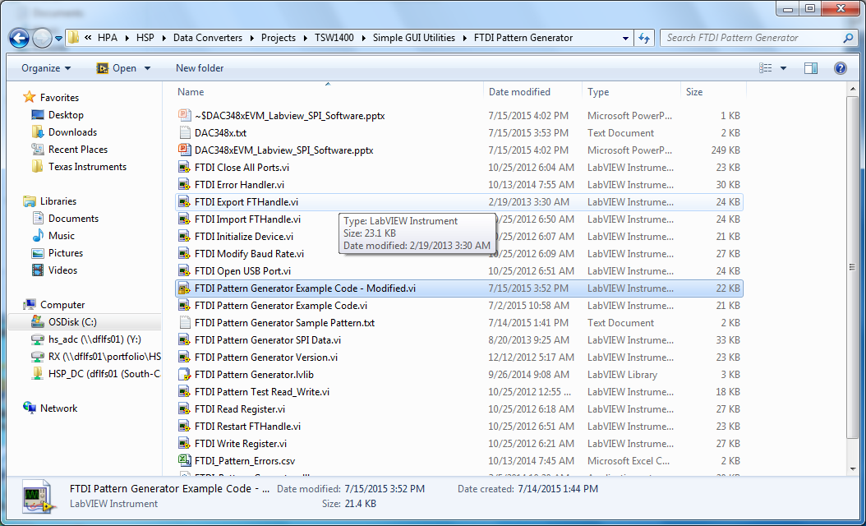
Step 1: Open the “FTDI Pattern Generator Example Code – Modified.vi”

Slide 4
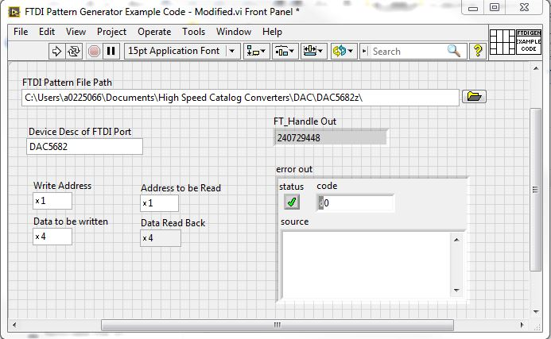
Step 2: FTDI Pattern File
Select “DAC5682.txt” file for the “FTDI Pattern File Path” Option

Slide 5
Step 3: Device Desc of FTDI Port
Type in “DAC5682zEVM” for the Device Description of FTDI Port

Slide 6
Step 4: Run the Program to Write and Read SPI Registers of DAC3484 EVM.
Power up the DAC5682z EVM and connect the USB to the EVM.
Type in the desired write and read address and write data. Press run to execute the program.

Slide 7
End of Document

