Slide 1
DAC902 Test

Slide 2
Test Setup
Test Setup:
TSW1400EVM, Fs = 125MHz, offset binary, 65K samples
Spectrum Analyzer span 0 – 62.5MHz, RBW 100KHz
Test conditions:
DAC Fs = external 125Msps (not filtered)
Plot 1: Fout = 50MHz, Spectrum Analyzer 20MHz BW, no filter
Plot 2: Fout = 50MHz Spectrum Analyzer 0 – 62.5MHz BW
Plot 3: Fout = 55MHz, Spectrum Analyzer 0 – 62.5MHz BW, bandpass filter
Plot 4: Fout = 46MHz, Spectrum Analyzer 0 – 62.5MHz BW, bandpass filter

Slide 3
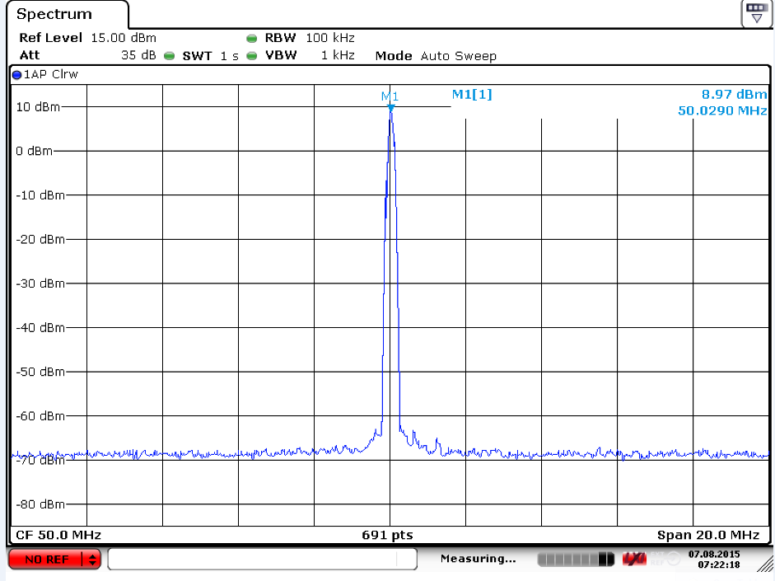
Plot 1

Slide 4
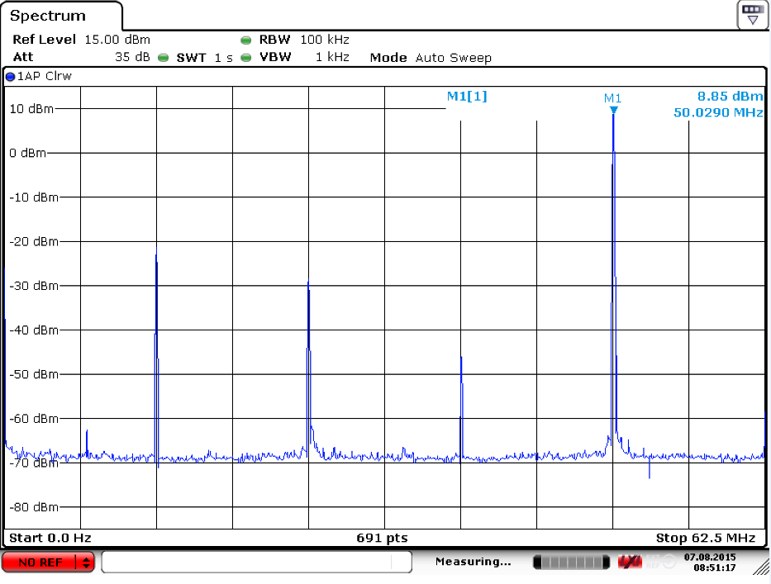
Plot 2

Slide 5
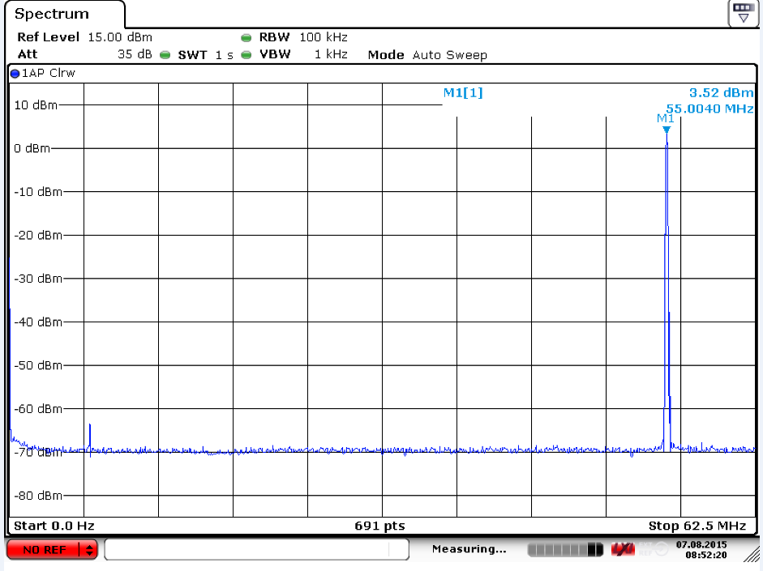
Plot 3

Slide 6
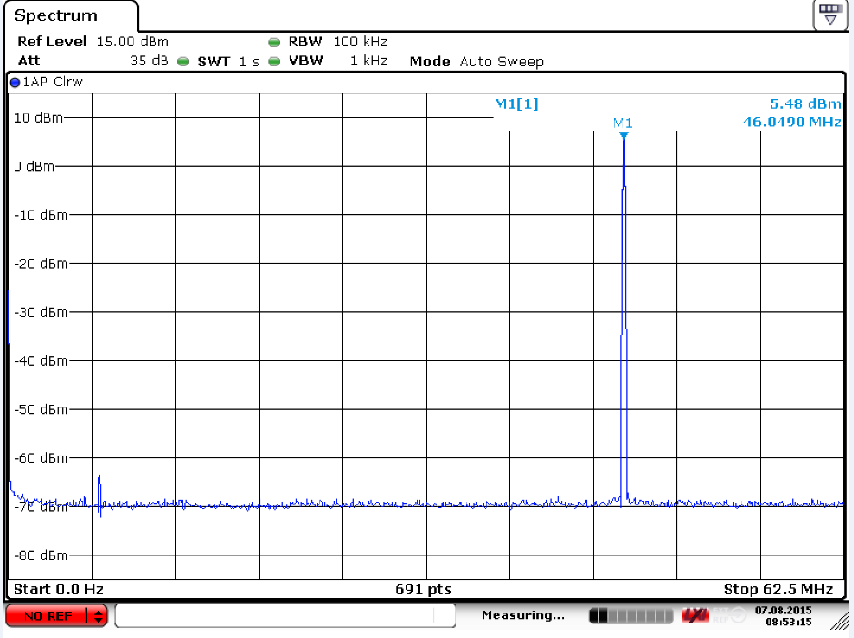
Plot 4

