Slide 1
Fixing TSW1400 after programming as DAC5682

Slide 2
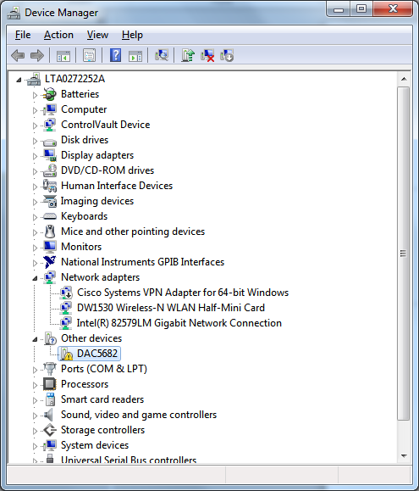
Look for DAC5682 in Device Manager

Slide 3
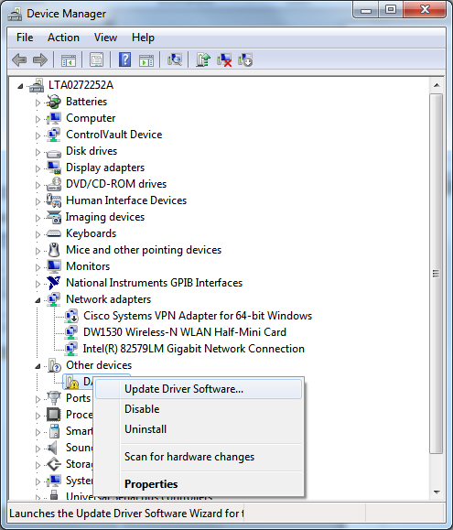
Right click “DAC5682” and select “Update Driver Software…”

Slide 4
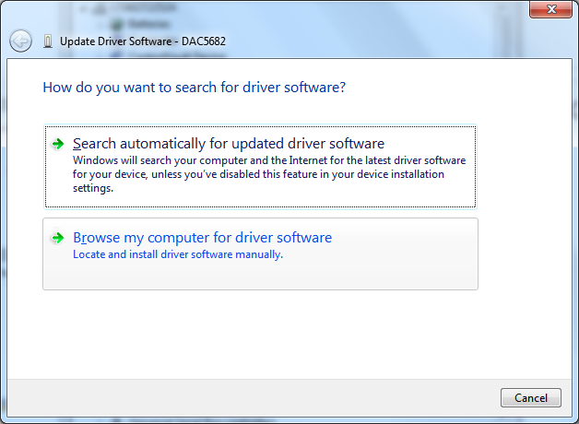
Select “Browse my computer for driver software”

Slide 5
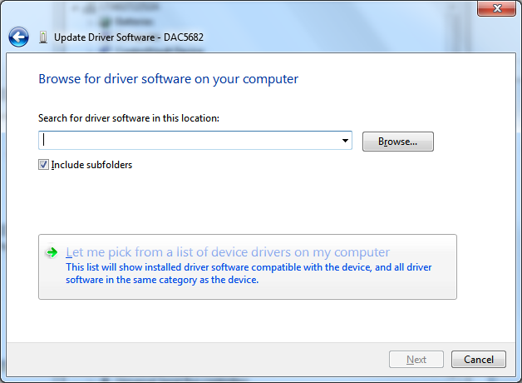
Choose “Let me pick from a list…”

Slide 6
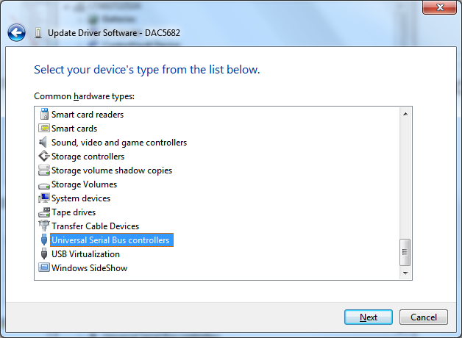
Choose “Universal Serial Bus controllers”

Slide 7
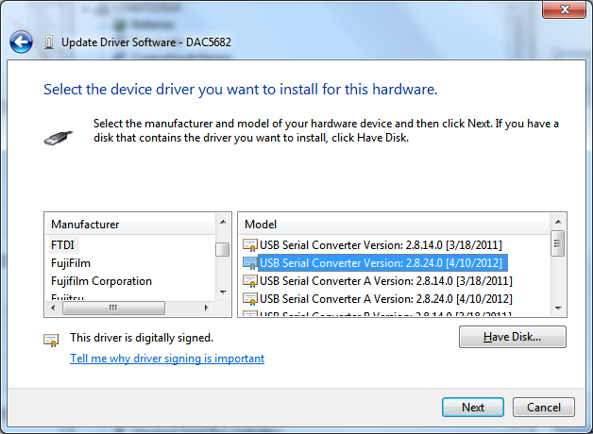
Choose “FTDI” and “USB Serial Converter”

Slide 8
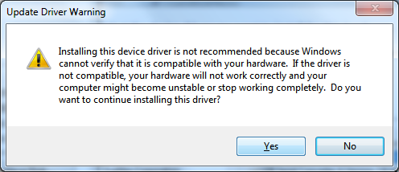
Click “Yes”

Slide 9
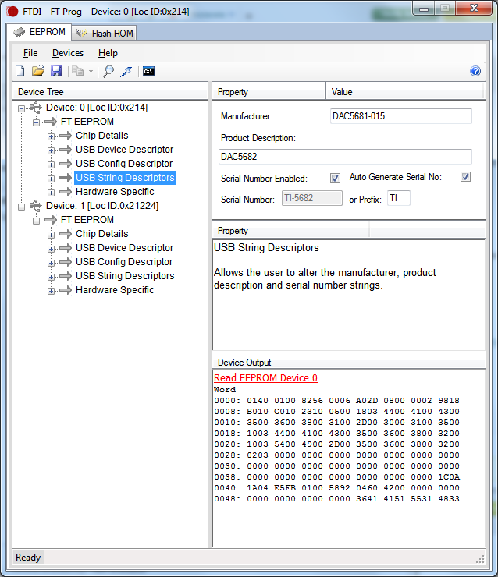
Should now see “DAC5682” in FT_Prog

