Slide 1
To achieve the desired results for the CMRR
We use the method Rerouting The Right Leg Drive Signal (Topic # 9.3.1.7.1 of the ADS1298R Datasheet)
As per the Figure shown in the Slide # 2, we have configured the Channel 1,2 & 3’s positive and Negative Inputs.
We are using Internal RLD Reference.
We Turned on the RLD Amplifier
We have connected RLD_OUT pin Directly to the ECG’s RL Electrode (with 210k Resistor in-between) and RLD_Out is directly feed to RLD_IN Through Resistor R21 as per the image on the slide # 2
We are improving on the CMRR by greater margin and even passing the 1mV/10mm criteria for each leads
Now Our questions are as follows
Is the above method of Rerouting the RLD is Called Open Loop or Closed Loop?
As per the section 5 of the “Improving Common-Mode Rejection Using the Right-Leg Drive Amplifier” document Consider a situation when the right arm (RA) electrode is open and the left arm (LA) electrode is snug. In this case, the output common-mode of the PGA is driven away from the reference voltage, which causes the RLD feedback loop to fail. Can you please explain how this works? As there is not enough information in Datasheet/Manual/Application Note
Does our Implementation mentioned above will effect it or not? If yes, it will effect then can you please guide us how we can solve it?
The Figure 6 (in Application Note) is an external components or inside the ADS1298R IC?
If there is any issue with the Patient leakage can we improve the same by increasing the Patient Protection resistors?
Note: We are able to Properly detect the Lead off Detection after Implementing above scenario.

Slide 2
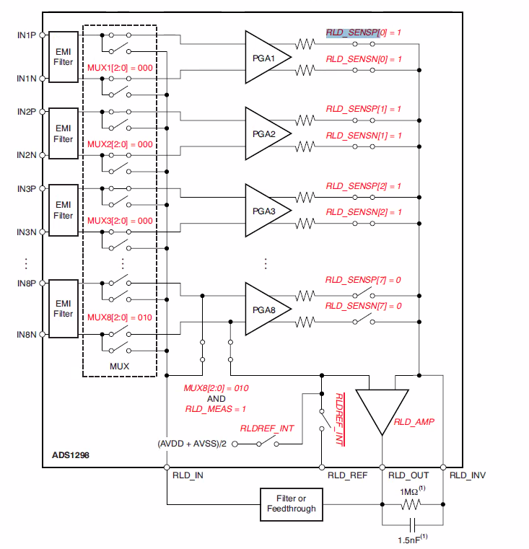
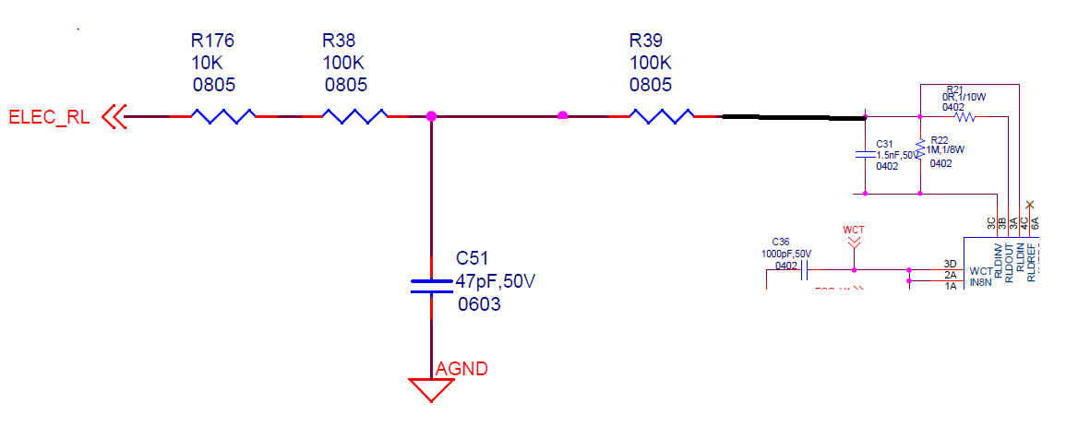
We have turned “On” Positive and Negative of this Three Channels to get the RLD Out & We are using the RLD Internal Reference.
RLD_OUT Point Which is connected to the ECG_RL Electrode with Resistor in Between
RLD_OUT and RLD_IN is Short (with O Ohm Resistor Ref # R21 in Above Snap)

