Slide 1
ADS1298R function test
“ADS1298RECGFE-PDK”
S/W version = 1.1.1
http://www.ti.com/tool/ADS1298RECGFE-PDK?keyMatch=ads1298r&tisearch=Search-EN-Everything
ftp://ftp.ti.com/pub/data_acquisition/ECG_FE/ADS1298/ads129xecg-fe-setup-1.1.1.exe

Slide 2
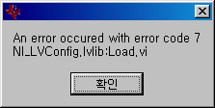

Slide 3
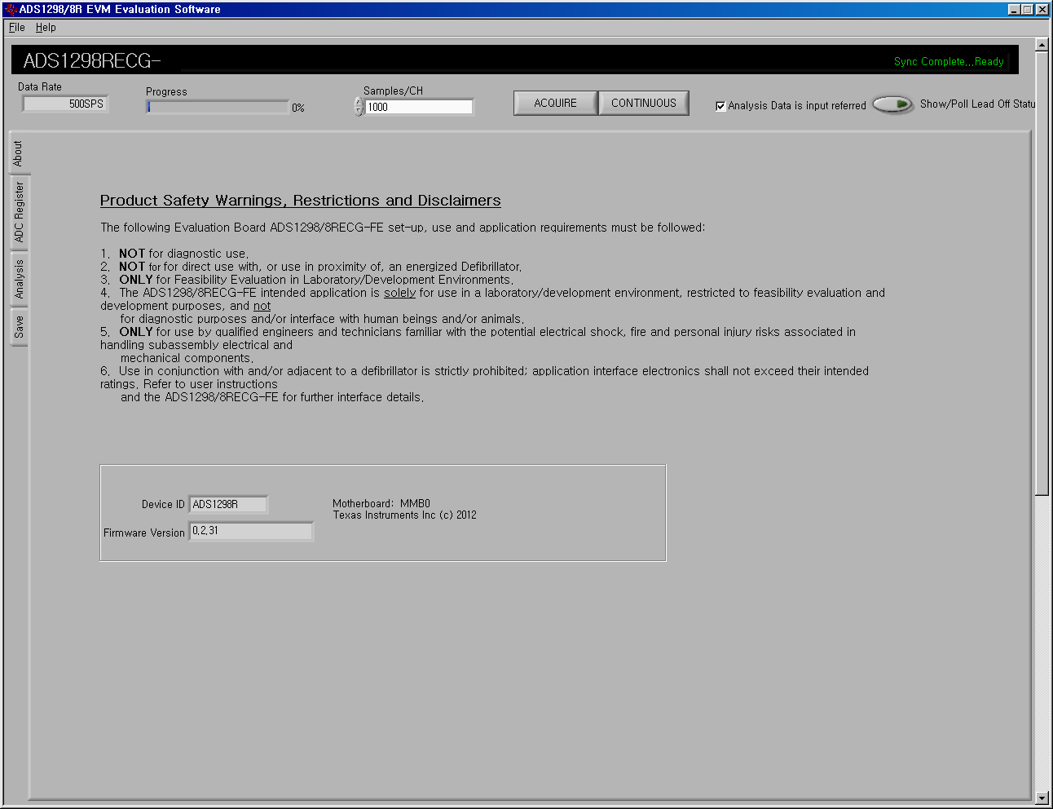

Slide 4
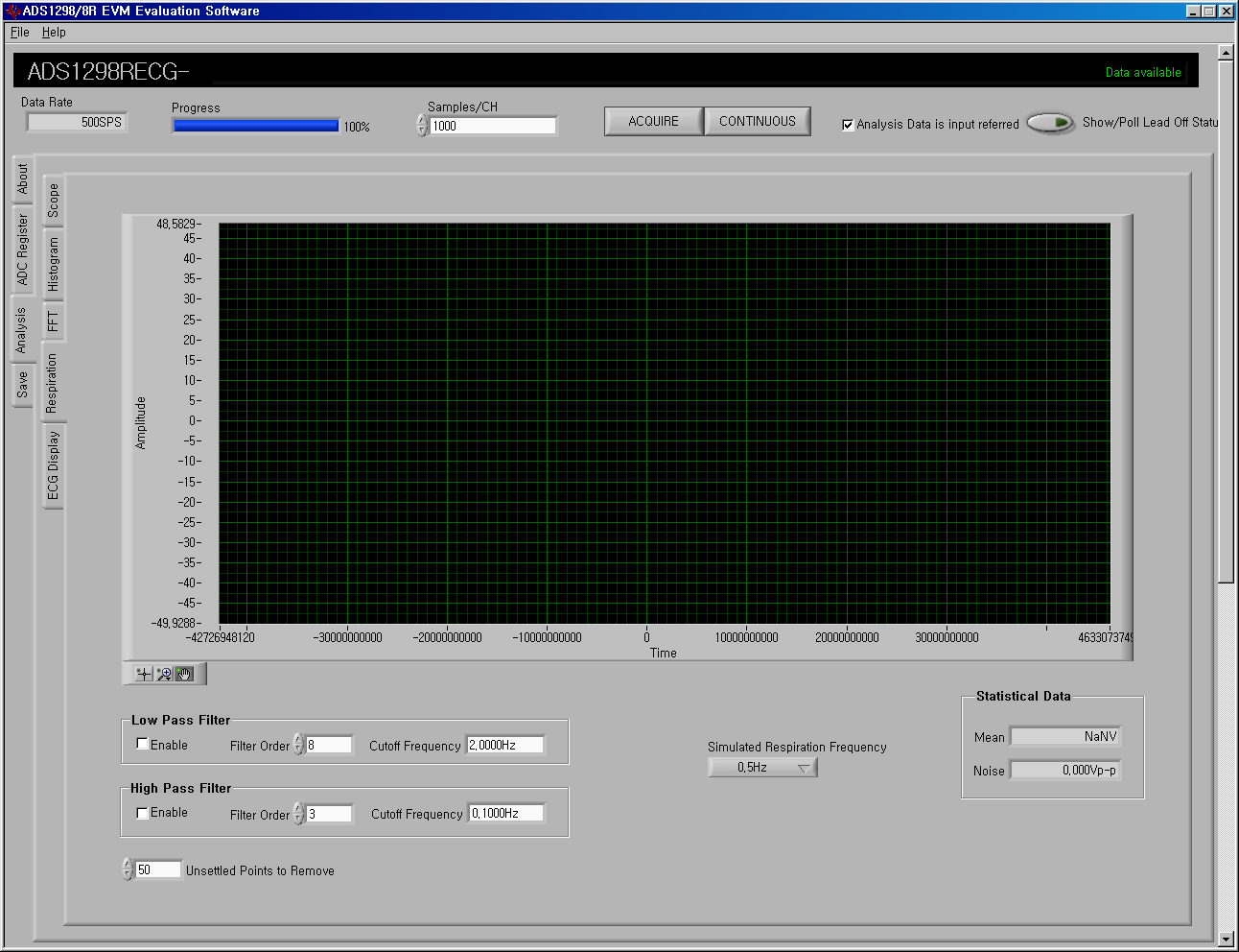

Slide 5
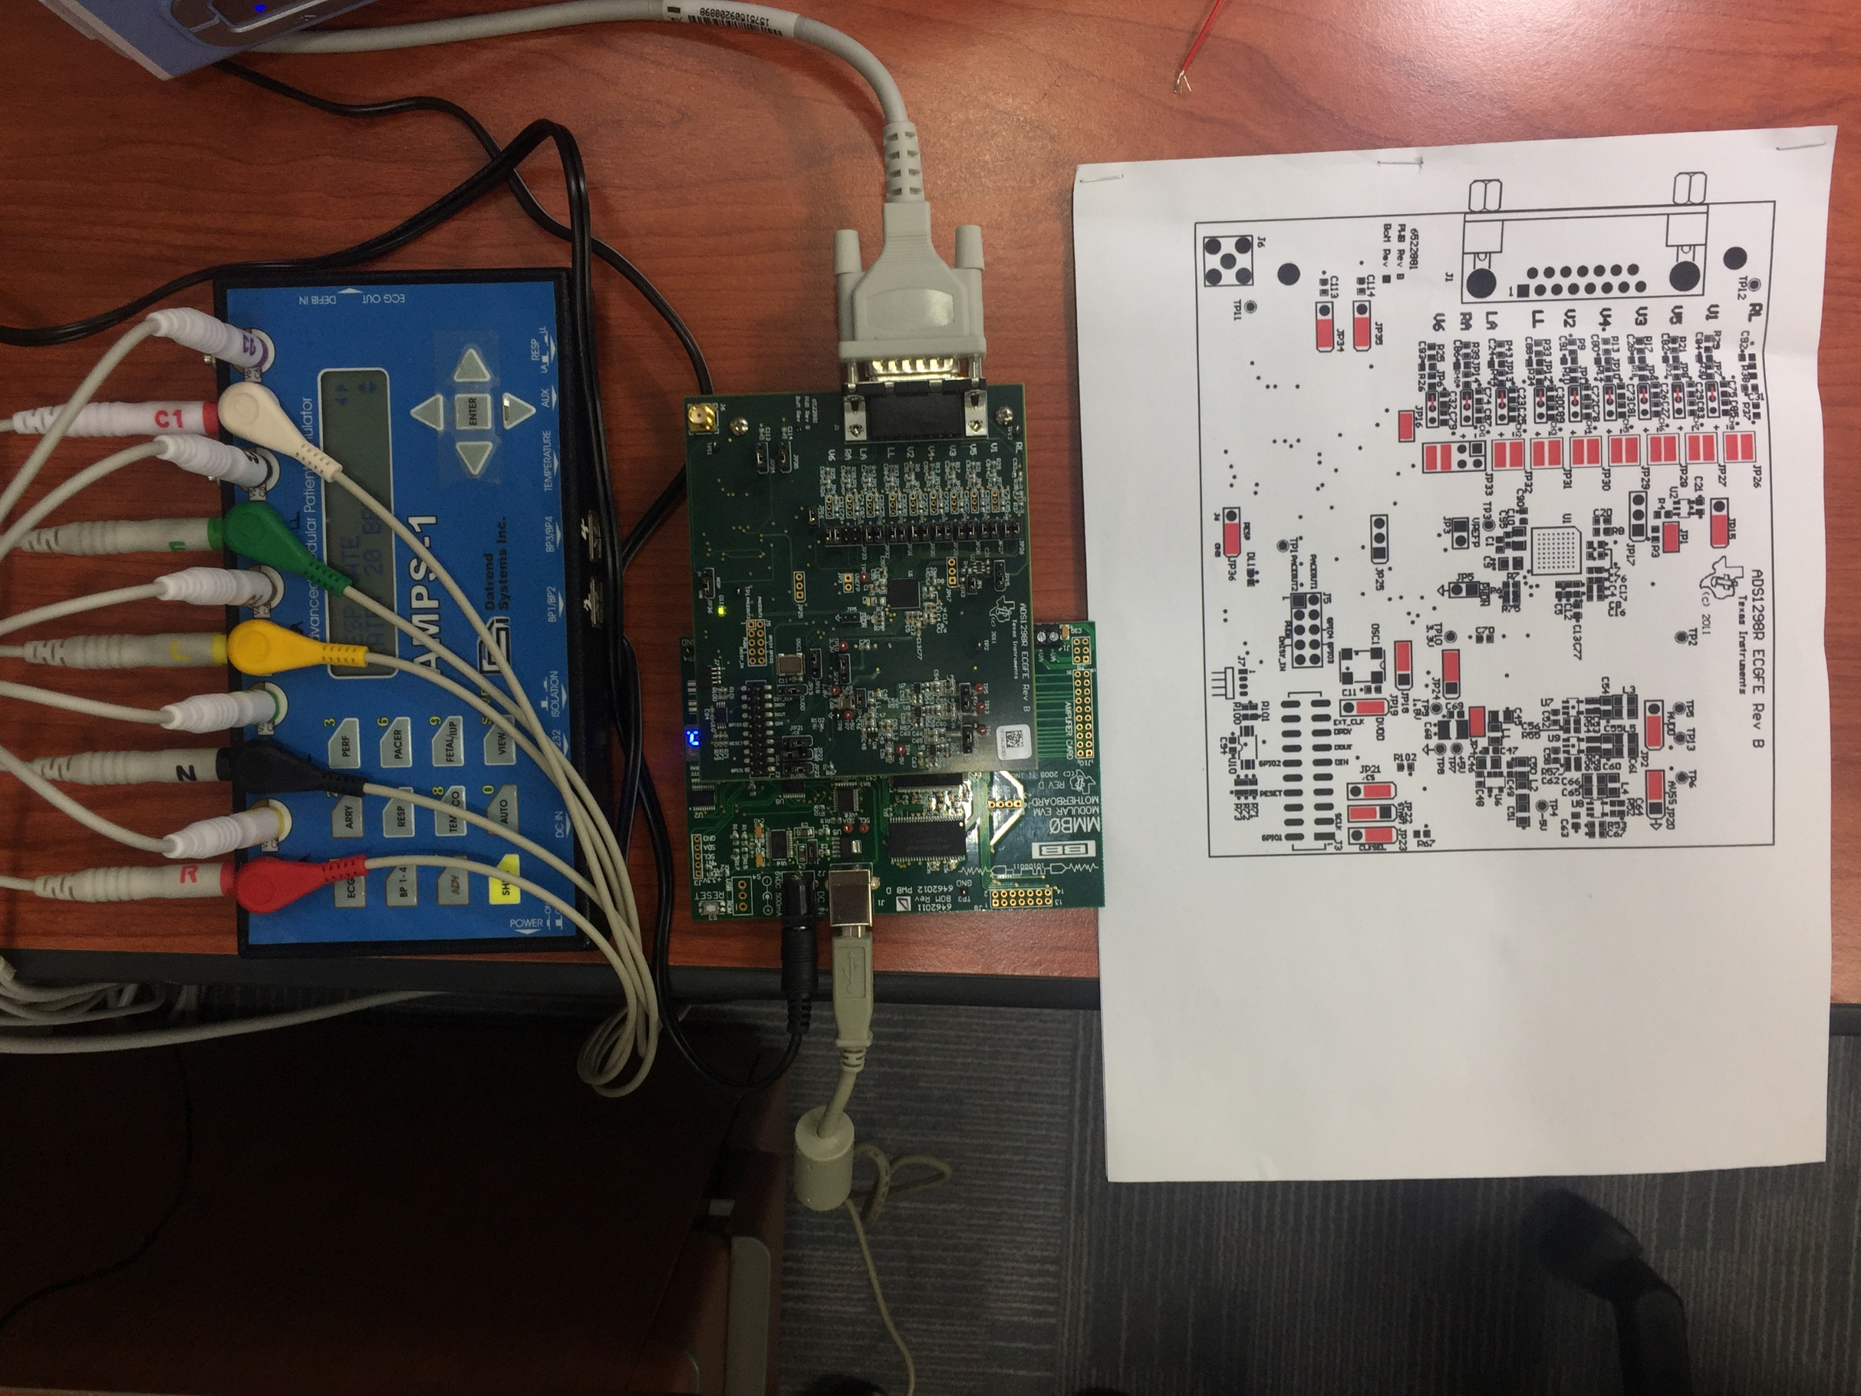

Slide 6
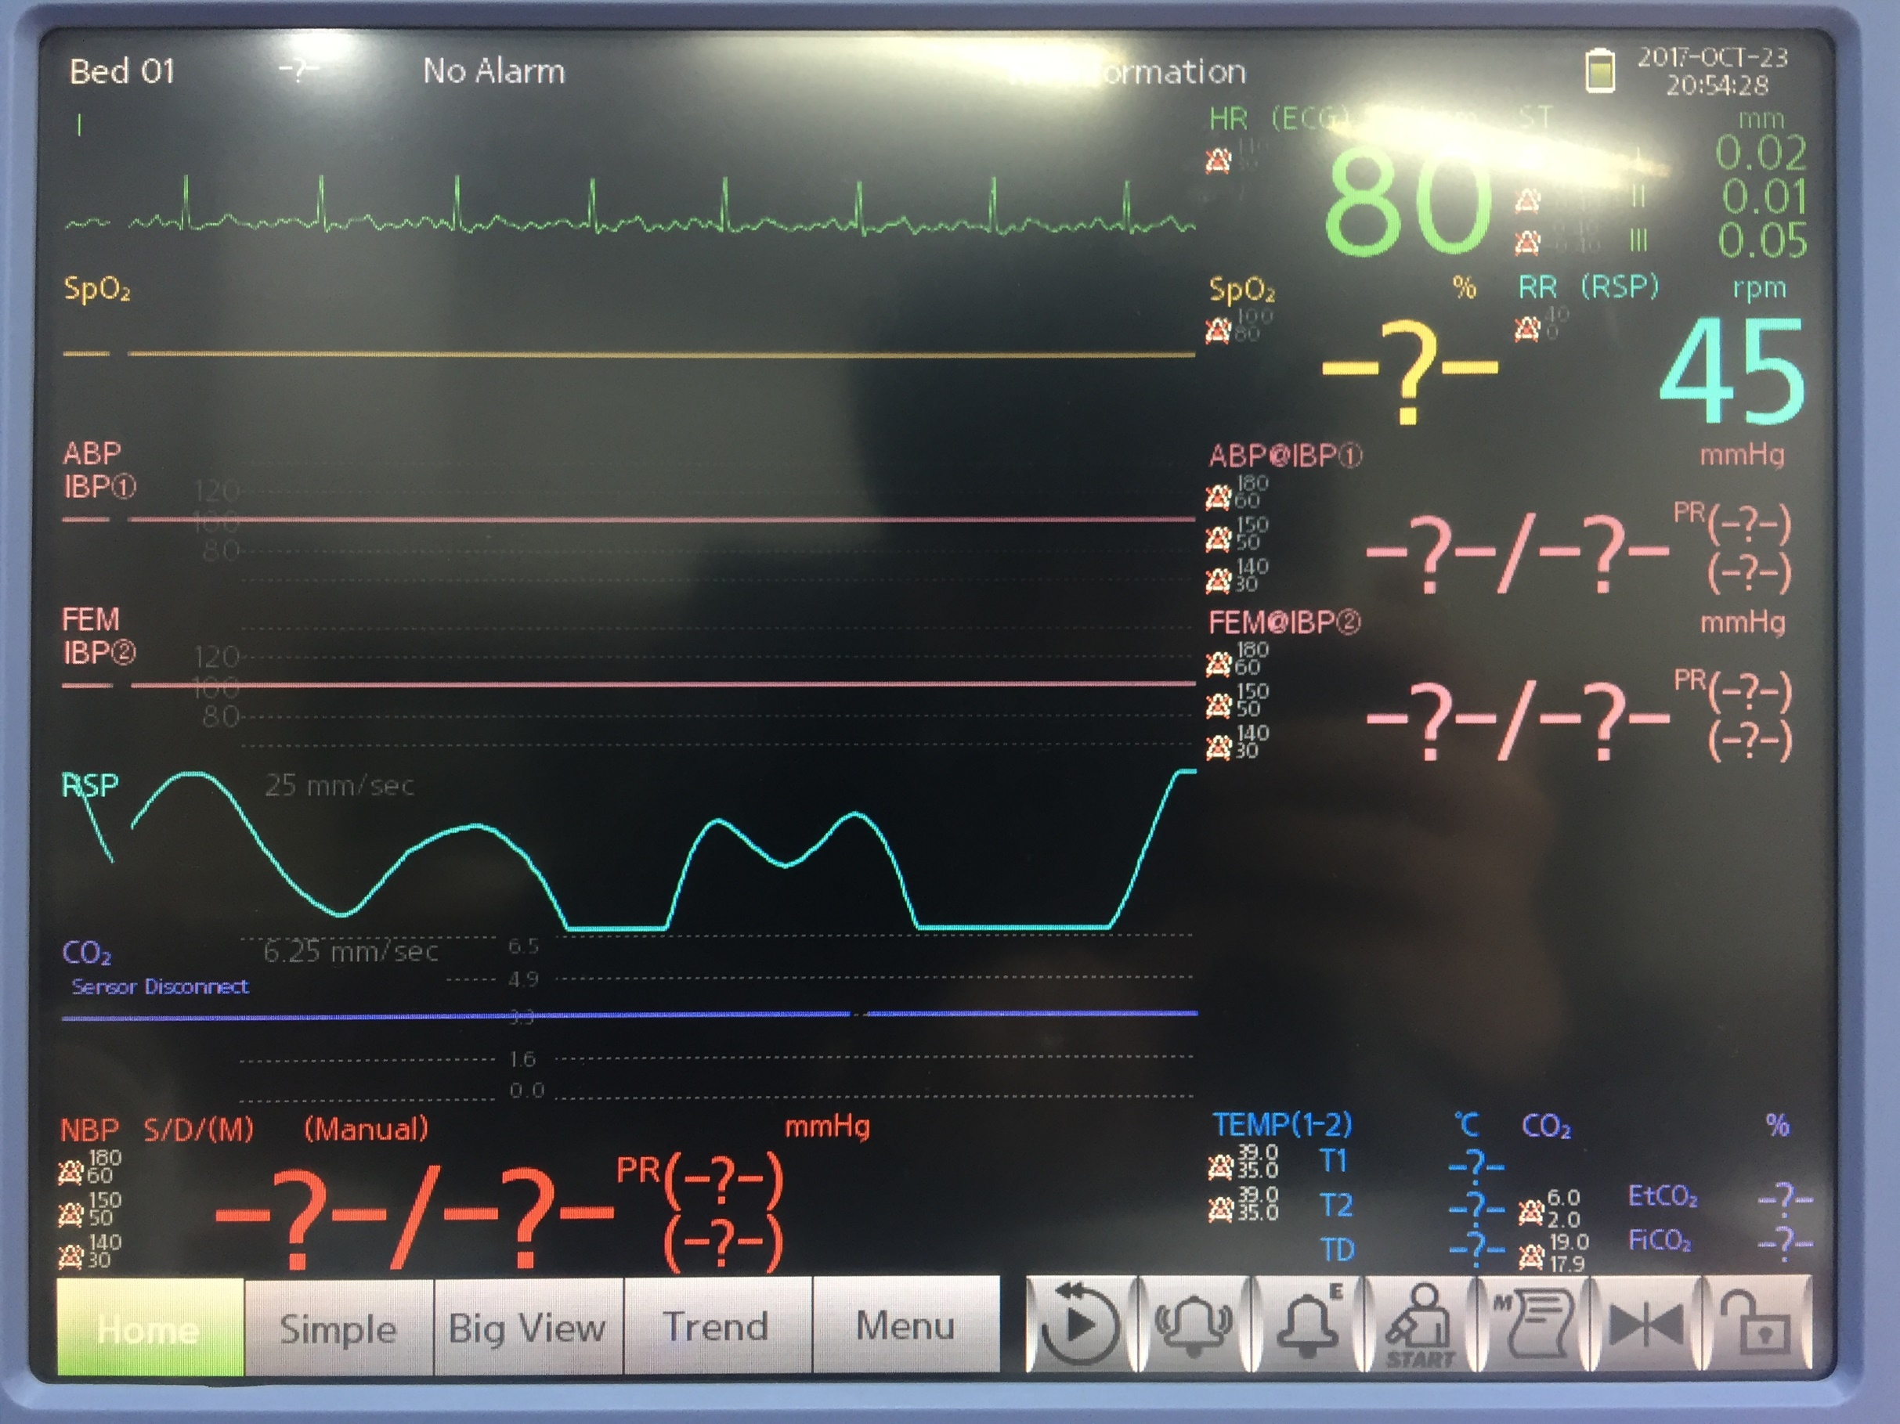

Slide 7
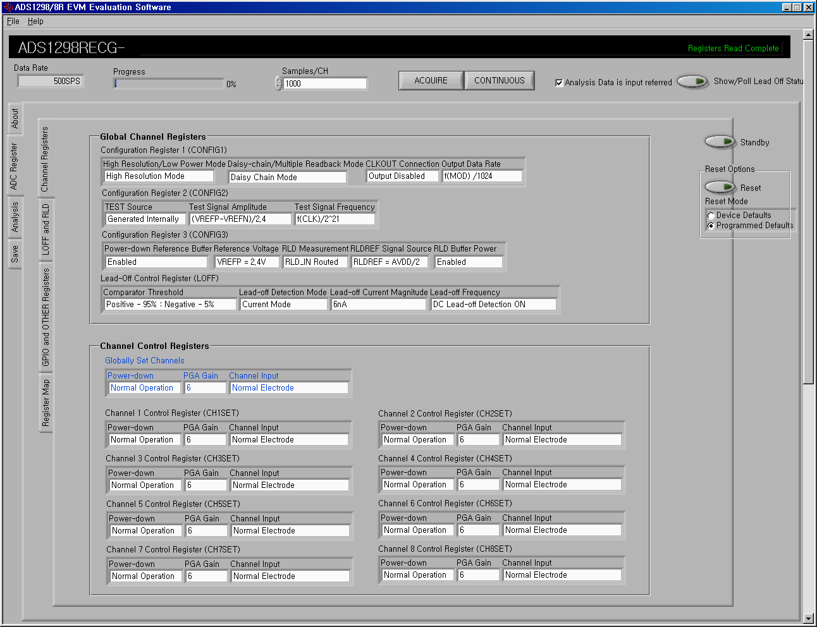

Slide 8
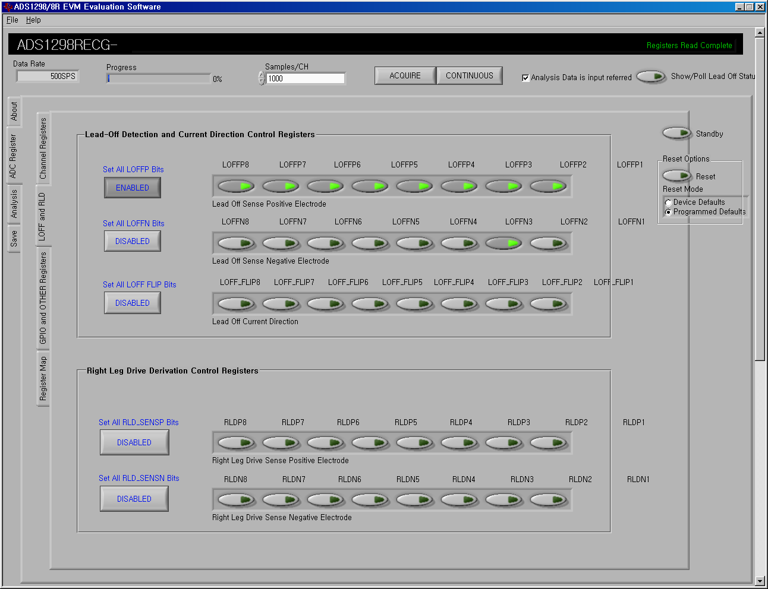

Slide 9
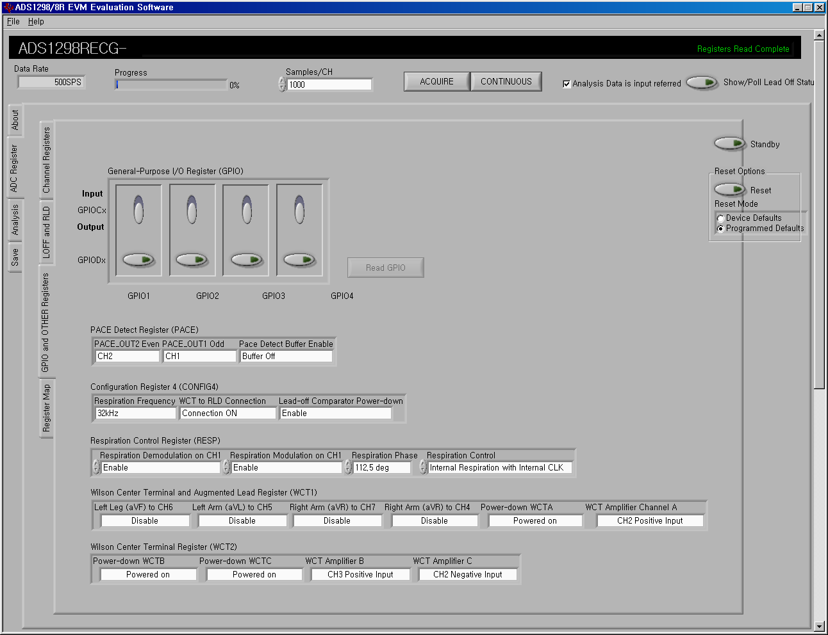

Slide 10
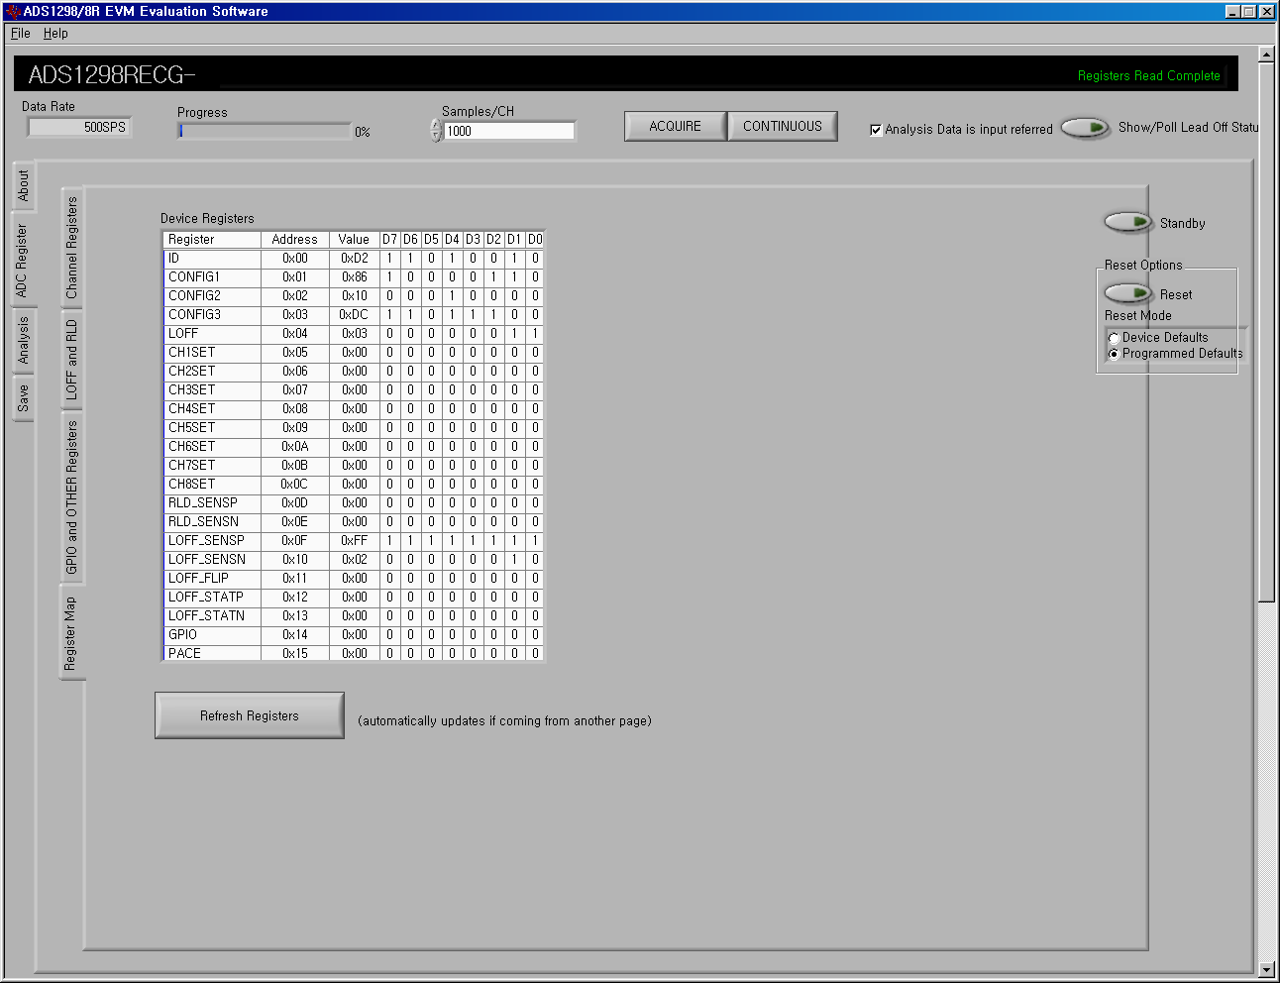
0x00~0x15(<0x18)
0x16?
0x17?
0x18?

Slide 11
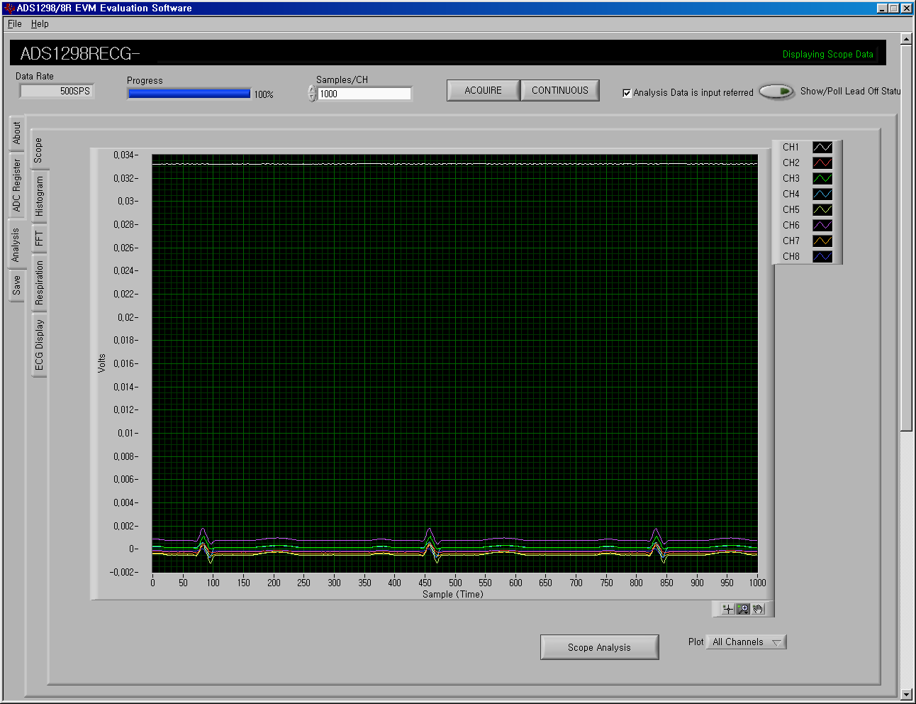
ECG scope view

Slide 12
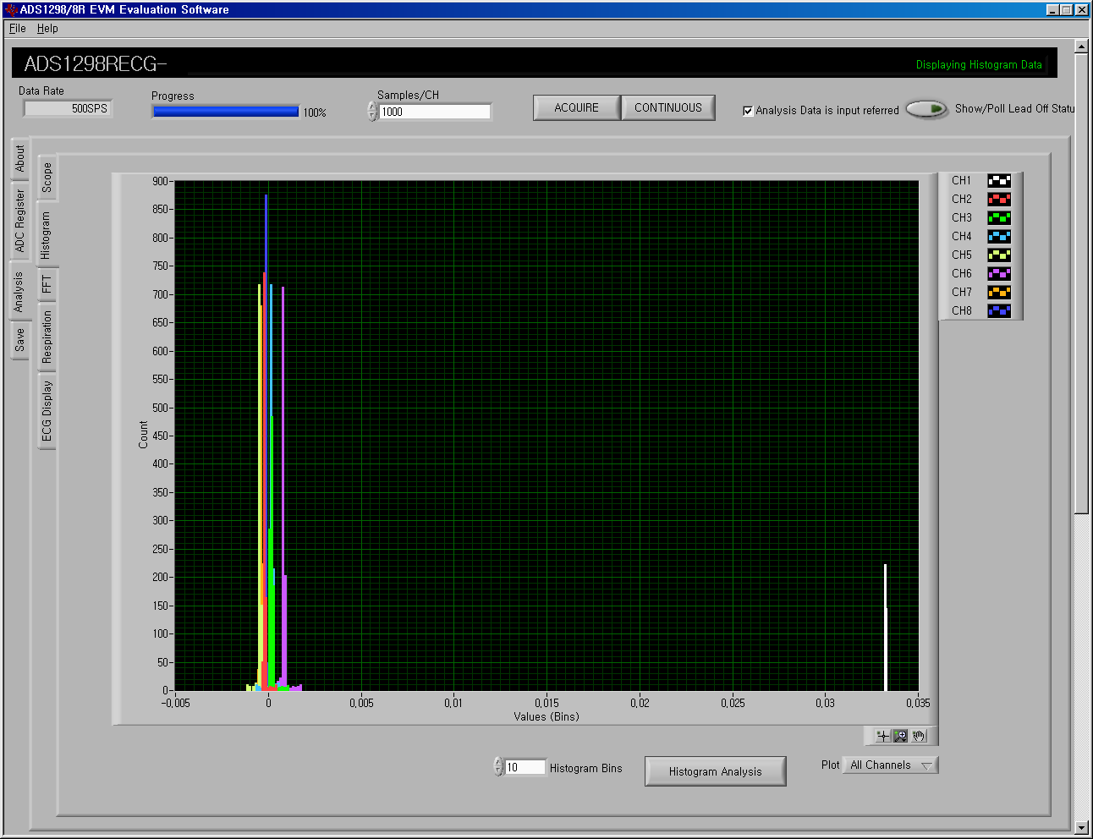
ECG Histogram view

Slide 13
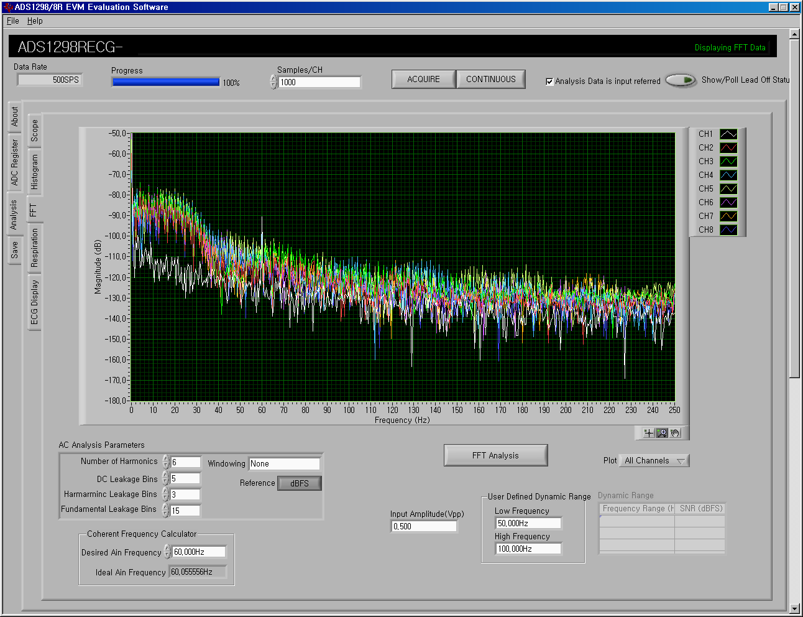
ECG FFT view

Slide 14
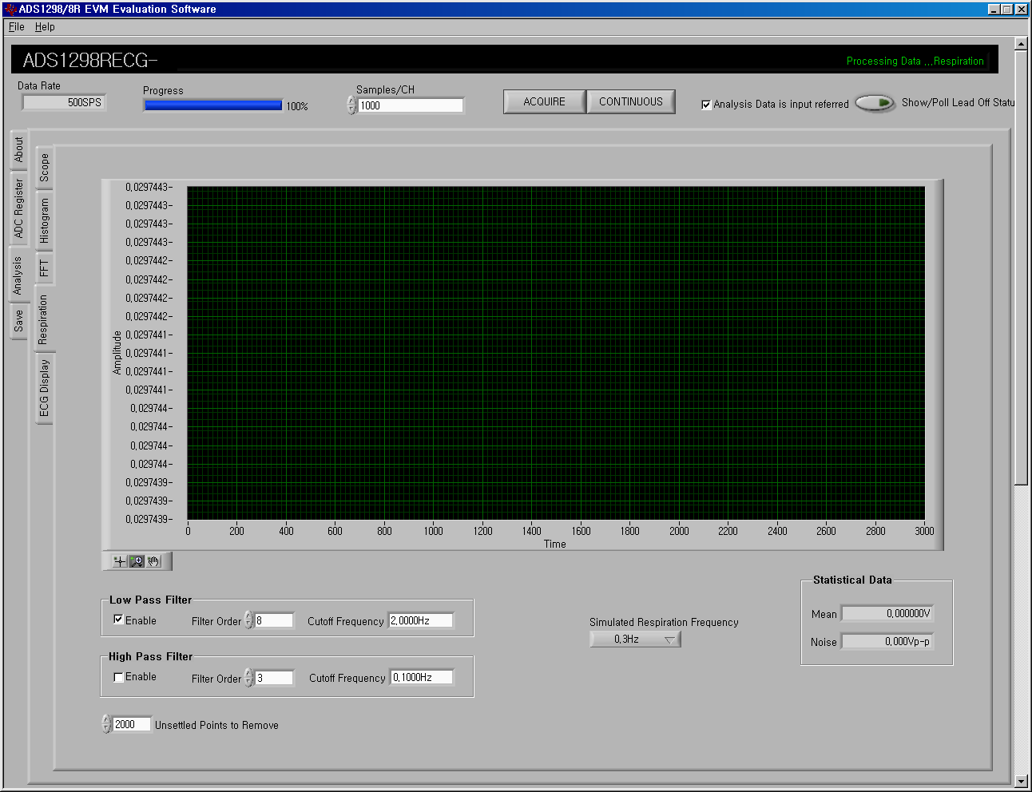
NO Respiration Signal

Slide 15
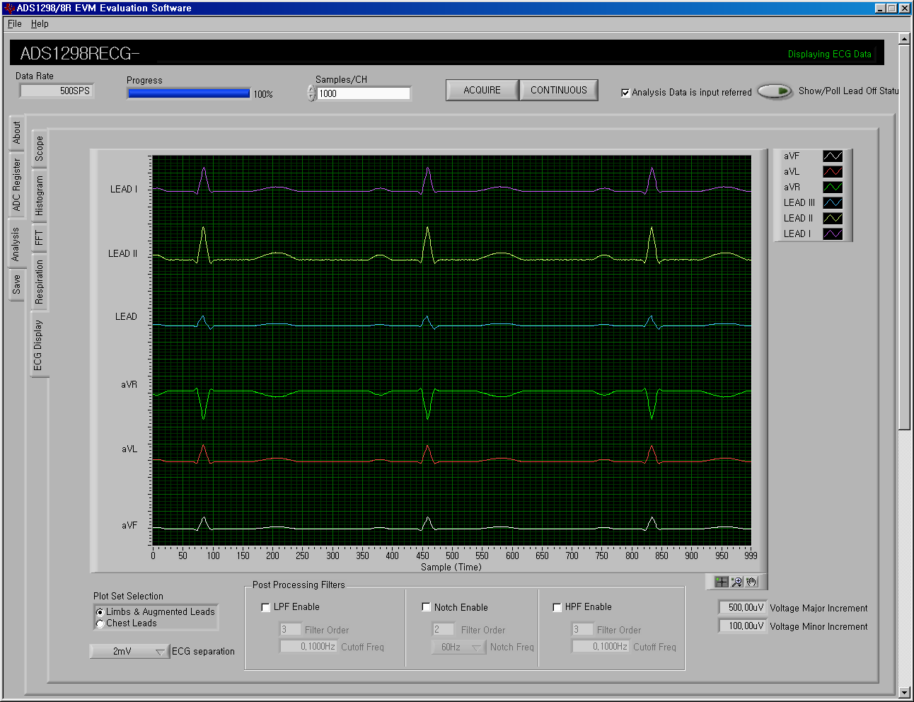
ECG signal view

Slide 16
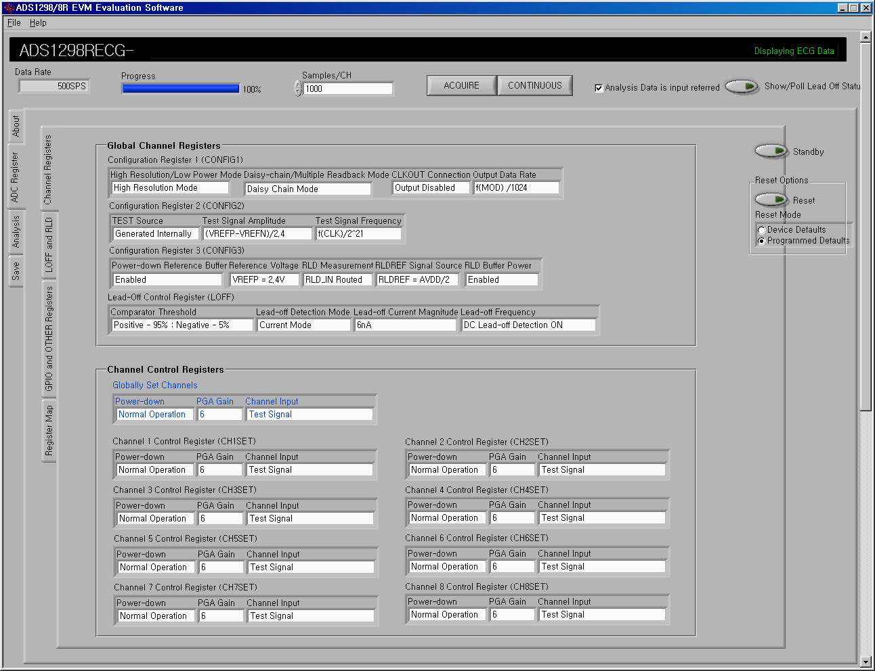
Test Signal

Slide 17
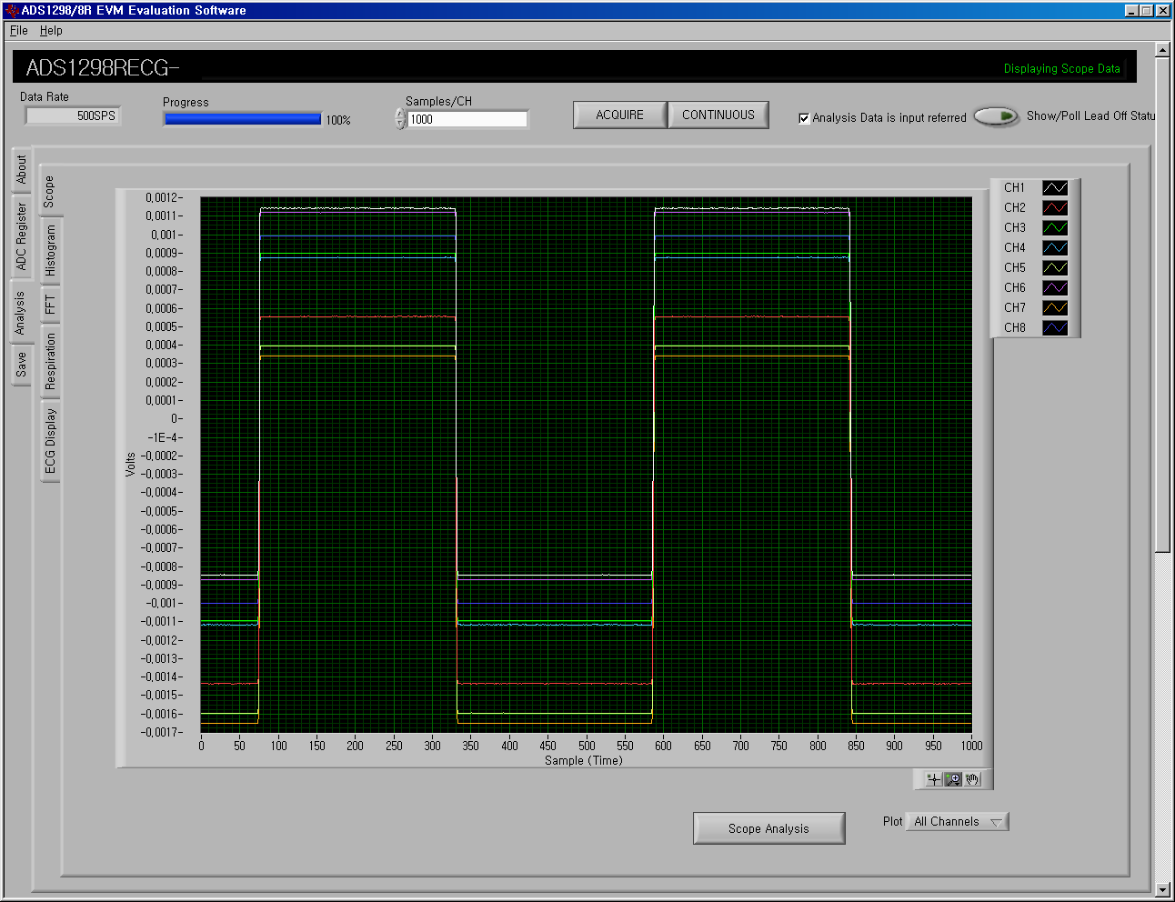
Test Signal

Slide 18
NO Respiration Signal

Slide 19
Test Signal

