Slide 1
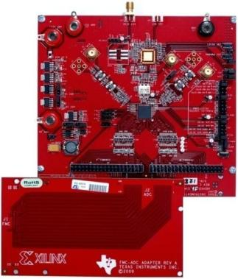
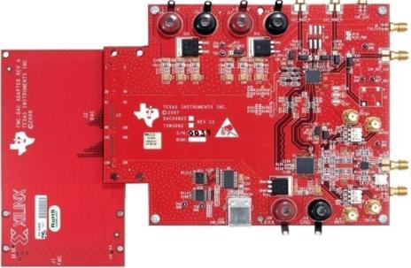
Connect TI High Speed Converters to Xilinx
FMC-ADC-Adapter
Connects over 70 high speed ADC EVMs to Xilinx development boards
FMC-DAC-Adapter
Connects over 10 high speed DAC EVMs to Xilinx development boards
FMC-DAC-Adapter
Online Literature
http://www.ti.com/lit/slab058
FMC-ADC-Adapter

