Slide 1
Power on the board aria & FMC DAC38rf82.
JP10 shunt connected.
JP1 (DAC_CLK) provided 6.4 GHz at +10 dBm power level.
Open the DAC38RF8XX EVM GUI.
Configure the following as per the slides 3 to 9.
Configure the LMK04828 as per the slides 11 to 14.
Open HSDC PRO connect the EVM to TSW14J56.
Configure the HSDC PRO as per the slides 16 to 17.
After the configuration as per above we are not able to generate any frequency using DAC.
A fixed 200 MHz output is present on the spectrum analyser.
How to tune to various outputs from the DAC EVM GUI.
We have measured the REF CLK at DCLKout0 going to FPGA. It is 200 MHz.
We are not able to measure the SYSREF on the oscilloscope we also find problem with the importing of the settings provided into tool discussed on slides.

Slide 2
DAC38RF82 Settings

Slide 3
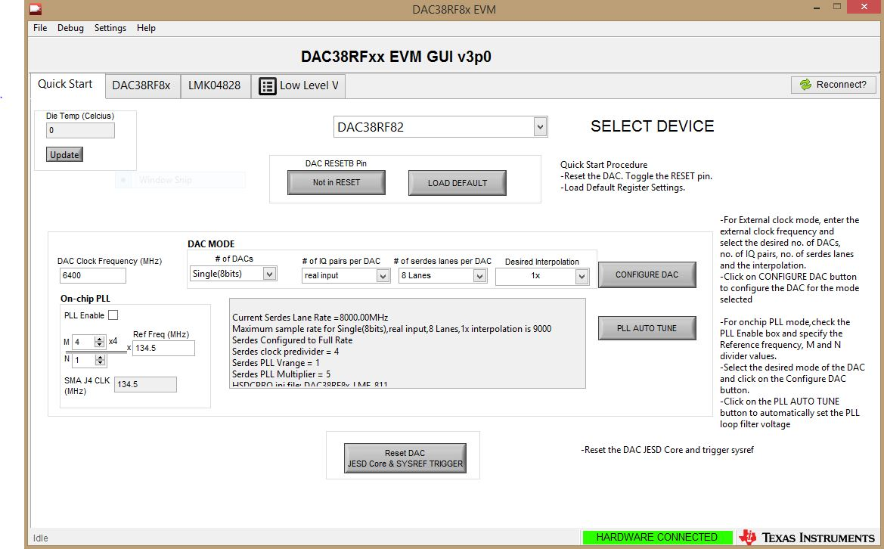

Slide 4
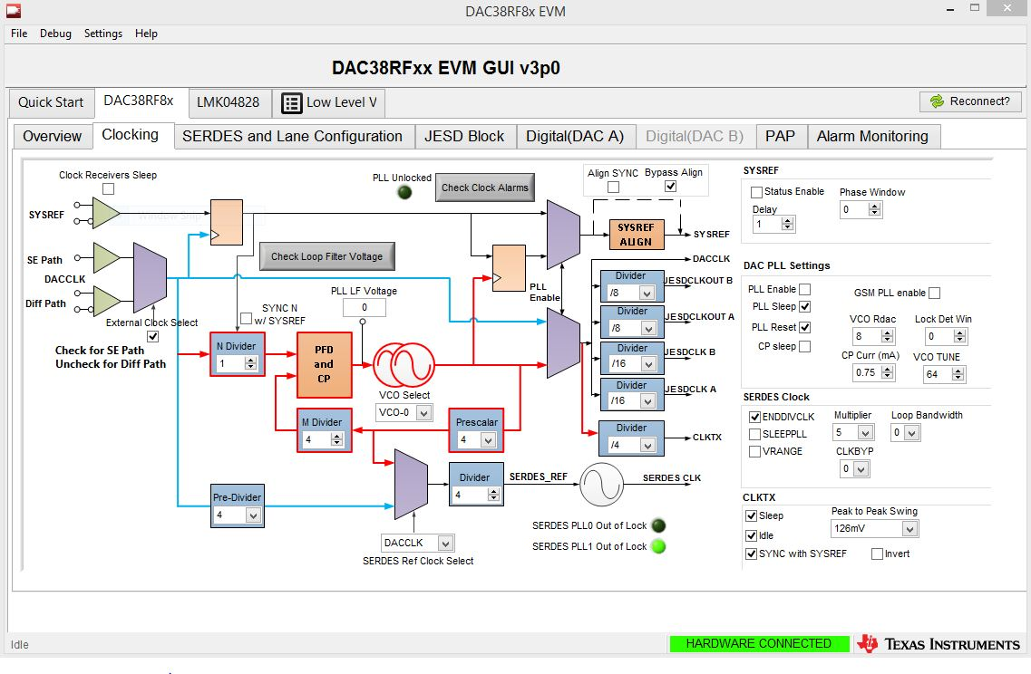

Slide 5
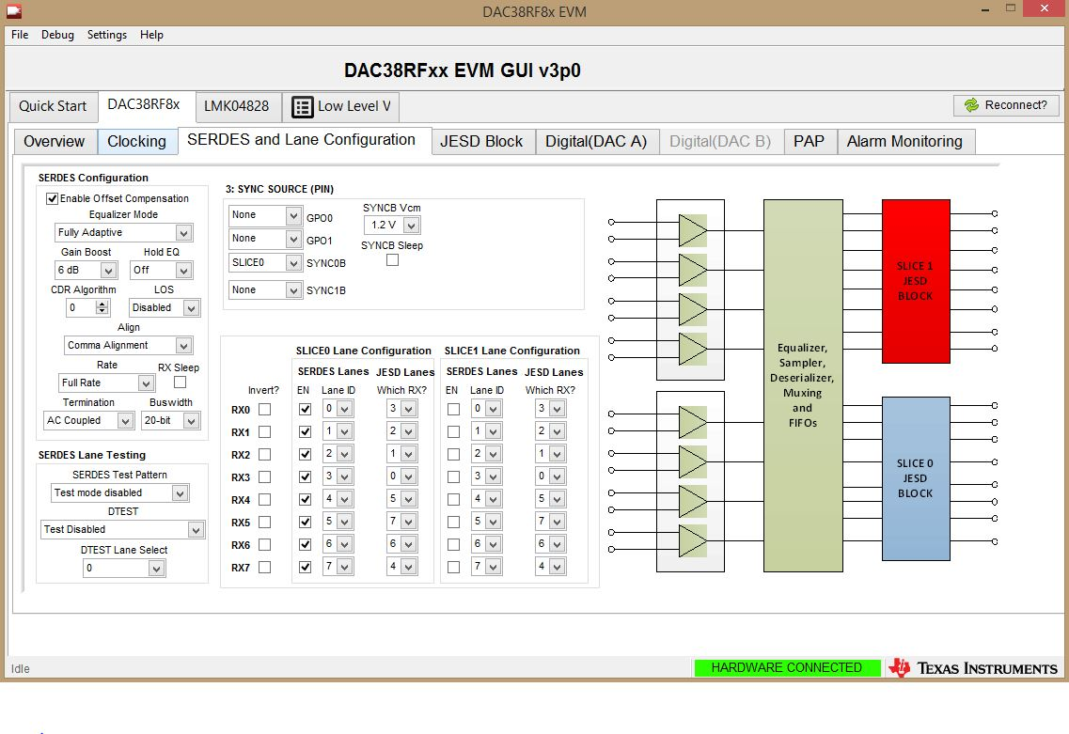

Slide 6
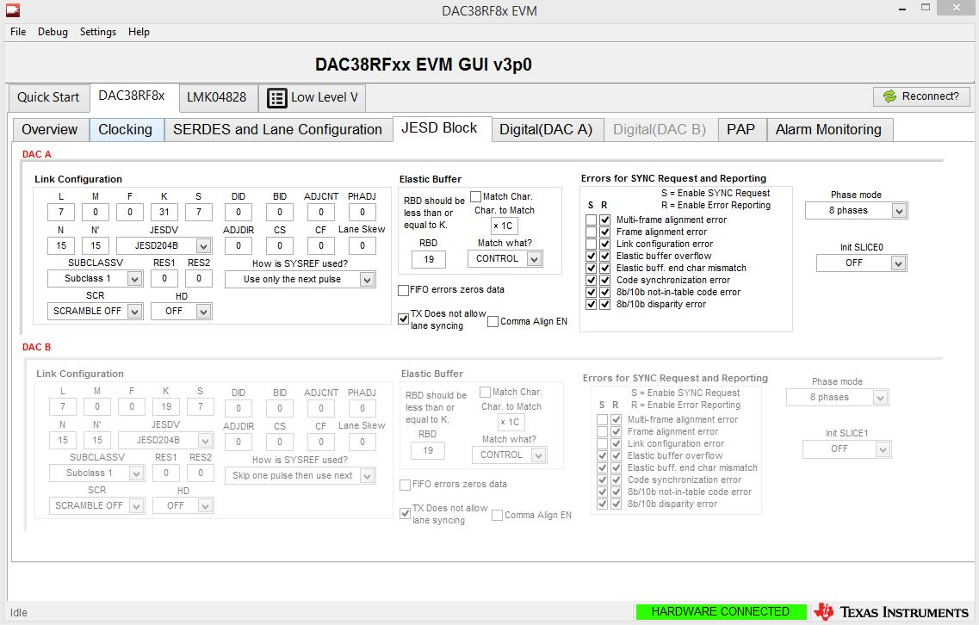
N and N’ needs to be 7 as we are using 8 bit, is it correct.

Slide 7
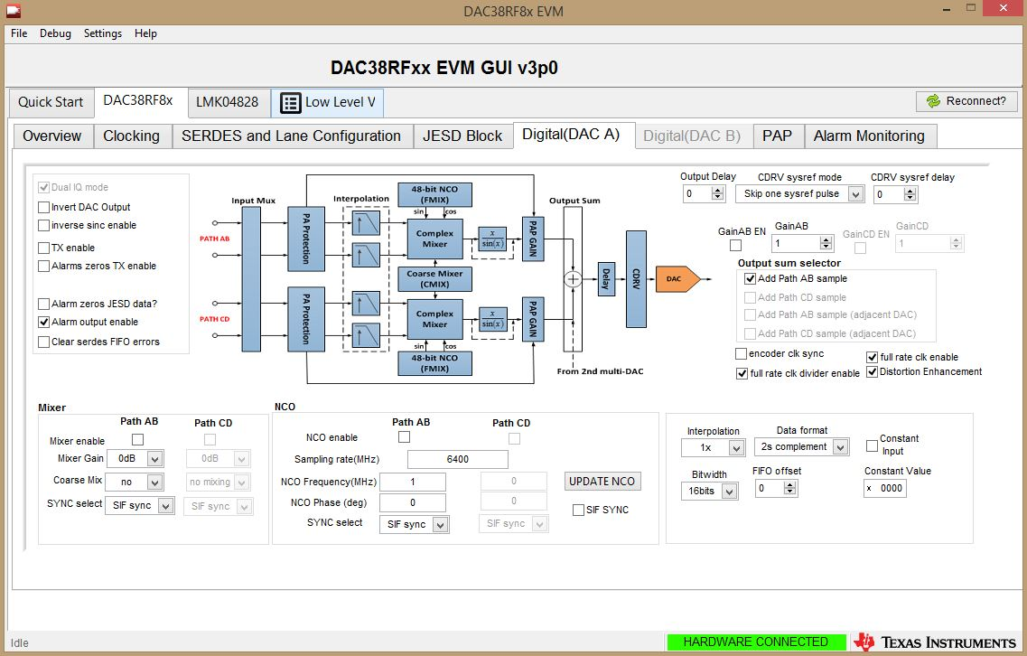
We are not sure what to set in this page, tried to change the NCO frequency to get frequencies from 0 to 3.2.
We are not seeing any change in the spectrum analyser.

Slide 8
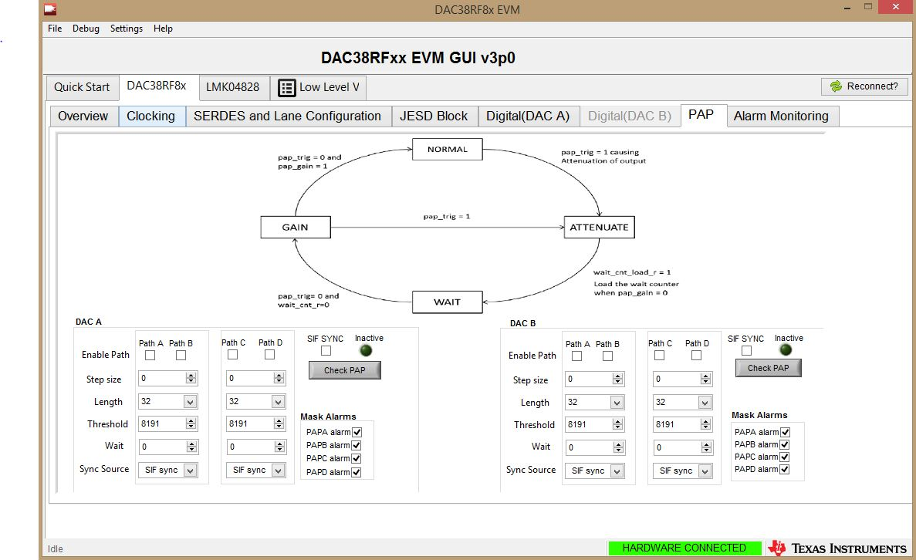

Slide 9
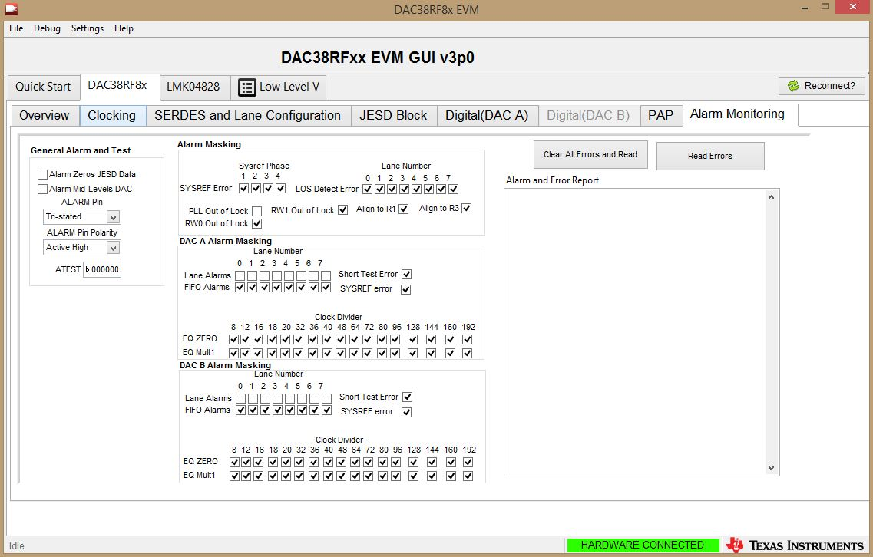

Slide 10
LMK04828 Settings

Slide 11
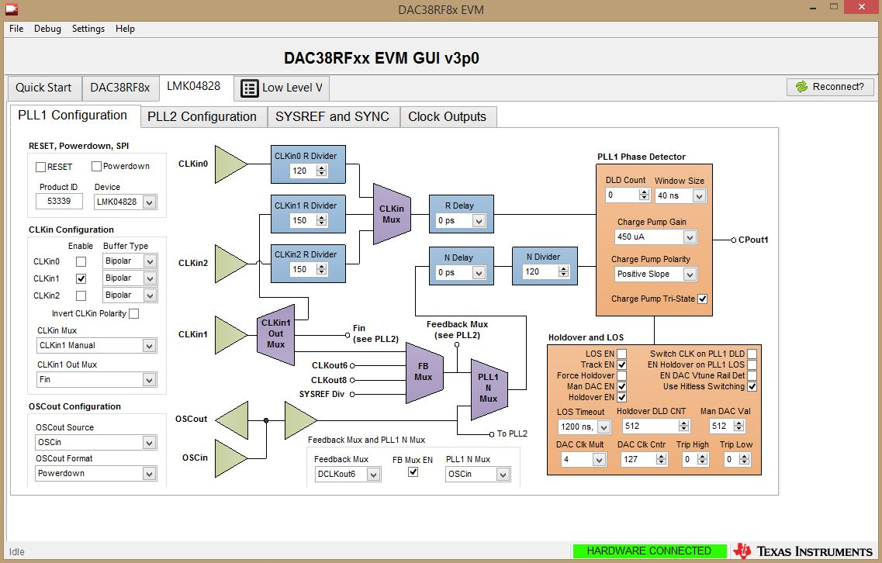

Slide 12
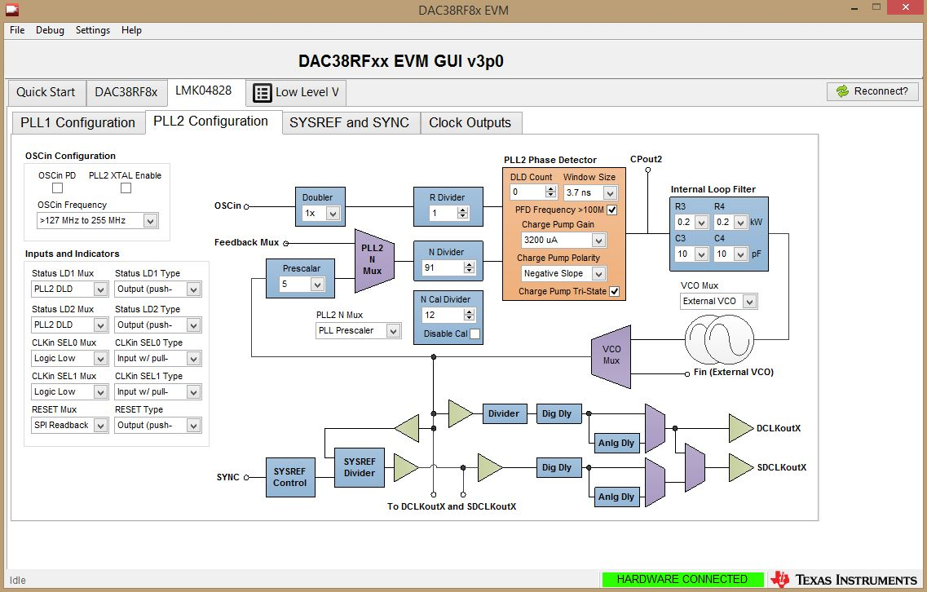
On board OSC is 122.88 but the OSCin Frequency selection is wrong.
The settings corresponding to R/N Divider if check in TICS showing wrong VCO value.

Slide 13
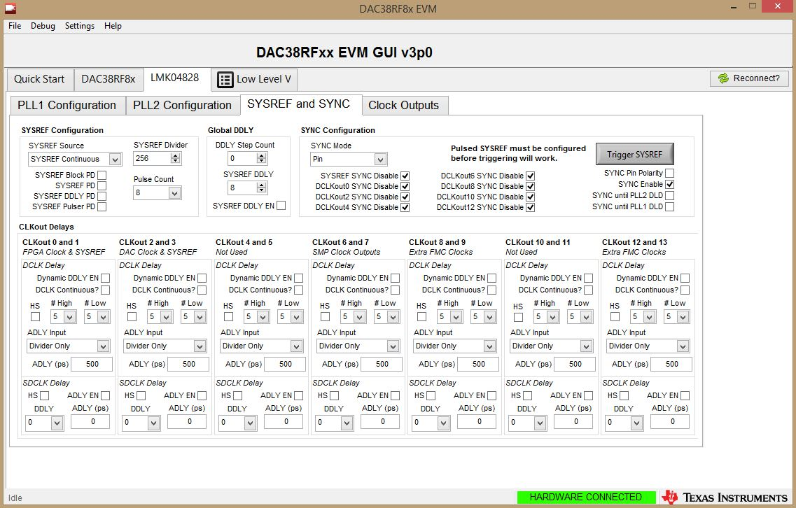

Slide 14
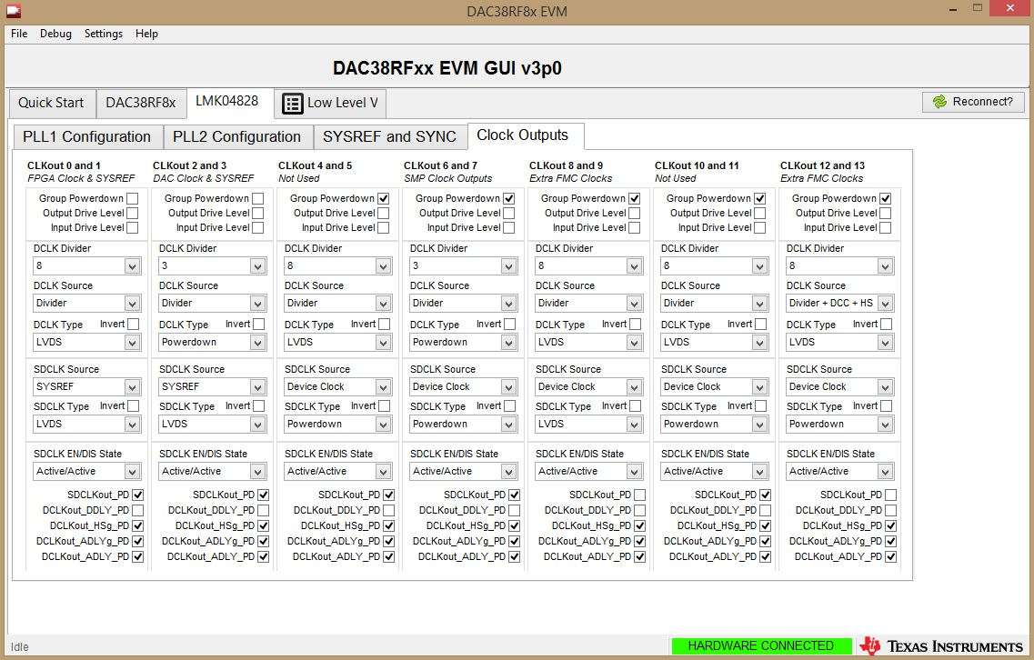
SDCLKout1_PD is enabled so the FPGA sysref is power down.
SDCLKout3_PD is enabled so the DAC sysref is power down. Please clarify.

Slide 15
HSDC PRO Settings

Slide 16
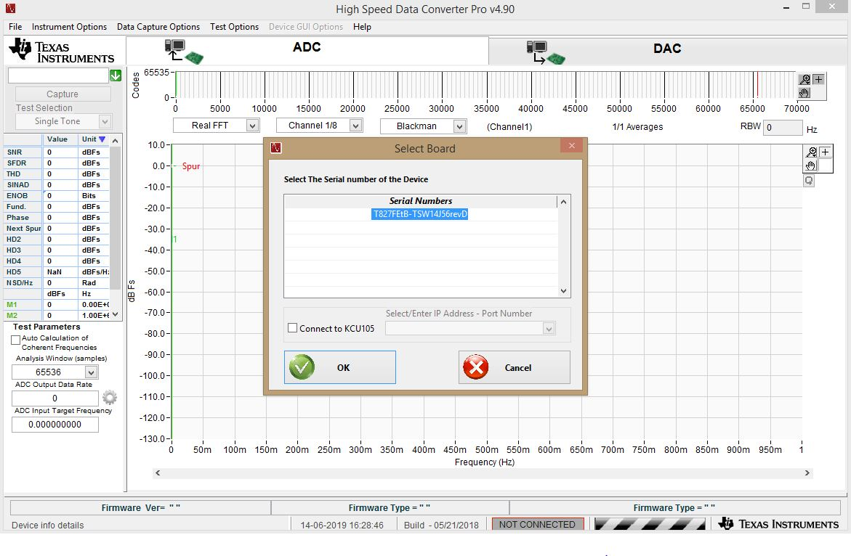

Slide 17
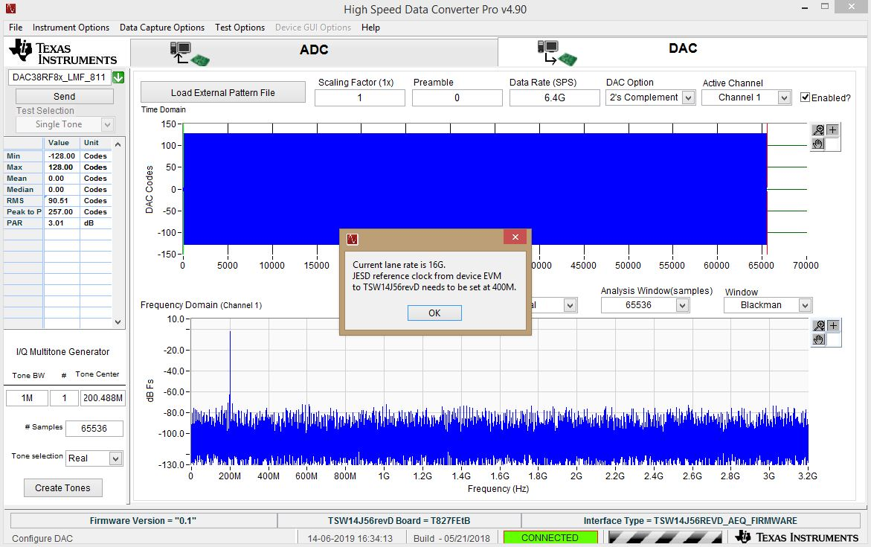

Slide 18
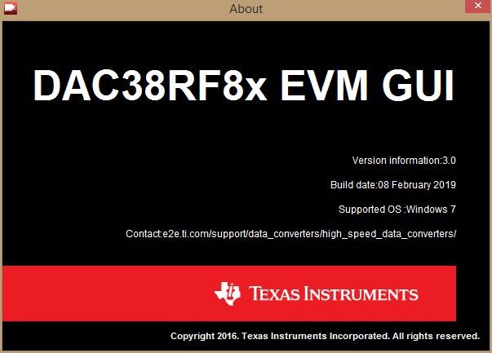
Please check for HSDC with DAC EVM compatibility.

Slide 19
