Slide 1
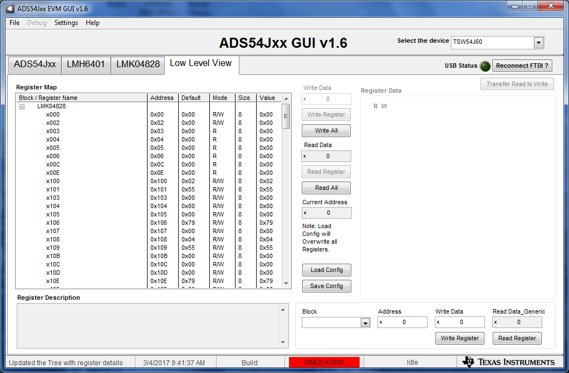
Click on Low Level View tab

Slide 2
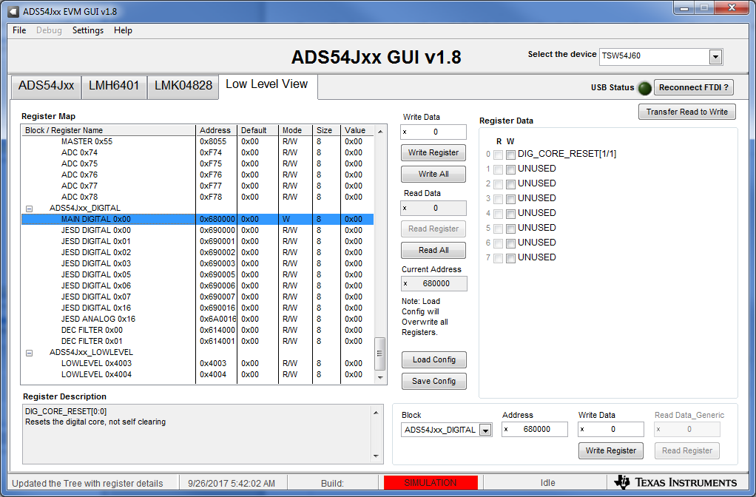
Scroll down to the ADS54Jxx_DIGITAL section and select “MAIN DIGITAL 0x00 row as shown below

Slide 3
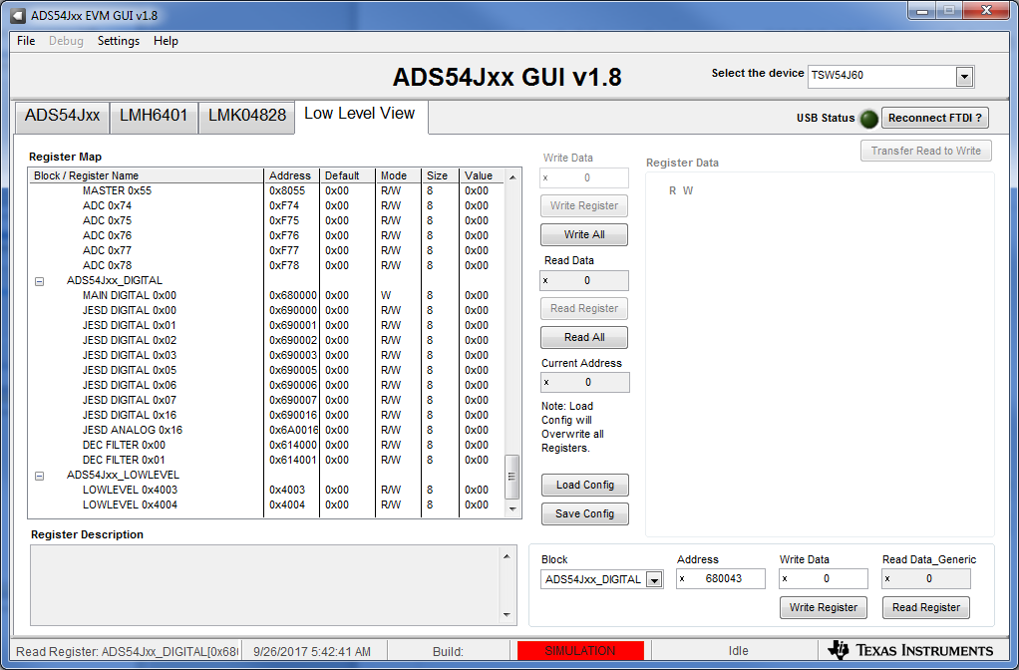
In the Address box, enter “680043”, then click on “Read Register”, as shown below

Slide 4
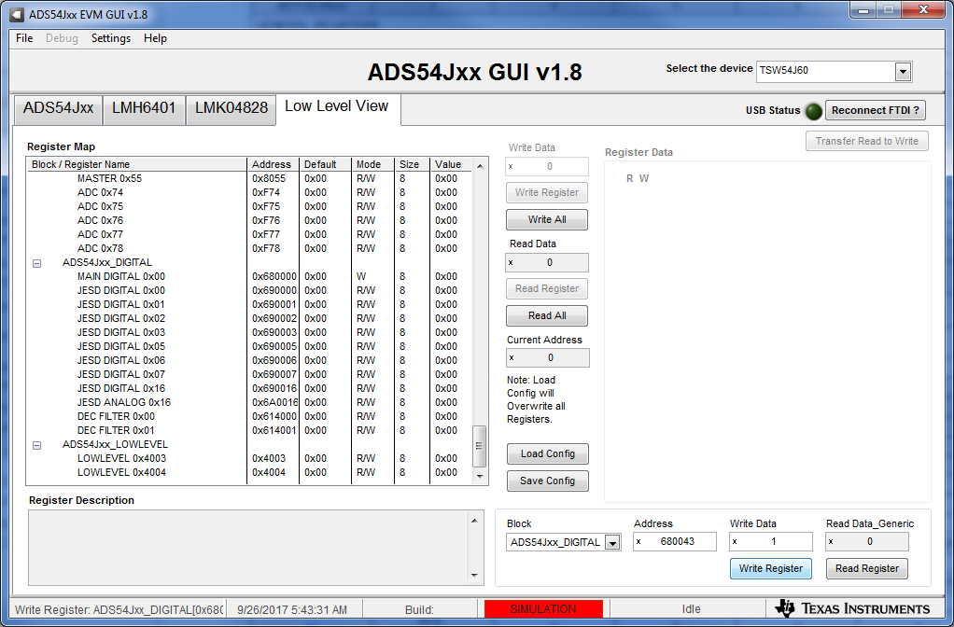
In the Write Data box, enter the desired value, then click on “Write Register”, as shown below. Follow the same steps for writing to address 68004B or any other address not listed in the GUI.

