Slide 1
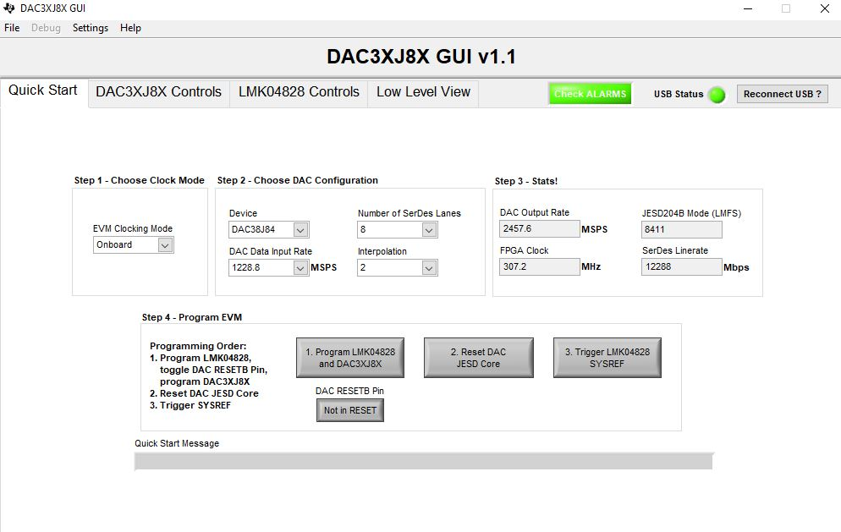

Slide 3
As CLKout0 and 1 is set up for DAC input data rate 2457.6/2= 1228.8
Core clock(FPGA clock) is set up by CLKout 12 and 13 i.e. 2457.6/8=307.2
*that’s all, i have set up these things to generate a pattern of 80 MHz ate the DAC output rate of 2457.6 MSPS.

