Slide 1
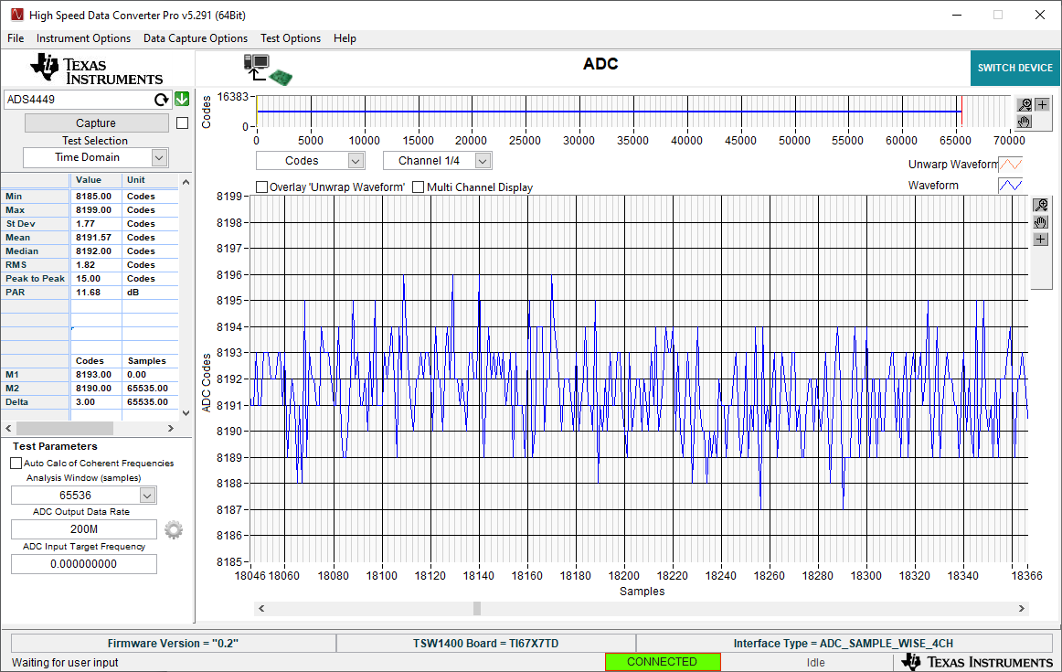
Input open digital functions enabled

Slide 2
Input open digital functions disabled

