Slide 1
Interfacing Data Converters with FPGAs
e2e.ti.com (TI Support Forum)

Slide 2
Agenda
I/O Formats
ADC Parallel data formats
  CMOS
  LVDS DDR
ADC Serial data formats
  1-wire
  2-wire
Development Tools available
Debug Tips

Slide 3
I/O Formats CMOS vs LVDS
CMOS
LVDS
Timing: may be from center or from Voh/Vol
Have to watch the datasheet carefully
Potential Problem: different supply voltage families
Ex: Voh from 1.8V logic into Vih of 2.5V logic
Timing is usually crossing to crossing
Logic is supply voltage independent

Slide 4
I/O Formats SDR vs DDR
SDR (Single Data Rate)
DDR (Dual Data Rate)
Single clock edge used to latch data
But clock toggles at 2x rate of data
Clock rate reduced
(or data rate increased)
Both edges of clock needed
(needs two input flops)

Slide 5
I/O Formats Clock Edge Alignment
CLK Centered Aligned
CLK Edge Aligned
Normal case, easy at receive end
Common in ASIC world, needs delay at receive end

Slide 6
I/O Formats Parallel
Parallel
Even Odd DDR Format
ADS4249
D0_D1 - bit 0 rising edge
- bit 1 falling edge

Slide 7
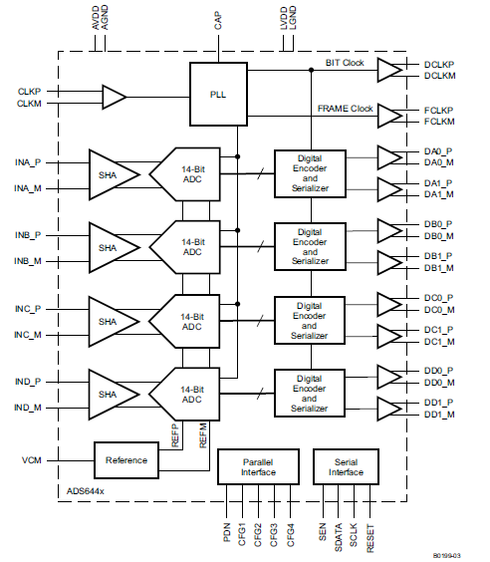
I/O Formats Serial (Hybrid Serial-Parallel)
Serial (hybrid serial-parallel)
Two outputs per device
2-wire mode (ADS6442)
Dx0 contain 8 LSB’s
Dx1 contains 8 MSB’s

Slide 8
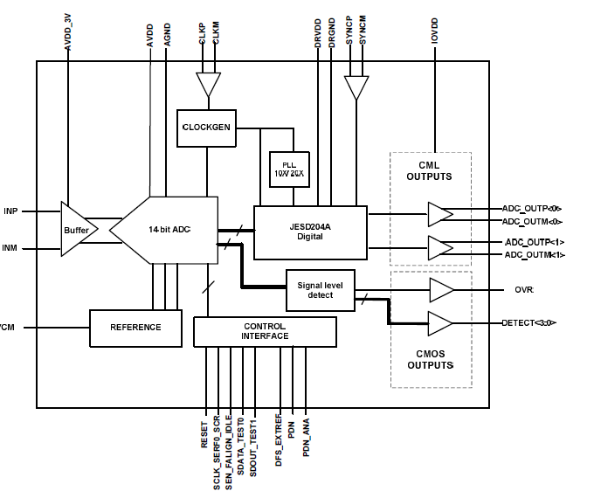
I/O Formats True Serial
Serial (8b/10b coded JESD204)
ADS61JB23

Slide 9
Parallel

Slide 10
ADC to FPGA - Parallel
Simplest format available
  Lowest data rate on the data lines
  Skew between clock/data is limiter if the bus needs to go any distance
    (such as board to board or board to daughter board)
Most common clocking for LVDS is DDR (Dual Data Rate)
  Ensures that toggle rate of clock signal is not 2x that of data
  Rising Edge clocks one data bit, Falling Edge the next data bit
  Most FPGA families have built-in DDR I/O cells
Sample-wise DDR
  One sample on rising edge of clock, next sample falling edge
  Number of LVDS drivers = number of bits of sample resolution
Bit wise DDR
  Half the data bits on rising edge, other half on falling edge
  Reduces number of LVDS pairs by half compared to Sample-wise DDR

Slide 11
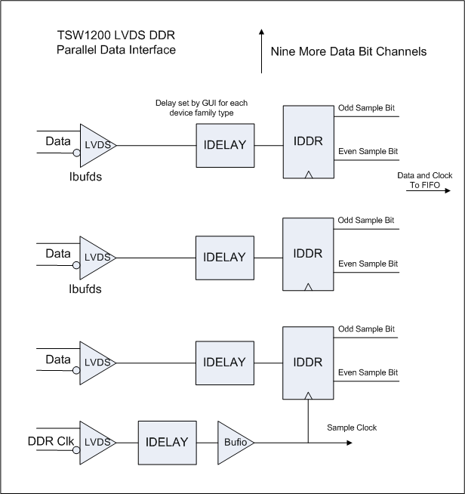
Xilinx Parallel DDR Format Example
Uses Input DDR cell from FPGA Vendor
Also uses delay element from FPGA vendor to adjust for different ADC setup/hold timings

Slide 12
Input DDR cell
One flipflop catches data on rising edge
Another flipflop catches data on falling edge
Falling edge data re-registered to rising edge
Presents two bits at a time out

Slide 13
FPGA interfaces
Xilinx offers delay elements, Altera/Xilinx offer PLL/DLL
  Different ways of positioning clock edges
Lower cost FPGA families may lack the flexibility
Most FPGAs have PLL-based clock managers
  Can use a feedback clock to adjust the phase of the output clock, effectively making a zero-delay clock buffer

Slide 14
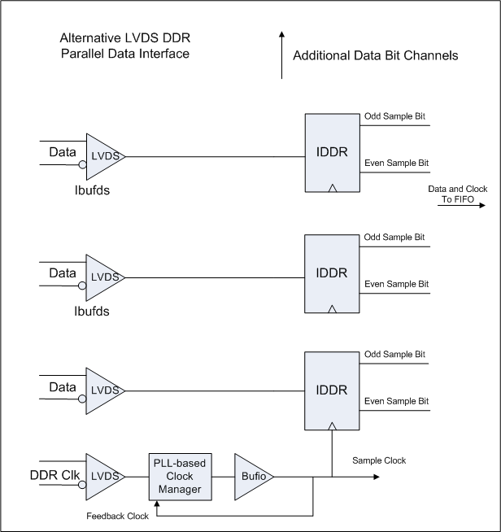
Altera FPGA clock timing
Clock Manager may have limited speed range min to max
Clock Manager may introduce clock jitter to reduce timing margins
Clock Manager may take some initialization, time to lock

Slide 15
Hybrid Serial-Parallel

Slide 16
ADC Serial Data Format 1-wire
No clock recovery at the receiving end
  Clock is provided with data
    This is why it is a hybrid serial-parallel format
      parallel lines of serial data, must watch skew between signals
  Framing information is provided with data
    Frame clock – identifies where first and last bit of sample data is
      Best to think of Frame Clock as another data pair that has known data
      Latch Frame Clock into FPGA using bit clock just like any other data
      Frame Clock will have same setup/hold timing as any other data
  Bit Clock and Frame Clock may service any number of channels of data
    Duals, Quads, Octals will all have one Bit Clock, one Frame Clock

Slide 17
ADC Serial Data Format 1-wire
14-bit serial format shown
  Frame Clock looks like pattern of 7 ‘1’s and 7 ‘0’s

Slide 18
Serial Data Format 2-wire
Similar to 1-wire format
  Serialization rate is cut in half
  Two LVDS pairs are now needed to carry the data
    Trade off of data rate vs pin count

Slide 19
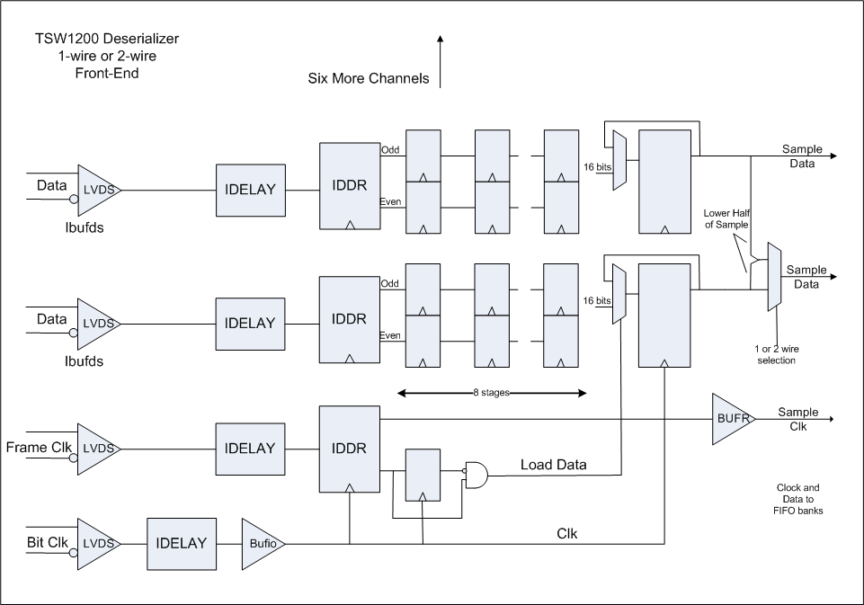
Xilinx Serial Format Example

Slide 20
Xilinx Serial Format Example
Note that front end of serial format looks just like logic for parallel format
  IDELAY adjusts for timing into IDDR
  Because serial format still uses a DDR clock
Frame clock is latched just like any other data line
  Look for low to high frame clock to know byte boundaries
Data is deserialized in a chain of flip-flops shift-register style
Same architecture for 1-wire or 2-wire

Slide 21
New Analysis and Development Tools

Slide 22
TSW1400 – ADC capture + DAC Pattern Generator
TSW1405 – Low cost ADC capture card, 16 bit, 64K samples
TSW1406 – Low cost pattern generator card, 16 bit 64K samples
JESD204B Translation card – Converts ADC & DAC JESD204B serial data to parallel LVDS data
TSW14J00 (in debug phase) – JESD204B ADC capture + DAC Pattern Generation
TSW1456 (in design phase) – Low cost ADC capture and pattern generator card, 16 bit 64K samples

Slide 23
Older Analysis and Development Tools
TSW1200 – ADC capture hardware + User Interface
TSW3100 – DAC pattern generation + User Interface
  TSW1200, 3100 are analysis tools meant for evaluation of TI ADCs, DACs, rather than development of new FPGA designs.
Adapter bridges orderable online
  Adapter bridge to Xilinx Development Platform
  Adapter bridge to Altera Development Platform
  Adapter bridge to Lattice Development Platform
    Available from Lattice

Slide 24
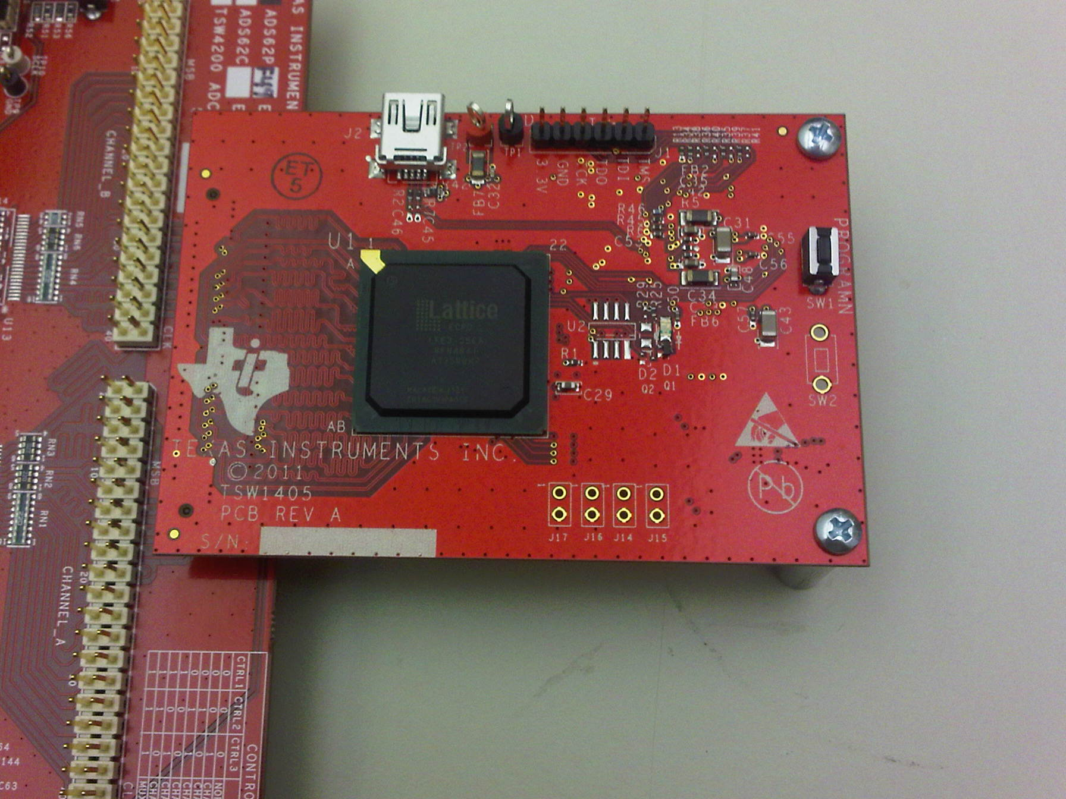
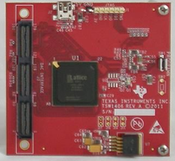
Analysis Tools
TSW1406 Pattern Generator Card
TSW1405 Capture Card

Slide 25
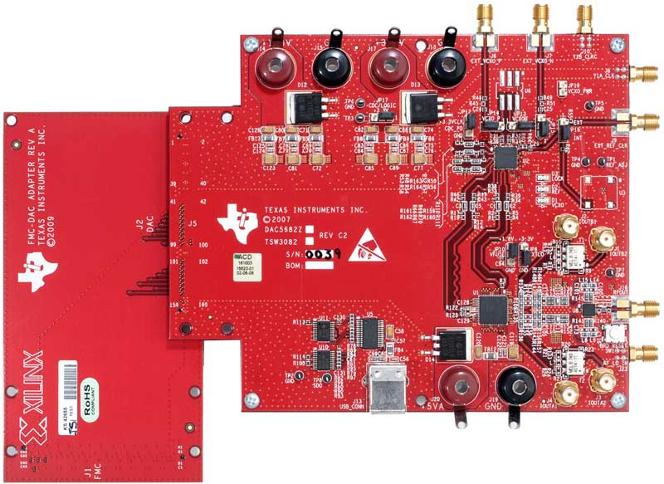
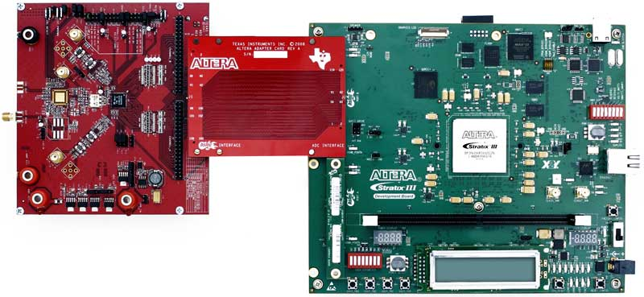
Adapter Boards

Slide 26
Debug Suggestions

Slide 27
Debug Suggestions
Have a way to capture and output a buffer of sample data
  Either using FPGA debug tools or output sample data to a test header and capture using a logic analyzer
Many ADCs have known fixed test pattern outputs
  Toggle, arithmetic count, custom fixed pattern
  If no pattern available, input *very* slow sine wave
    Can get a ‘slow’ sine wave by sampling an IF that is very near sampling frequency
      Example, if 100MHz sample rate, set IF to 100.01MHz for 10KHz sine
Logic analyzer view of raw samples can reveal many bugs
  Misplaced bit order
  Timing errors
  Improper deserialization boundary

Slide 28
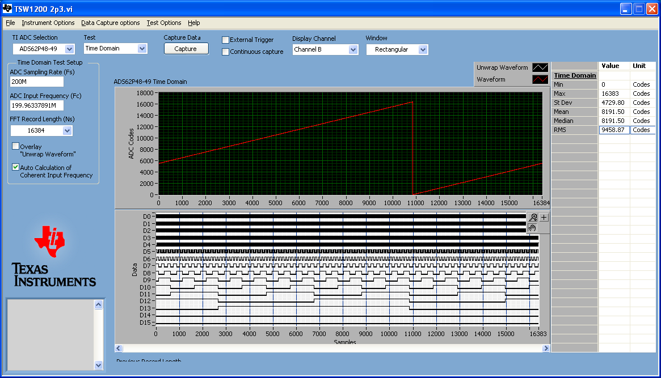
Debug tips – Arithmetic count pattern
Arithmetic count pattern (ramp) can quickly identify that bits are in the right position

Slide 29

Debug Tips – Slow input sine wave
If Ramp is not available, very slow sine wave may work almost as well
Or, use custom pattern to walk a single ‘1’ through all possible bit positions

Slide 30

Debug Tips – setup/hold errors
Setup/hold errors (sometimes called sparkle) show as deviations from expected

Slide 31
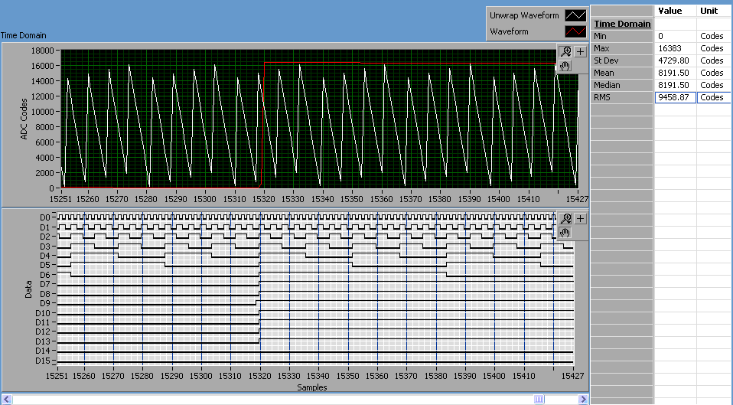
Debug Tips – bit ordering, pipelining
Actual example of a timing bug – note bit 9 is seen one cycle early using ramp pattern

Slide 32
End

