Slide 1
Issue with DCLK divider=1 for CLKout0 and 1 (FPGA clock and SYSREF)
DAC38RF82EVM is configured in CMODE3.
Jumper JP10 is open (Enable On-Chip PLL Clock Mode).
Provided a 4dBm external reference clock=250MHz to SMA J4.
Checked the PLL Enable box and enter the desired on-chip PLL reference clock frequency.

Slide 2
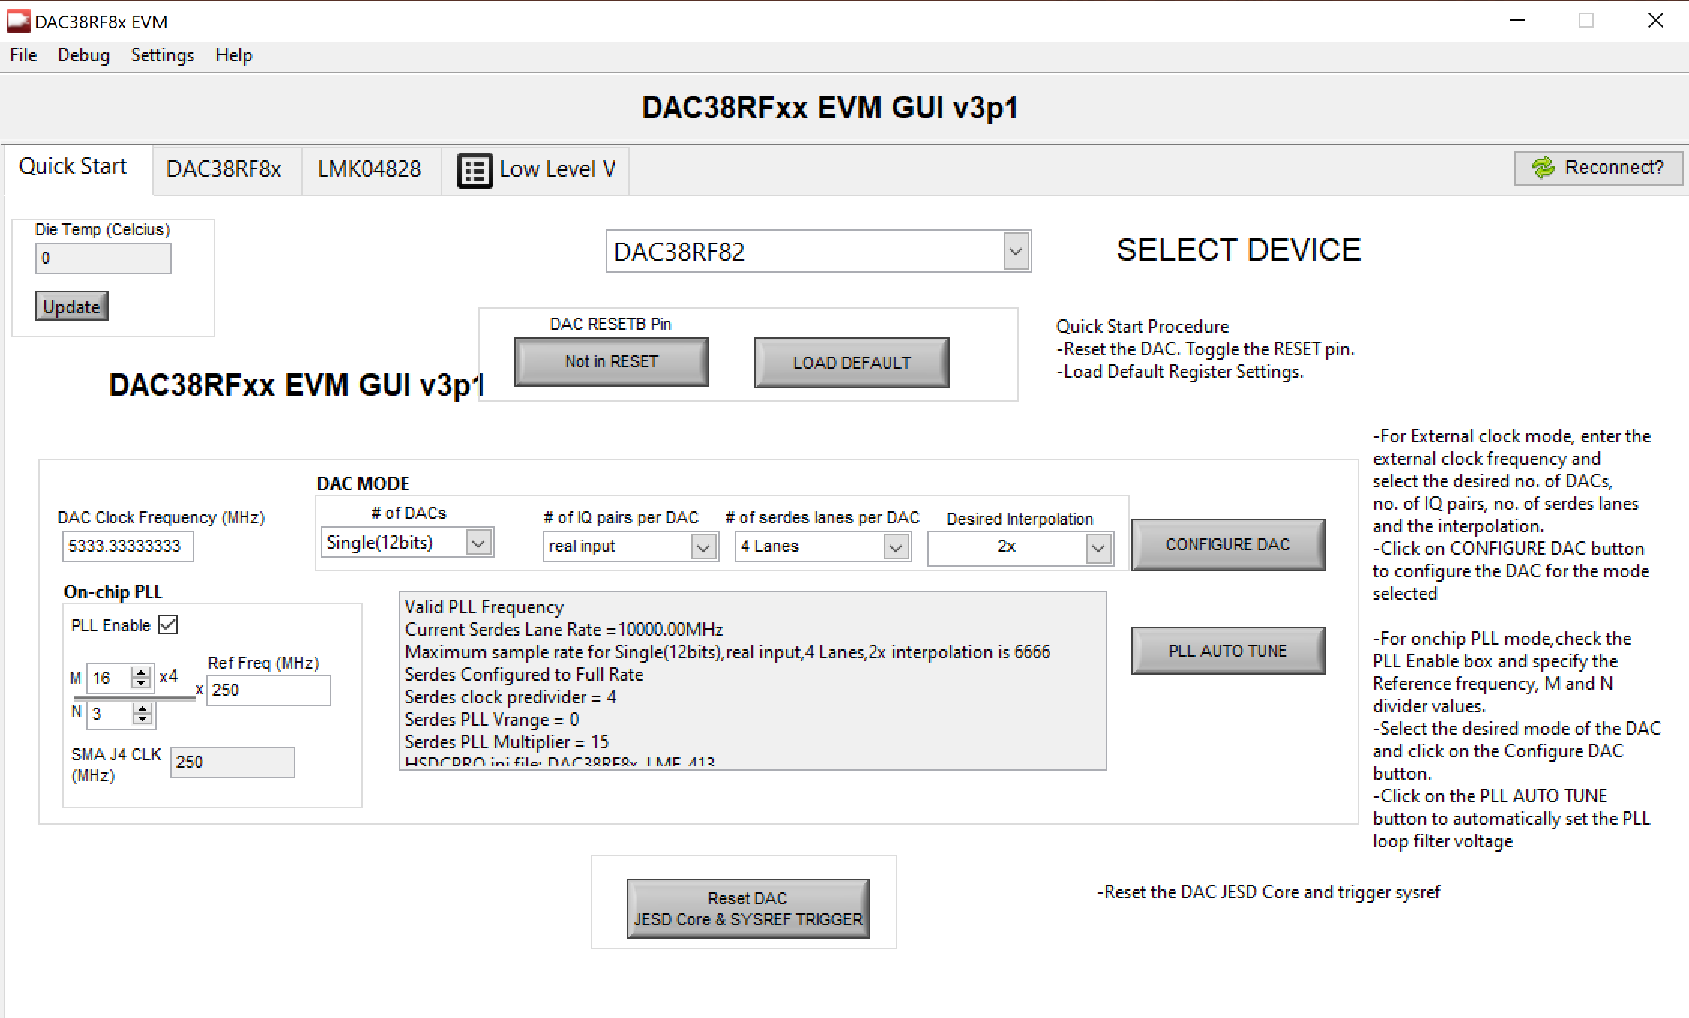
GUI Front page

Slide 3
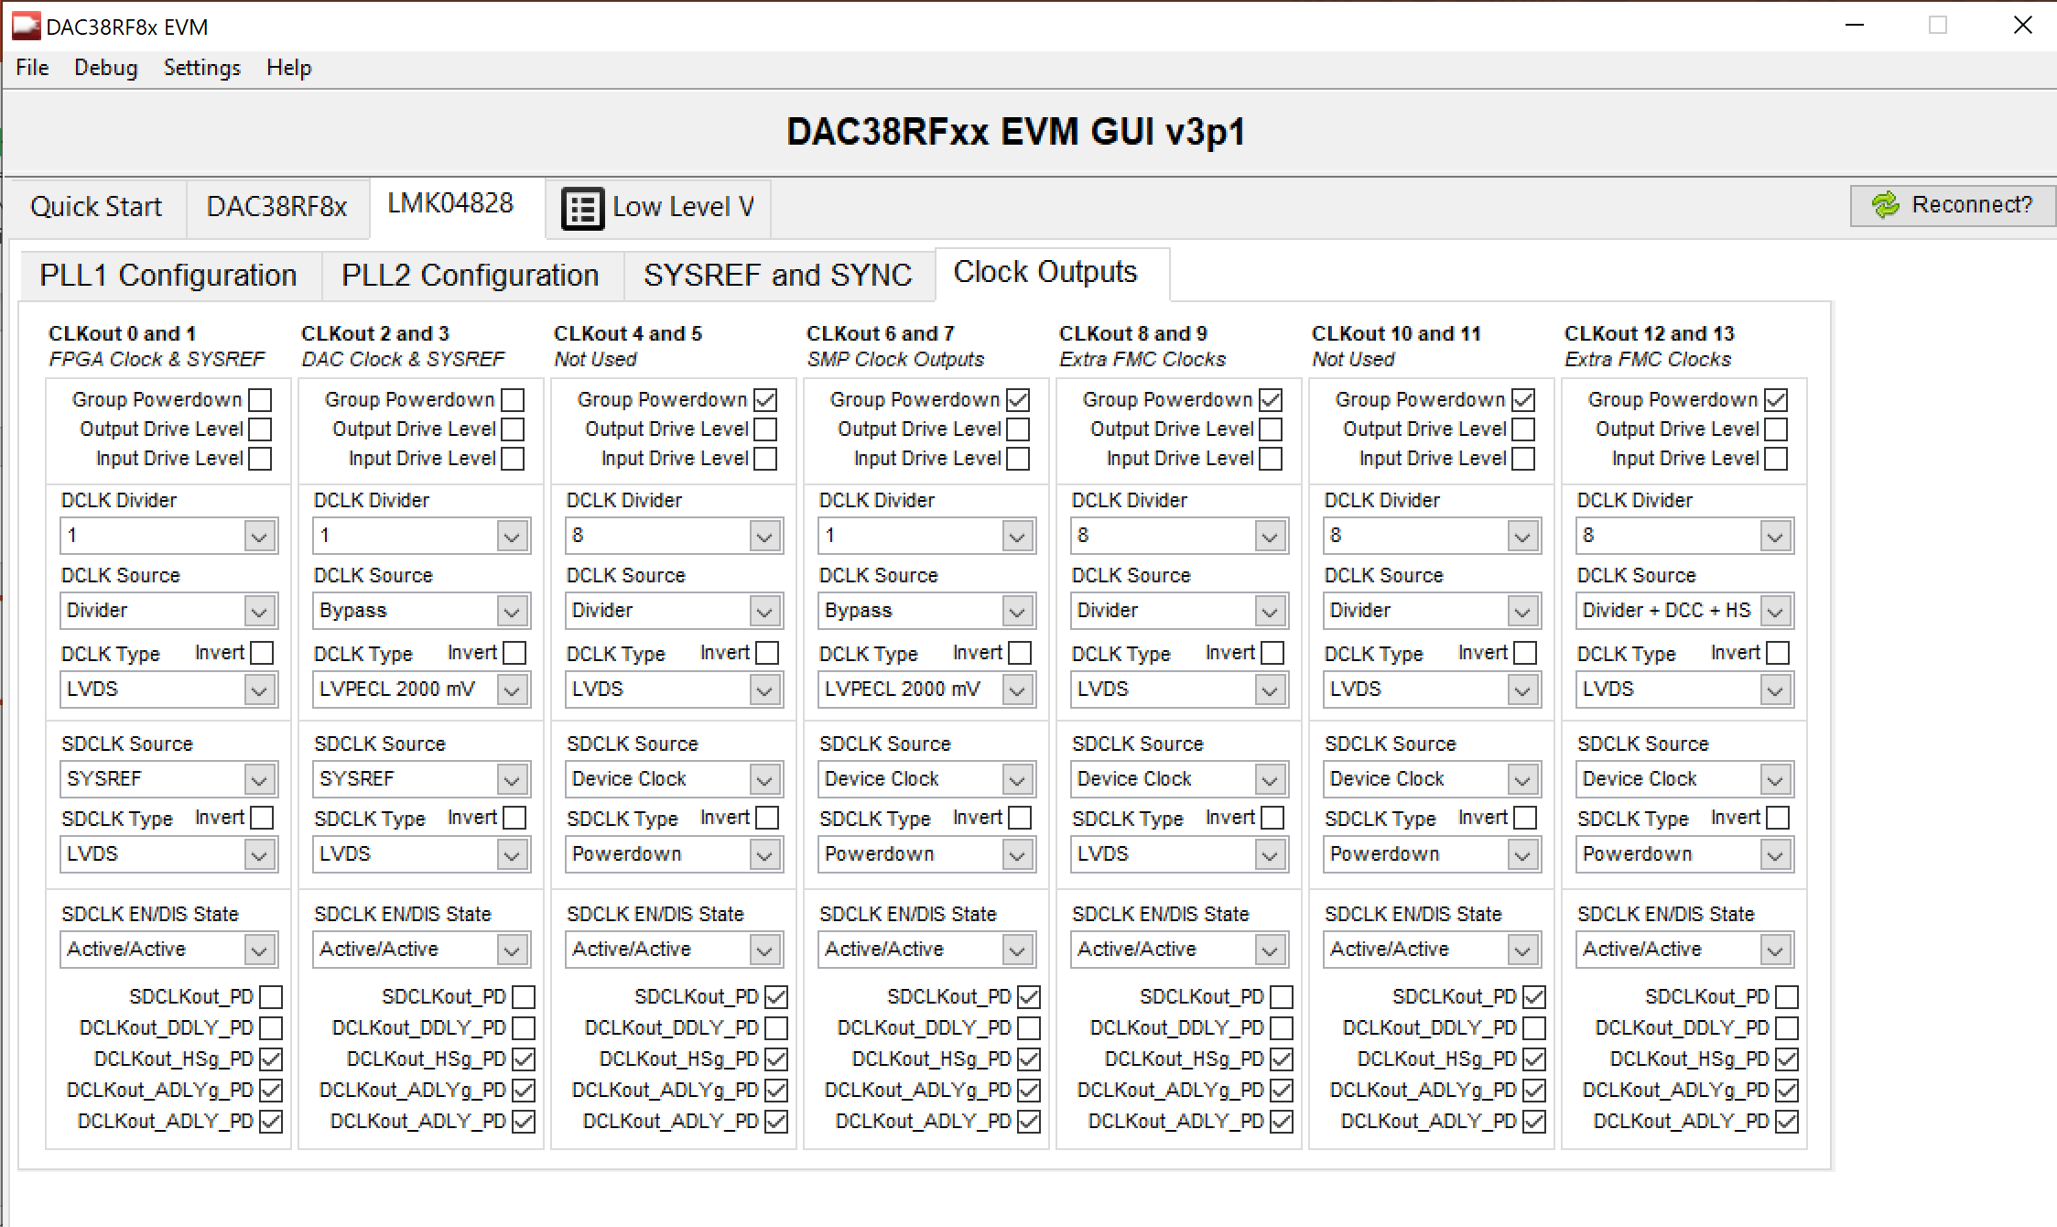
We are changing DCLK Divider (CLKout 0 and 1) in LMK04828.

Slide 4
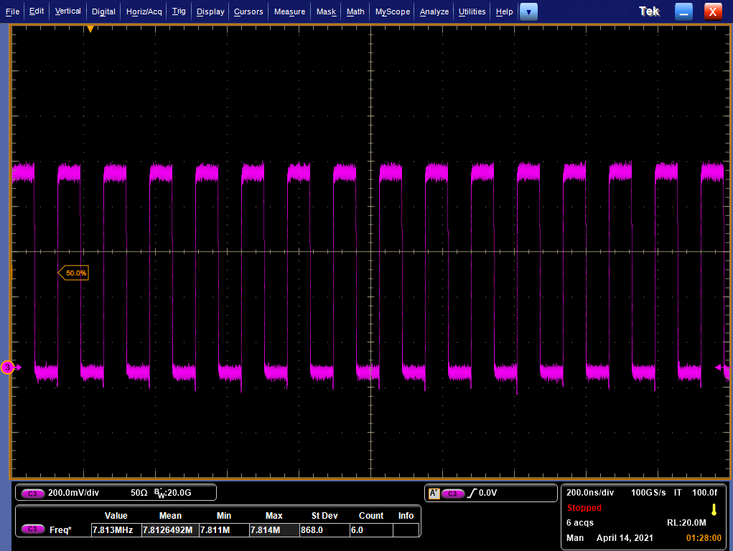
DCLK Divider=1→ Input PLL ref clock is 250MHz and Output frequency is not 250MHz for this case.

Slide 5
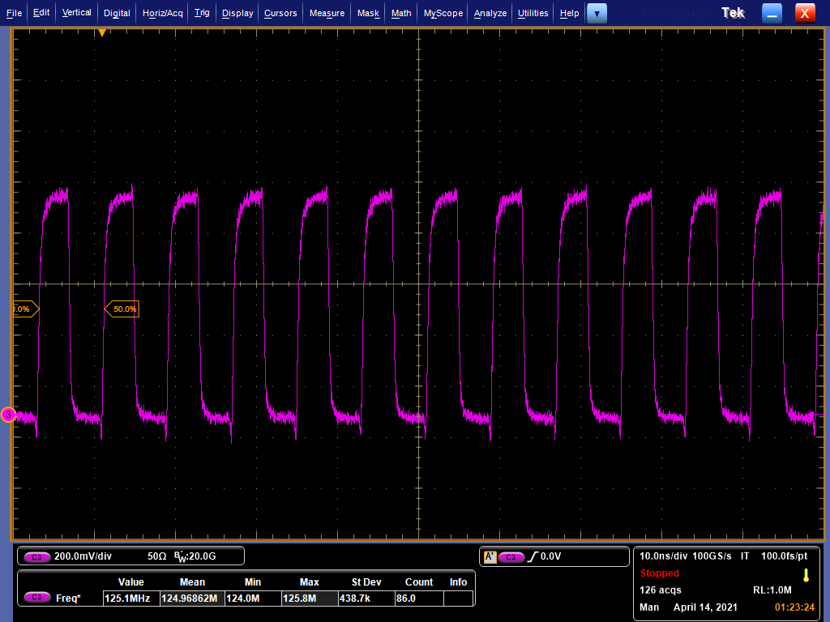
DCLK Divider=2→ Input PLL ref clock is 250MHz and Output frequency is 125MHz for this case

Slide 6
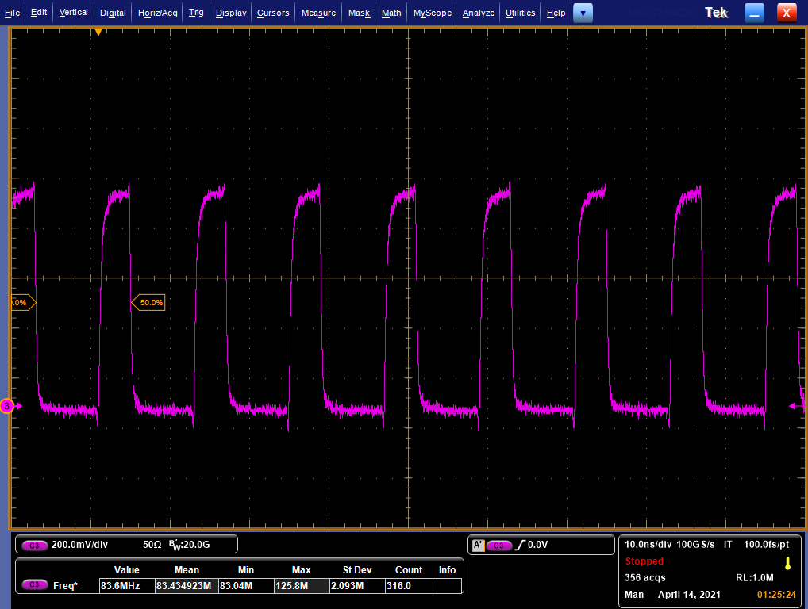
DCLK Divider=3→ Input PLL ref clock is 250MHz and Output frequency is 83.33MHz for this case

Slide 7
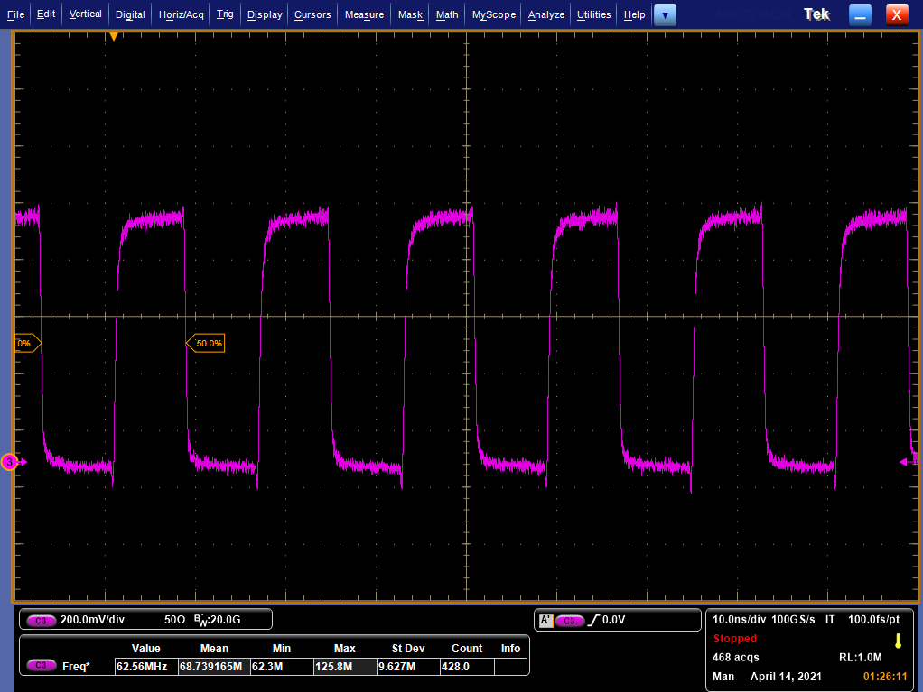
DCLK Divider=4→ Input PLL ref clock is 250MHz and Output frequency is 62.5MHz for this case

Slide 8
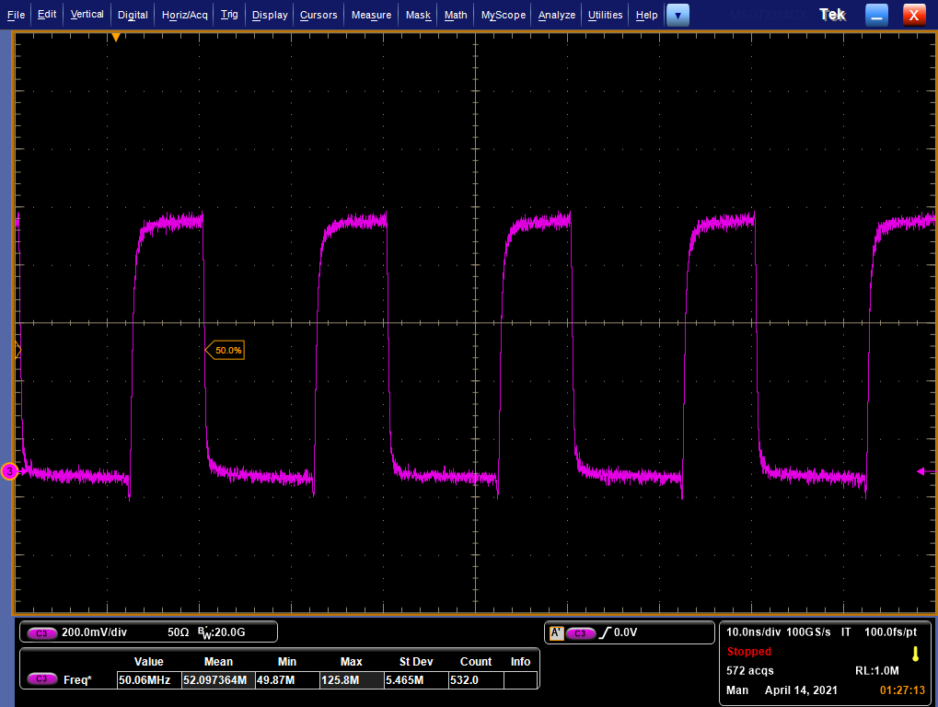
DCLK Divider=5→ Input PLL ref clock is 250MHz and Output frequency is 50MHz for this case

Slide 9
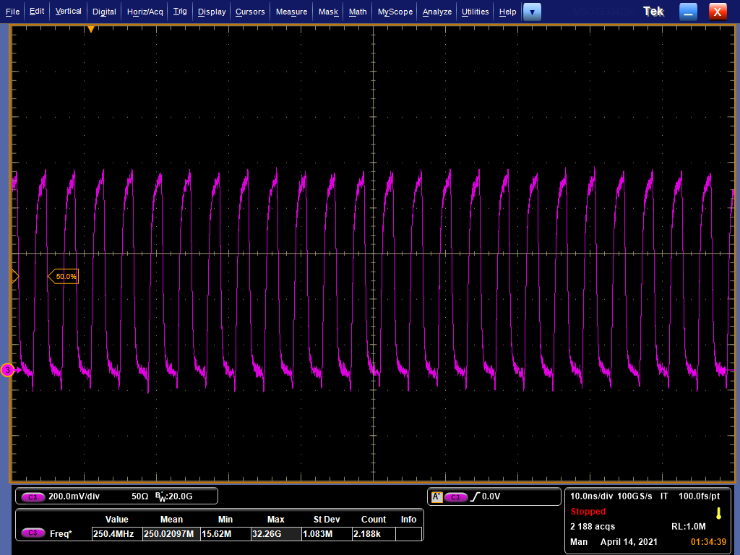
DCLK Divider=2→ Input PLL ref clock is 500MHz and Output frequency is 250MHz for this case

