Slide 1
JESD204B Training
The Physical Layer (PHY)
5/29/2014

Slide 2
Overview
What is the Physical Layer (PHY)?
Speed Grades and Compliance Types
SERDES Interface
Solutions for Long/Lossy Channels
Device Clock, SYSREF and SYNC~ Interfaces
PCB Layout Recommendations

Slide 3
What is the Physical Layer (PHY)?
The “Physical Layer” refers to the serial data transmitter and receiver of the JESD204B link
Point-to-point, unidirectional serial interface
Definition includes electrical and timing characteristics
This presentation also considers the other signal interfaces

Slide 4
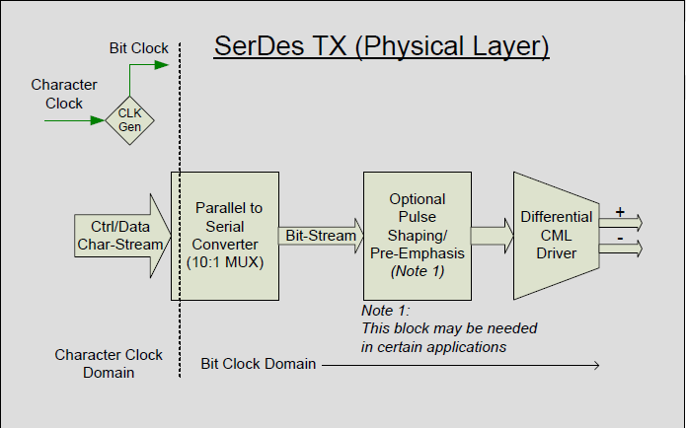
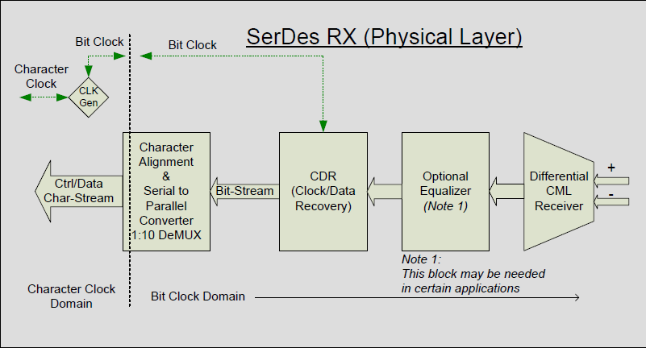
What is the Physical Layer (PHY)?
Transmit and receiver data over a high-speed serial differential link
Clocking information is embedded at TX and recovered at RX (CDR)
Optional pulse-shaping and equalization techniques reduce error rate across link
Transmitter (TX) | Receiver (RX)
Serialization | De-Serialization w/ Character Alignment
Pulse Shaping Pre-/De-emphasis (Optional) | Equalization (Optional)
 | Clock/Data Recovery (CDR)
Differential Output Driver | Differential Input Receiver

Slide 5
Speed Grades and Compliance
The JESD204B standard defines 3 speed grade variants
Based on OIF Optical standards (OIF-CEI-02.0)
Variants differ most importantly in data rate, eye mask, and BER
Compliance refers to AC or DC coupling and impacts the electrical characteristics of the driver/receiver
Parameter | LV-OIF-Sx15 | LV-OIF-6G-SR | LV-OIF-11G-SR
Data Rates | 312.5Mbps – 3.125Gbps | 312.5Mbps - 6.375Gbps | 312.5Mbps – 12.5Gbps
Differential Output Voltage | 500 – 1000 (mV) | 400 – 750 (mV) | 360 – 770 (mV)
Output Rise or Fall Time (20% - 80% into 100Ω load) | ≥ 50 (ps) | ≥ 30 (ps) | ≥ 24 (ps)
Bit Error Rate (BER) | ≤ 1e-12 | ≤ 1e-15 | ≤ 1e-15

Slide 6
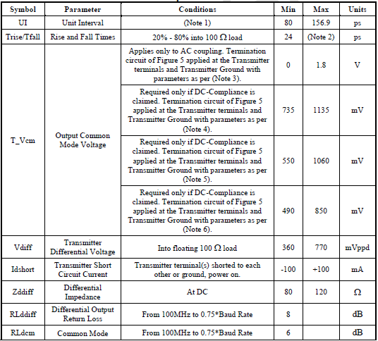
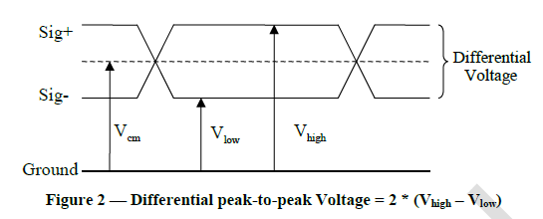
PHY Electrical Requirements
PHY defines the I/O electrical structure of the driver and receiver
Common Mode
Voltage Range
Signal Swing Range
Impedance and
Return Losses

Slide 7
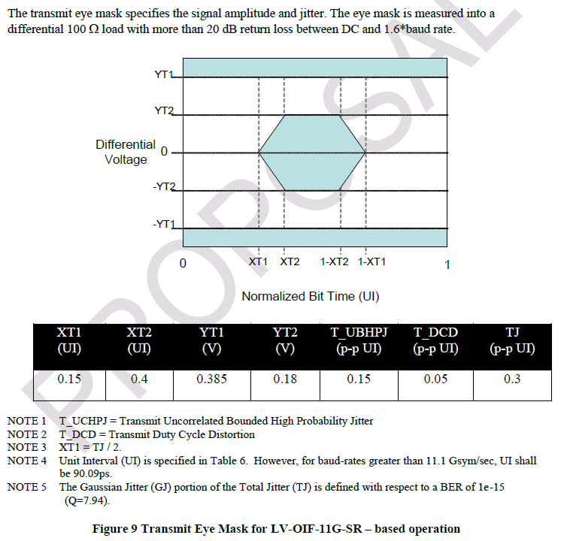
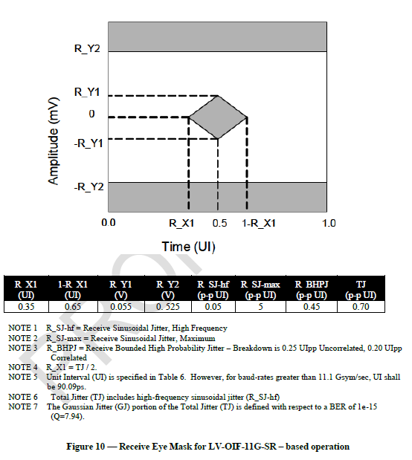
PHY Eye/Timing Requirements
TX and RX Eye Masks with amplitude, rise-time, and jitter requirements
RX must recover signal after channel loss and inter-symbol interference (ISI)
Transmit Eye Mask
Receive Eye Mask
Random Jitter
Random jitter plus Deterministic Jitter (ISI)
Bit-Error Rate

Slide 8
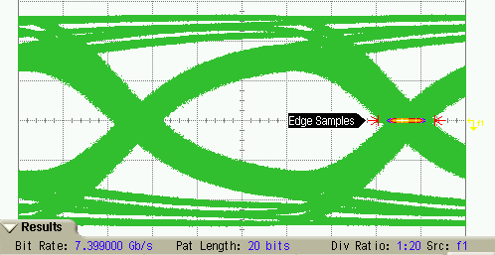
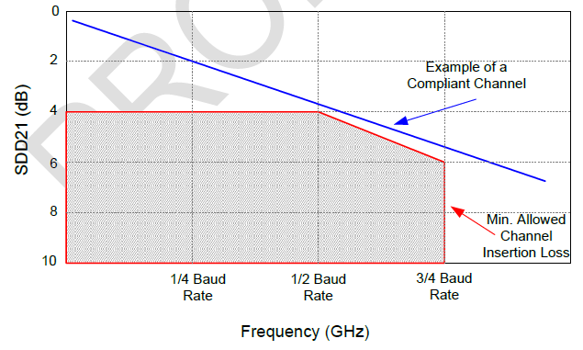
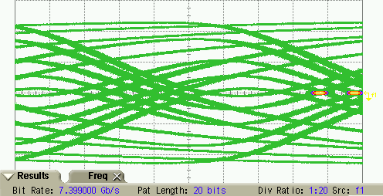
Solutions for Long/Lossy Channels
Channel dielectric loss degrades the signal integrity of the signal
Reduces the vertical/horizontal Eye opening and edge rate due to loss and inter-symbol interference (ISI)
ISI is a form of deterministic jitter
JESD204B Acceptable Loss Profile
5in. FR4 channel @ 7.4Gb/s
20in. FR4 channel @ 7.4Gb/s

Slide 9
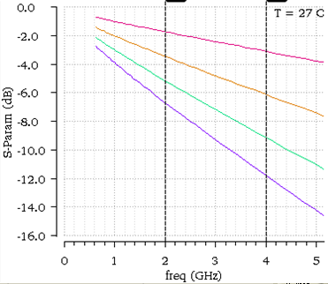
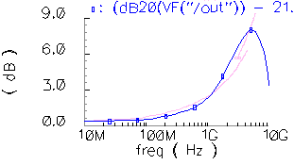
Solutions for Long/Lossy Channels
Equalization can be used to pulse-shape at TX or pulse-correct RX
High-pass profile of equalization counteracts low-pass loss profile of channel
Pre-emphasis
  AMPLIFY HIGH frequencies to achieve high-pass profile
De-emphasis
  ATTENUATE LOW frequencies to achieve high-pass profile
  May require broadband amplification to meet eye requirements at large de-emphasis
5”
10”
15”
20”
Loss profile for microstrip trace lengths over FR4
High-pass emphasis profile (blue)
matches the inverse of the
channel loss profile (pink)

Slide 10
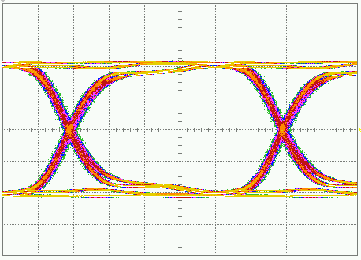
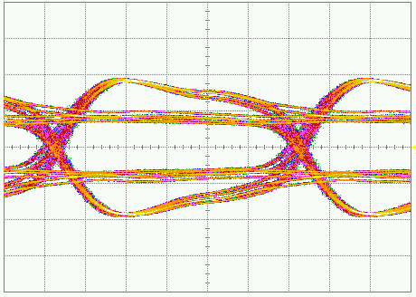
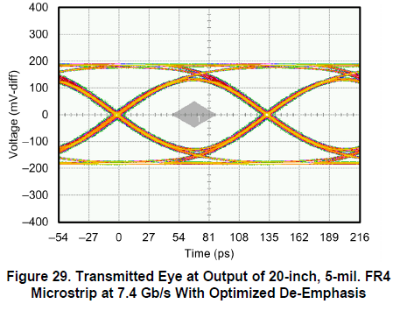
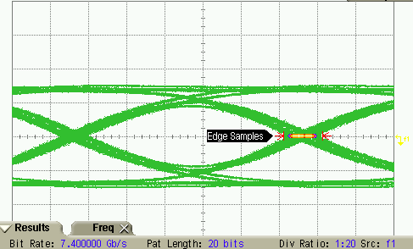
Solutions for Long/Lossy Channels
ADC16DX370 De-Emphasis Waveform @ 5 Gb/s at TX output
Waveform @ 7.4 Gb/s at output of 20-inch FR4 channel
De-emphasis disabled
Maximum De-emphasis
Easily Meets JESD204B RX Eye Spec!!!
De-emphasis disabled
De-emphasis Optimized

Slide 11
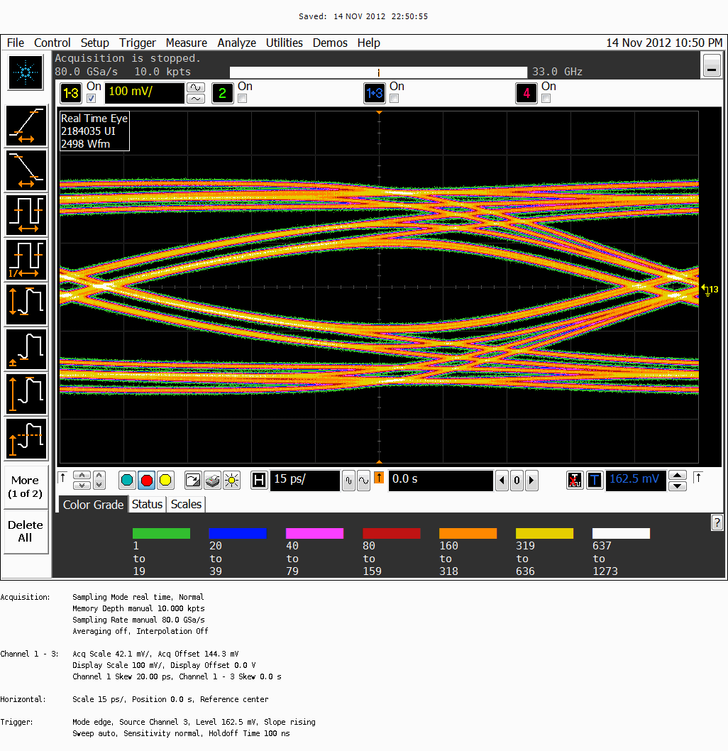
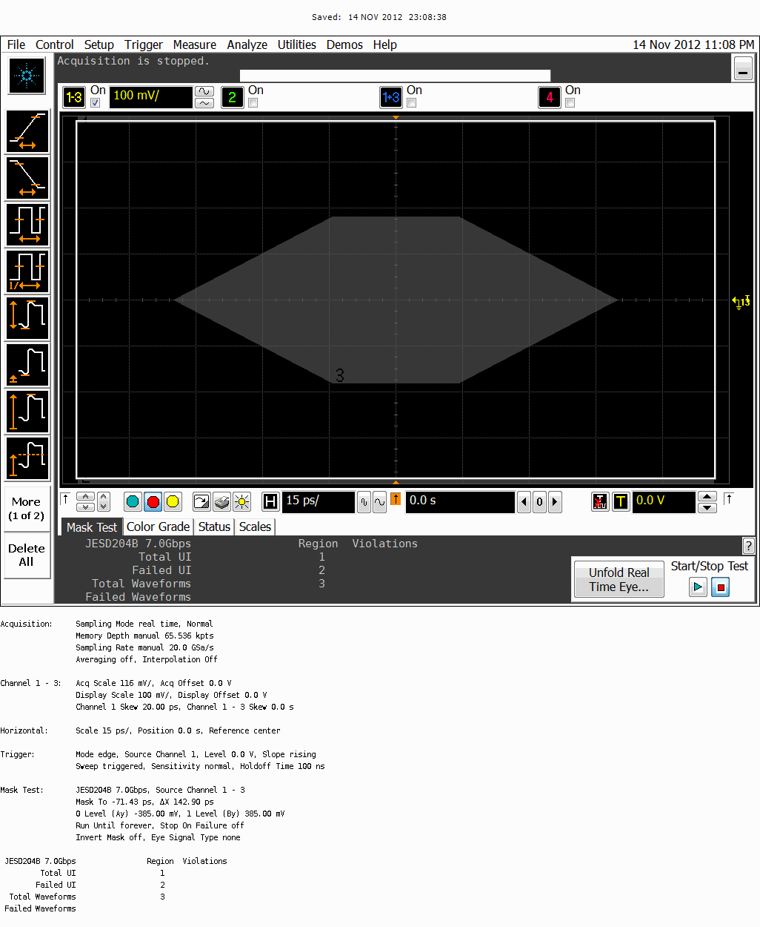
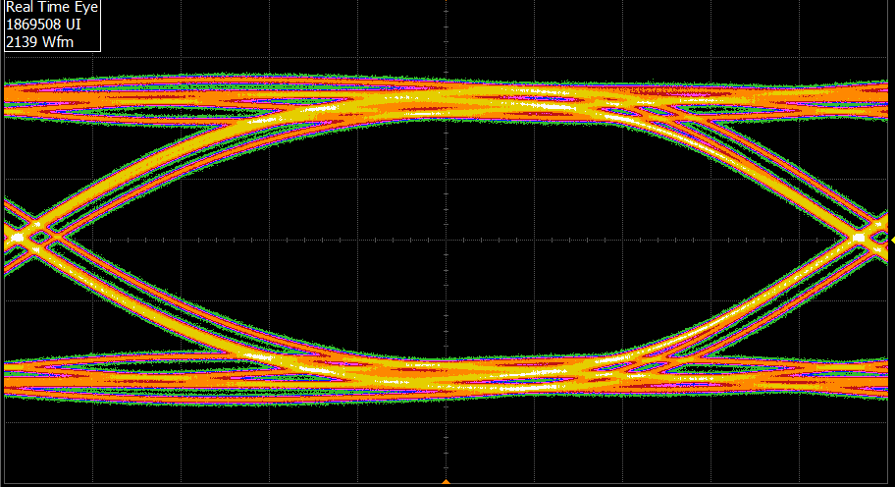
Solutions for Long/Lossy Channels
ADC12J4000 Pre-Emphasis Waveform @ 7 Gb/s over 7 inches FR4
Pre-emphasis disabled
Pre-emphasis Optimized
Even Meets TX Eye Spec!!!

Slide 12
TI Devices SERDES Summary
Device | Max Conversion Rate | Max Bit Rate | Min #Lane/Ch. (at full MSPS) | Emphasis / Equalization?
ADC16DX370 | 370 MSPS | 7.4 Gb/s | 1 | TX De-emphasis
ADS42JB69 | 250 MSPS | 3.125 Gb/s | 2 | Not needed
ADC12J4000 (Preview) | 4000 MSPS | 8 Gb/s | 8 | TX Pre-Emphasis
DAC38J84 | 2500 MSPS | 12.5 Gb/s | 0.25 | RX Adaptive Equalizer

Slide 13
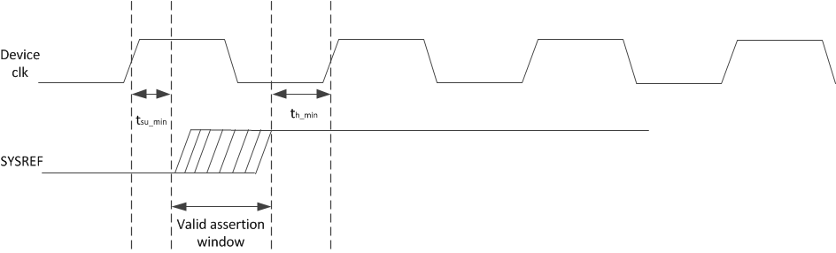
Device Clock and SYSREF Interfaces
No strict definition for electrical characteristics
  LVDS, LVPECL are common solutions
Device clock frequency may be equal to sampling rate or multiple
Noise on device clock typically sets jitter performance of converter
Attention required for DC-coupled common-mode compatibility of TX/RX
Subclass 1
  SYSREF must meet setup/hold relative to device clock
  Electrical characteristics recommended to be consistent between device clock and SYSREF
Subclass 2: SYSREF not required

Slide 14
SYSREF Interface (Signal Types)
Periodic
  SYSREF always ON with periodic edges
  Risk of interferer spurs near IF due to SYSREF
Gapped-Periodic
  Send periodic edges for a brief pulse of time
  No spurs
One-Shot
  Single SYSREF pulse and then leave in logic-low state
  No spurs
SYSREF pulse period equal to integer multiple of multi-frame period
Disabling and gating the SYSREF signal may be employed
TI Information – NDA Required
Notes:
1

Slide 15
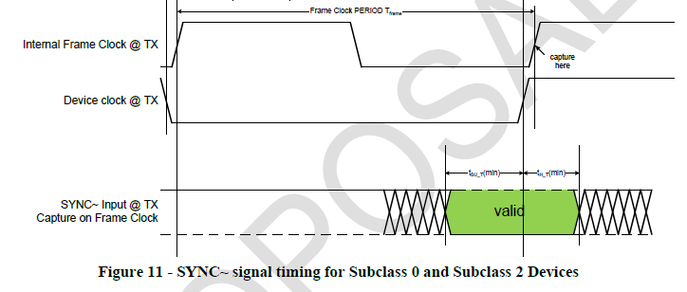
SYNC~ Interface
No strict definition for electrical characteristics
  LVDS, LVPECL, CMOS are common solutions
DC coupling mandatory
Subclass 1
  SYNC~ does not have strict timing
Subclass 2
  SYNC~ must meet setup/hold relative to device clock
  Timing requirements very difficult to meet for device clock rates > 250MHz

Slide 16
Differential Interfaces
(Example circuits)
Serial Lane Interface
  AC or DC Coupling
  100Ω differential channel
  Routing signal integrity is MOST critical of all JESD204B interface signals
Device Clock / SYSREF Interface
  AC or DC Coupling
  AC coupling SYSREF requires provision for DC balancing at receiver
  100Ω differential channel
  Match device clock and SYSREF interface to meet setup/hold requirement

Slide 17
Differential Interfaces (Example Circuits)
SYNC~ Interface
  DC Coupling only
  100Ω differential channel
  Routing VERY critical for subclass 2
  Routing is LEAST critical for subclass 1

Slide 18
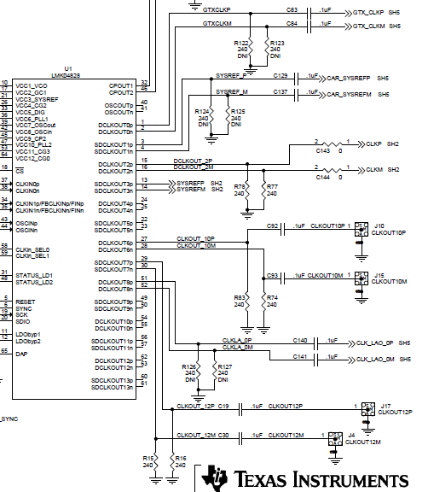
Generating Device Clocks and SYSREF
Example: LMK04828
  Subclass 1 capable
  7 Device CLK / SYSREF pairs
  Low Jitter clock source
  SYSREF Disable feature
  Delay options
  LVPECL, LVDS, HSDS outputs
  Supports Clock Distribution mode using external clock source

Slide 19
PHY Debug (Test Patterns)
Test patterns can verify the PHY layer signal integrity
PRBS and D21.5 patterns available on all TI JESD204B devices
Most FPGA giga-bit transceivers have built-in PRBS generators/detectors
Pattern | Use Test
PRBS7 /15 /23 /31 | Long pattern performance Deterministic Jitter (ISI)
01010101010 (D21.5) | Random Noise

Slide 20
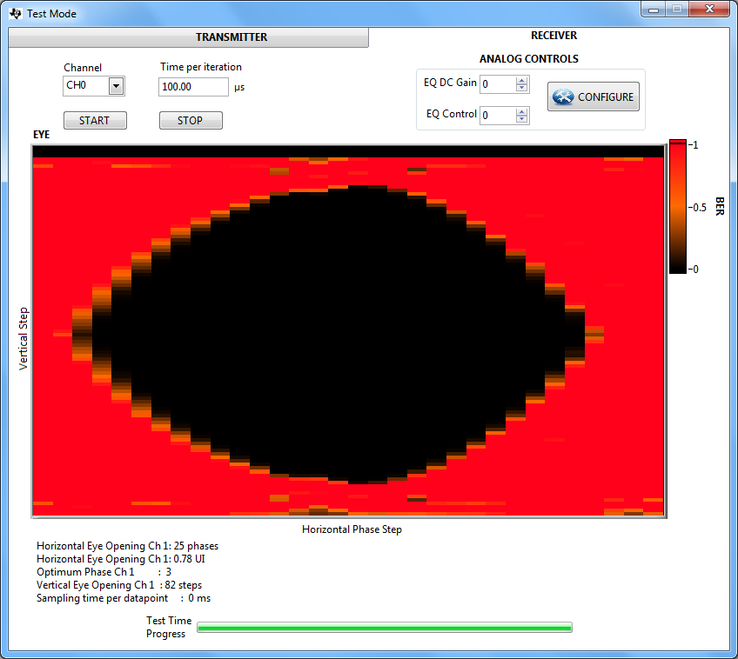
PHY Debug (Built-In Tools)
HSDC Pro Eye Tool uses built-in Altera features to view signal integrity

