Slide 1
JESD204B Subclass Overview

Slide 2
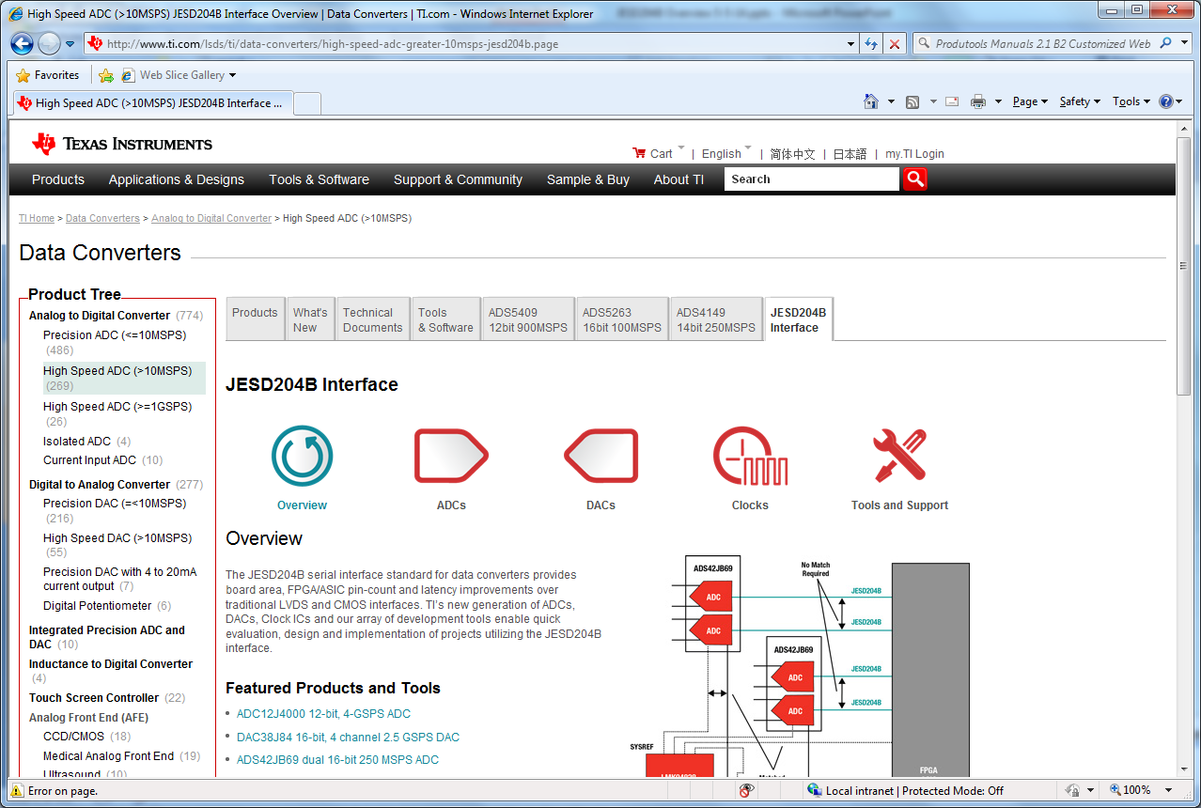
www.ti.com, select data converters, then High Speed ADC, then JESD204B Interface

Slide 3
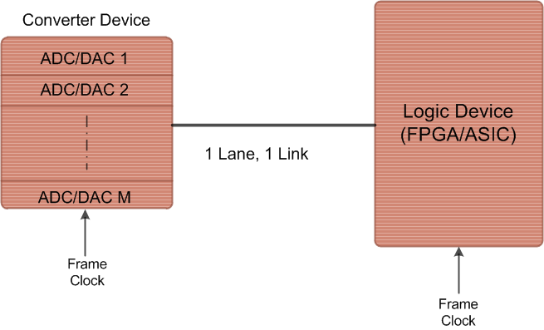
Original Spec
JESD204 – April 2006
Defines a single lane high speed serial link connected to single/multiple
data converters with speed up to 3.125Gbps.
TI Information – NDA Required

Slide 4
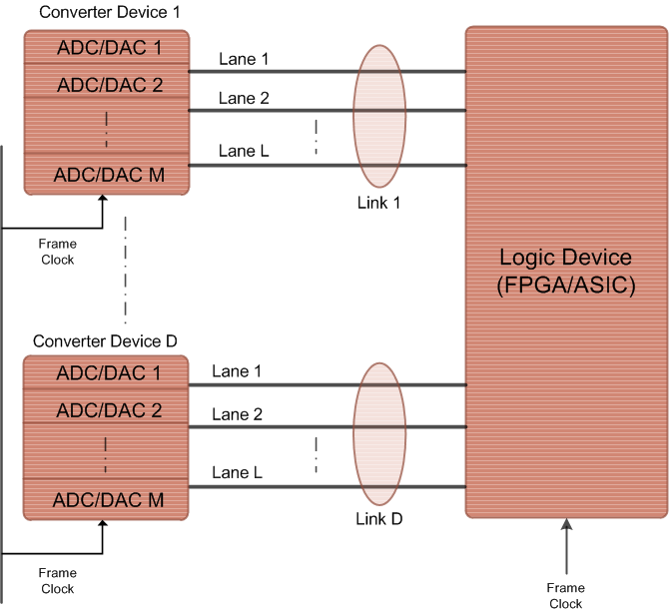
REVISIONS
JESD204A – April 2008
Revision A extends the support to multiple aligned lanes with multipoint link. Maximum supported speed is the same, 3.15Gbps.
TI Information – NDA Required

Slide 5

JESD204B – July 2011
Subclasses: 0 (backward compatible), 1, 2
Support for Deterministic Latency
Frame clock changed to device clock
Serial lanes speeds up to 12.5Gb/s
TI Information – NDA Required
Notes:
0.5

Slide 6
Deterministic Latency: Achieved
JESD204B achieves deterministic latency: known/constant latency
Subclass 0: DL not achieved (JESD204A)
Subclass 1: DL achieved using SYSREF with strict timing
Subclass 2: DL achieved using SYNC~ with strict timing
Deterministic Latency achieved with these architecture features
SYSREF or SYNC~ are used to provide a deterministic reference phase to all devices for synchronization
LMFC provides a low frequency reference to avoid frame clock phase ambiguity in the presence of link delay changes
RX has an “elastic buffer” that absorbs link delay variation
Texas Instruments recommends/supports subclass 1
LMFC phase easier to control with source synchronous SYSREF than with system synchronous SYNC~
Notes:
1

Slide 7
Subclass 0, 1, 2
Three device subclasses have been defined. Each subclass uses a different link synchronization method.
Subclass 0: Deterministic latency not supported. Backward compatible with JESD204A. No defined method for aligning local multi-frame clocks. Uses SYNC~ signal.
Subclass 1: Deterministic latency is supported. Uses SYSREF clock to align local multi-frame clocks to device clocks in both TX and RX devices. May use SYNC~ signal to initiate a lane alignment sequence.
Subclass 2: Deterministic latency supported. Uses SYNC~ to align local multi-frame clocks.

Slide 8
JES204B Subclasses: 0
Backward compatible with JESD204A but supports high line rates
No support for deterministic (known/constant) latency
Supports alignment of multiple lanes/device
Multi-device synchronization requires strict frame clock frequency and tight SYNC~ setup/hold timing
SYNC~ of subclass 0 has special timing requirements for error reporting
Mixing subclass 0 with subclass 1, 2 devices requires special SYNC~ error reporting considerations
TI Information – NDA Required
Notes:
1

Slide 9
JES204B Subclasses: 0
TX device
Clock
Source
Frame Clock
SYNC~
Data
Frame Clock
RX device
Critical Timing Path for: Synchronization
TI Information – NDA Required
Notes:
0.5

Slide 10
JES204B Subclasses: 1
Each device has an internal frame and local multi-frame clock
Frame clock achieves serial transfer of symbols
Local multi-frame clock (LMFC) achieves known latency
Requires the SYSREF signal
SYSREF must be source synchronous with the device clock (critical)
Phase of SYSREF events determine frame clock and local multi-frame clock alignments
Deterministic latency achieved
Supports alignment of multiple lanes/device
Multi-device synchronization achieved with close attention to device clock and SYSREF distribution
SYNC~ used for synchronization but is not timing critical
TI Information – NDA Required
Notes:
1

Slide 11
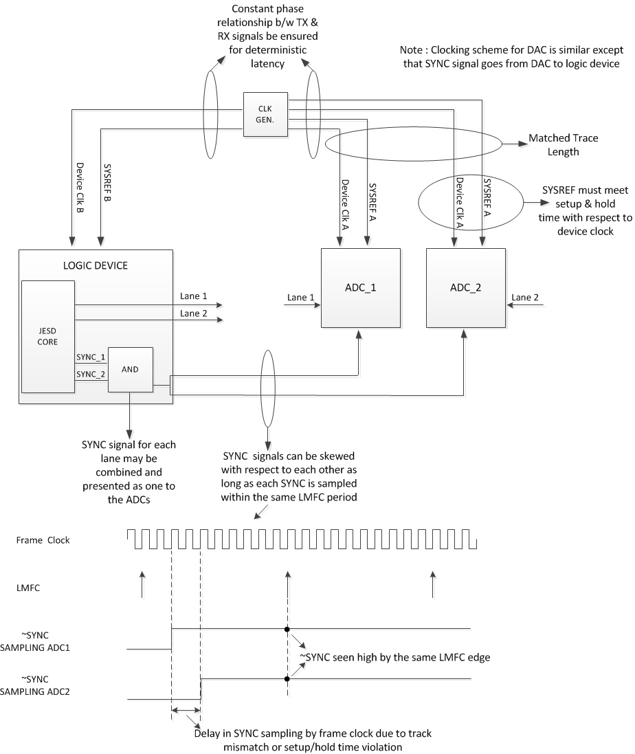
Clocking Scheme - Subclass 1
TI Information – NDA Required

Slide 12
JES204B Subclasses: 2
Each device has an internal frame and local multi-frame clock
Same as subclass 1
SYNC~ signal used for synchronization and deterministic latency
SYNC~ must be system synchronous with the device clock (critical)
Phase of SYNC~ events determine frame clock and local multi-frame clock alignments
Deterministic latency achieved
Supports alignment of multiple lanes/device
Multi-device synchronization achieved with close attention to device clock and SYNC~ distribution
Since meeting setup and hold time becomes a challenge at higher sampling rates, it is recommended, as per standard, to use Subclass 1 for speeds above 500MSPS for both ADC and DAC.
TI Information – NDA Required
Notes:
1

Slide 13
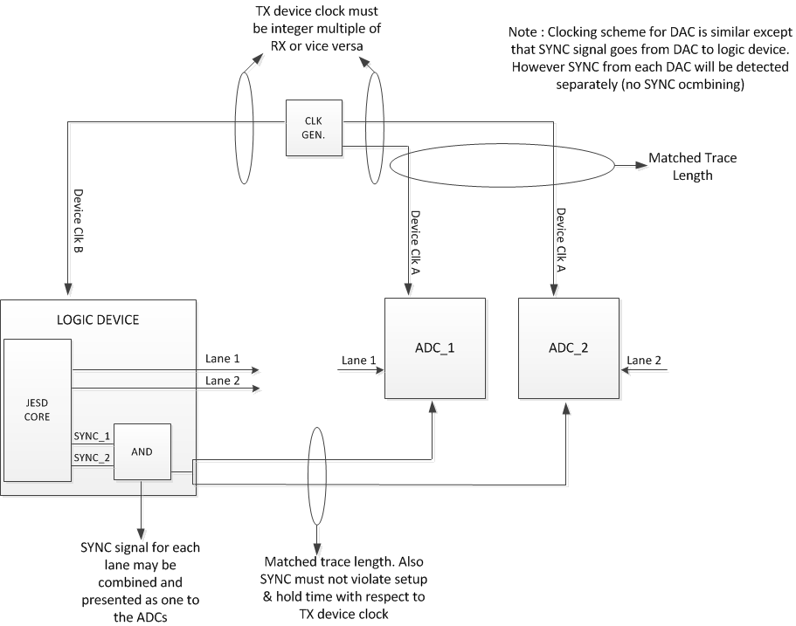
Clocking Scheme – Subclass 2

Slide 14
Summary
JESD204: Standard serial data interface for data converters
JESD204B subclasses offer 3 implementation variations
Transport Layer defines data framing into serial lanes
Link layer defines encoding, synchronization and data monitoring
Physical layer defines the electrical and timing performance
Deterministic latency achieved with subclasses 1, 2 and is required for known/constant latency through link
TI Information – NDA Required

