Slide 1
DAC38RF82 82380 Frame Format

Slide 2
Transport Layer Parameters
Important parameters associated with transport layer include
L # of lanes per converter device
M # of converters per device
F # of octets per frame (per lane)
S # of samples per converter per frame clock cycle
Hd High-Density bit which controls whether a sample may
be divided over more lanes
LMFS = 82380
Notes:
1

Slide 3
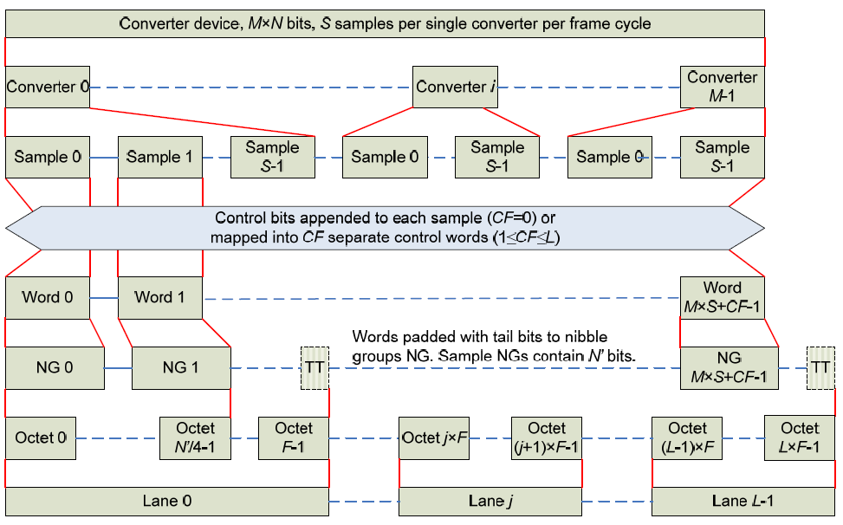
Transport Layer Overview
This chart specifies how samples map to octets, lanes, etc
Notes:
1

Slide 4
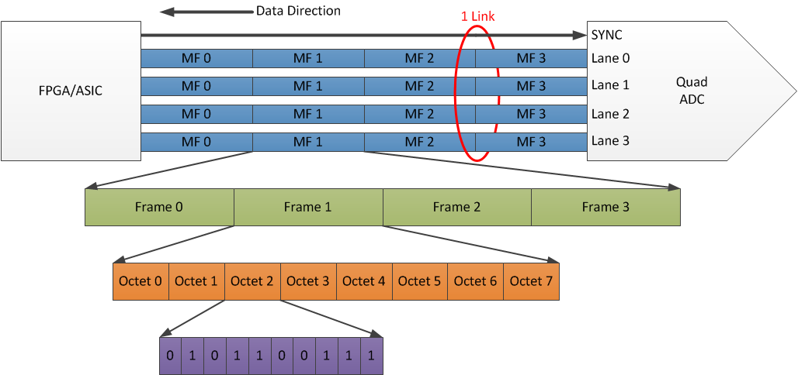
Example of LMFSHd = 44840
Highest Level
Lowest Level

Slide 5
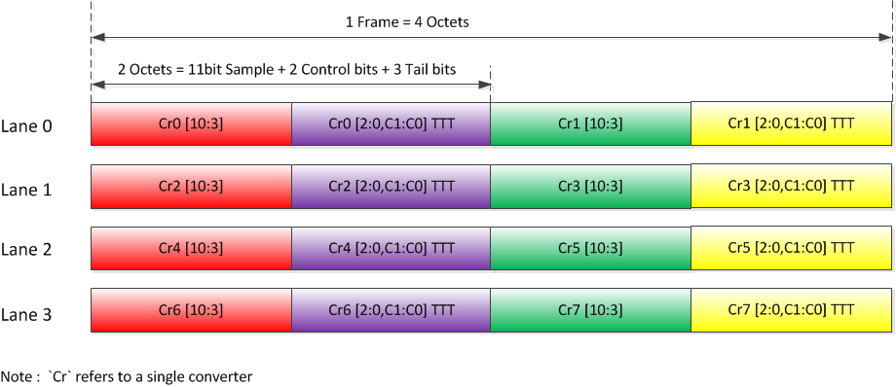
Transport Layer Example
Example: 11-bit octal ADC converter
L = 4, M = 8, F = 4, S = 1, CS = 2
Notes:
2

Slide 6
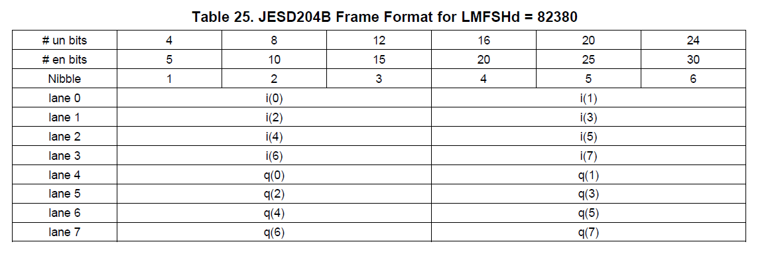
Transport Layer Example
Example: 12-bit Dual DAC38RF82
L = 8, M = 2, F = 3, S = 8, Hd = 0
Notes:
2

Slide 7
Transport Layer Example L = 8, M = 2, F = 3, S = 8, Hd = 0
Below 12-bit Dual DAC38RF82 example is only showing Lane 0 and Lane 1 data
CH1 will contain I data, and CH2 will contain Q data
S0 = sample 0, S1 = sample 1, ect…
Lane 0 = CH1 S0 bits [11:4], CH1 S0 bits [3:0], CH1 S1 bits [11:8], CH1 S1 bits [7:0]
F1
F2
F3
Lane 1 = CH1 S2 bits [11:4], CH1 S2 bits [3:0], CH1 S3 bits [11:8], CH1 S3 bits [7:0]
F1
F2
F3
S
1 Frame with 8 samples ( only 4 samples are shown. The other 4 samples will be on Lanes 2 and 3)
With F = 3, there will be three octets per Frame
Notes:
2

Slide 8
With F = 3, there will be three octets per lane per Frame. Each octet is 8 bits unencoded or 10 bits encoded (8b/10b).
With S = 8, there will be 8 samples of data per channel per Frame.
Notes:
2

