Slide 1
ADC12J4000 testing with KC705
Oct, 2014

Slide 2
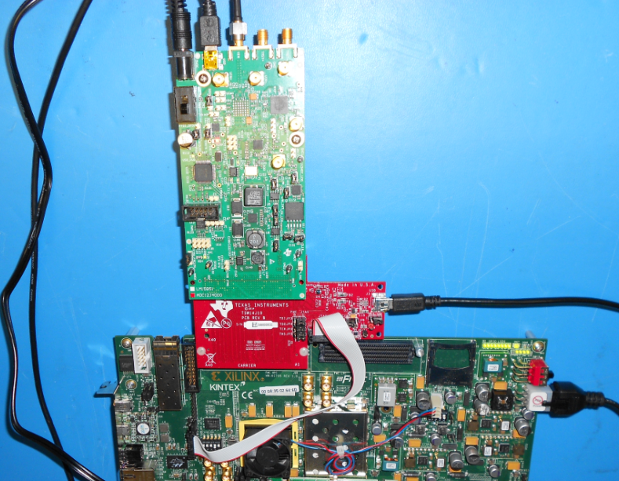
Test Setup using ADC12J4000, TSW14J10, and KC705
Board power
USB interface
IF input
ADC12J4000
TSW14J10
USB interface
Board power
+5VDC Input
USB interface
Kintex KC705

Slide 3
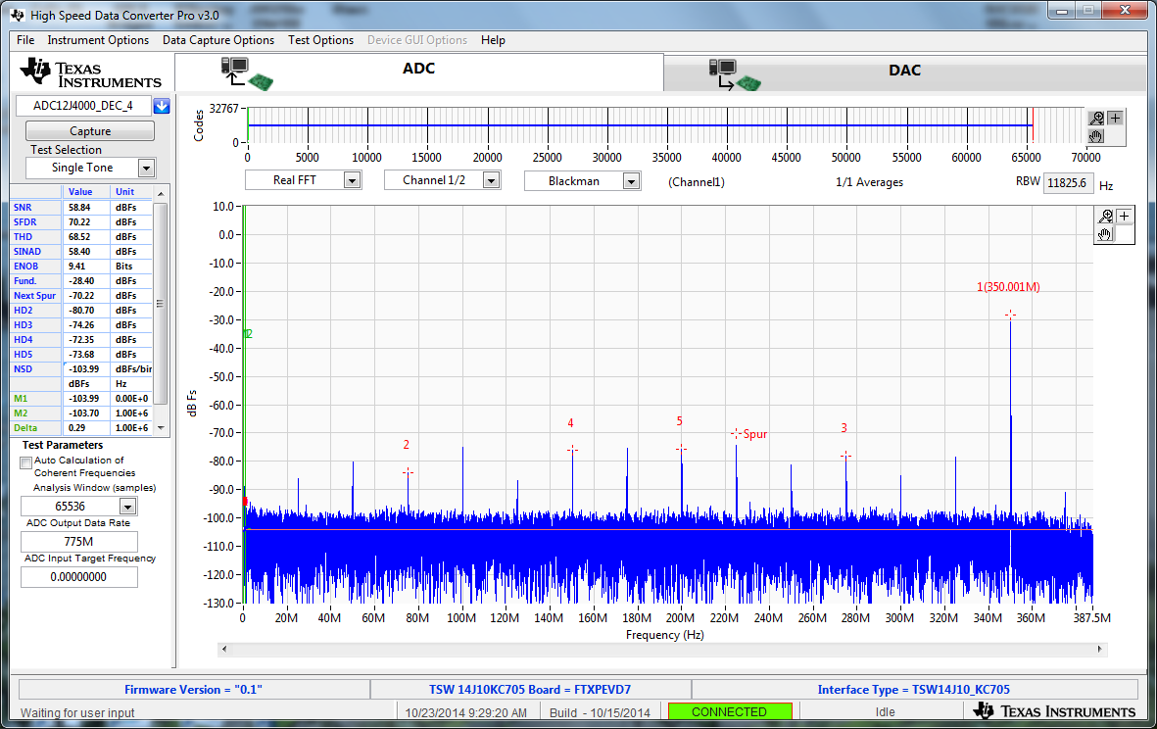
HSDC Pro GUI data capture of 350MHz tone

Slide 4
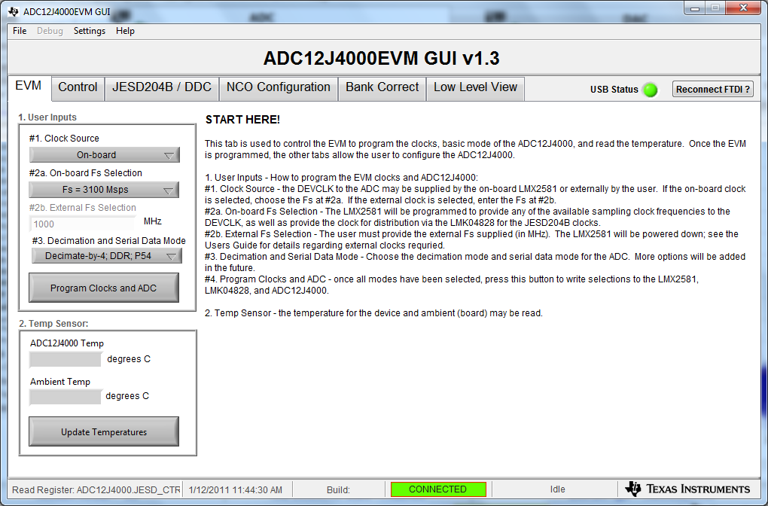
ADC12J4000 GUI

Slide 5
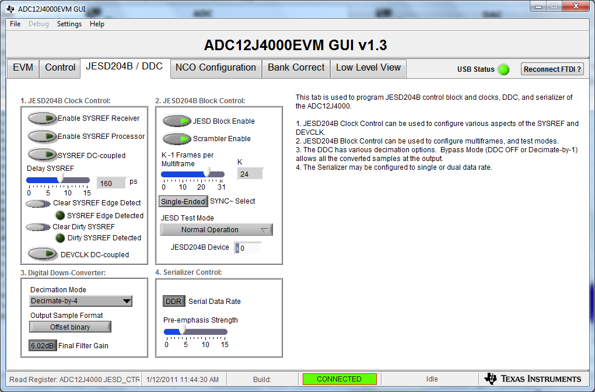
ADC12J4000 GUI

Slide 6
ADC12J4000 GUI
Load GUI as shown in slide 4.
Go to low level tab, click on “Load config” and select “LMK04828_D.B4_Fs_3100Msps_VC707_DEC_4.cfg.
Go to low level tab, click on “Load config” and select “ADC12J4000_DB4_DDR_P54.cfg.
Set K = 24 as shown in slide 5.
Open TSW14J56, select ADS12J4000_DEC_4. Load firmware.
Set ADC data output rate to 775M. Click on “Capture”.

