Slide 1
ADC12DJ3200 Testing with KCU105 (JMODE0)

Slide 2
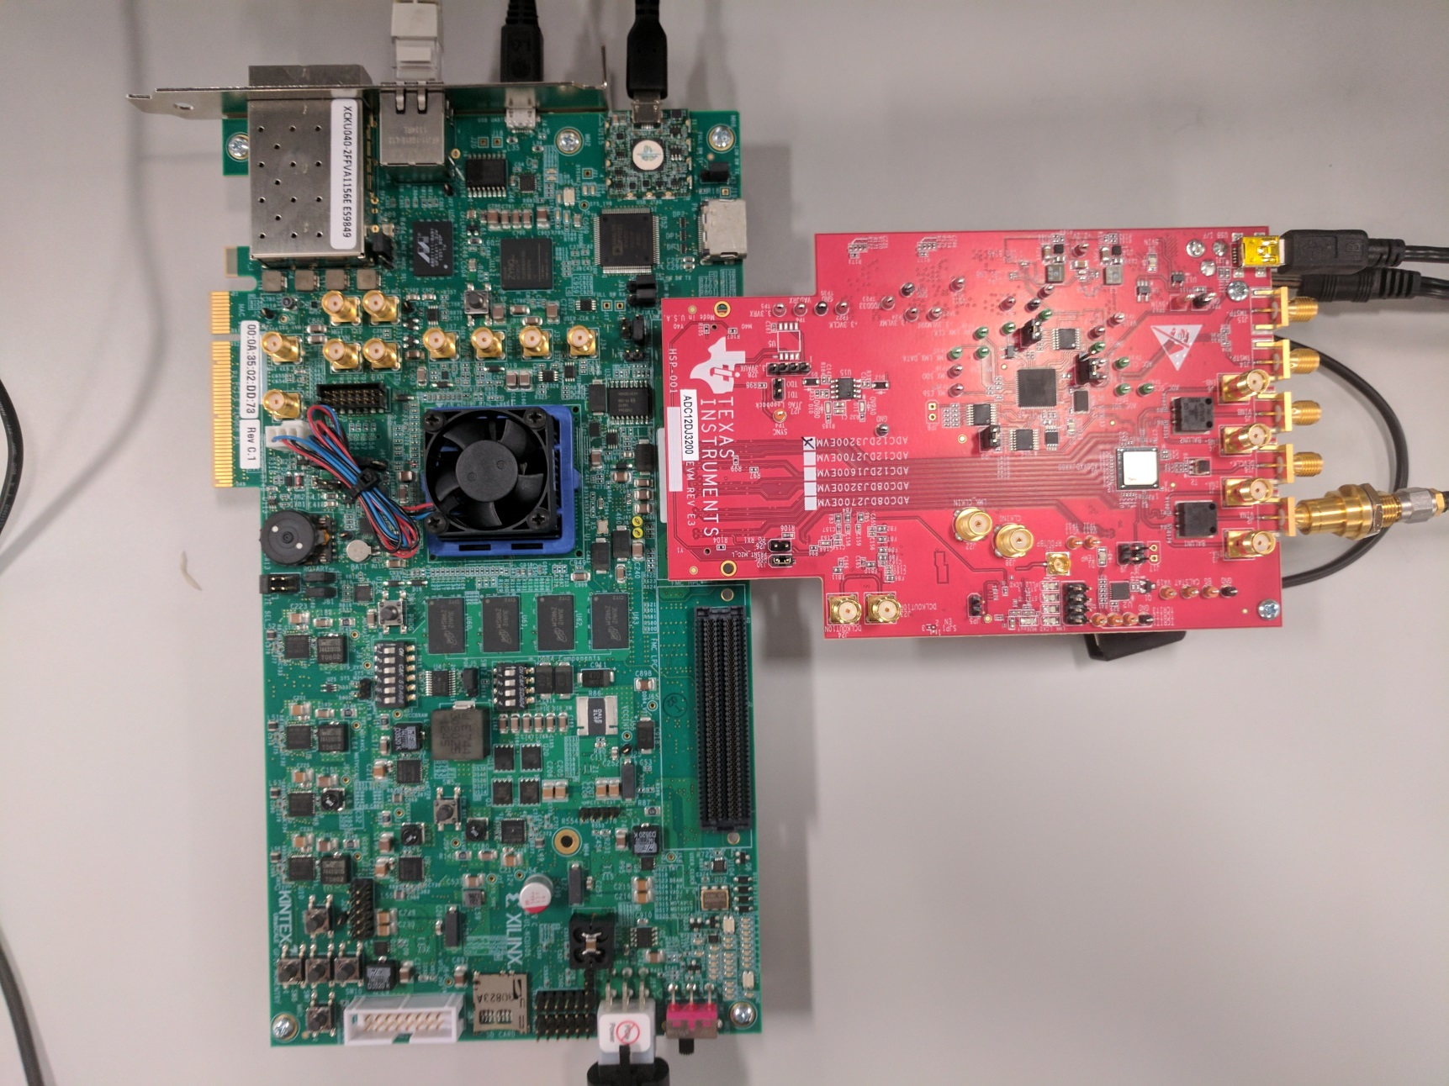
ADC12DJ3200 & KCU105 Setup

Slide 3
Test Setup:
Single tone is given as input to the device.
Test conditions:
Fs = internal 4GHz
Fin = 376MHz
Clock Source = On-board
LMK = 2GHz input, clock dist mode
LMFS = 8485
Mode = JMODE0
Ref clock = 200MHz
Core clock = 200MHz

Slide 4
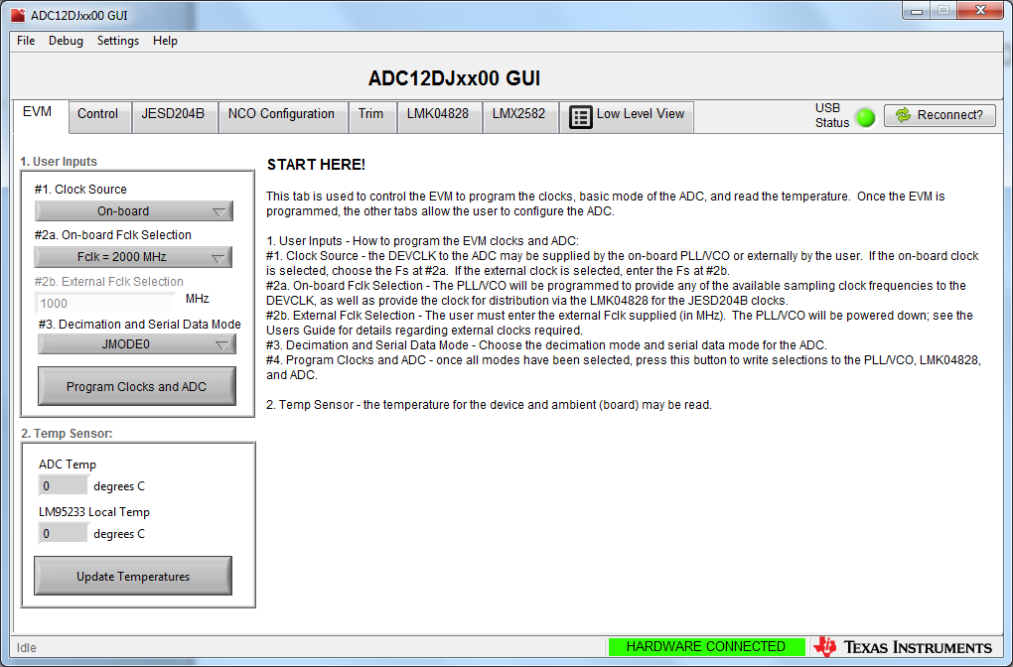
ADC12DJ3200 GUI EVM tab setting

Slide 5
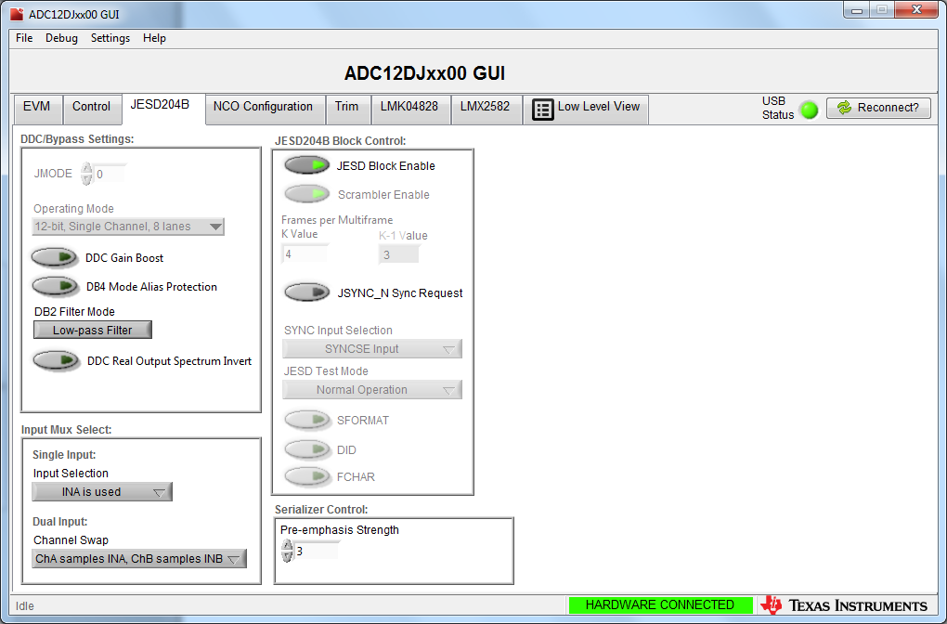
ADC JESD Settings

Slide 6
KCU105 JESD Settings
JESD IP Core_CS=0
JESD IP Core_F=8
JESD IP Core_HD=1
JESD IP Core_K=4
JESD IP Core_L=8
JESD IP Core_Lane_Enable=255
JESD IP Core_M=4
JESD IP Core_N=12
JESD IP Core_NTotal=12
JESD IP Core_S=5
JESD IP Core_SCR=1
JESD IP Core_Tailbits=4
JESD IP Core_LaneSync=1
JESD IP Core_Subclass=1

Slide 7
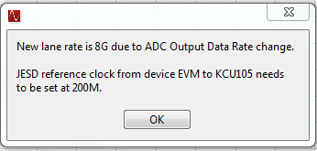
Open HSDCD Pro, select: “ADC12DJ3200_JMODE0” Enter “4G” for ADC Output Data Rate Lane rate and required ref clk are shown below

Slide 8
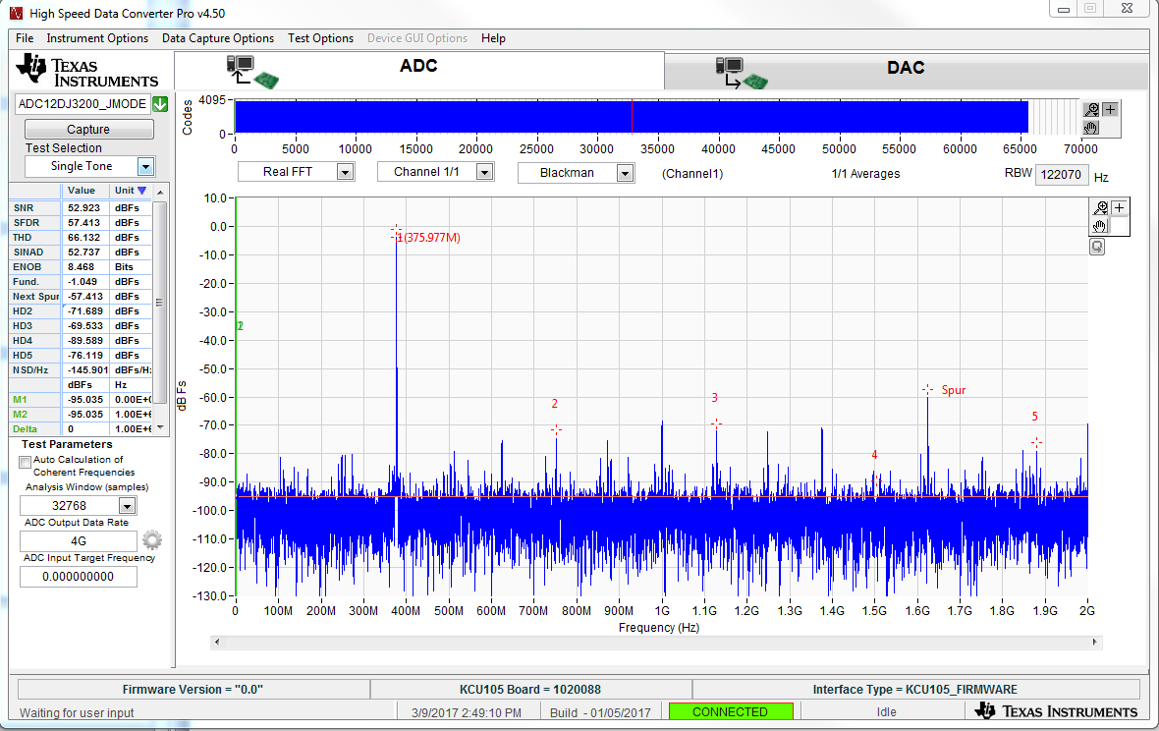
Capture results using a 376MHz input tone

Slide 9
KCU105 limitations
KCU105 can only have xMult = 40 when lane rate is greater than 3.9G, which allows REFCLK and Core clk to be driven by a single clock.
When lane rate is less than 3.9G, the GUI will not change the divider to match the core FPGA clock. The FPGA will require a separate clock input for REFCLK and Core clock

Slide 10
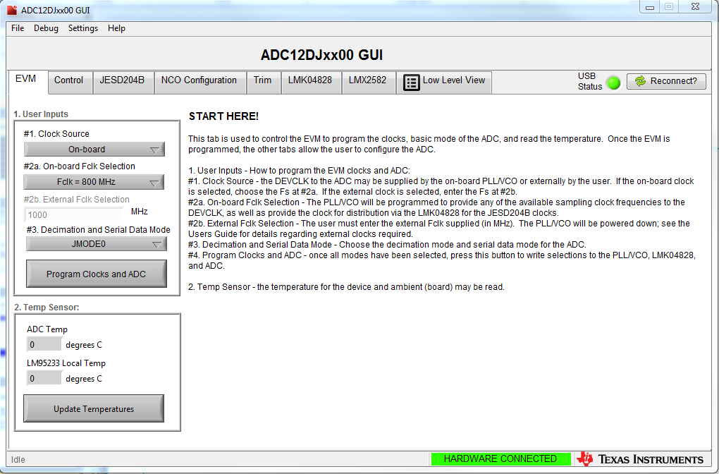
Example: Fclk = 800 MHz

Slide 11
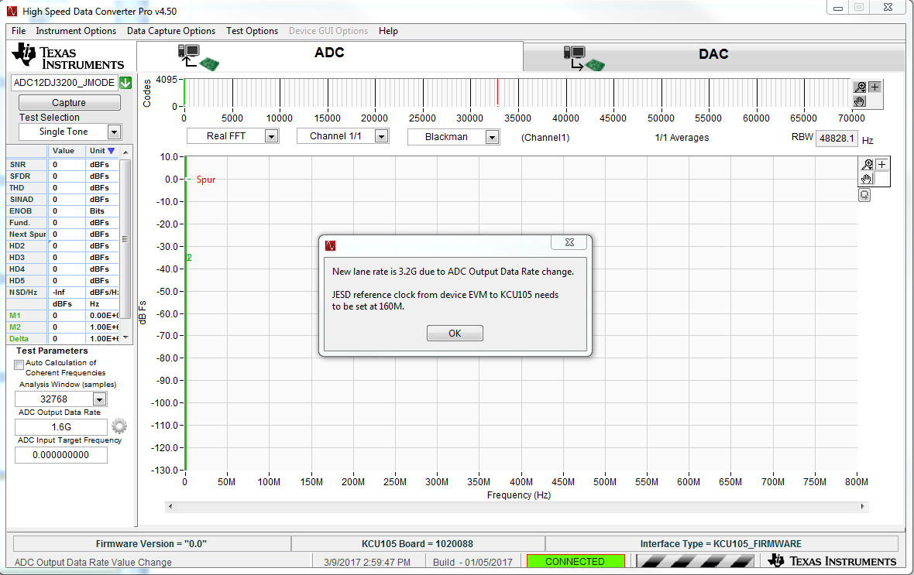
HSDC Pro – Data Rate = 1.6G
Lane Rate 3.2G, REF CLK = 160 MHz

Slide 12
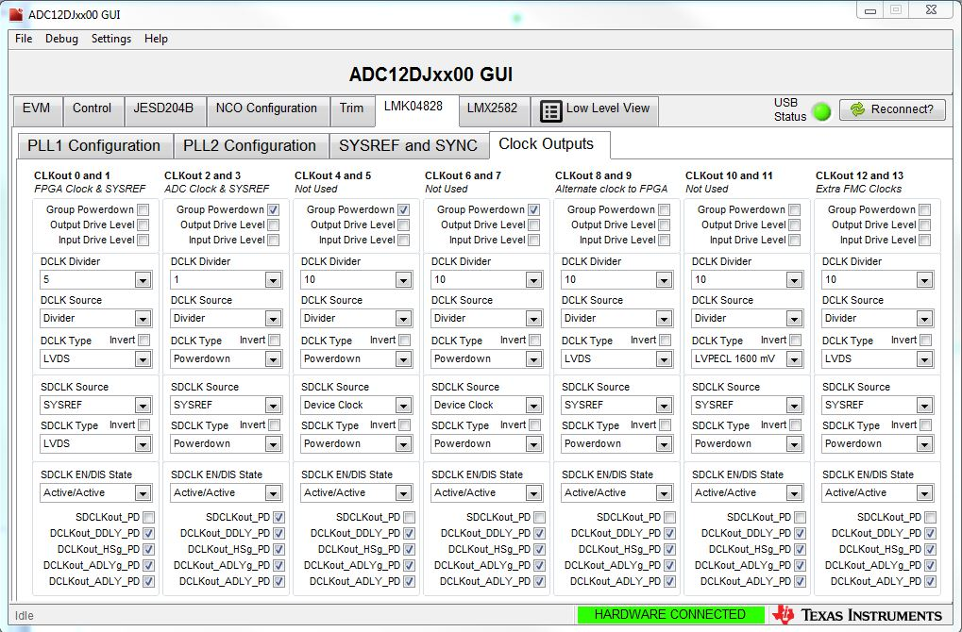
REFCLK = 160Mhz, Core clock = 80 Mhz
800 Mhz / 5 = 160 Mhz
CLKout 0 and 1; DCLK Divider = 5

Slide 13
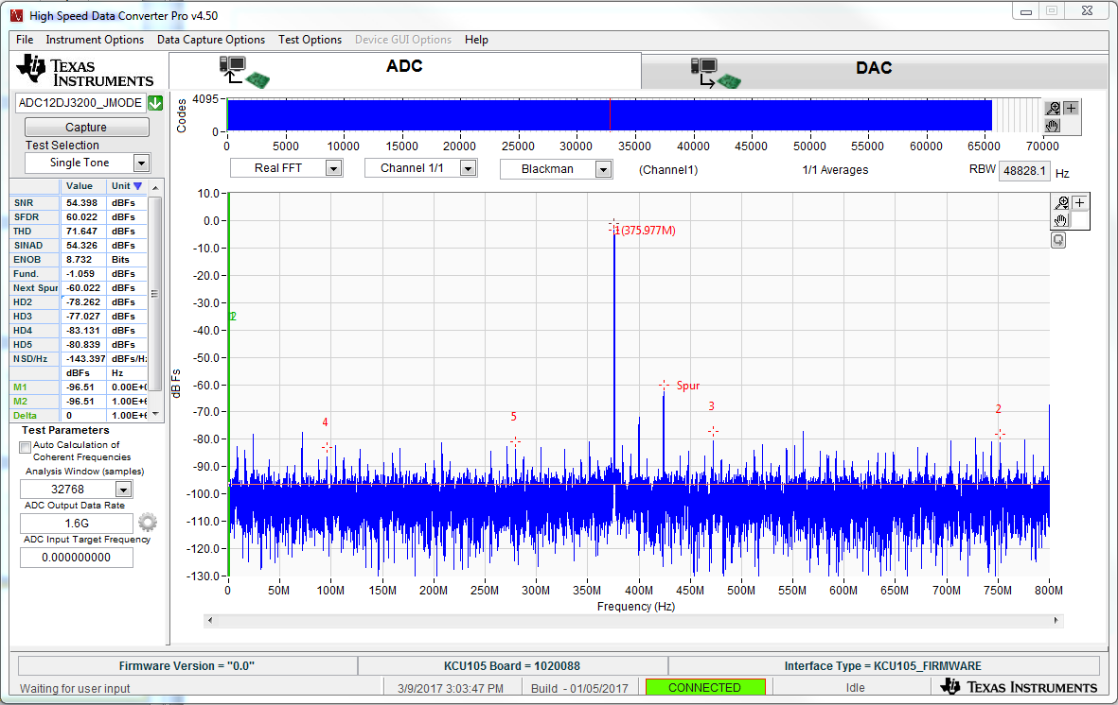
Capture results using a 376MHz input tone

